Slide 1
A Novel Therapeutic Approach for Pulmonary Fibrosis: Targeting Profibrotic Macrophages Using Mir-33 Inhibitor
Farida Ahangari, M.D.
Pulmonary, Critical Care & Sleep Medicine at Yale
farida.ahangari@yale.edu

Slide 2

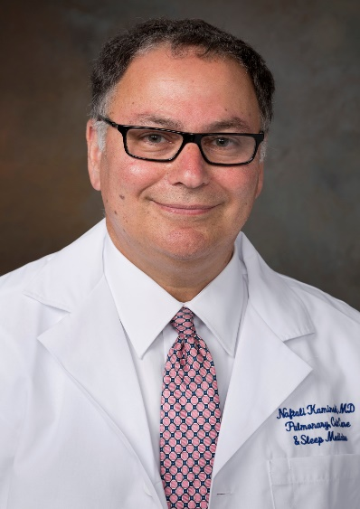
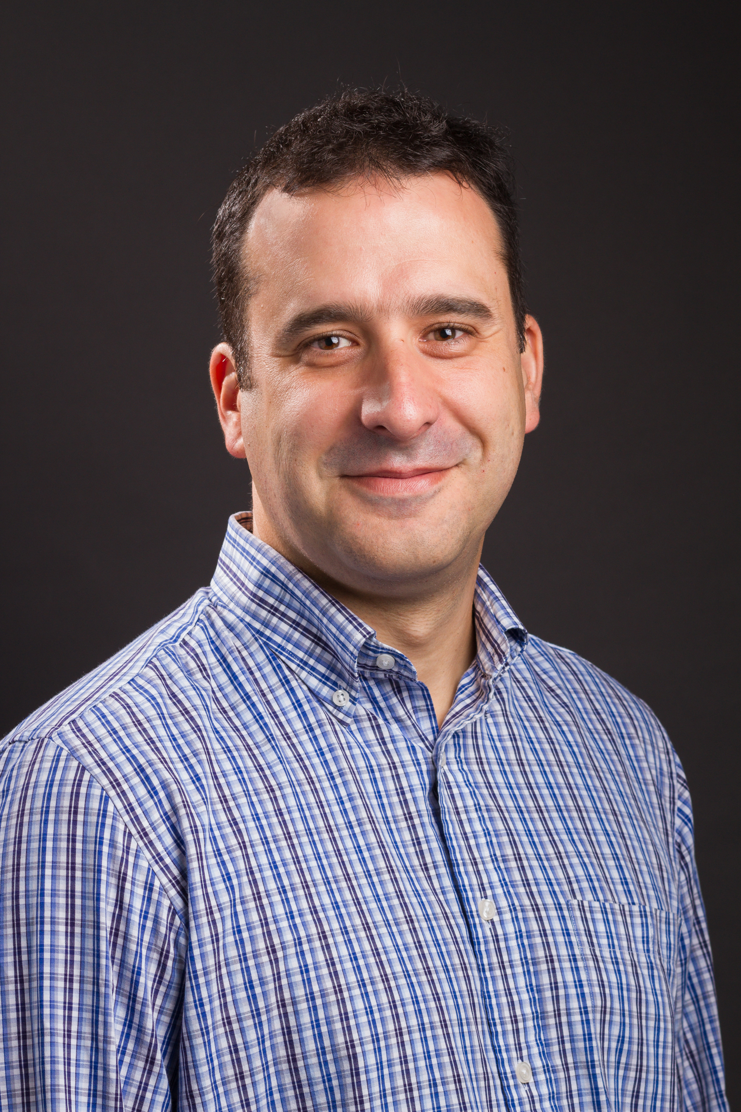

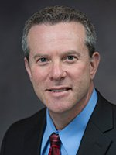
Our Team
Farida Ahangari, MD
Investigator
Assistant Professor
Yale PCCSM
Naftali Kaminski, MD
Investigator
Chief, Yale PCCSM
Carlos Fernandez-Hernando, PhD
Investigator
Director, Yale VBT Program
Raman Bahal, PhD
Consultant
Associate Professor of Pharmaceutics, UCONN
John Puziss, PhD
Director of Business
Development,
OCR, Yale
Expertise in metabolism, lung diseases and drug development
Track record of discovery and innovation
  New Molecular targets
  microRNA/ncRNA
  Industry collaborations and relations

Slide 3

Idiopathic Pulmonary Fibrosis
Debilitating, and fatal lung disease of unknown origin
190,000 patients in the US
30,000 to 40,000 new cases each year, 6M WW
Half of the patients will die 3 years after diagnosis (30,000 death a year)
Metabolically deranged profibrotic macrophages are one of the dominating cells in the IPF lungs.
2 FDA approved drugs since 2014
Huge Unmet Need
Neither cure IPF nor improve the symptoms, no effects on QOL
Sales:> $1.9 B, Market expected to reach: $4.2 B by 2025
Urgent need for the development of more effective & safe therapy
Lung transplantation remains the only curative option

Slide 4
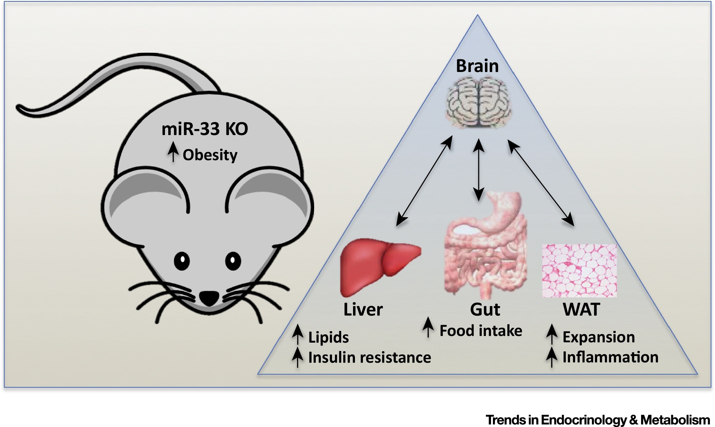
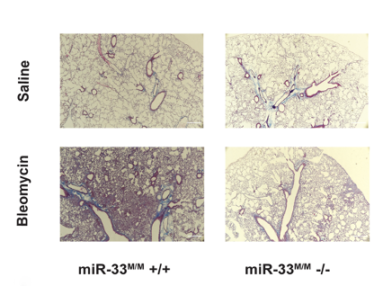
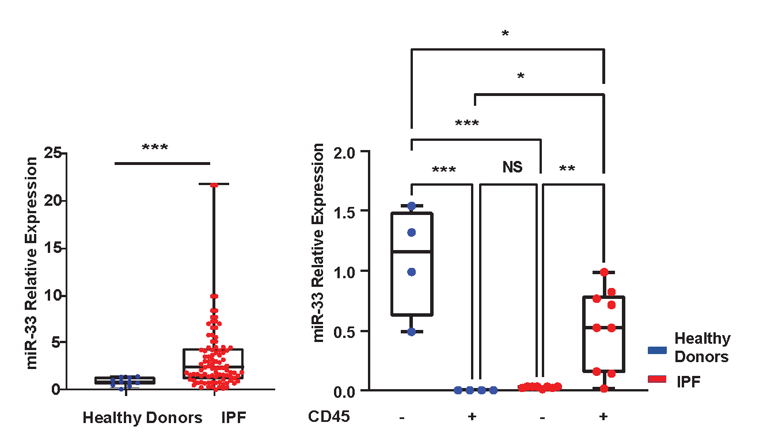
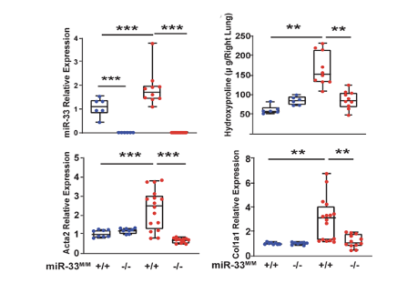
miR-33 Family
in Pulmonary Fibrosis
Master regulators of fatty acid metabolism and mitochondrial function
Regulatory role in macrophage metabolism and immune cell
Macrophage targeted miR-33 KO mice are protected against Bleomycin-Induced Lung Fibrosis
miR-33 Is Increased in IPF Lung monocytes/ macrophages

Slide 5
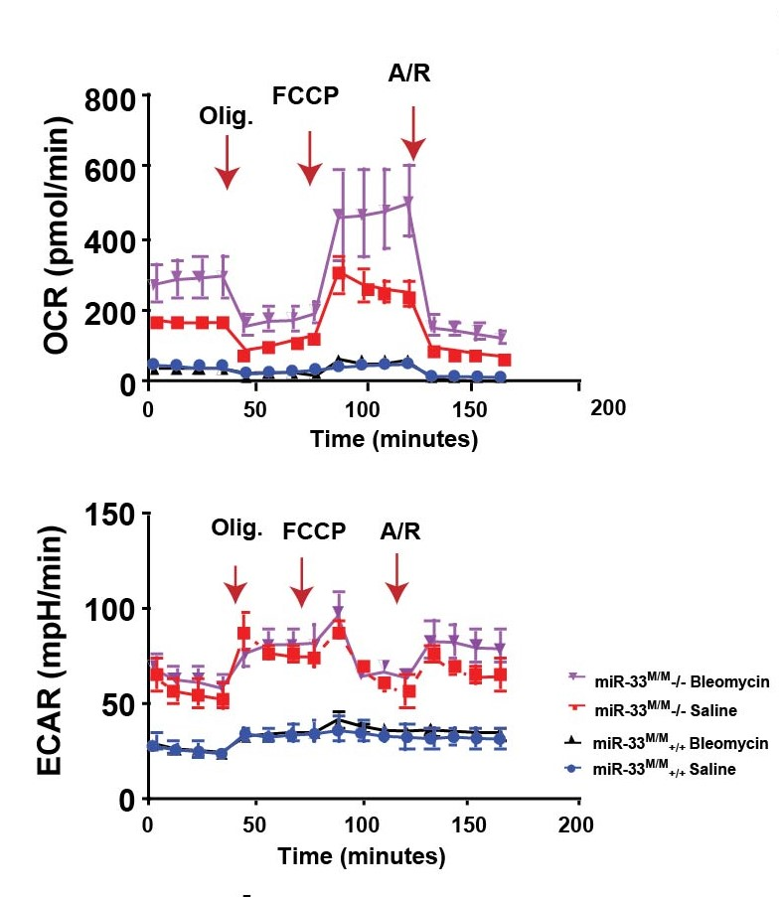
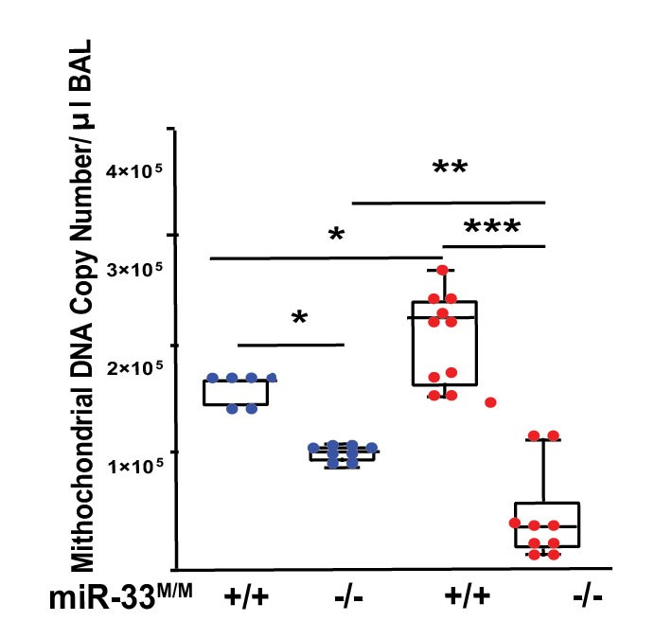
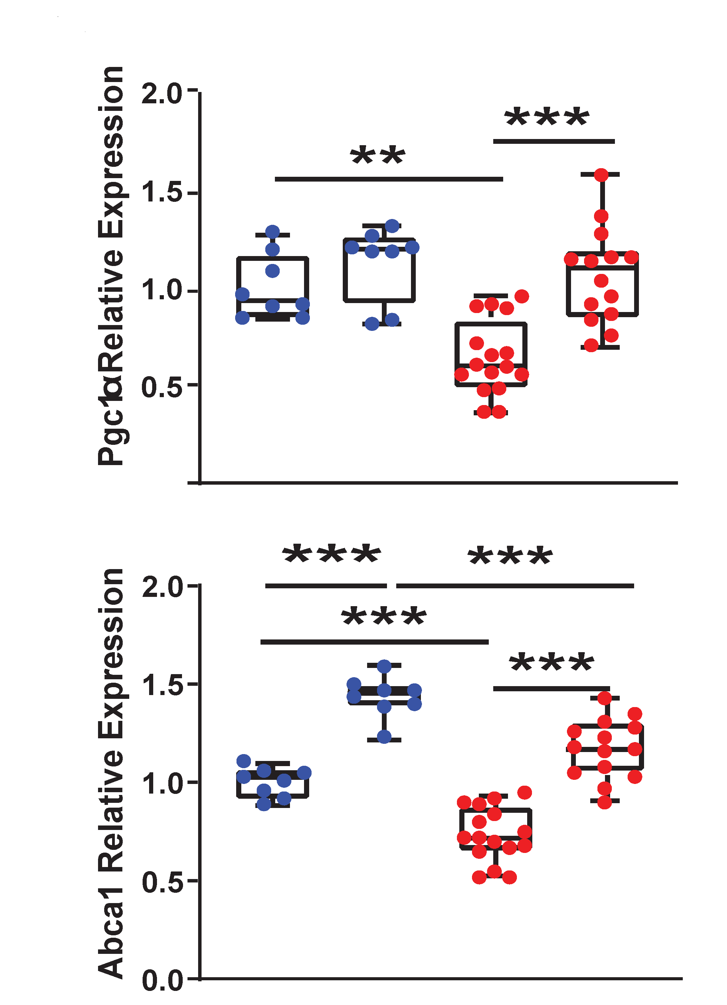
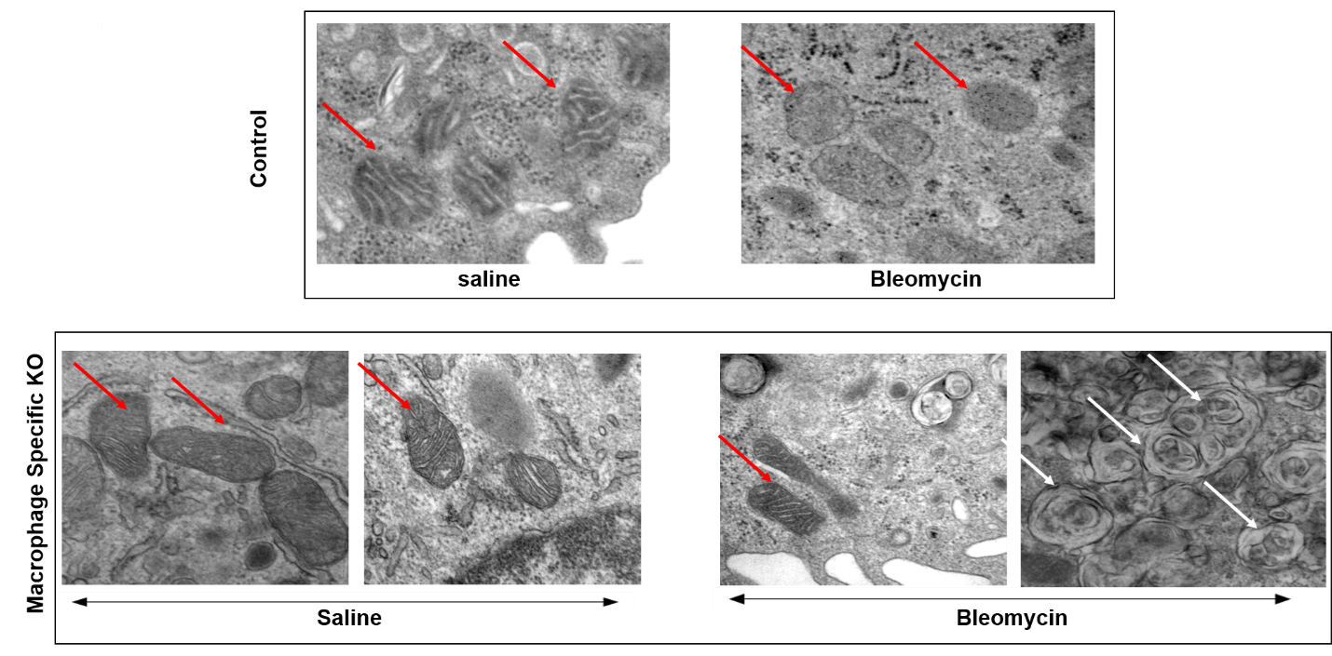
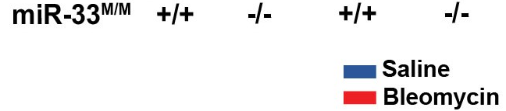
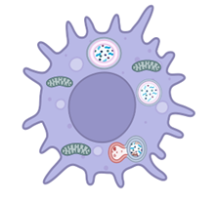
miR-33 Inhibition Improves Mitochondrial Homeostasis in Macrophages
Function
Damage
Expression
Structure
Healthy Macrophages after miR-33 Inhibition

Slide 6
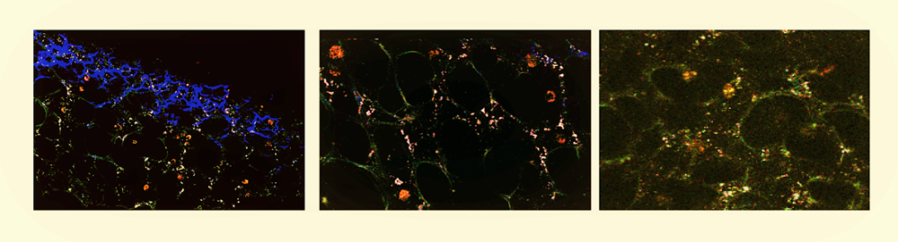
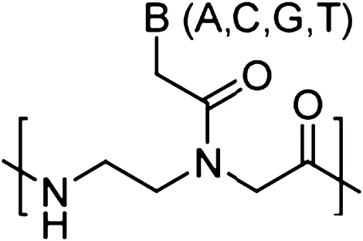
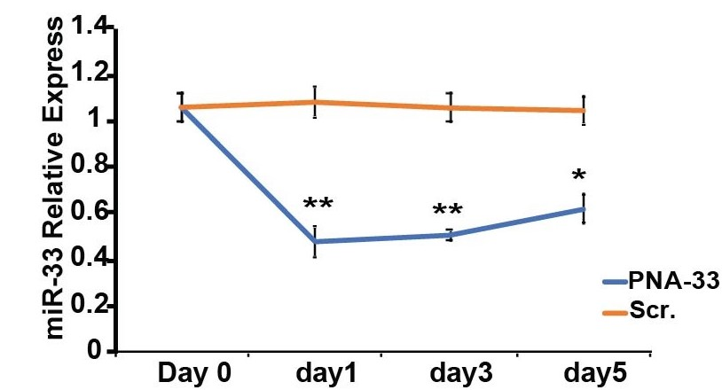
Therapeutic Approach: Using Peptide Nucleic Acids (PNAs) to inhibit miR-33
Peptide Nucleic Acids (PNAs):
Synthetic nucleic acid analogs with pseudo-peptide backbone
Resistant to nuclease enzymes
Strong binding with DNA and RNA targets
Accumulation of the compound inside the lung macrophages after IV and IN injection
miR-33 level in BAL macrophages is decreased

Slide 7
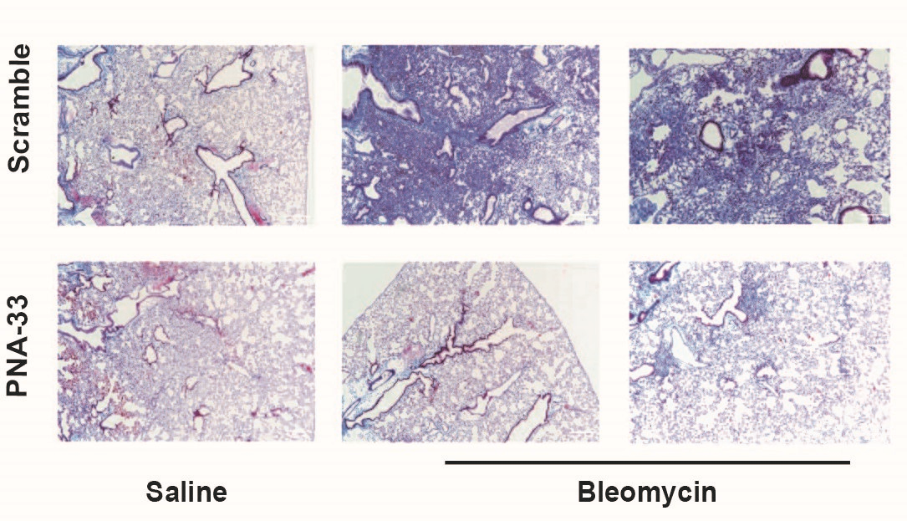
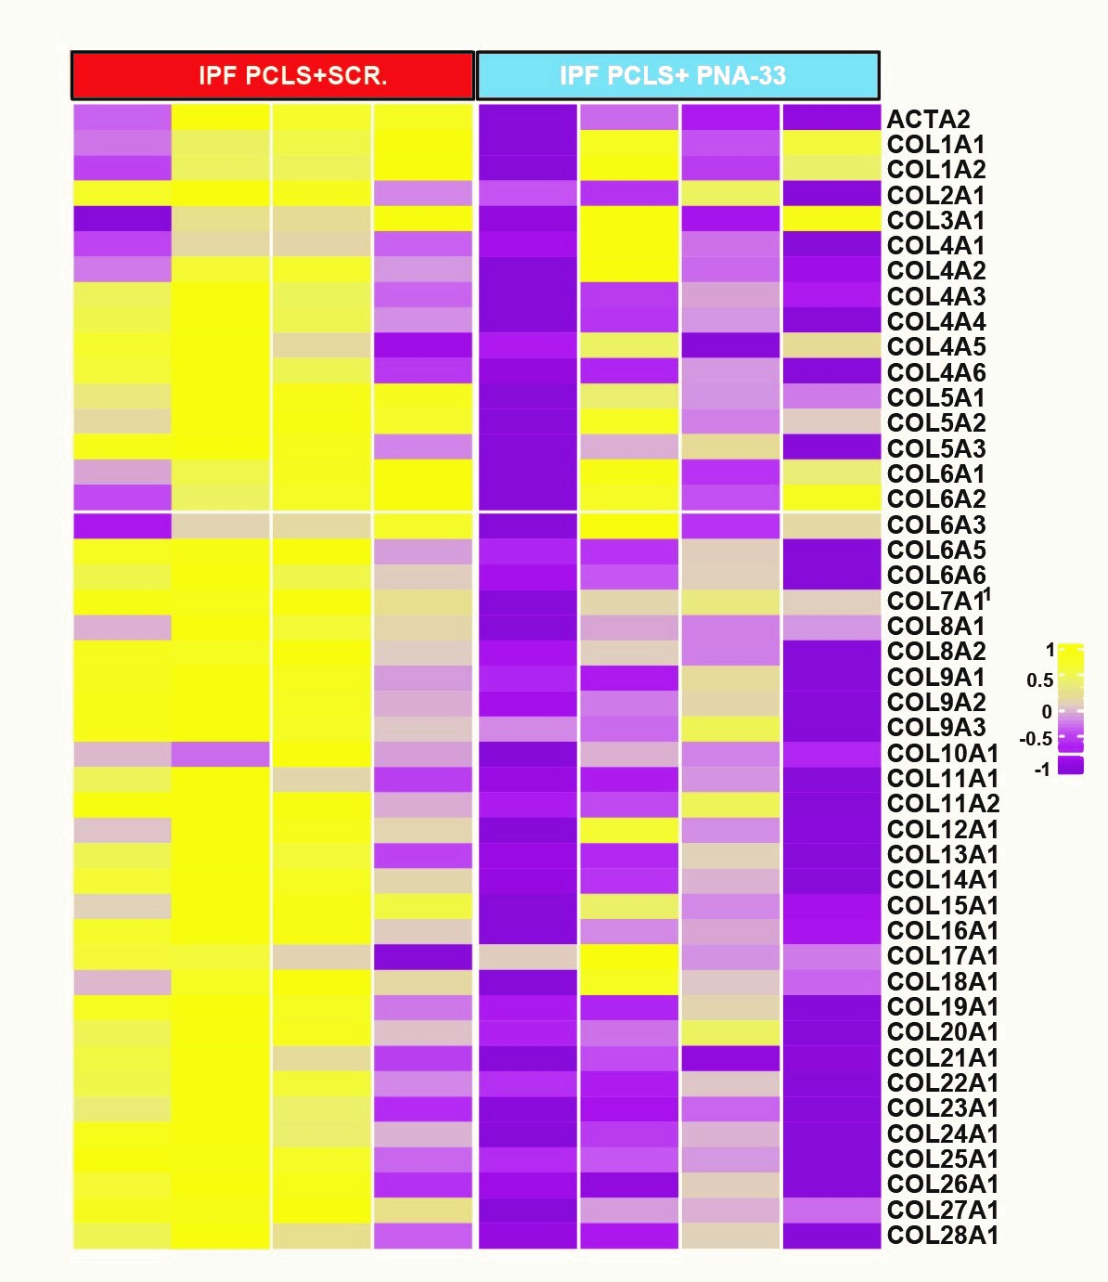
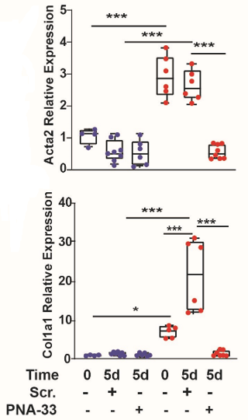
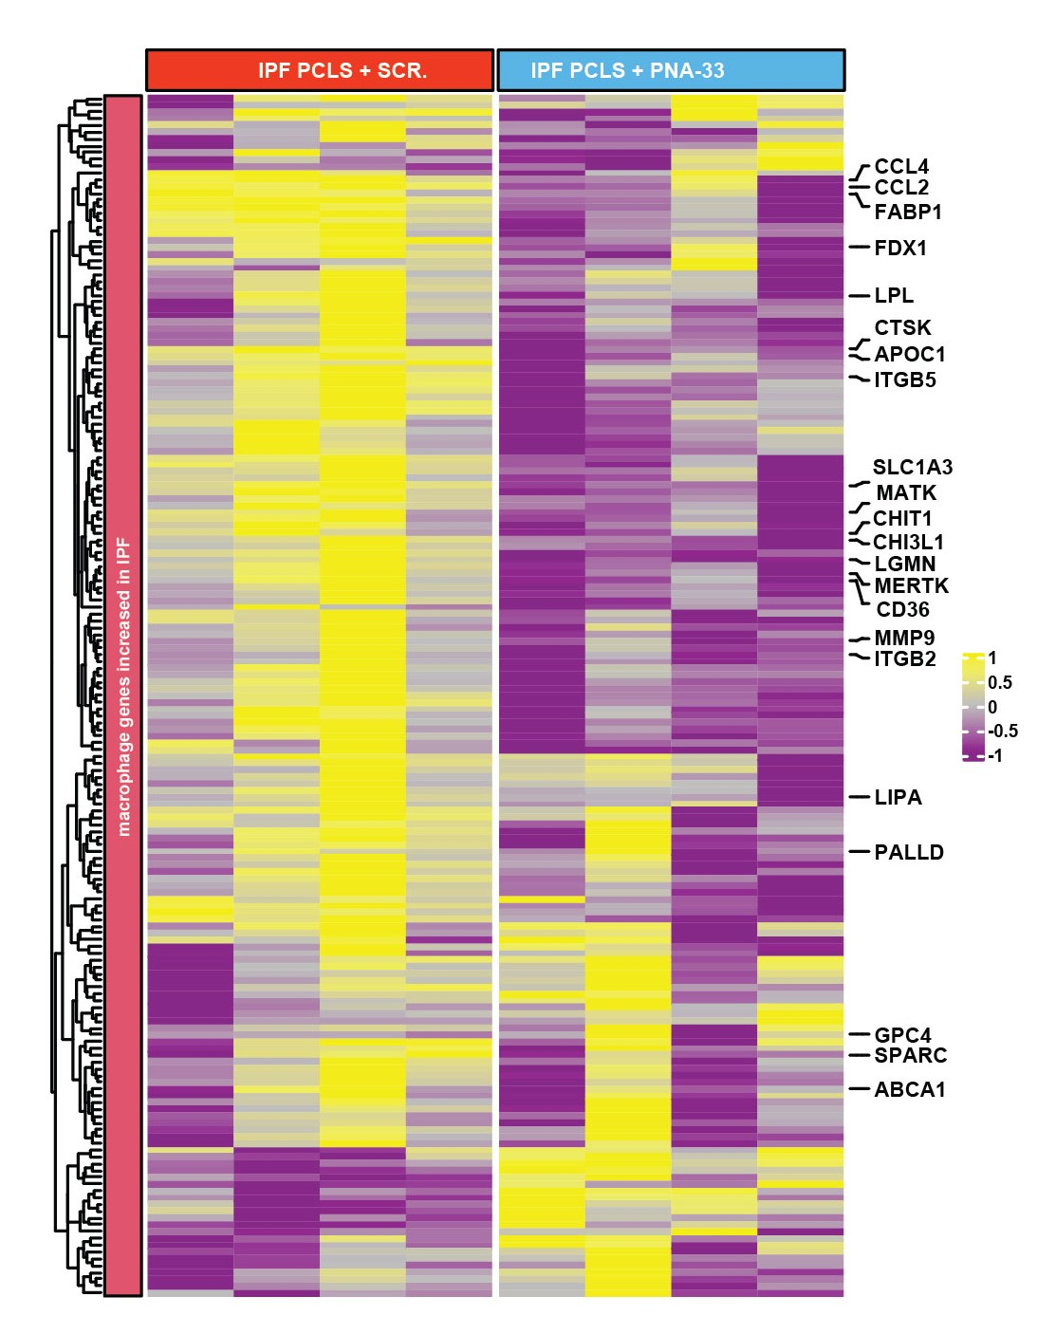
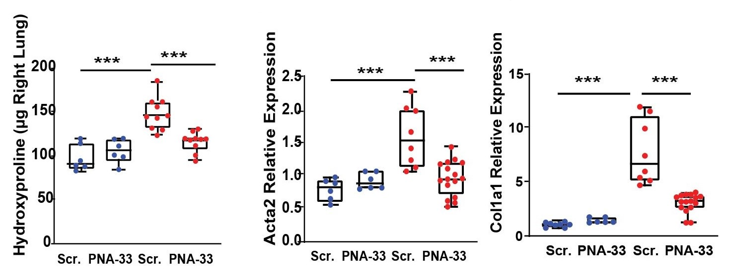
PNA-33 Blunts Lung Fibrosis In In Vivo and Ex Vivo Models
Ex vivo Mice Model
(PCLS)
In vivo Mice Model
IN. Delivery
Ex vivo Human IPF
(PCLS)
Fibrosis Genes
IPF Macrophage Signature

Slide 8
Summary
Innovative Approach with new IP: Macrophages targeted therapy for pulmonary fibrosis (Stable compound, efficacious, well recognized, safe, easy to modify). Yale has filed patent for PF (Methods of use, application & formulation)
Novel Mechanism of Action: Altering profibrotic MQ signature, Improving mitochondrial homeostasis
Identified Potential Therapeutic Candidate: Localized (Intranasal) lung delivery of PNA-33 resolves lung fibrosis
Next Steps to Optimize Candidate: Need Blavatnik funding for dose optimization, oral formulation, PK/PD, Toxicity and IND
Potential for IND Enablement in 3 Years: Plausible case that the road to humans is open

Slide 9
Blavatnik Funding Proposal: $300K for PNA-33 Development
Year 1
Year 2
Efficacy Studies (In vivo)
Dose Optimization,
Oral & Inhalational Formulation/Delivery
Second Animal Model (TGFβ mice model)
PK/PD
Detailed Toxicology
$150K
$100K
Project
Efficacy Studies
Optimization
Characterization
Safety
Efficacy Studies (Ex vivo)
Human IPF Lung, Precision Cut Lung Slices, PCLS
Comparing with the other 2 approved drugs
Biomarker discovery
Proceed toward IND Application
Additional source of funding
$50K

