Slide 1
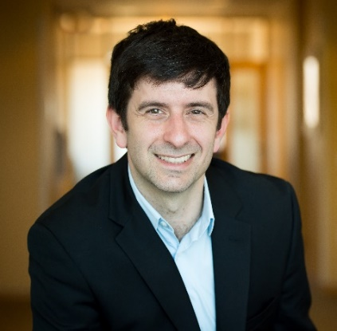


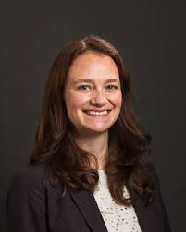


The Team
Garrett Ash, PhD
(exercise physiology)
International leader on consumer wearables
Prof. Stuart Weinzimer, MD
(endocrinology)
International leader on
diabetes technology
Prof. Mark Gerstein, PhD
(analytics)
ENCODE lead
h-index = 180
Assoc Prof. Lisa Fucito, PhD
(behavioral psychology)
Personalized digital therapeutics
Rajat Doshi
(analytics)
Selene Mak, PhD
(quality improvement)
VA Evaluation and Support Unit
Notes:
My team has extensively published together and includes Stu Weinzimer a world expert in CGM and experienced industry collaborator with Medtronic, Mark Gerstein a world-leading machine learning expert, and Lisa Fucito a behavioral psychologist.

Slide 2
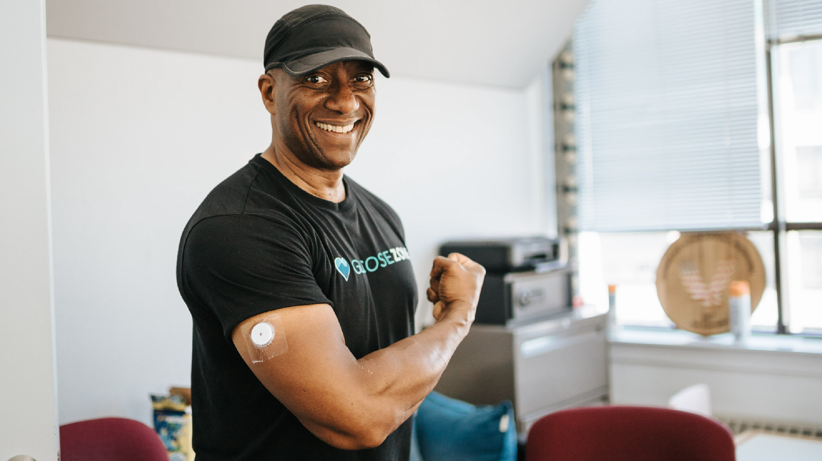
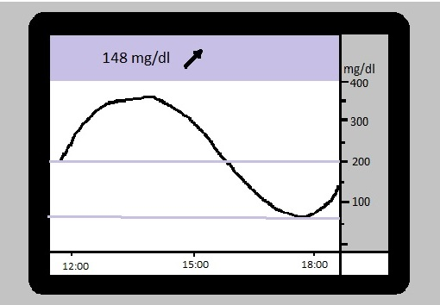
Combination Therapy –
Continuous Glucose Monitoring (CGM) Technology with Digital Fitness
as a Therapy for Type 2 Diabetes
Notes:
Type 2 diabetes is insensitivity to insulin with eventual burnout of ability to make insulin. It features chronically elevated blood sugar leading to long-term heart disease, nerve damage, blindness, and death. It currently affects almost half a billion people including 34 million Americans, is increasing in correlation with the obesity epidemic, and incurs almost $10k per patient per year in direct medical costs alone
Continuous glucose monitoring has revolutionized diabetes care by replacing snapshot fingersticks with directional trends and 24 hour analysis of variability. But unfortunately, CGMs are only utilized to monitor safety of insulin medication after it is started. We are missing the opportunity to apply CGM as a therapeutic to guide exercise intervention.

Slide 3

Exercise with Type 2 Diabetes
COMPLICATED: exercise can make blood glucose ↑ or ↓
RESULT: frustration and discouraging symptoms
NECESSARY: w/o exercise, medications ineffective and escalate
GAP:
  Current apps display CGM and sports watches but do not address diabetes-specific needs
  CGM not reimbursed for type 2 diabetes until insulin is started
ADA Standards of Care 2021; AACE/ACE Type 2 Diabetes Management Algorithm 2020
Notes:
Exercise is first line defense strategy to mitigate or reverse early-stage type 2 diabetes by improving metabolic regulation, before piling on costly medications. (Diabetes medications are not even recommended unless adjunctive with exercise.)
But exercise can make blood glucose up or down; patients get frustrated and discouraged by this unpredictability and the related symptoms. Doctors say “by the time blood glucose is high, it’s too late to exercise because the patient feels unwell.” This just means the exercise is not being tailored; when blood glucose is 200, you need different exercise than when it is 100.
But no technologies analyze exercise & CGM trends. They lack the real-time responsiveness and informed, nuanced exercise guidance. They don’t know the difference between a step and a bicep curl.
We are missing a major opportunity to combine these tools and losing the 71% of the type 2 diabetes market that do not receive insulin and have expressed high interest in such a product.
From Amy:
*abbreviate last bullet
NOTES FROM ILIAS:
*The two JAMA articles about using CGM. Benefit went away after stopping CGM. This is showing that lifestyle was modified. Ehrhardt’s studies.
OLD NOTES
FROM AMY:
*don’t need complete sentences.
Remove “currently”. Remove “to provide therapeutic exercise for type 2 diabetes”
Remove “despite”. “Exercise is first-line therapy”
(more telegraphic)
COMENTS:
Why can’t existing companies do what we are trying to do
Should we develop a new product? Versus AI in an existing product?

Slide 4
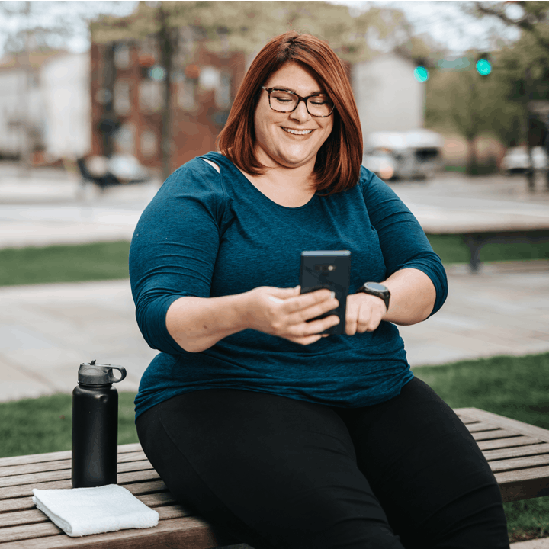
Combination Therapy Mobile App
CGM
+
Diabetes-specific digital exercise guidance
=
The right exercise at the right time for each patient
Notes:
Hence, my proposal of Combination Therapy. Combine CGM and diabetes specific digital fitness guidance to find the right exercise at the right time for each patient

Slide 5
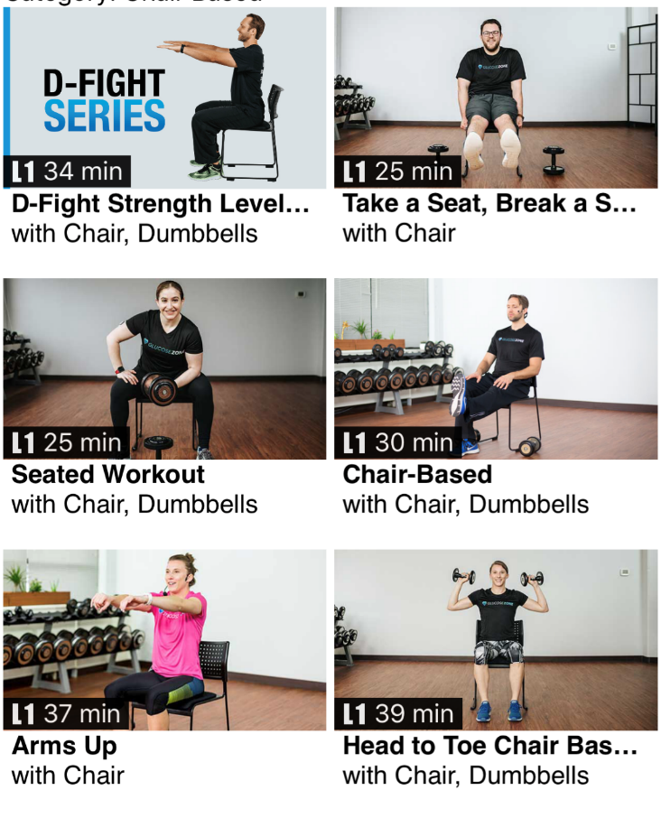
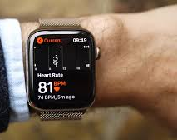
IP #1: Coaching Algorithm
Glucose
Survey of meds, symptoms, diet
CGM Cloud
Exercise video
completion log with smartwatch
Use machine learning to predict individual glucose response to exercise
Exercise video recommendation
Notes:
Therefore I will use Blavatnik funds to develop an AI-powered mobile application to personalize exercise according to CGM data. Cloud inputs will include the CGM, patient surveys, and the attributes of their exercise just completed based on our tagged library of 700 exercise videos and fitness smartwatch data. Machine-learning will predict their individual glucose response and recommend exercise videos on subsequent days.

Slide 6
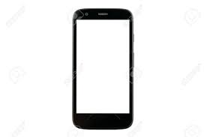

IP #2: Behavioral Change Strategies
Your glucose: 180 and rising
Workout recommendation:
30-45 minutes, strength-based
Video options:
Great job, see blood glucose change below!
See you tomorrow for next workout!
45 mins later
Start
End
Notes:
The recommendations are followed up with graphics of short-term and long-term results in relation to goals.

Slide 7
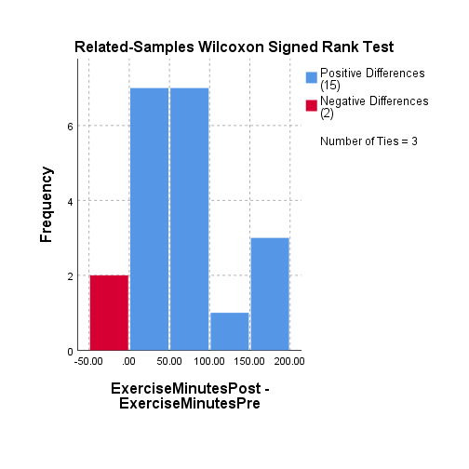















Ash et al. JMIR Diabetes 2021;6(3):e28309; Ash et al. Clin J Sport Med 2022 In Press; NIH K01DK129441; American Heart Association Career Development Award #852679; Veterans Healthcare Administration HSR&D CIN 13-407; Patterson Foundation.
Preliminary Studies
Study 1: CGM/fitness combination therapy helps current users of CGM
█ Positive Differences (15)
█ Negative Differences (2)
No change = 3
37min exercise
72% heart rate max
Resistance, upper body
Frequency
0 2 4 6
-50 0 50 100 150 200
Change (exercise minutes per week)
Study 2: CGM/fitness combination therapy appeals to 85% of current non-users of CGM and their healthcare providers
Notes:
I started investigating this by enrolling patients with insulin-dependent diabetes already using CGM and supplementing their standard CGM app with overlaid graphs showing how their exercise and sugars were related (as illustrated in the left-hand graph) also discussed these graphs in a motivational enhancement therapy session so I could deliver data-driven insights and perceive their reactions. The results were promising as you can see all the patients in blue on this histogram increased their weekly exercise minutes after 10 weeks and only a small number were stagnant or worse. They also said these discussions where they saw their data overlaid was the most appealing component.
In my second study, I expanded to the target audience of the new product: I interviewed or surveyed 21 patients with non-insulin dependent type 2 diabetes and 10 of their healthcare providers. There was 80-90% positive reactions and expression of frustration that CGM is not currently covered by their insurance.
In summary, combination therapy is helpful beyond CGM alone. The non-insulin dependent diabetes cohort has high interest in becoming new adopters.
From Irene:
From Charlie:
Study #2: exercise based on BG helps patients improve A1c.
LivingWell Cares Study. 1.9% A1c improvement. Therapies in diabetes are evaluated by impact on A1c. This is what determines drug decisions.

Slide 8
The Market
34M Americans, 463M globally (increasing with obesity)
Direct medical costs $10k per patient per year (~50% due to medications)
Trying to deescalate medications, large health systems pay ~$4k per patient per year for competitor products
Industry-leading software maker Fitscript^{LLC} interested to partner on the product
  Platform hosting
  Network to CGM companies
  Network to customers
American Diabetes Association. Diabetes Care. 2018;41:917; Fonda et al. J Diabetes Sci Tech. 2016;10(4):898;
Milliman Inc. Report “Analysis of Type 2 Diabetes Reversal Cost Savings.” Sept 15, 2021. Avail at: www.virtahealth.com/blog
Notes:
As I said it’s a large market nationally and globally. 24M Americans with T2D not yet on insulin. 330M globally.
Apps have been shown to de-escalate drug requirements.
The direct medical costs are $10k per patient per year, of which about half is medications which quickly escalate. Mobile apps have been shown to achieve de-escalation. We also know there’s precedent for health systems to pay for these apps. And, even if we assume just 50% of the eligible patients uptake the app, that would still be hundreds of thousands in a large healthcare system.
From Amy:
*Move the QALY to back pocket for questions
*Drop last bullet.
*For example, Yale-New Haven Health is currently paying this amount for a system that does not use CGM and only uses XYZ. Shows: 1) clear interest. 2) this model gives better information.
*We are estimating that xx% of non-insulin dependent T2D would adopt this, which translates into X million Americans. Be ready to defend the hypothetical number of adopters.
From Charlie:
*Mention A1c
*early adopting health systems already paying for this type of care. up to $3k-$4k per year. “I’d be happy to talk more afterwards. I don’t have exact data, I would have to speak to the company. Companies like Virta Health and GlucoseZone have established traction with health plans generating as much as $3k-$4k in revenue.” It’s a burgeoning new field and the fact health plans already willing to pay is a good sign.

Slide 9
Timeline
Budget (Blavatnik Pilot, $100,000)
Software contractor - $56,400
Yale machine learning research scientist partial salary - $36,000
CGM consumables - $7,600
Study Methodology
1-month trial
Ongoing interviews & refinements
Human-delivered before data kicks in
Milestone
Peer-reviewed publication with final design
Industry-sponsored
or
STTR
Real-world efficacy trials
Cost savings analyses
Go to market through health systems and pharmaceutical companies
Clinical Efficacy Trial
*Development
*Feasibility
Study
Refinements
Formative interviews and
human-delivered interventions
2020-22
2023
2024
2025
2026
2027
Notes:
Intervention development occurs in stages. Our first study is for feasibility/acceptability. Patients use the app for one month with intensive interviews and ongoing software refinements. Before the machine-learning algorithm has been fed with enough data, we will revert to visual displays reviewed in human counseling sessions; again, this allows us to see up close and personal how patients react to data in motivational context.
Then stage 2 is an efficacy trial done by a sophisticated within-person design, so we don’t waste patients on a control condition and maximize the amount of data to feed machine-learning algorithms. It’s a sophisticated crossover design where each patient completes a run-in control before intervention. Thus we don’t waste patients by assigning them only to control, so we can maximize the number receiving the intervention and feeding the machine-learning algorithms. These are the outcomes assessed for efficacy.
Our go-to-market strategy is health systems interested in risk management such as Kaiser.
From Amy:
*be more brief about stage 2.
This funding will go to the stage 1 project. Spend time walking through that.
I just want to let you know I’ve been working on this and if you’d be interested

