Slide 1
Tackling Drug Toxicity and Resistance with PAMS
--------------------------
Choukri Ben Mamoun
Professor of Medicine and Microbial Pathogenesis
Yale
Founder: CURATIX
  choukri.benmamoun@yale.edu
        860-906-7302

Slide 2
Global Impact of Fungal Infections
~1 Billion fungal infections
>150 Million serious clinical cases
>1.6 Million deaths
Notes:
TIP/FAQ
What are examples of how the drug may provide specific value to patients?
Proposed treatment may include a different route or frequency of administration, lower cost to manufacture or dispense, shorter clinical or regulatory path, higher metabolic and safety profile.

Slide 3
GLOBAL ANTIFUNGAL MARKET
$16.6 billion in 2020 $25 billion by 2023
Major Players
Abbott Laboratories
Pfizer
Merck
Arbor Pharma, Inc
Baxter
Astella Pharma Inc
Bayer Healthcare
Problem: Drug Toxicity and Resistance
www.marketresearchfuture.com; www.grandviewresearch.com
Notes:
TIP/FAQ
What are examples of how the drug may provide specific value to patients?
Proposed treatment may include a different route or frequency of administration, lower cost to manufacture or dispense, shorter clinical or regulatory path, higher metabolic and safety profile.

Slide 4
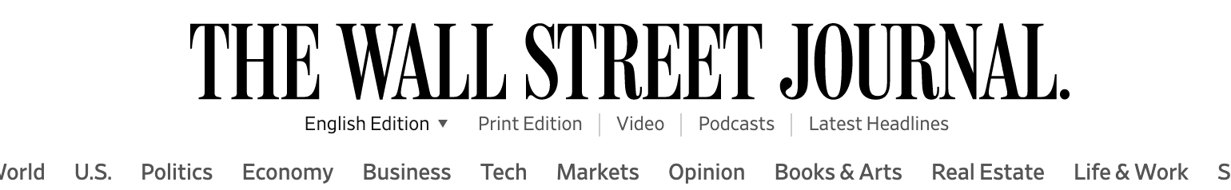
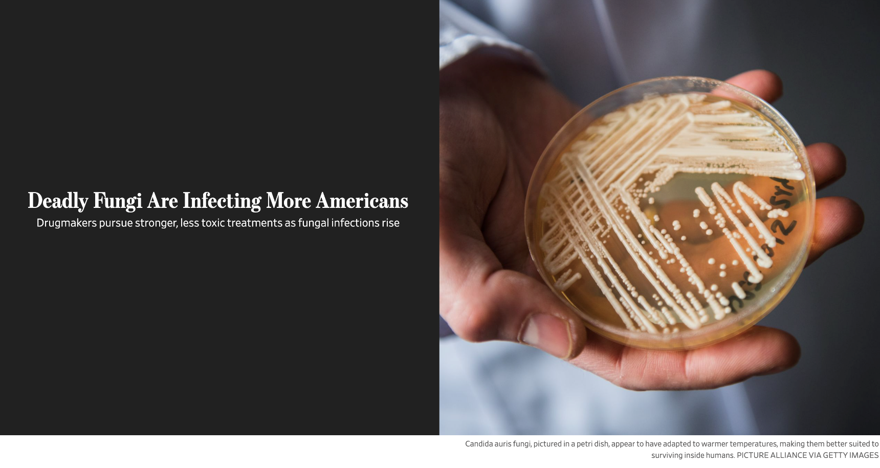
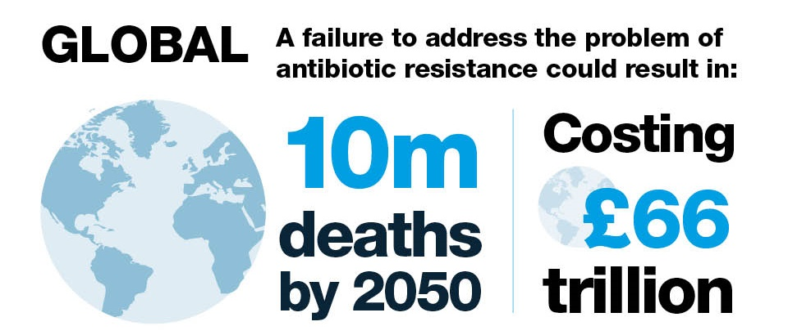
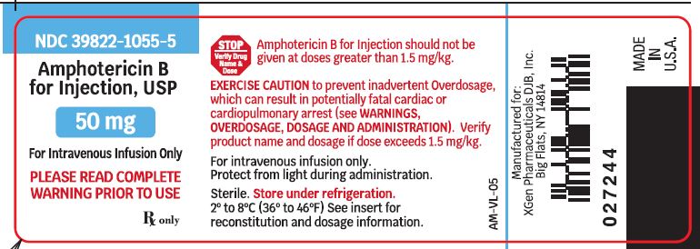
Antimicrobial Resistance and Toxicity
Candida auris
GOV.UK
Toxicity
Notes:
TIP/FAQ
What are examples of how the drug may provide specific value to patients?
Proposed treatment may include a different route or frequency of administration, lower cost to manufacture or dispense, shorter clinical or regulatory path, higher metabolic and safety profile.

Slide 5
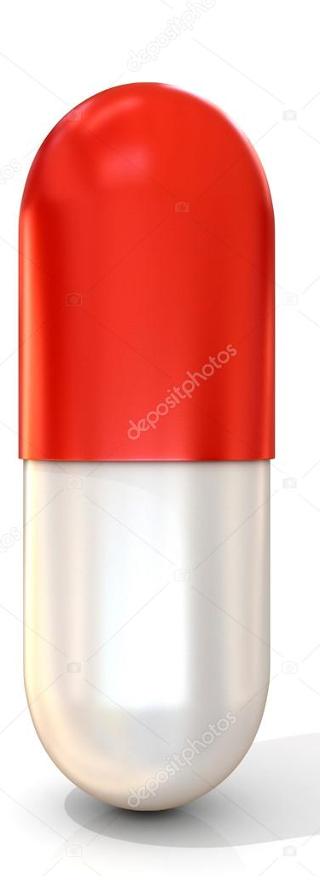

PROBLEM
SOLUTION
PAMS: Potentiators of AntiMicrobial Susceptibility
S
R
Low Effective Dose
PAMS
Efficacy
S
Reduced toxicity
High potency
S
R
Toxicity
Notes:
TIP/FAQ
What are examples of how the drug may provide specific value to patients?
Proposed treatment may include a different route or frequency of administration, lower cost to manufacture or dispense, shorter clinical or regulatory path, higher metabolic and safety profile.

Slide 6
Inhibition of CoA Metabolism Leads to Enhanced Susceptibility to Antimicrobials
Pantothenate
Coenzyme A
CoA
BioSynthesis
Drug Susceptibility

Slide 7
1-2 Punch Strategy
Pharmacological Evidence
A
B
AmphoB
Chiu et al., JBC 2019
Notes:
TIP/FAQ
What are examples of how the drug may provide specific value to patients?
Proposed treatment may include a different route or frequency of administration, lower cost to manufacture or dispense, shorter clinical or regulatory path, higher metabolic and safety profile.

Slide 8
1-2 Punch Strategy
Genetic Evidence
10⁵ 10⁴ 10³ 10² 10¹
WT
YPD
Mut
Comp
WT
Fluconazole
Mut
Comp
WT
Amphotericin B
Mut
Comp

Slide 9
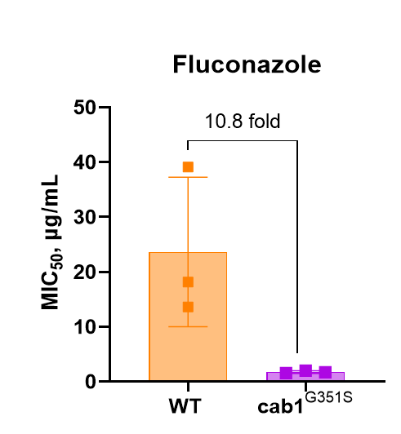
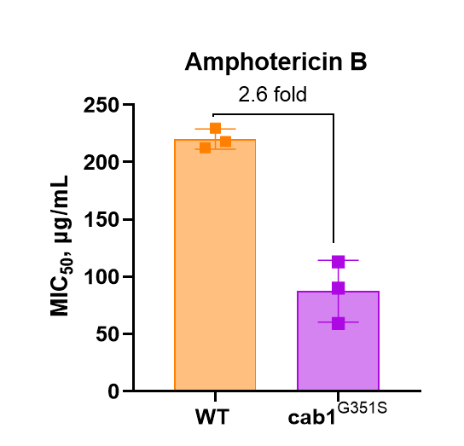
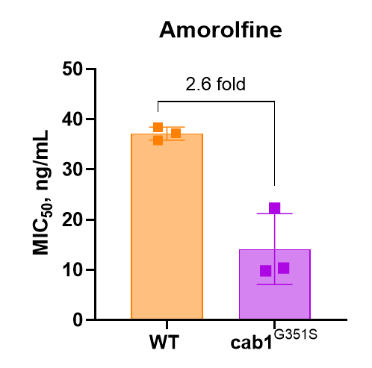
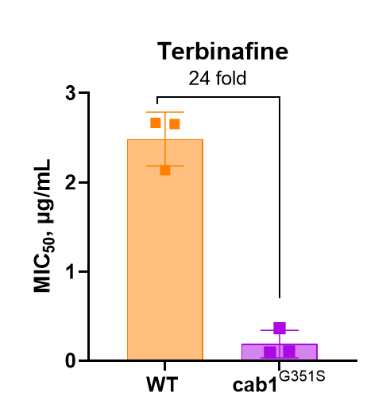
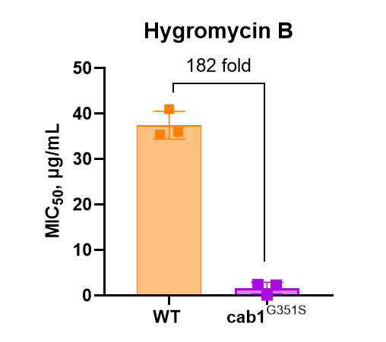
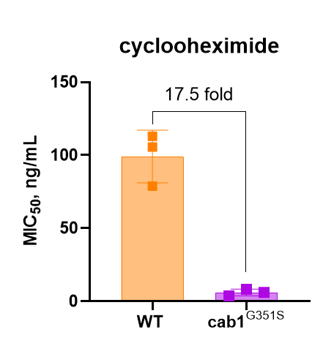
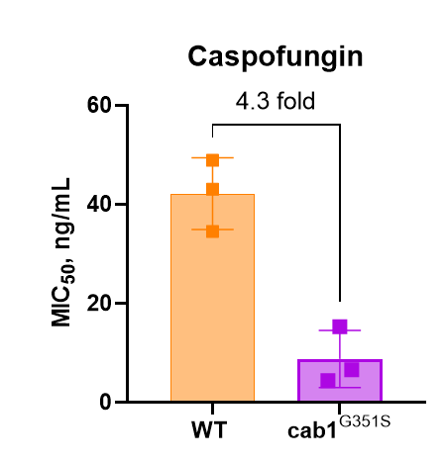
1-2 Punch Strategy
Genetic Evidence

Slide 10
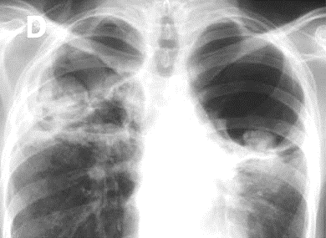
Evidence in Fungal Pathogens
Aspergillus fumigatus
3 to 4-fold increase in Voriconazole susceptibility
Aspergillosis CFR : 58-88%

Slide 11
Three Classes of PAMS in Advanced Stages of Pre-Clinial or Clinical Development
PAMS
Class I
Class II
Class III
Ph. I
Ph. II
Pre
clinical
Gihaz, Structure 2022
DeVries, Nat. Comm. 2022
Sharma, Nat. Comm 2018
Yale IP (2042) Filed

Slide 12



Dramatic increase in Candida susceptibility to Terbinafine by PAMS3
Candida parapsilosis
-
PAMS3
Terb
Terb
+
PAMS3

Slide 13
Milestones & Use of funds
AIM 1: $75K
In vitro efficacy
AIM II: $75K
Pharmacology
AIM III: $150K
In vivo efficacy
In vitro assays
PAMS (~50 compds)
- PZ-2891 and analogs
- ELVs PanK inhibitors
- PA analogs
Pathogens
Candida auris
Candida albicans
Aspergillus fumigatus
NIH pathogen collection
Drug sensitive and resistant isolates
Top 10 combinations
Safety profile
PK/PD
MTD
Top 2-3 combinations
Mouse models of fungal infections
Go / NoGo
Go / NoGo
IND / CLINICAL CANDIDATE

Slide 14
Summary
Novel Therapeutic Strategy
ASK:
$300K
Novel Mode of Action
Milestone:
IND + Phase I
Competitive Advantage
IP (2022-2042)
Goal:
Radical Cure
Notes:
TIP/FAQ
What are examples of how the drug may provide specific value to patients?
Proposed treatment may include a different route or frequency of administration, lower cost to manufacture or dispense, shorter clinical or regulatory path, higher metabolic and safety profile.

Slide 15

PAMS
THANK YOU
Anti
infectives
December 8, 2022

