Slide 1
Sustained Drug Delivery LLC
Notes:
What if patients didn’t have to remember to take their medication?
If we could solve compliance, how many lives would be saved? How much less blindness?
That’s what this company is about

Slide 2
Overview
What are we doing?
Why is it important?
What is the competition?
What is our roadmap?

Slide 3
Team
Vicente A Diaz, MD, MBA,
Chief of Ophthalmology, Yale Health
Chief of Subspecialty Services, Yale Health
Chief of Ophthalmology, Bridgeport Hospital
C Michael Samson, MD, MBA, Manhattan Eye & Ear
CEO of CLS Pharma, successful exit/license
Richard Eiferman, MD, University of Louisville
Lifetime Achievement Award AAO
Dale DeVore, PhD, DV Consulting
Over 35 years in clinical development and R&D, has authored 75 patents
Notes:
Seasoned team
1 scientist, 3 clinicians
All have experience in tech development
I have 3 Chief titles in the Yale New Haven Health system, track record of running organizations well

Slide 4
The biggest challenge in treating Glaucoma?
1
Compliance
Notes:
Patients do not feel symptoms, and often stop taking their medication
This leads to irreversible vision loss

Slide 5
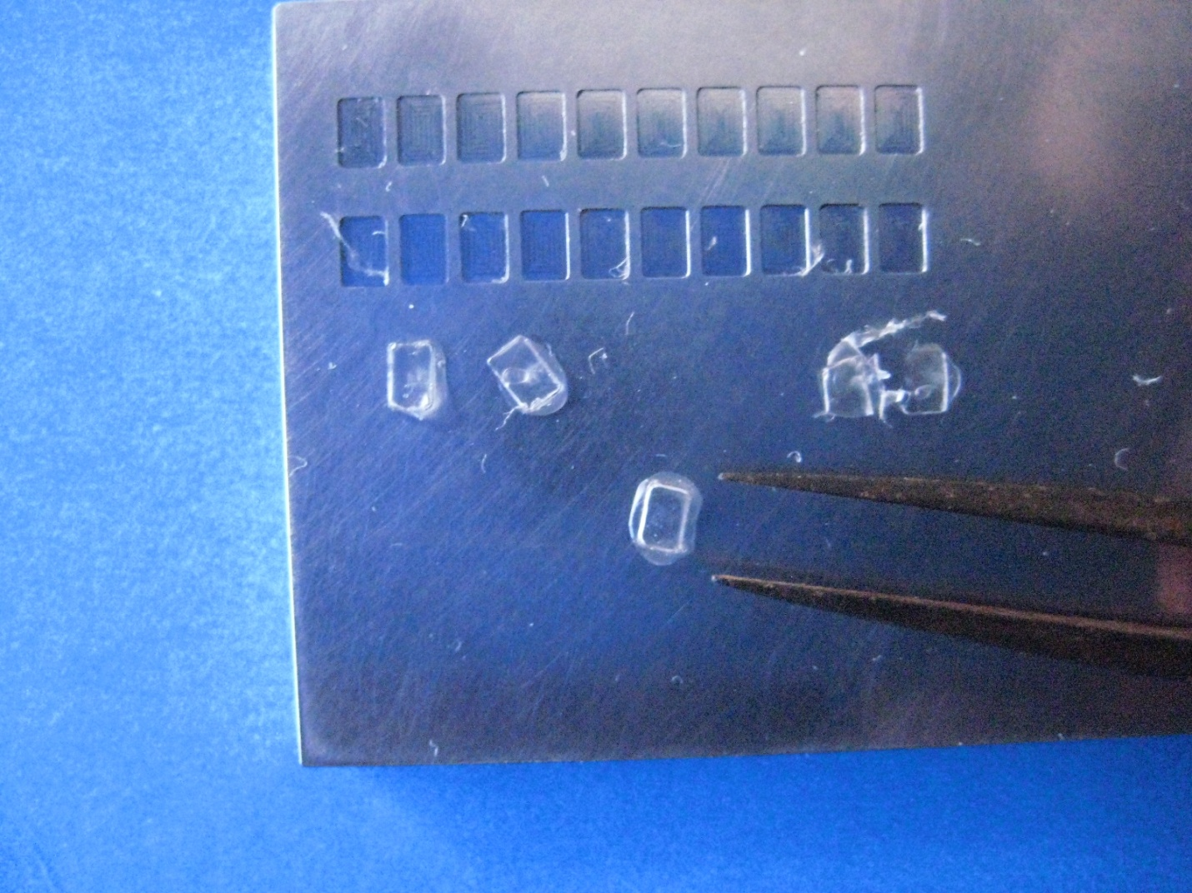
The Solution
Mix Latanaprost (glaucoma medicine) into collagen wafers
Dissolves continuously releasing the medicine over six months
THEN IT COMPLETELY DISAPPEARS

Slide 6
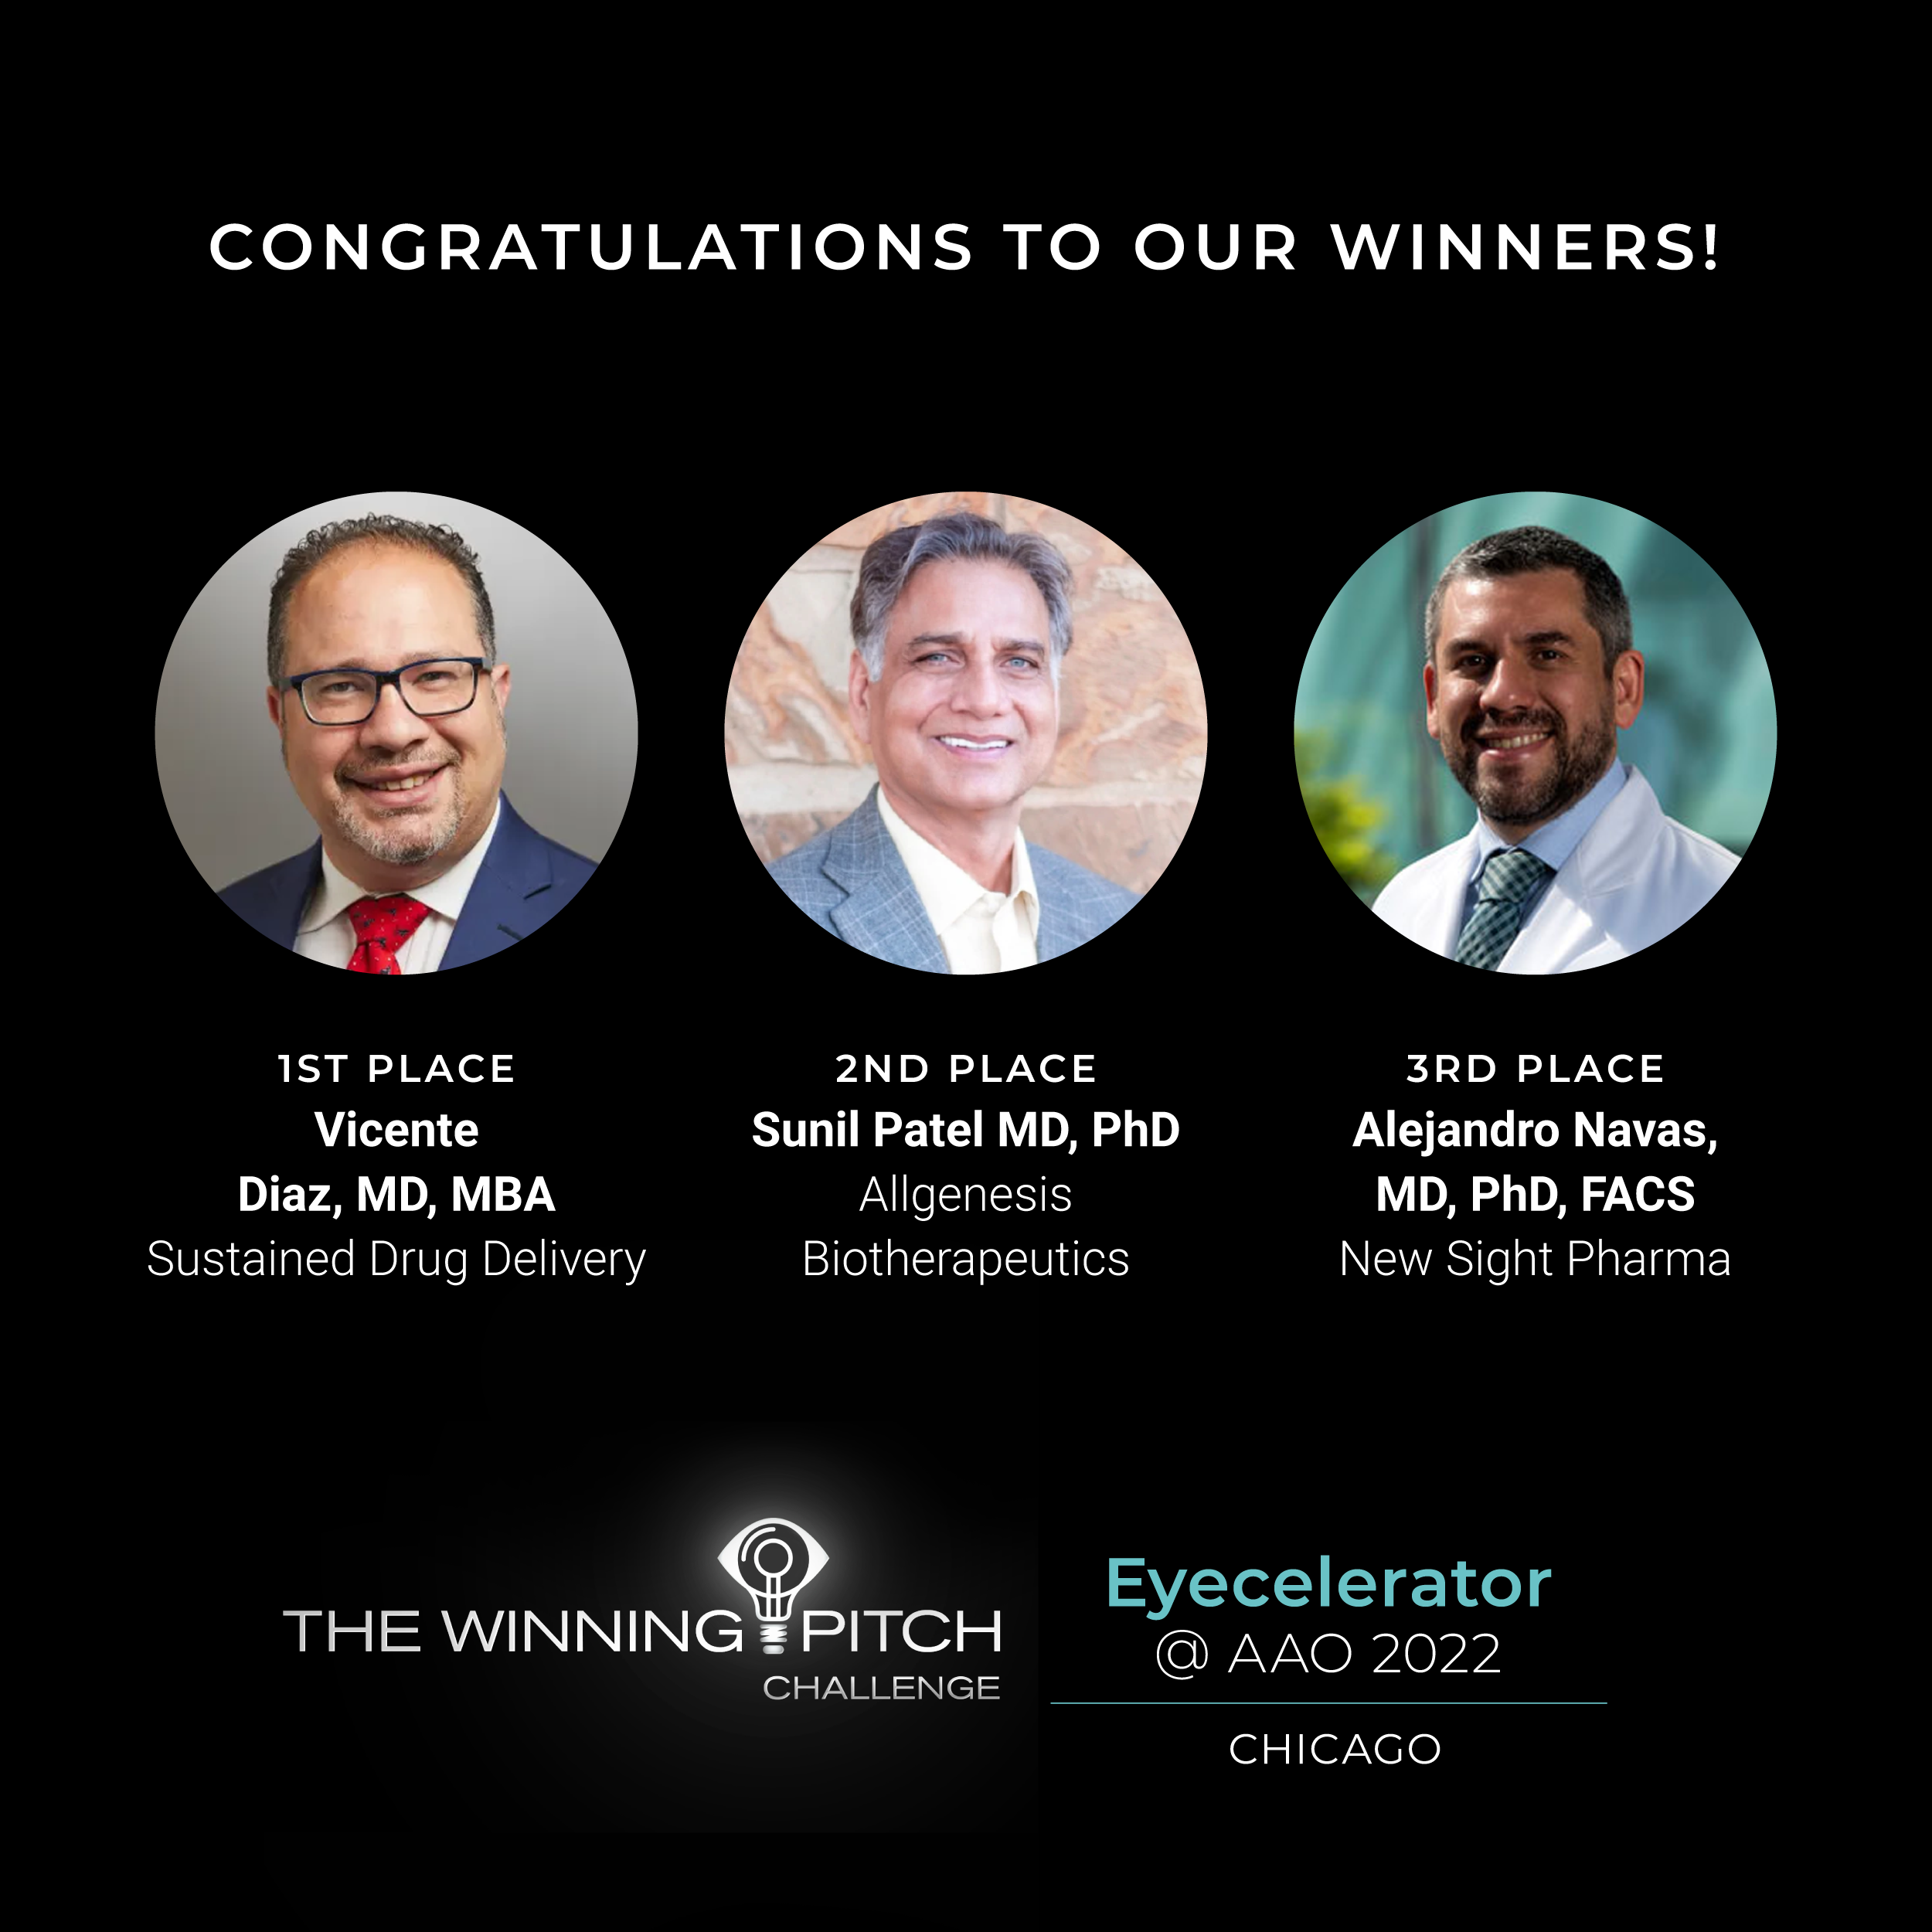
Intellectual Property
Provisional Patent
- In process of turning into non-provisional

Slide 7
Pharmacokinetics
Latanoprost release in vitro
(diffusion chamber)

Slide 8
Animal Study
Inserted Latanoprost wafers into 6 groups of 3 animals
Photo: One month post implant in rabbit eyes

Slide 9
Pharmacokinetics
Latanoprost release from collagen implanted in rabbit eyes

Slide 10
Why does this matter?
2

Slide 11
80,000,000
Second leading cause of blindness worldwide
Global Prevalence of Glaucoma

Slide 12
6.59 Billion USD$
11.05 Billion USD$
Glaucoma Therapeutics Market 2019
Projected Size by 2027
https://www.fortunebusinessinsights.com/industry-reports/glaucoma-therapeutics-market-100312

Slide 13
What is the competition?
3

Slide 14
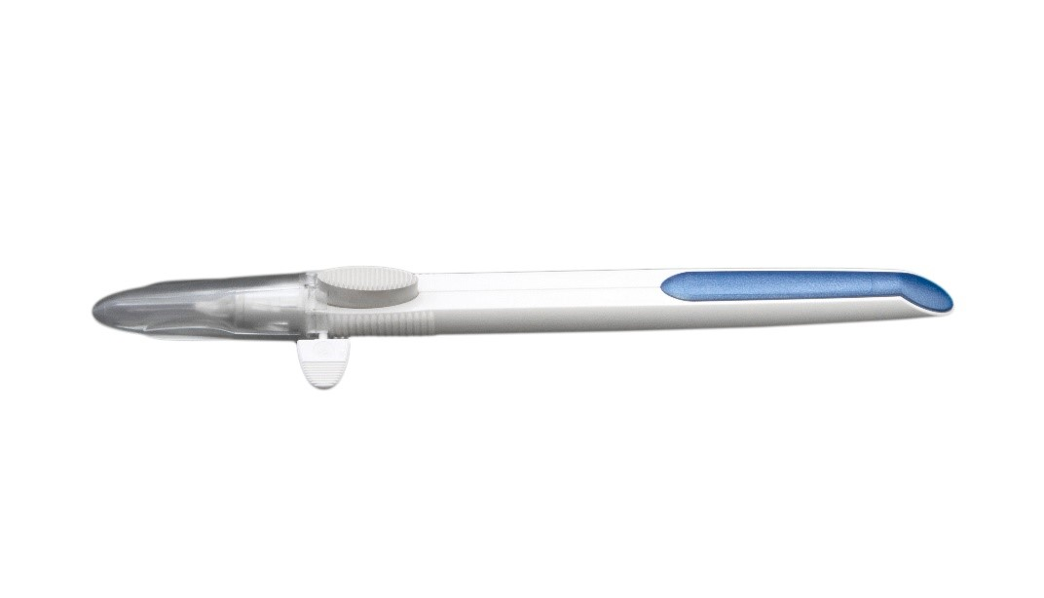
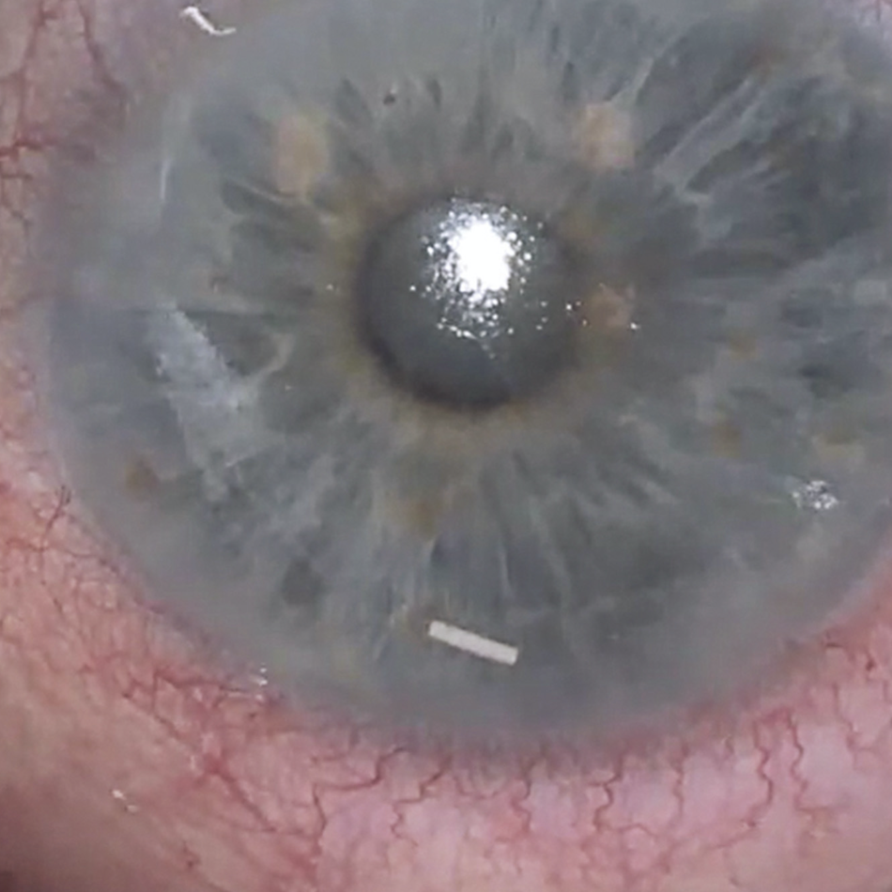
Durysta - Allergan
Bimatoprost releasing implant
Placed in anterior chamber
Weakness:
Approved for once in a lifetime
Damage to corneal endothelial cells
Notes:
A pellet is injected into the anterior chamber
It can damage the cornea
Hard to reverse
Once in a lifetime

Slide 15
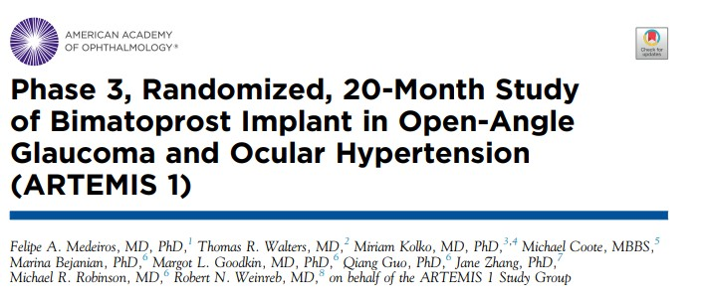
Regulatory Path Established

Slide 16
Our Roadmap
4

Slide 17
Roadmap
CGMP Manufacturer: Formacoat
Chaska, MN
FDA Investigational New Drug Application
Phase I/II Study
1
3
5
2
4
6
CRO: ORA
Andover, MA
Series A
Series B or Exit

Slide 18
Use of Funds
Materials: (Molds, Method of Production, Sterility & Stability Testing) $47k, Formacoat
Toxicology Study: $16k, Toxicon
Regulatory Consultants: $25k, ORA
Pre-Clinical Study: $175k, Michigan State University (5 dogs, 6 month follow up)
Total: $263,000
Notes:
These dogs have a genetic disposition for open angle glaucoma
The rabbits gave us good pharmacokinetic data, the dogs will validate the effect on pressure

Slide 19
Bigger concept
This platform can extend beyond glaucoma and beyond Ophthalmology

Slide 20
Conclusion
What are we doing?
Sustained Release Latanoprost
Why is it important?
Addresses Compliance
What is the competition?
Intraocular based solutions
What is our roadmap?
File IND, Complete Phase I/II Study, Phase III or Exit

Slide 21
Thanks!
Vicente Diaz
Vicente.Diaz@Yale.edu
Rich Eiferman Reiferman@cs.com
C Michael Samson CMSamson77@gmail.com
Dale DeVore Dalecol1@aol.com
Any questions?
You can find us at:

