Slide 1

RE³ MMUNE, INC
R E ³ MMUNE. All in One.
T CELL IMMUNOTHERAPY WITHOUT GENETIC ENGINEERING
Tarek Fahmy (Biomedical Engineering)
Venture Associate: Richard Andersson (Yale Ventures)

Slide 2
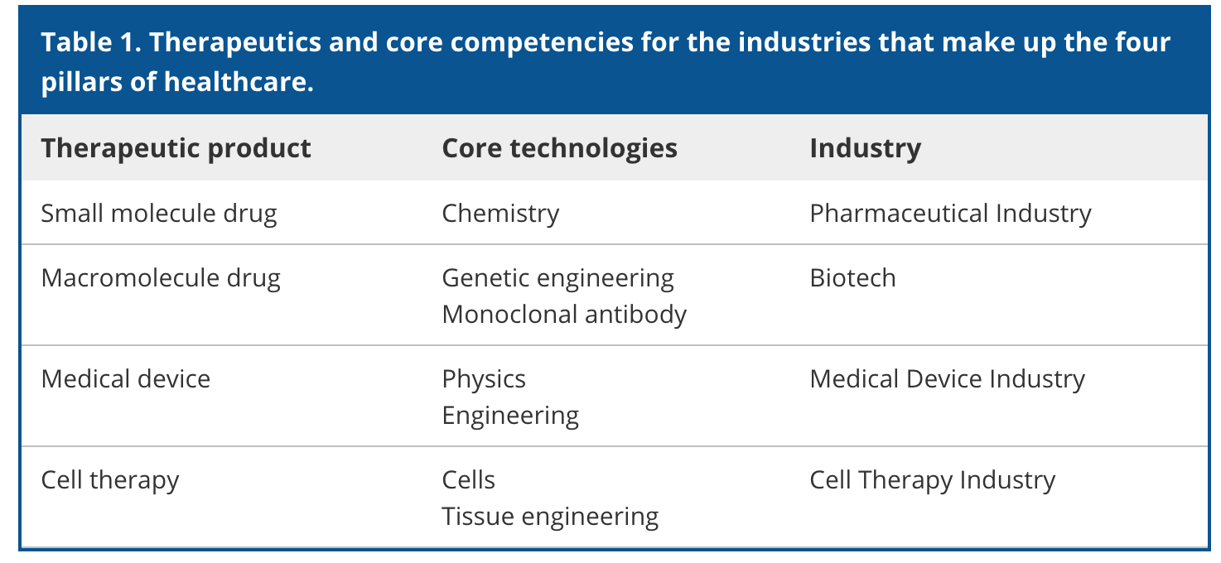
CELL THERAPY
is a “Cornerstone” technology that remains inaccessible
FOUR FOUNDATIONAL HEALTHCARE PRODUCTS

Slide 3
CELL THERAPY
is a “Cornerstone” technology that remains inaccessible
FOUR FOUNDATIONAL HEALTHCARE PRODUCTS
Effectiveness +
MANUFACTURING +
SKILL/EXPERTISE +
COST +
Limited
Public accessibility
=

Slide 4
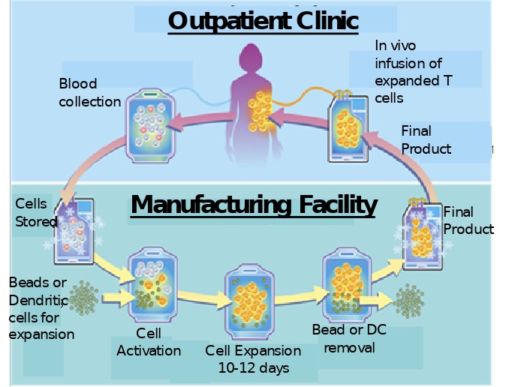
T CELL THERAPY
IS PROMISING BUT…
CLASSICAL: 1. Extract. 2. EXPAND. 3. RE-INFUSE
PROCESS

Slide 5
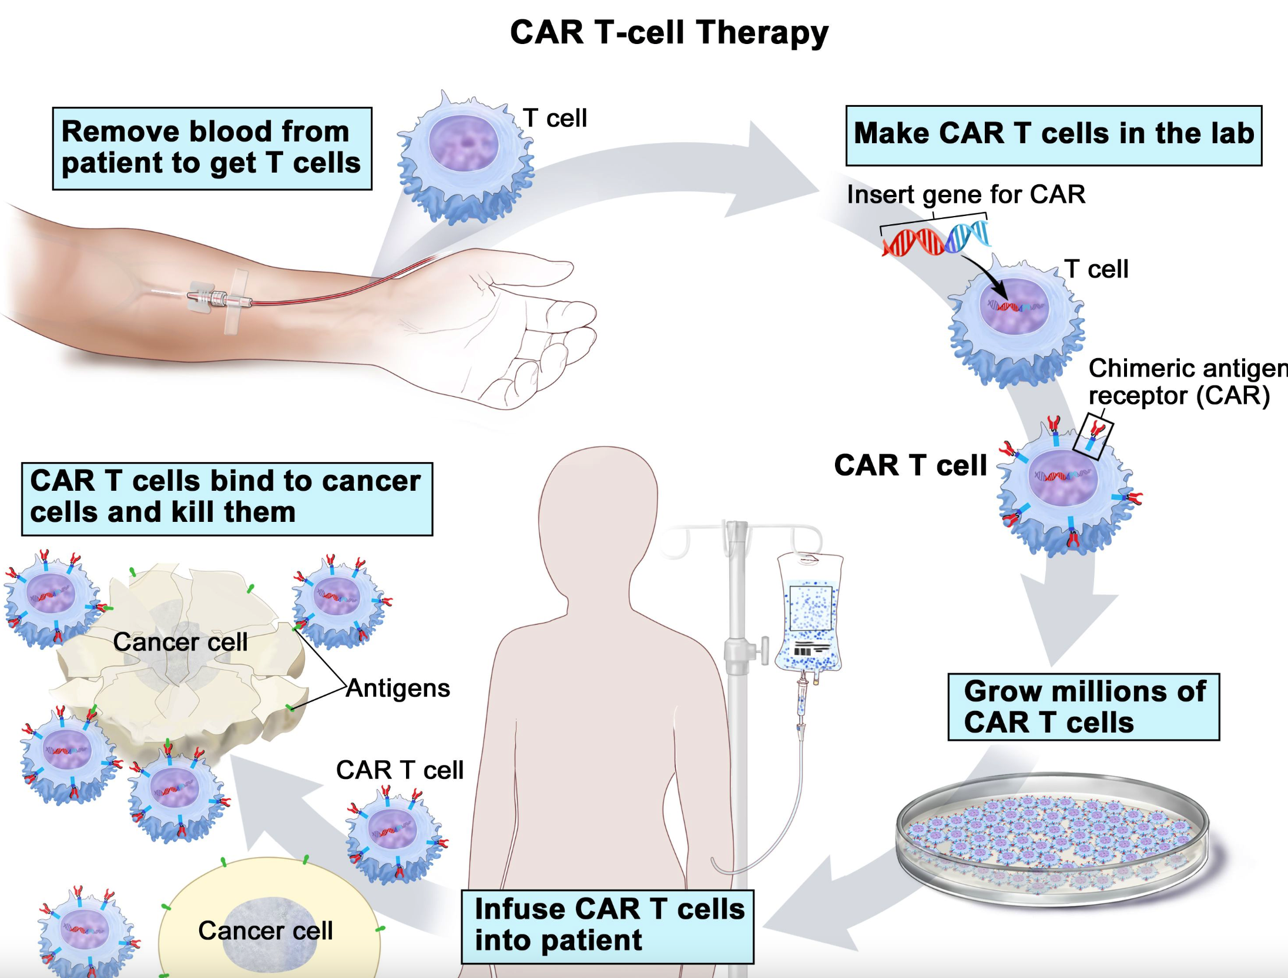
T CELL THERAPY
IS PROMISING BUT…
CAR-T: 1) Extract. 2) Engineer cells. 3) Expand. 4) reinfuse
PROCESS

Slide 6
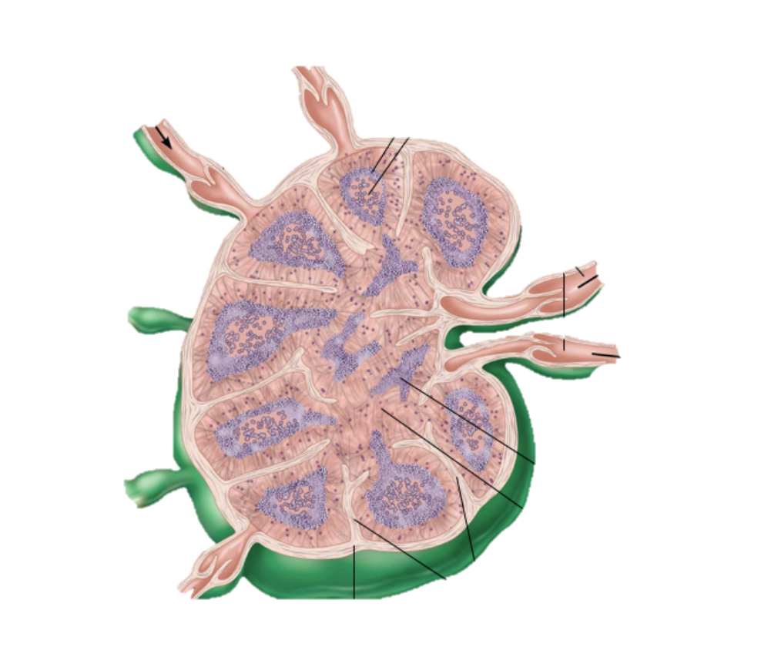
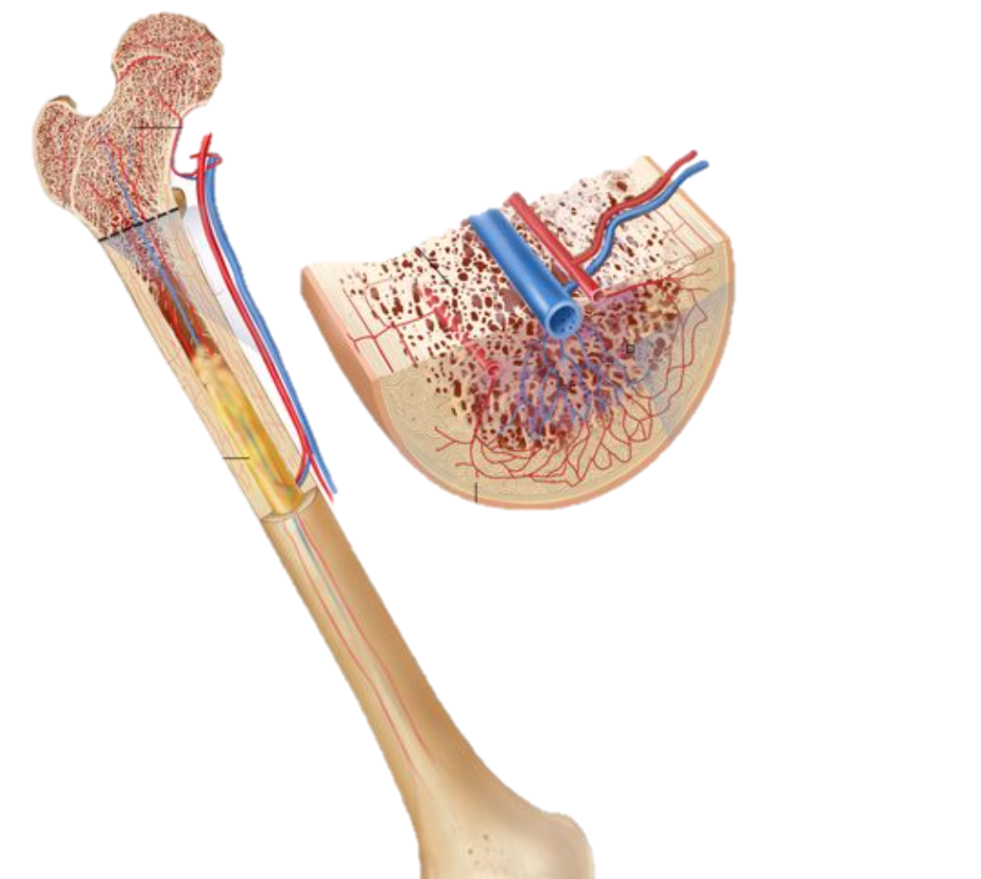
FASTER PROLIFERATION In Vivo compared to Current T cell Culture
LYMPH NODE
Inside the Body
Outside (Cell Culture)
Doubling Time ~ 2 – 4 hours
Doubling Time ~ 1 – 2 days
 | INSIDE BODY | CULTURE
Initial Cell Number | 1 Million | 1 Million Cells
Final Cell Number | 1 Billion | 1 Billion Cells
DURATION | 19 – 40 Hrs | 10 – 20 Days
BONE MARROW

Slide 7
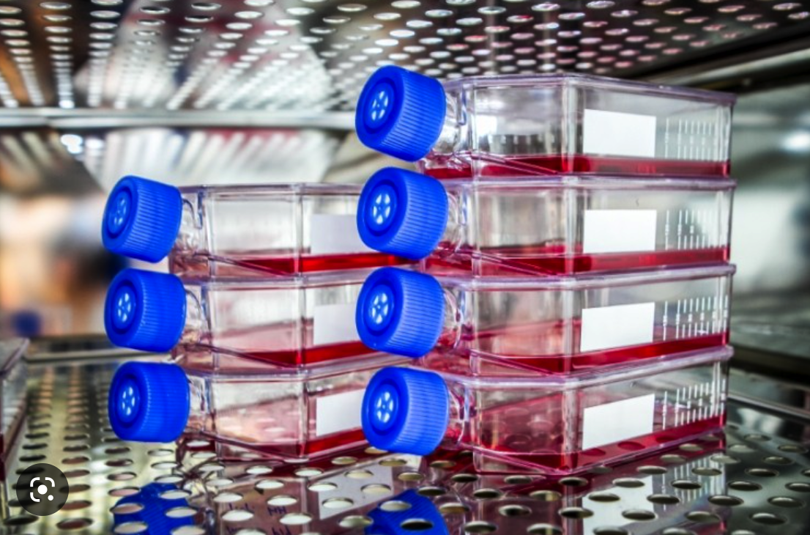
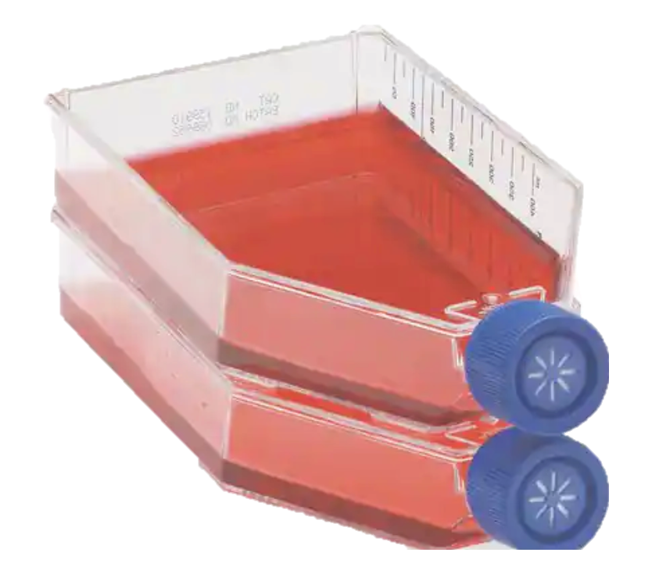
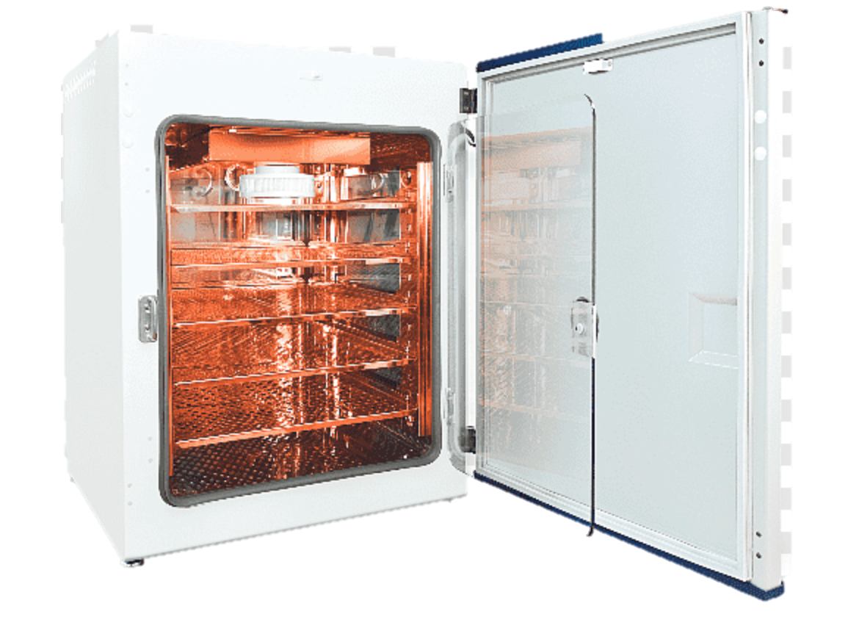
Traditional Ex Vivo Culture Conditions
are NOT “physiological”
Inside the Body
Outside (Cell Culture)
LYMPH NODE
BONE MARROW

Slide 8
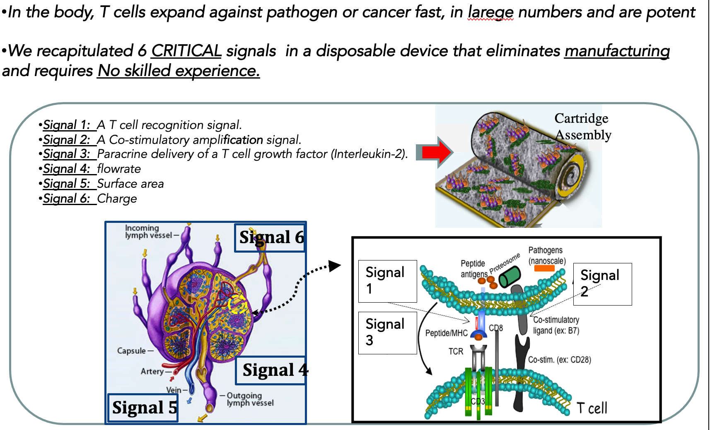
R E³MMUNE.
Doubling time~ 4 hours, Cells produced are More Effective.
Recapitulates the Physiological Environment

Slide 9
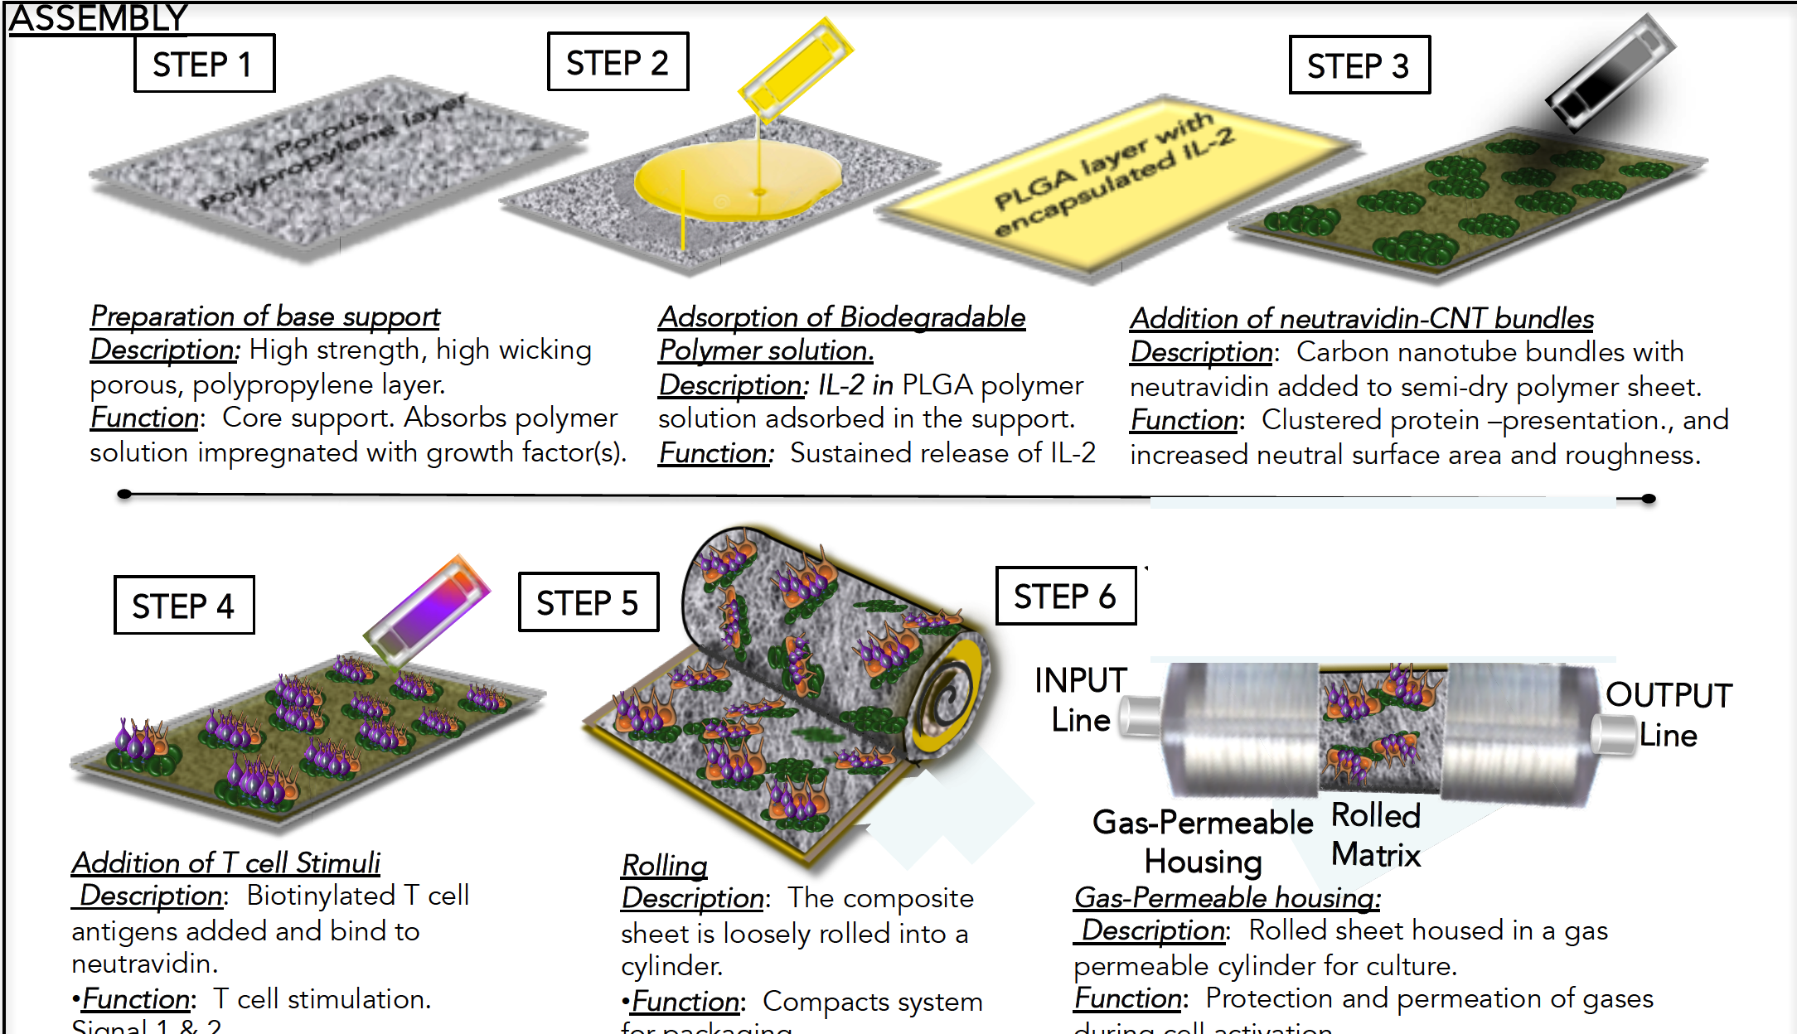
BILL,this is for questions (will not be shown). Also needs a bit of fixing.
R E³MMUNE.
“Under The Hood”: A validated-sequential
Fabrication process

Slide 10
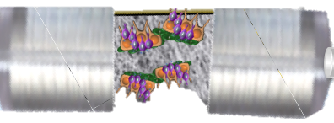
R E³MMUNE. All in One.
FINAL CLINICAL DEVICE.

Slide 11
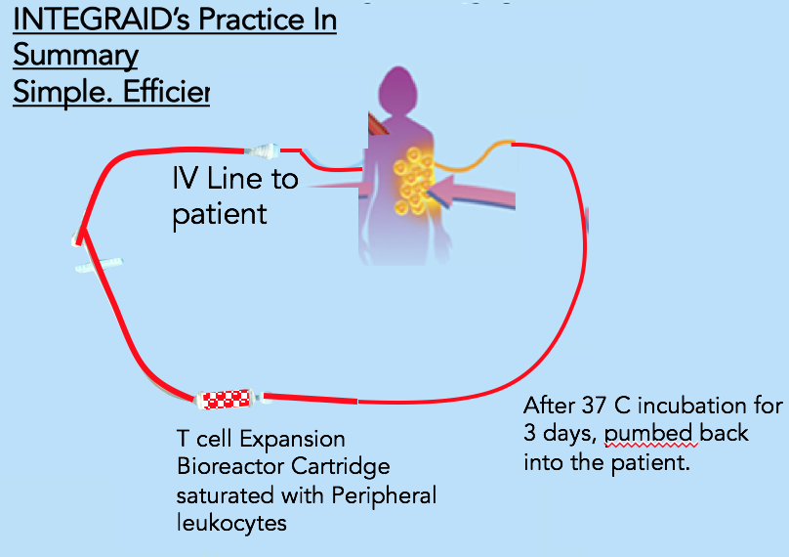
Bill; this is reserved for questions.
R E³MMUNE. All in One.
Only Three Steps
Faster, More Potent T cells
RE³MMUNE
Process:
1. Extract
2. Expand
3. Reinfuse
Three Step Process
Inject contentback to patient
Incubate Expansion unit (3 days)

Slide 12
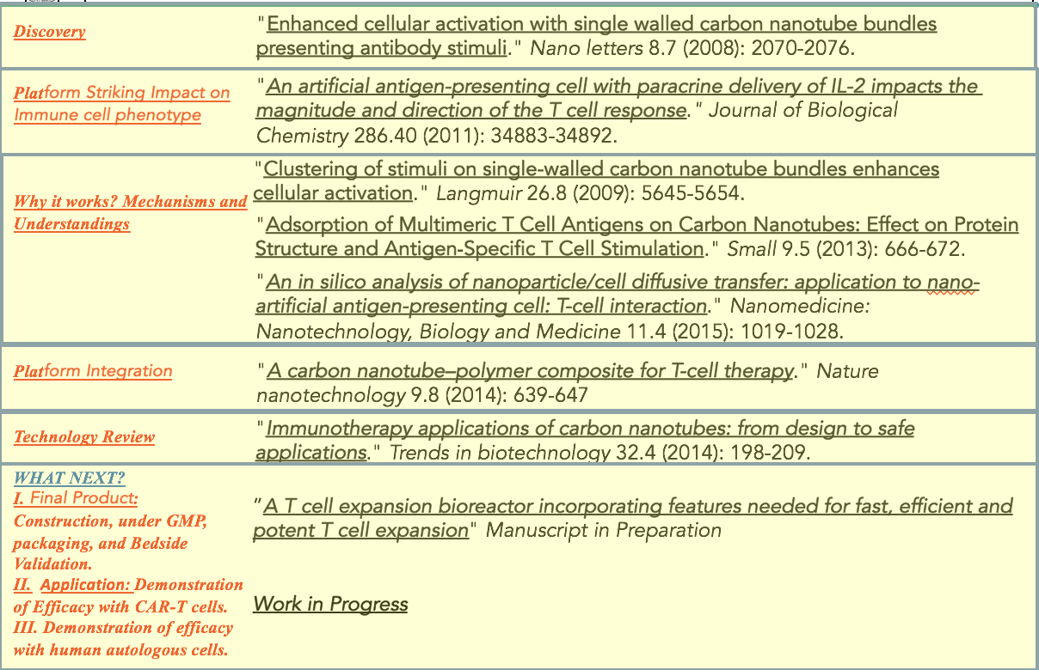
R E³MMUNE Technology is the product of years of R&D, 2 patents and 6 peer-reviewed publications

Slide 13
Big Pharma: moving from exploration to exploitation of cell therapy?
There is no doubt that there has been a steady increase in the interest in the cell therapy sector from Big Pharma as well as the larger biotech and medical device companies [21,22]. For example, Neucentis’ (previously Pfizer Regenerative Medicine, Cambridge, UK) recent partnering program (December 2010) with Athersys (Cleveland, OH, USA) [23] includes conducting a Phase II trial to evaluate the administration of MultiStem® (adult stem cells) for inflammatory bowel disease. This is despite the inevitable set backs of pharma-backed CTI ventures, the most high profile being the Genzyme–Osiris Therapeutics partnership [24]. However, the defining event for the CTI came with the long awaited success of Dendreon and its potential blockbuster cell therapy product with agreed reimbursement by CMS at $93,000 [105]. It is all the more remarkable being that the therapy is autologous and not a more easily scalable allogeneic therapy. This success has certainly made both potential investors and strategic partners reassess their positions on cell therapies. Recent activity includes the $1.7 billion deal by Cephalon (Frazer, PA, USA) with an up-front payment of $130 million to Mesoblast (Melbourne, Australia) to develop and commercialize adult stem cell therapies for a range of medical disorders. Cephalon also paid $220 million for a 19.99% equity stake and a seat on the board of Mesoblast [25]. Venture capitalist, Daphne Zohar of PureTech Ventures (Boston, MA, USA) best sums up the general CTI view of this deal by saying that “The up-front payment is higher than most we’re seeing. Most recent deals are structured as earnouts that are more backloaded, but Cephalon must have thought it was worth it”[25].
R E³MMUNE.
BLAVATNIK FUNDS
PHASE I: PARAMETERIC TESTING/ENGINEERING ($200K)
(with subcontractors –different antigen-specific applications)
Effect of substrate surface area
Effect of porosity
Effect of flowrate
Effect of cytokine gradients (fast and slow).
Engineering plasma and RBC removal modules.
Comparison with CAR-T ($25K).
Expansion of CAR-T ($25K)
PHASE II: MANUFACTURING & CLINICAL DIST. ($100K).
Manufacture 10 units. Quality Control. Testing.
Distribution to 10 clinical research settings (Yale, Mayo, NCI, UPENN, Johns Hopkins, Moffit, BIDMC, U.Maryland, Dartmouth, Rosewell)

Slide 14
Big Pharma: moving from exploration to exploitation of cell therapy?
There is no doubt that there has been a steady increase in the interest in the cell therapy sector from Big Pharma as well as the larger biotech and medical device companies [21,22]. For example, Neucentis’ (previously Pfizer Regenerative Medicine, Cambridge, UK) recent partnering program (December 2010) with Athersys (Cleveland, OH, USA) [23] includes conducting a Phase II trial to evaluate the administration of MultiStem® (adult stem cells) for inflammatory bowel disease. This is despite the inevitable set backs of pharma-backed CTI ventures, the most high profile being the Genzyme–Osiris Therapeutics partnership [24]. However, the defining event for the CTI came with the long awaited success of Dendreon and its potential blockbuster cell therapy product with agreed reimbursement by CMS at $93,000 [105]. It is all the more remarkable being that the therapy is autologous and not a more easily scalable allogeneic therapy. This success has certainly made both potential investors and strategic partners reassess their positions on cell therapies. Recent activity includes the $1.7 billion deal by Cephalon (Frazer, PA, USA) with an up-front payment of $130 million to Mesoblast (Melbourne, Australia) to develop and commercialize adult stem cell therapies for a range of medical disorders. Cephalon also paid $220 million for a 19.99% equity stake and a seat on the board of Mesoblast [25]. Venture capitalist, Daphne Zohar of PureTech Ventures (Boston, MA, USA) best sums up the general CTI view of this deal by saying that “The up-front payment is higher than most we’re seeing. Most recent deals are structured as earnouts that are more backloaded, but Cephalon must have thought it was worth it”[25].
R E³MMUNE. All in One Commercialization Plan

Slide 15
Parallel devices enable expansion of T cells with different antigen-specificities. The T cell equivalent of combination drug therapy
R E³MMUNE. A Plug & Play Platform
Expand cells with different antigen-specificities, or combine to enhance chemotherapy, immunotherapy, or radiation.

Slide 16
R E³MMUNE. All in one Works with CAR-T Cells or Replaces them
1) RE³MMUNE. is administered bedside without the need of the extensive and expensive offsite production of CAR-T cells.
2) CAR-T currently takes some 22 days from extraction to infusion compared with only three days with RE³MMUNE.
3) The CAR-T process requires highly skilled technicians. As a result, Novartis charges $475K/CAR-T infusion. RE³MMUNE. Process is bedside and only requires a nurse. Projected cost of devivce is less than $100 !!
4) CAR-T cells are genetically modified. RE³MMUNE. amplifies a patient’s innate cells without genetic modification.
5) Due to genetic modification, CAR-T cells are often too potent and, therefore, toxic. Patients have experienced CAR-T “cytokine storms” with extremely high temperatures, comas and stroke symptoms. RE³MMUNE. cells should be less toxic and, thus, avoid the life threatening side effects of CAR-T.
6) CAR-T is approved only for childhood leukemia and is ineffective against solid cancer tumors. RE³MMUNE. have preliminarily been shown to be effective against murine melanoma tumors. Melanoma is extremely aggressive.
7). RE³MMUNE can work for amplification of CAR-T cells further reducing it’s cost.

Slide 17
1) All components have been tested separately (some in combination). NOT the entire, integrated system.
2) Efficacy and expansion rates of T cells exceeds other ex vivo cell therapies.
3) T cells amplified using components have eradicated melanoma solid tumors in mice.
4) Shown to rapidly expand human T cells to combat the Epstein–Barr virus.
5). Background patents are issued. Device patent is pending.
Investment funds are to:
Expedite device integration and validation. Optimize key parameters
Work with clinical collaborators in mouse and human studies.
An anticipated funding rate of $500K/year for two years is needed to prepare the RE³MMUNE platform for human clinical trials. This funding rate includes research, research overhead, administrative and legal expenses.
R E³MMUNE. All in One Therapy
Current status and Investment Call

