Slide 1
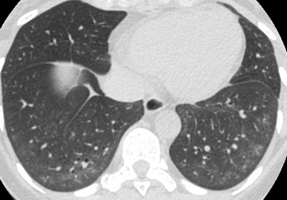
Epiregulin Inhibition to Treat Scleroderma Skin and Lung Fibrosis
Ian Odell, MD, PhD & Richard Flavell, PhD, FRS

Slide 2
Our Team
Ian Odell, MD, PhD
Yale Assistant Professor of Dermatology
Research expertise in scleroderma and other fibrotic disorders
Clinical expertise as dermatology lead of Yale Scleroderma Program
Richard A. Flavell, PhD, FRS
Yale Sterling Professor of Immunobiology
Investigator, HHMI
h-index 265
Founder multiple successful biotech companies, including Alexion
Previous CSO of Biogen
Market cap >$80 billion

Slide 3
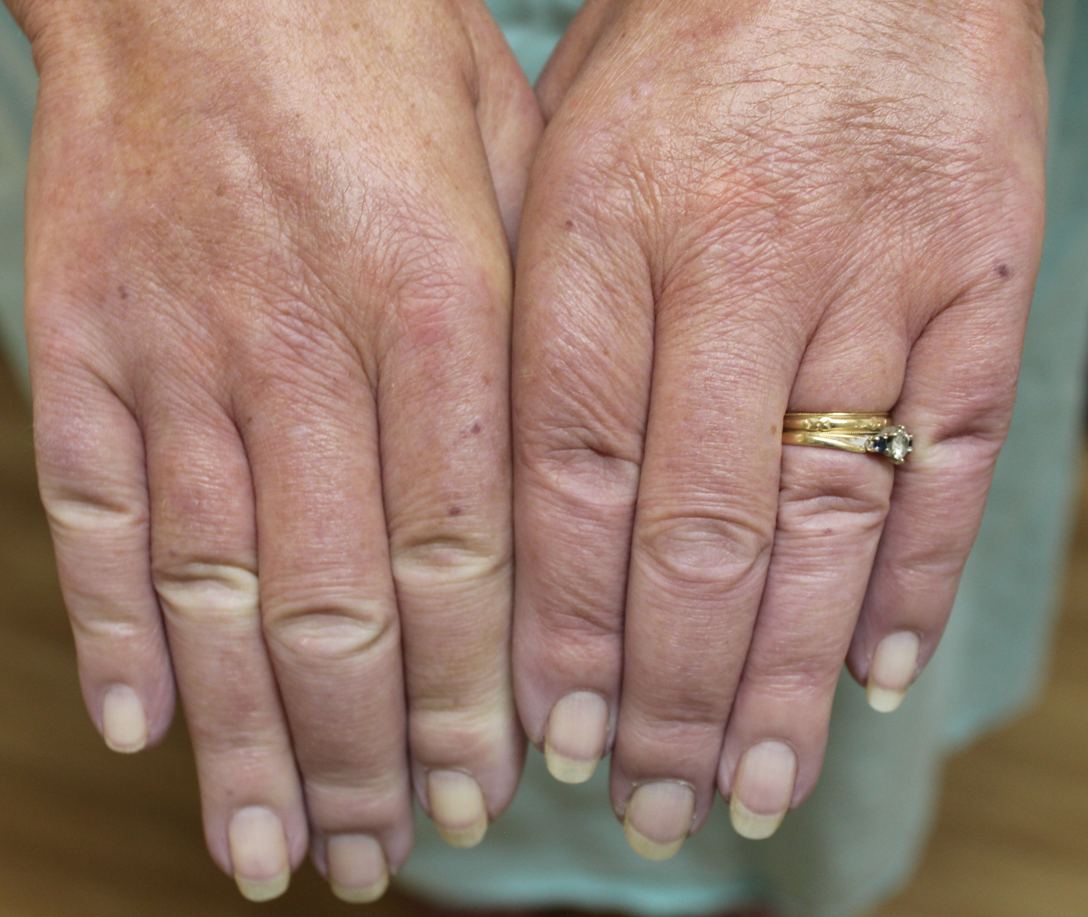
Systemic sclerosis (scleroderma, SSc) is the prototypic fibrotic disease and progresses through 3 characteristic phases.
edema of
hands and face
sclerodactyly and calcinosis cutis
SSc skin ~ lung fibrosis
1. inflammatory phase
2. fibrosis
3. atrophy
0-6 months
1-4+ years
lack of effective treatments
best time to treat, but
often misdiagnosed
Clinical need for safe and effective antifibrotic therapies
Notes:
SSc is an autoimmune disease that causes fibrosis of the skin and internal organs, resulting in high morbidity and mortality.
Its natural history involves 3 phases, initially inflammation with edema followed by fibrosis and eventual atrophy. Most patients present during the fibrotic phase which has limited therapeutic options.

Slide 4
Scleroderma has no FDA approved therapy for treatment of skin fibrosis.
sclerodactyly
Incidence 1/50,000 adults per year
Median survival: 11 years
FDA-approved treatments for SSc-ILD:
2019: nintedanib (Boehringer Ingelheim)
Tyrosine kinase inhibitor against FGFR, PDGFR, VEGFR, FLT3
limited tolerability due to GI symptoms (16% of pts stop med)
2021: tocilizumab (Genentech) IL-6 receptor antagonist
No FDA-approved treatment for SSc skin disease
Competition: Off-label use of mycophenolate mofetil
Mayes et al. 2003, Arthritis Rheum.
Steen and Medsger. 2007, Ann Rheum.
Distler et al. 2019, N Engl J Med.
Khanna et al. 2021, Lancet Respir Med.

Slide 5
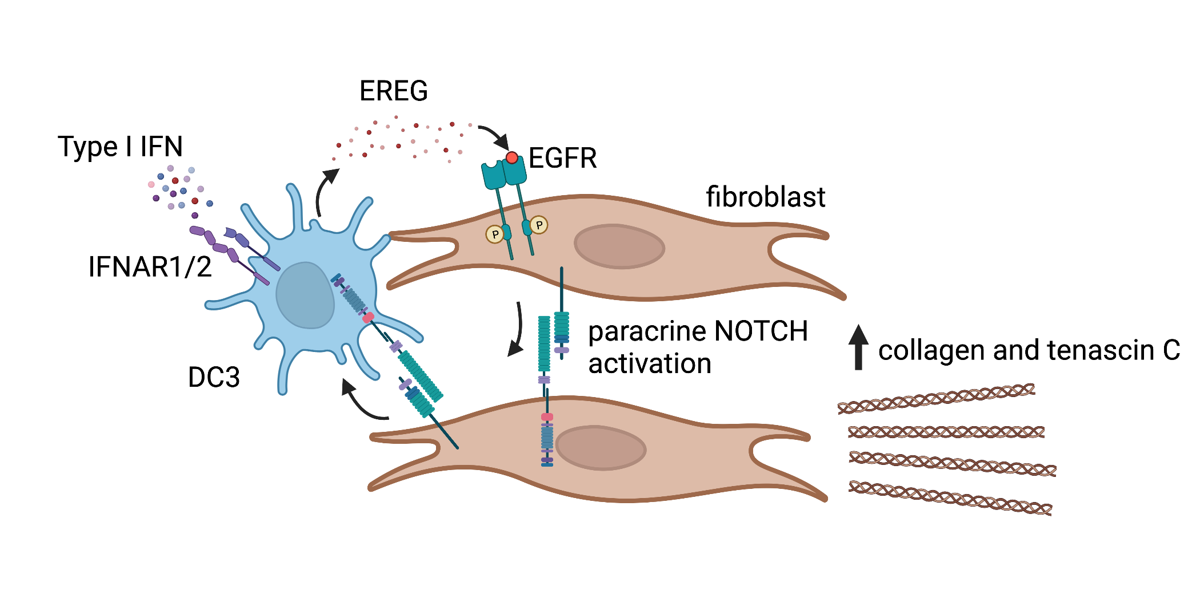
Epiregulin is an EGFR ligand that maintains skin and lung fibrosis which can be blocked with a neutralizing antibody.
U.S. Provisional Application No. 63/316,691
For: METHODS FOR TREATING AND PREVENTING FIBROSIS
Filed: March 4, 2022
Yale Ref: OCR 8349
TP Ref.: 251609.000031
Odell et al. Science Immunology, Accepted.
Notes:
We believe we have elucidated the mechanism of fibrosis in scleroderma and graft-vs-host disease.
This is driven by a protein to which one can make a therapeutic antibody.
Development of a neutralizing human antibody against this target is the next step before commercialization.

Slide 6
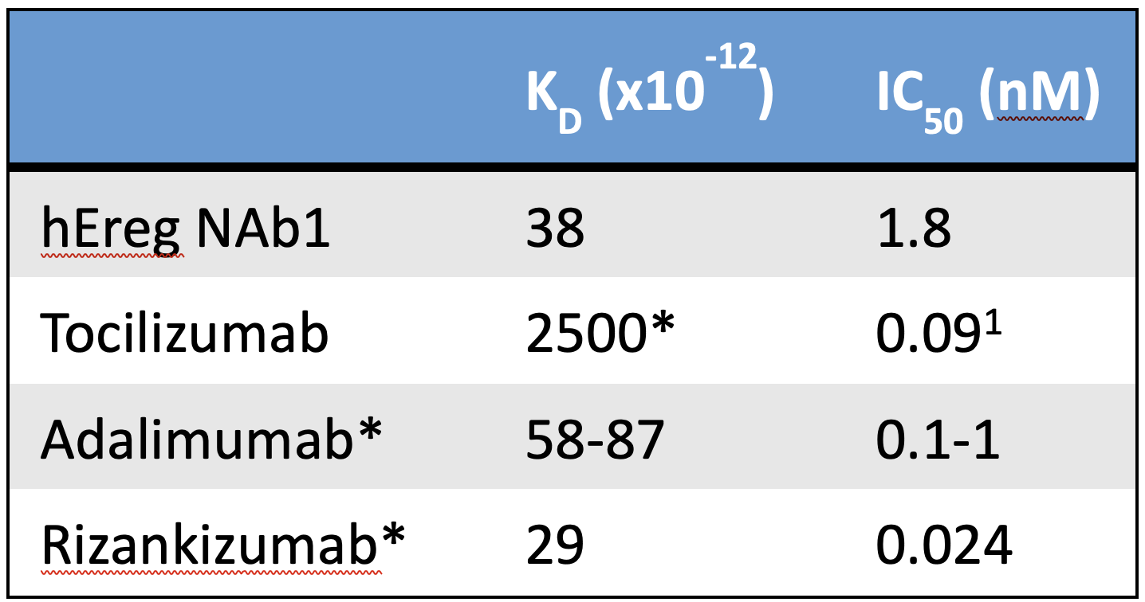
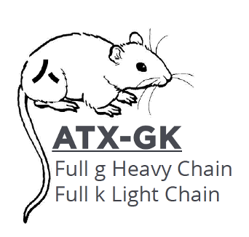
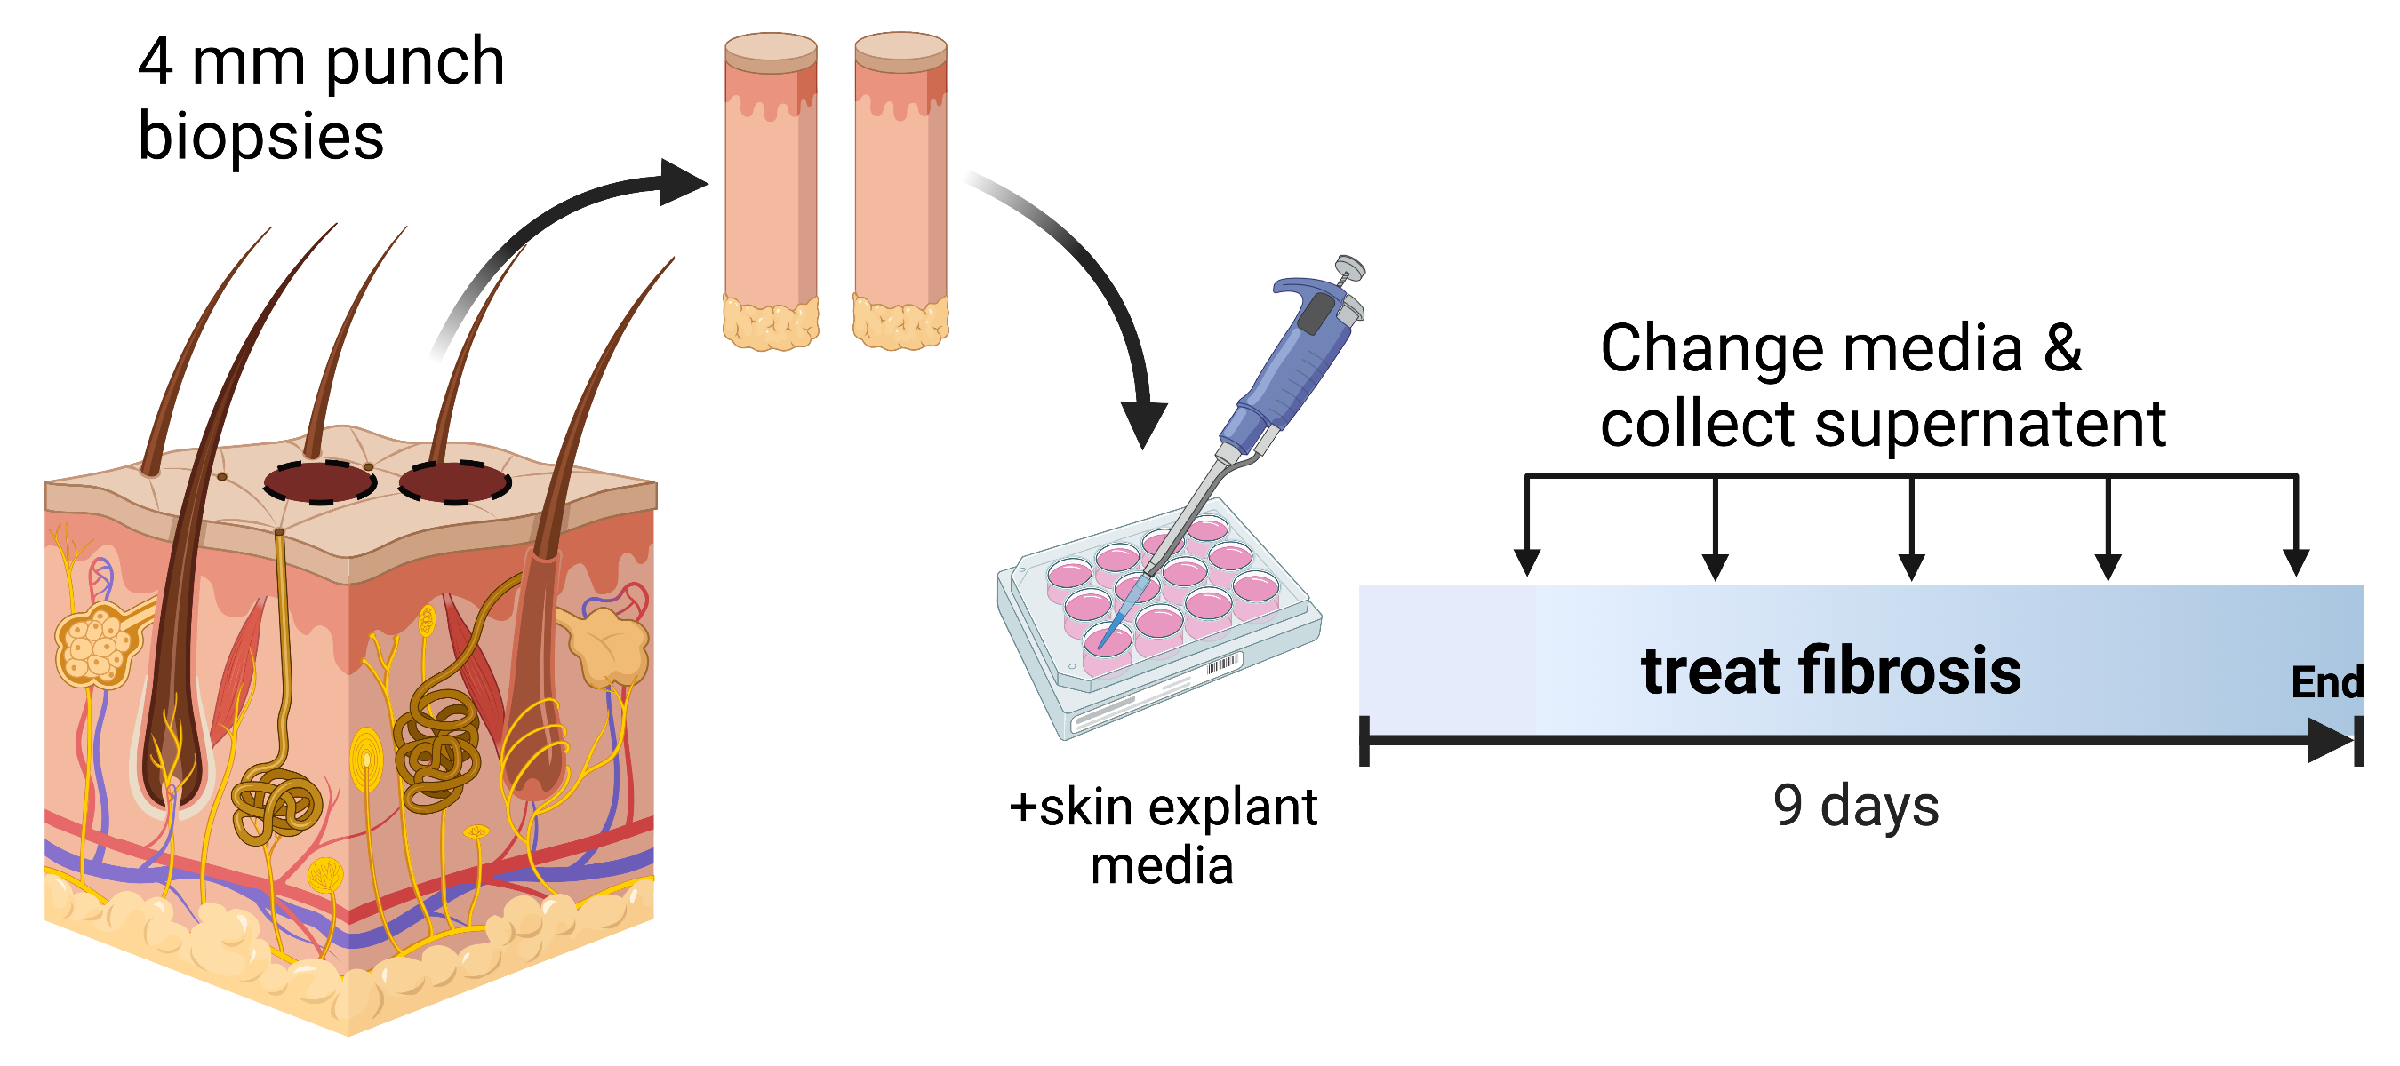
We developed a human epiregulin neutralizing antibody that has kinetics comparable to FDA-approved monoclonal antibodies and improves fibrosis of human skin and lung explants.
rhEreg EGF domain
Sigma adjuvant
1 unique Ereg neutralizing
hybridoma clone
hEreg NAb1 x mouse Ereg IC₅₀ 87 nM
Scleroderma Skin
Non-treated
Ereg Ab
Odell et al. Science Immunology, Accepted.
PINP = Procollagen N-terminal peptide
1. Garbers et al. JBC 2011.
*data from European Medicines Agency.
Notes:
Octet Bio-Layer Interferometry

Slide 7
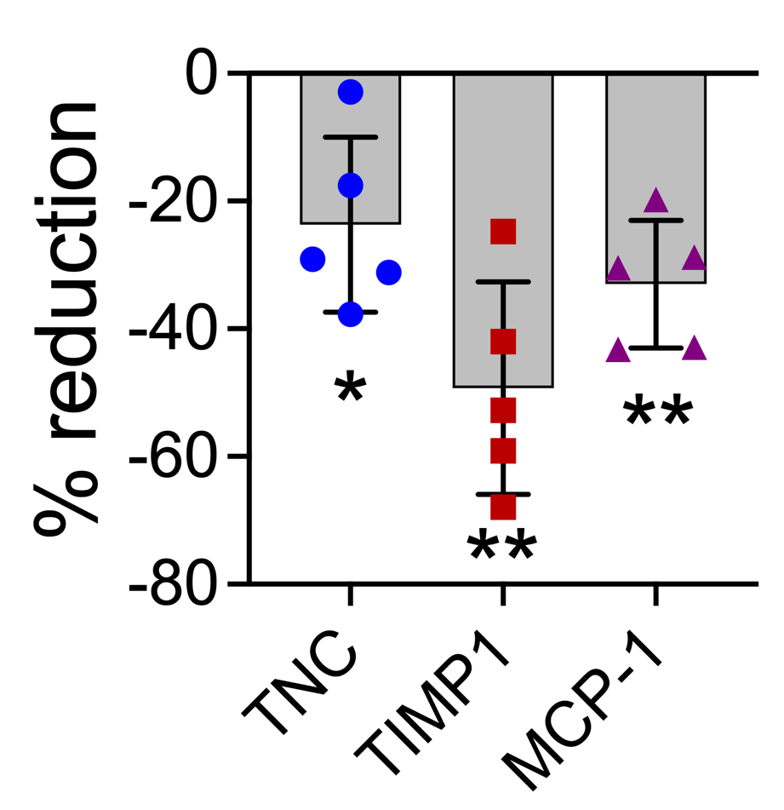
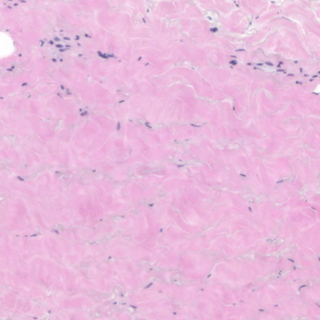
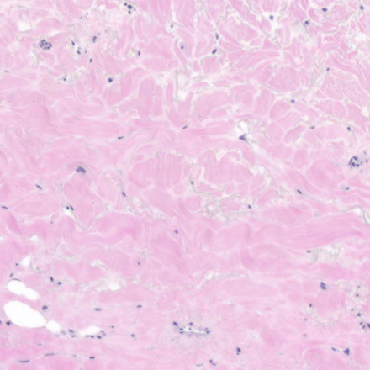
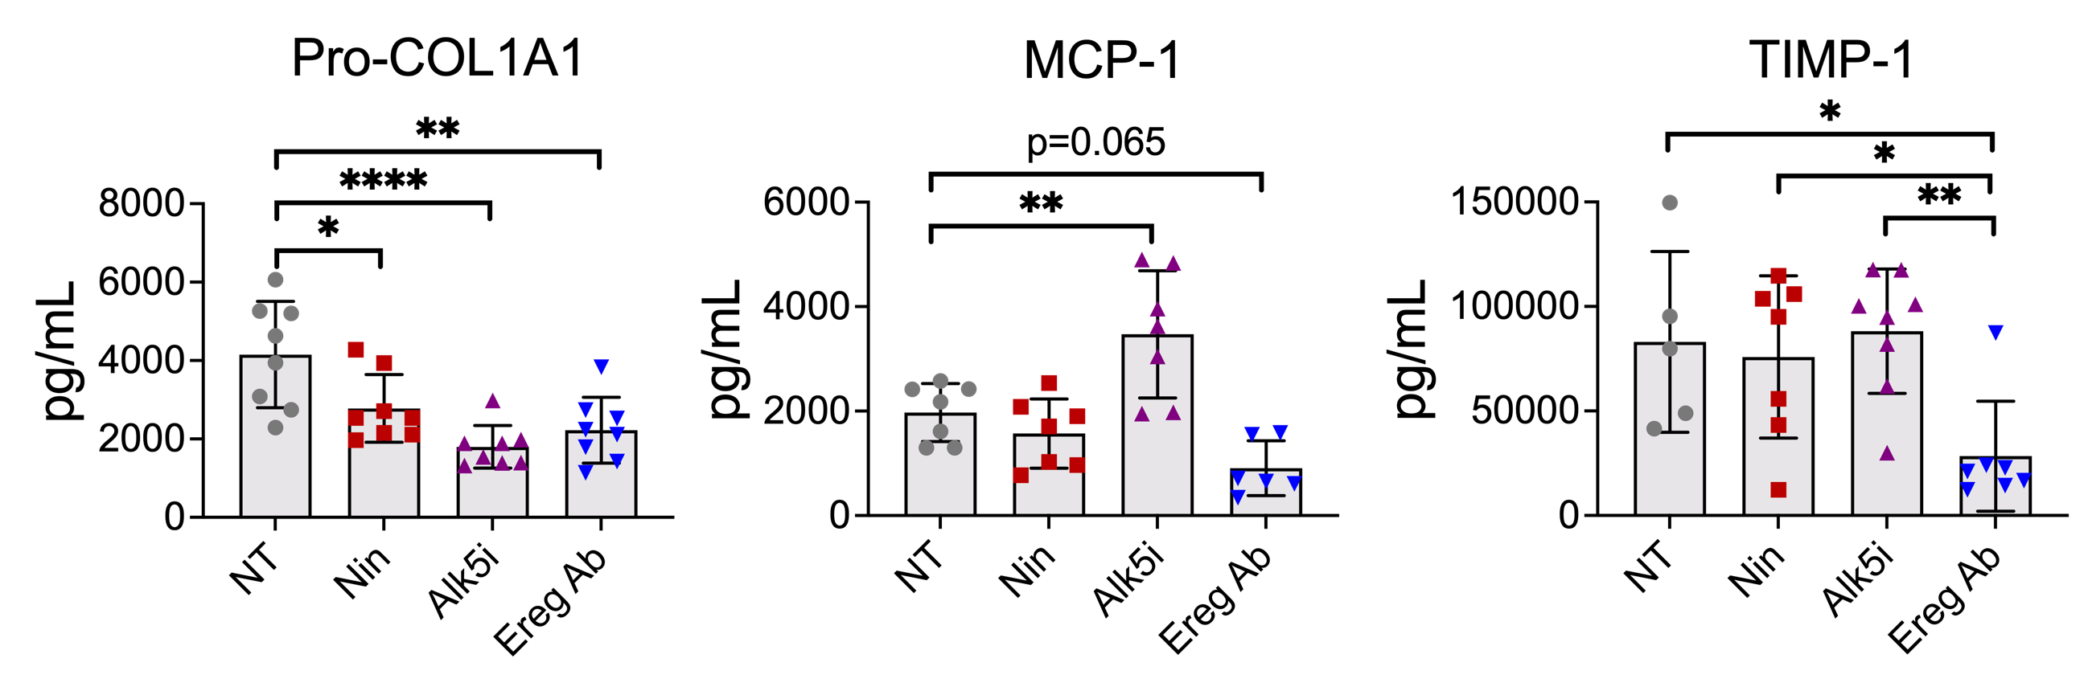
We developed a human epiregulin neutralizing antibody that has kinetics comparable to FDA-approved monoclonal antibodies and improves fibrosis of human skin and lung explants.
GvHD Skin
Isotype Ab
Ereg Ab
IPF lung
H&E
trichrome
New Provisional Application
U.S. Provisional Application No. 63/316,704
For: ANTI-EPIREGULIN ANTIBODY AND ITS USE
Filed: March 4, 2022
Yale Ref: OCR 8362
TP Ref.: 251609.000078
Notes:
Octet Bio-Layer Interferometry

Slide 8
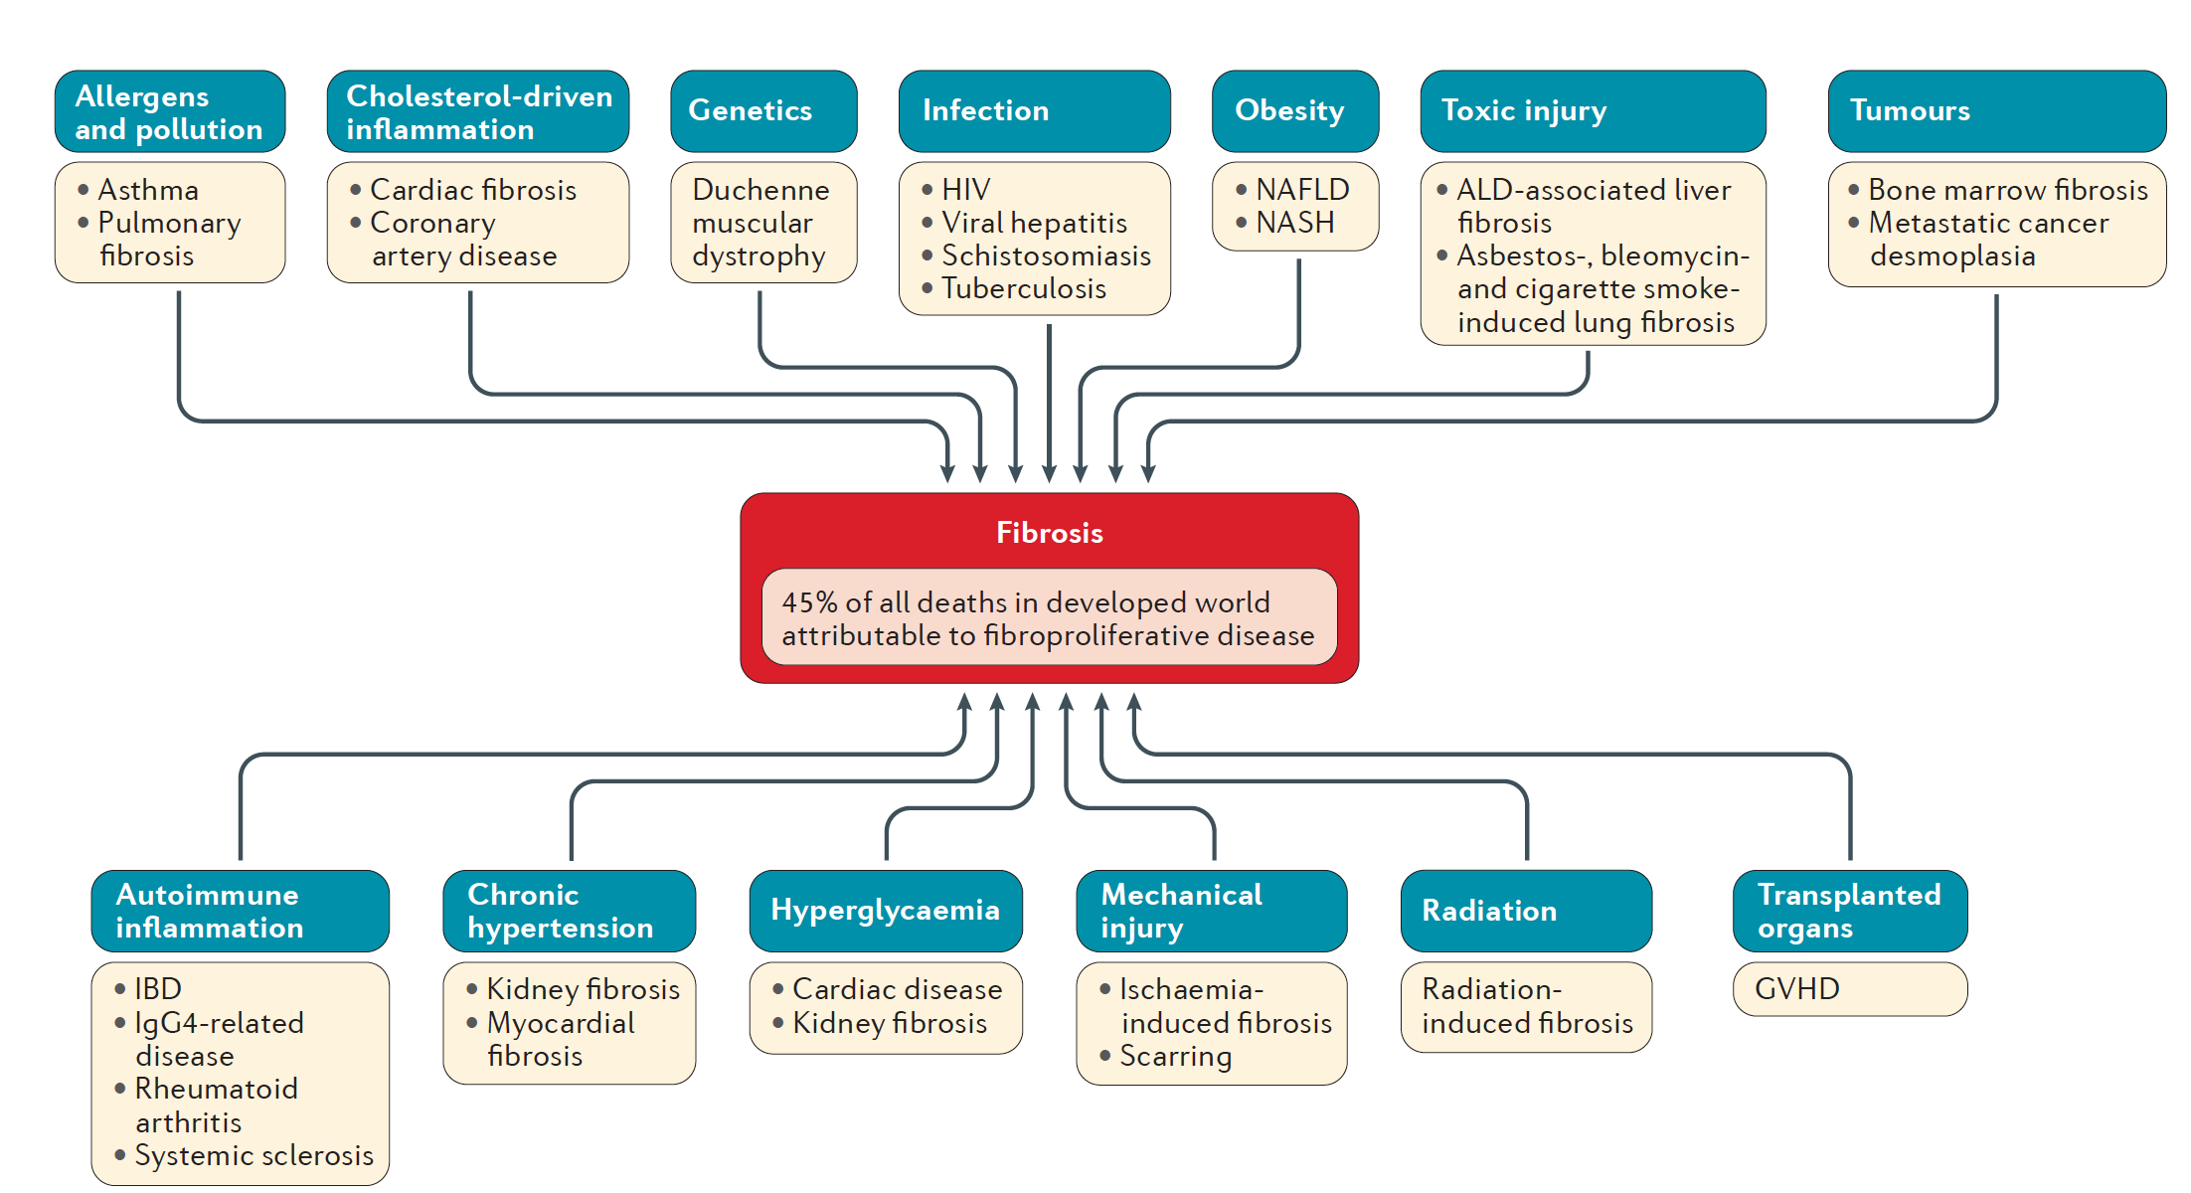
Fibrosis is a common final outcome of most chronic inflammatory diseases and contributes to 45% of all deaths in the developed world.
Gieseck et al. 2017. Nat Rev Immunol.
Notes:
Chronic graft-vs-host disease (GvHD) and idiopathic pulmonary fibrosis (IPF) are equally devastating and treatment merely slows disease progression.

Slide 9
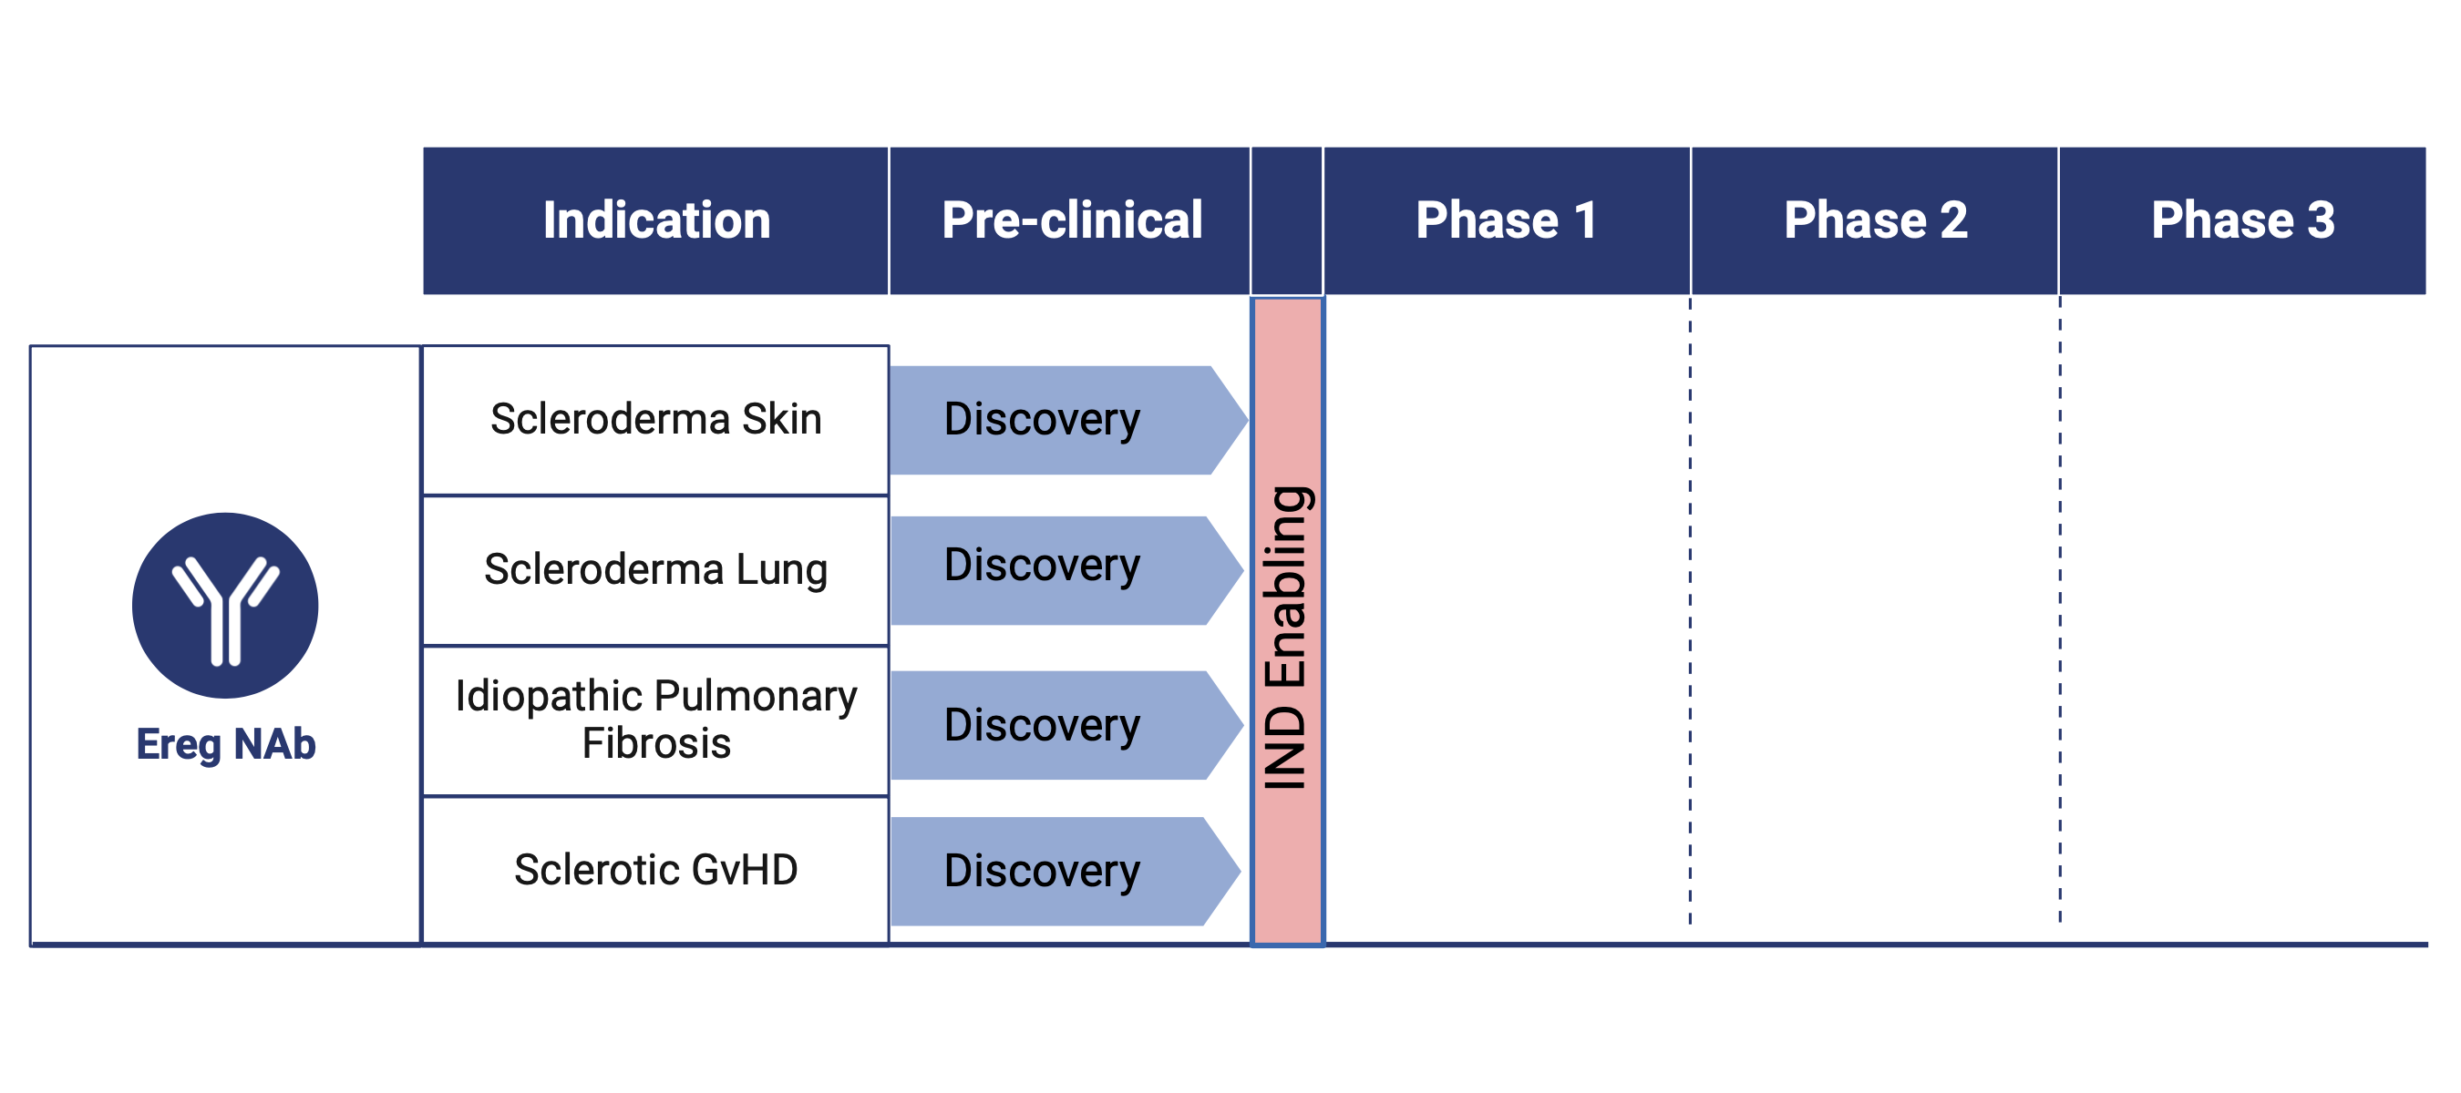
Epiregulin antibody development:
The Blavatnik Fund will support IND enabling development of existing Ereg NAb:
Affinity maturation/optimization and cell line development
Chemistries, manufacturing, and controls (CMC) studies
Toxicology studies in rodents and non-rodent species
Expand portfolio of epiregulin inhibitors
Provide further unique humanized antibodies that represent first in class
Notes:
Optimize hybridoma production efficiency

Slide 10
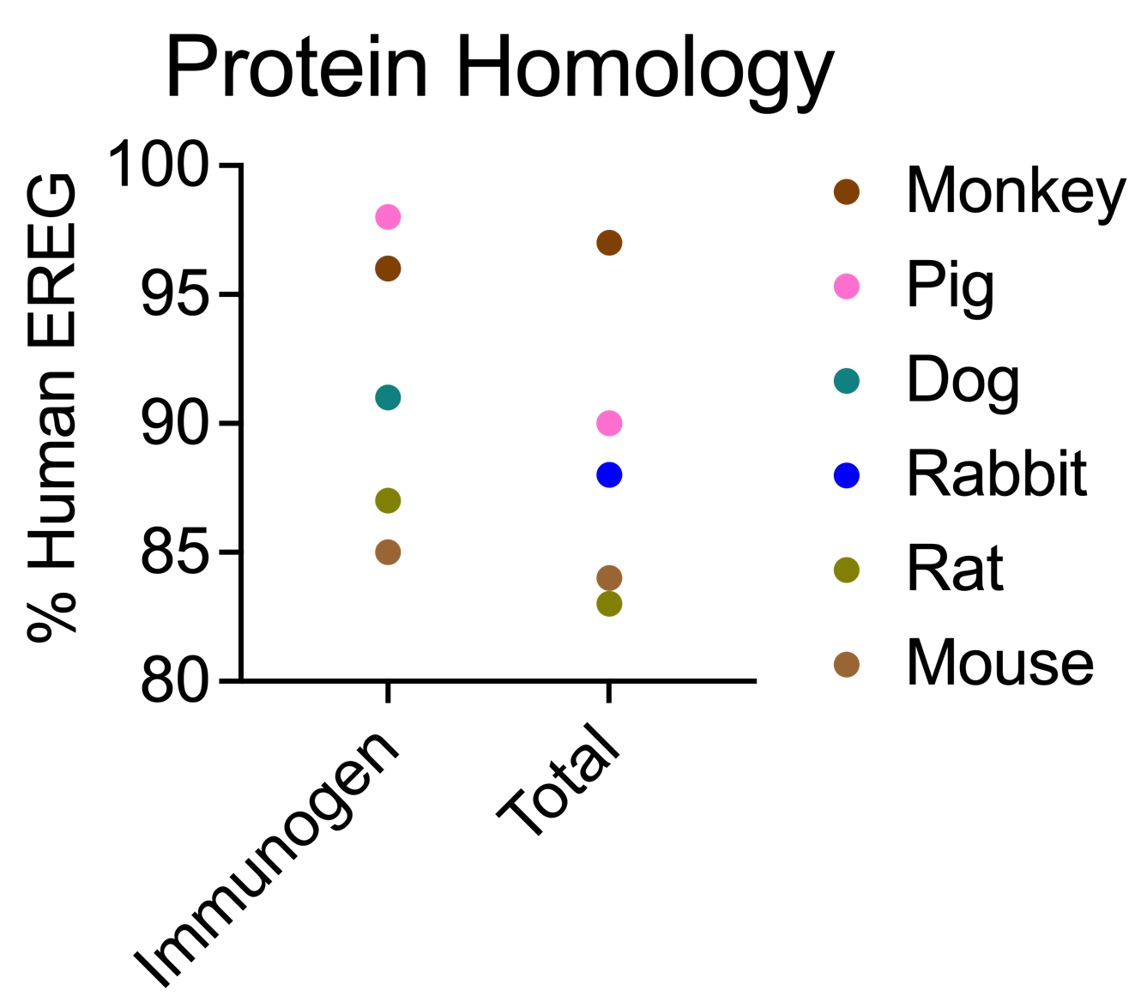
Blavatnik Milestones
Year 1 Budget - $100k
Affinity maturation and cell line development
Biomarker discovery
Expand portfolio of epiregulin inhibitors
Screen off-target binding using membrane proteome array (Integral Molecular) to de-risk program
Rodent toxicology x 1, 6 months
Year 2 Budget $200k
Chemistries, manufacturing, and controls (CMC) studies
Validate cross-reactivity with Göttingen minipig vs Cynomolgus monkey protein (ELISA)
Scale up antibody production
Pre-IND FDA meeting
Notes:
AP-1B and AP-2 = clathrin adaptor proteins for basolateral delivery and endocytic sorting
Where is ADAM17 / TACE cleavage site?
NHP: 3 kg
Mini pig: 20 kg
% homology to human
immunogen total
Pig 98 90
Monkey 96 97
Dog 91 90
Rabbit 96 88
Rat 87 83
Mouse 85 84

Slide 11
Human Epiregulin protein (169 aa, 15.9 kD):
Ex1
Ex2…
MTAGRRMEMLCAGRVPALLLCLGFHLLQAVLSTTVIPSCIPGESSDNCTALVQTEDNPRVAQVSIT
KCSSDMNGYCLHGQCIYLVDMSQNYCRCEVGYTGVRCEHFFLTVHQPLSKEYVALTVILIILFLIT
VVGSTYYFCRWYRNRKSKEPKKEYERVTSGDPELPQV
…Ex2
EGF-like domain
Bold = immunogen
Ex3
Disulfide bonds
Ex4
Cytoplasmic domain
AP-1B, AP-2 binding sites
Ereg NAb immunogen
EGF domain

