Slide 1
ConsultUS: Your Digital Addiction Consultants
Darve Robinson, MD MS - Internal Med/Addiction Med Yale School of Medicine darve.robinson@yale.edu
DECEMBER 2022

Slide 2
Your addiction medicine consultants
Addiction related illnesses are on the rise
In 2019, there were over a million admissions for patients with an addiction diagnosis
Hospitals from 2020 to 2021 saw over 20% increase in addiction hospital presentations
Cost start at $500 and total to over $100 million in hospital spending for addiction care
*Based on federal government data from AHRQ (www.ahrq.gov)
Notes:
- Addiction on the Rise
- Over 1 Million Primary Addiction Admissions
- Rising by over 20% in 2021
- Costing over $100 Million

Slide 3
Section title
Hospital providers are overwhelmed and exhausted
The pandemic continues to overwhelm hospitals and providers. While the opioid overdose epidemic and novel addictive substances such as Fentanyl, Xylazine, and Designer Benzodiazepine flood the market with no end in sight.
Notes:
- Doctors are burnt out
- Pandemic and Opioid overdose crisis
- New addiction substances with novel treatments that are not widely known
- **They Need Expert Help**

Slide 4
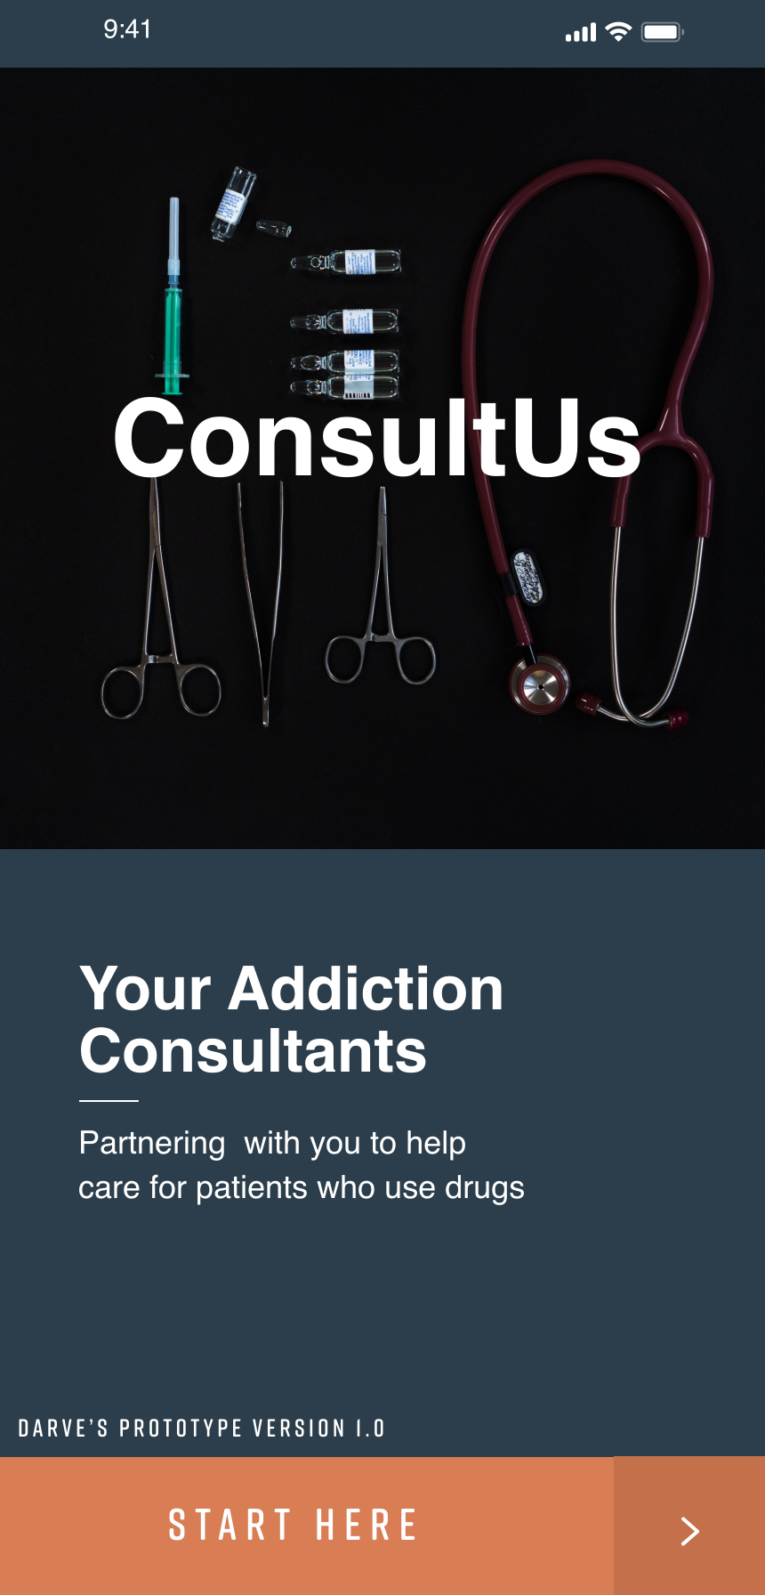
Your addiction medicine consultants
ConsultUS is your innovative solution
ConsultUS provides live and secure messaging-based Addiction medicine insights to hospital providers
Our Multidisciplinary team will provide help with acute intoxication, addiction treatments, in-hospital pain, safe discharges
Each market would have the expert services of an Addiction specialist, Social Work, and Regional Care Coordinator
Timely solutions within a day and often within the hour of new consult.
Notes:
- They should ConsultUS
- Live Tele-help and Securing Messaging
- Multidisciplinary help
- Withdrawal
- Complex Non-Surgical Pain
- Treatment Recommendations
- Help with discharging patients
- Solutions tailored to each market with answers within a day and sometimes within an hour!

Slide 5
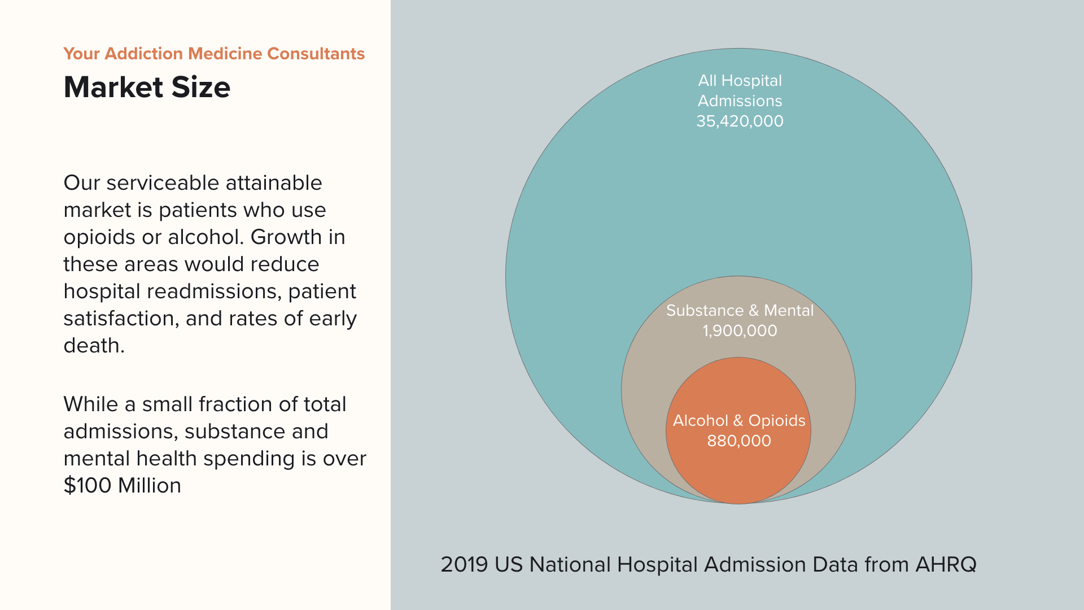
Notes:
- Of the 34 Million Hospital encounters - about 2 million cases are due to Mental Health and Addiction
- We want to tackle the biggest issues in those group Alcohol and Opioids
- Many Treatment opioids
- The bad outcomes of unmanaged addictions has huge hospital and health system impacts

Slide 6
Your addiction medicine consultants
The Competition
General psychiatry consults
Focused on diagnosing severe psychiatric illness and the need for admission to a psych hospital
Limited focus on disposition for community addiction treatment, medications for addictions, pain management, acute withdrawal
Acute pain service
Focused on post surgical pain and improving peri-procedure analgesia
Limited focus on non-surgical pain management, pain and addiction treatment, outpatient pain or addiction treatments, acute withdrawal management
Social work
Focused on referral to care and outpatient treatment options.
Limited to no training on addiction treatment options, unable to manage acute hospital addiction concerns, highly utilized and stretched thin
Notes:
The current landscape has a few existing structures that have been stretched and pulled to try to meet the needs of patients with Addictions; however, they all fall short.
Our solution really meets that wholistic needs of hospital providers caring for patients with Addictions and with results that lead to shorter stays and improved overall satisfaction

Slide 7
Your addiction medicine consultant
Current Stage and Strategy
We are pre-launch and working to refine our MVP through ongoing Customer Discovery amongst hospital systems.
Out goals in addition to refining the MVP are:
1. Development of strong referral network in the target region
2. Development of clinical training toolkit for SW and Care Coordinators
3. Integration into Payor health system and development of physician referral network
Likely these development cost will cost $100,000 with most of the cost being for protocol and app development.
Ongoing networks are established at Hartford Hospital, Jefferson Health System, with opportunities for expanding existing Addiction Services at regional hospitals without on the ground consultation services
Notes:
Pre Launch working on Refining MVP through Customer Discovery
Three Key Goals centered around fine-tuning the product for the ideal hospital system
Will need $50,000 in this goal to prepare for launching this product
Established Networks throughout Connecticut, Philadelphia and Boston with hospital leadership excited about this work.

Slide 8
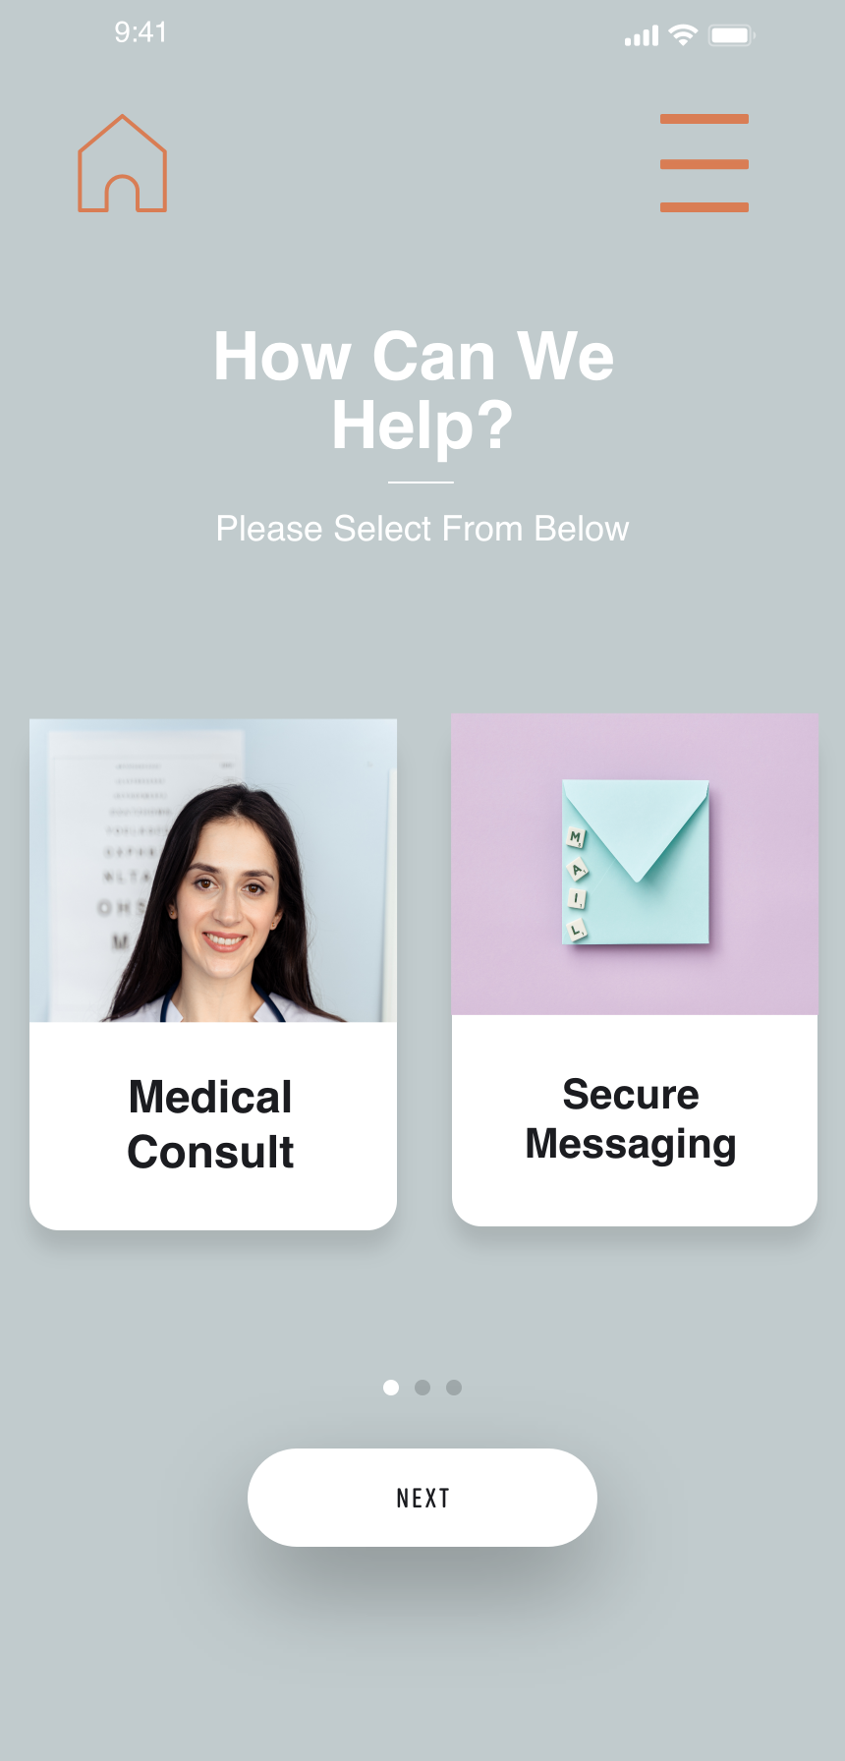
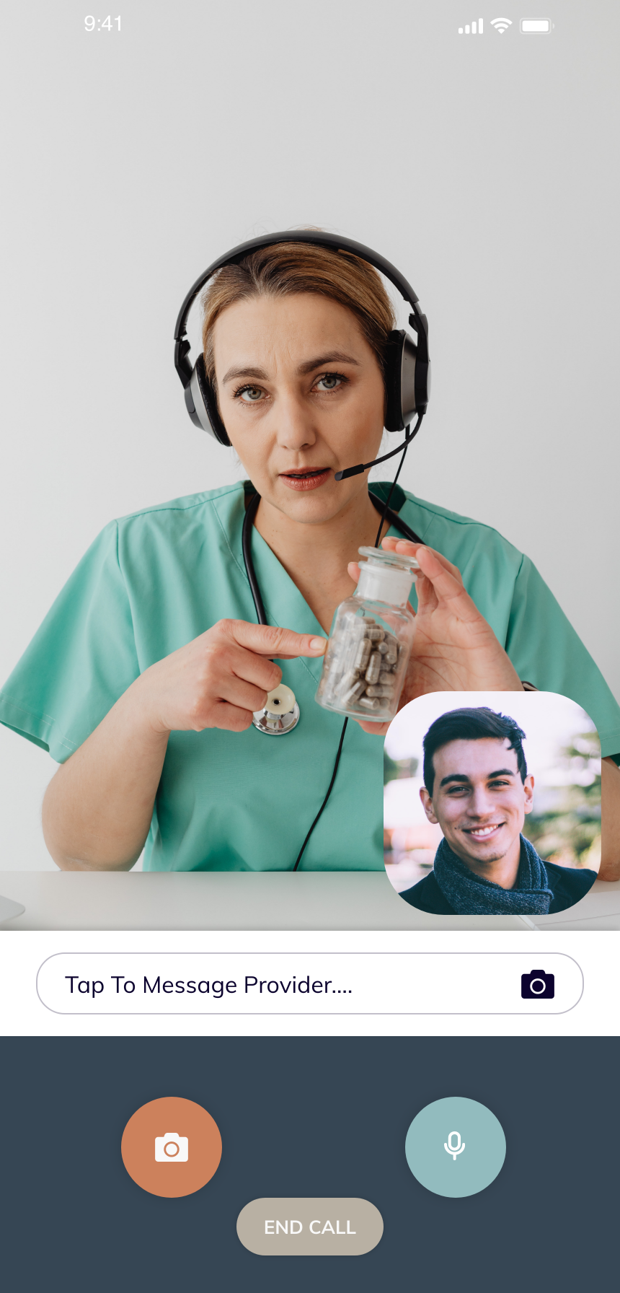
Your addiction medicine consultants
Exit Strategy and IP
Aside from a traditional IPO, unique business exit strategy includes:
1. Payor-provider health system.
2. Health Insurances could purchase the company as a tool
Our unique IP centers around localization of the consult service for each client and the digital platform and care algorithms.
Notes:
- IPO
- Large Payor Health System
- Large Insurance company
The unique IP is based on our innovative localized approach of building the service to each hospital system and our digital platform + algorithims

Slide 9
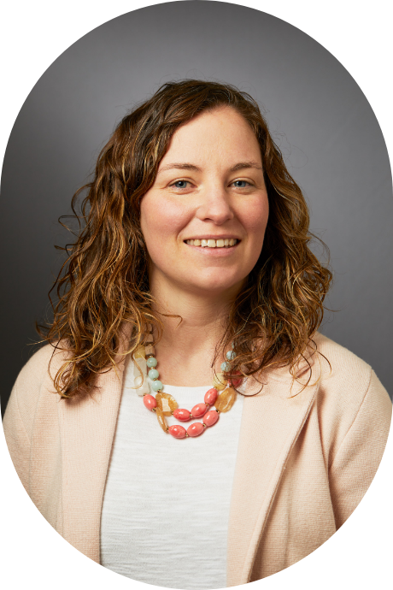
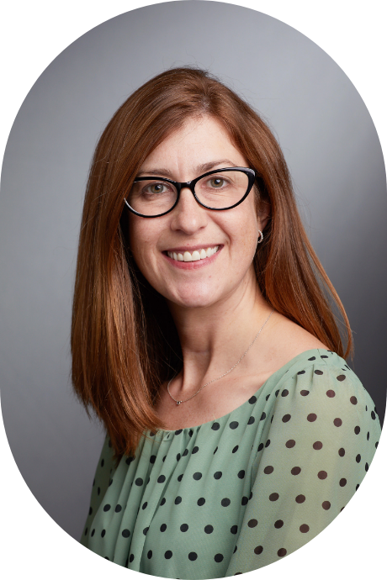
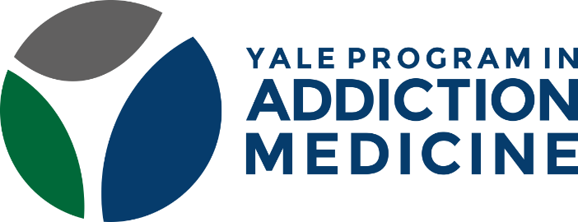
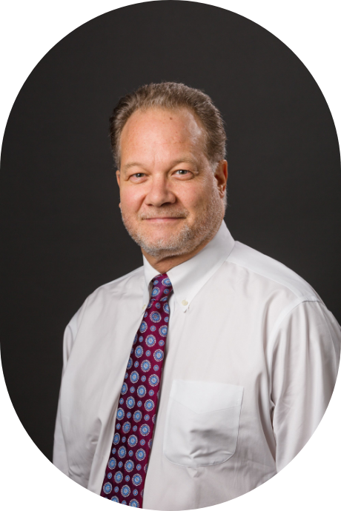
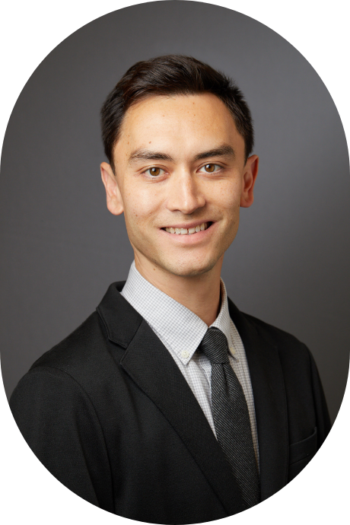
Melissa Weimer, MD
Jeanette Tetrault, MD
David Fiellin, MD
Kenneth Morford, MD
Built on decades of experience
This solution works and has been built from the ground up due to discoveries and innovations developed by Yale’s Program for Addiction Medicine. Above are personal mentors and advisors who have been instrumental to Yale’s integration of addiction medicine into every facet of clinical care—and leading national and international efforts to increase addiction care.
Notes:
Build on Decades of Expertise with skills on integrating Addiction Care throughout all aspects of hospital medicine

Slide 10
Thank You
Darve Robinson, MD
darve.robinson@yale.edu
ConsultUS: Your Addiction Medicine Consultants

