Slide 1
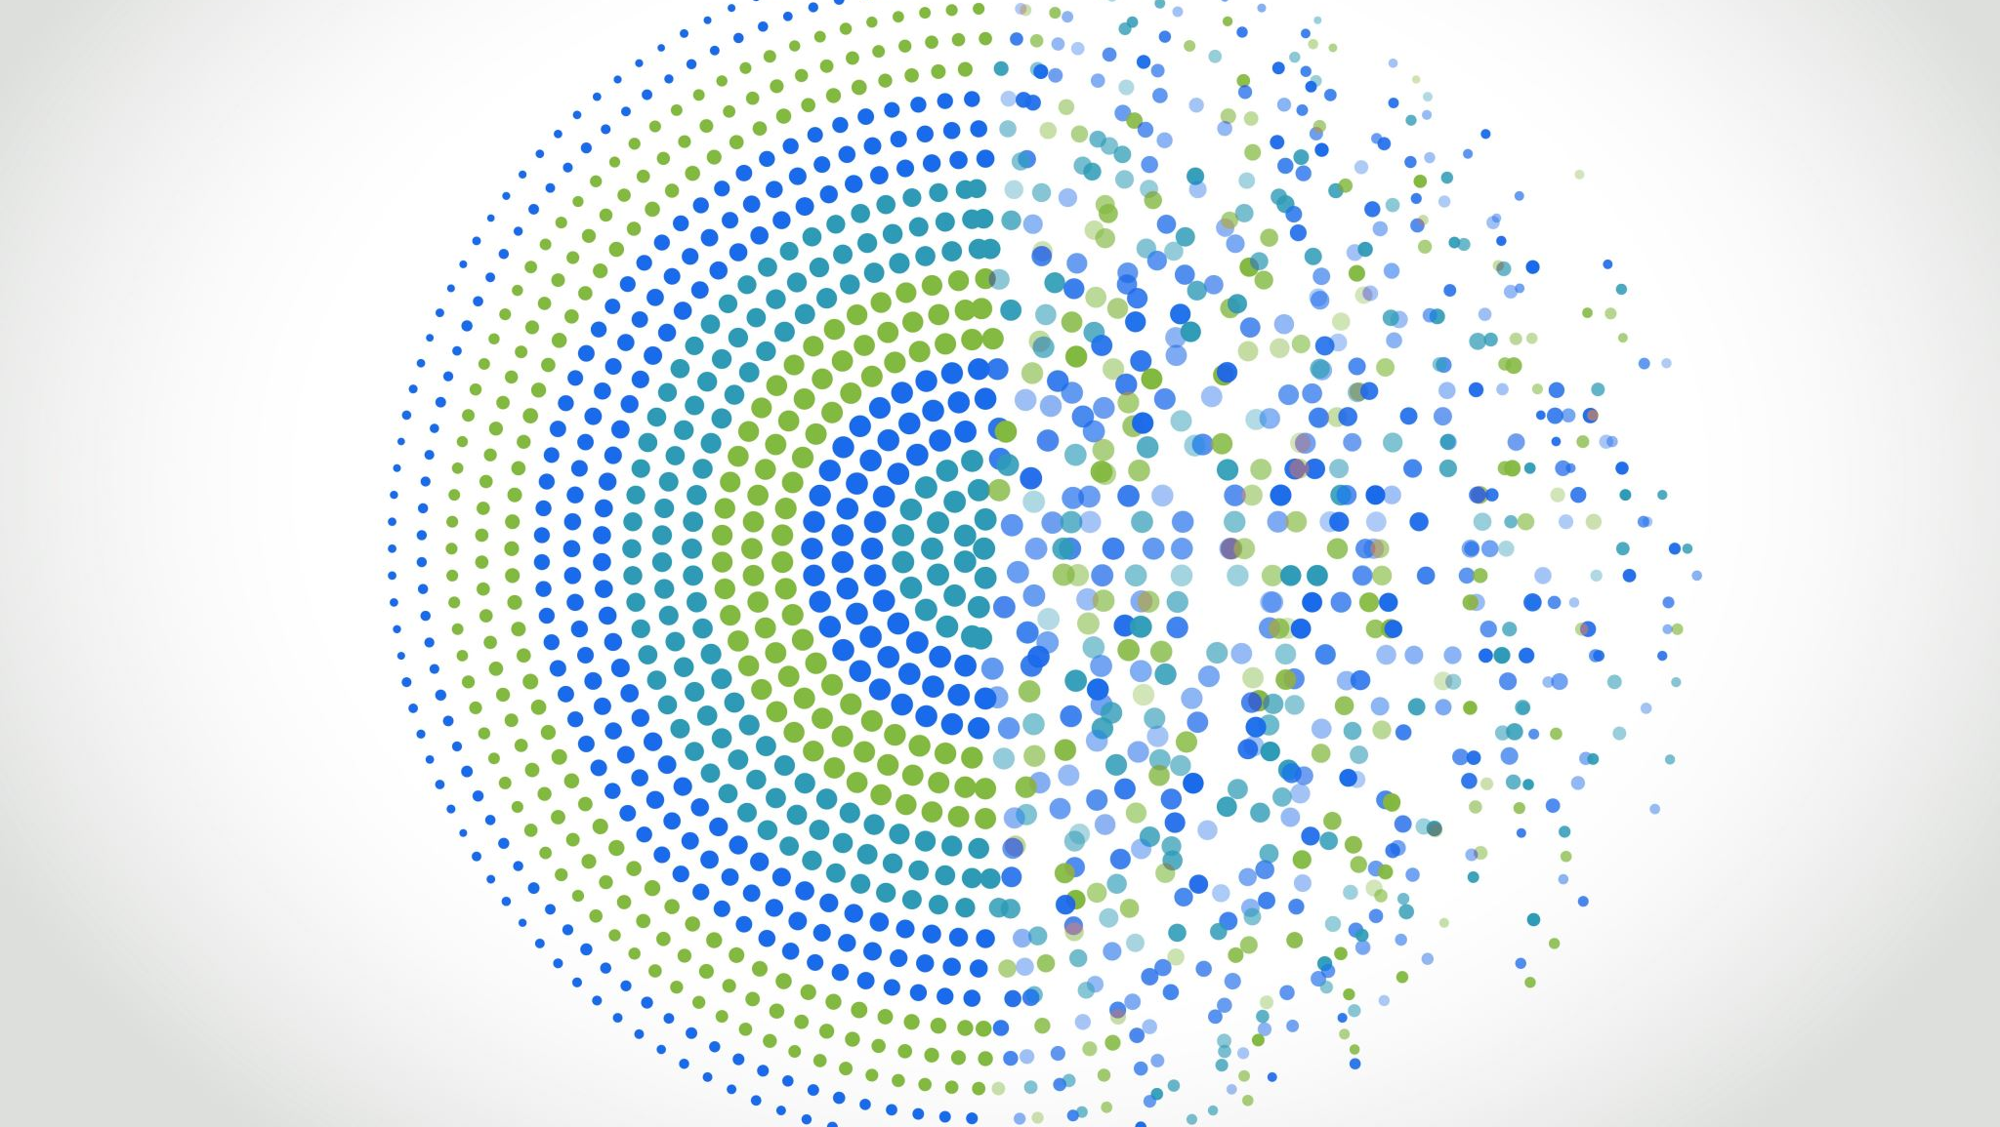
An Online Software Suite to Improve the Accuracy of Newborn Screening
Curt Scharfe, MD, PhD, Yale University, Genetics
Tina Cowan, PhD, Stanford University, Pathology
Hongyu Zhao, PhD, Yale University, Biostatistics
Gang Peng, Indiana University, Medical and Molecular Genetics

Slide 2
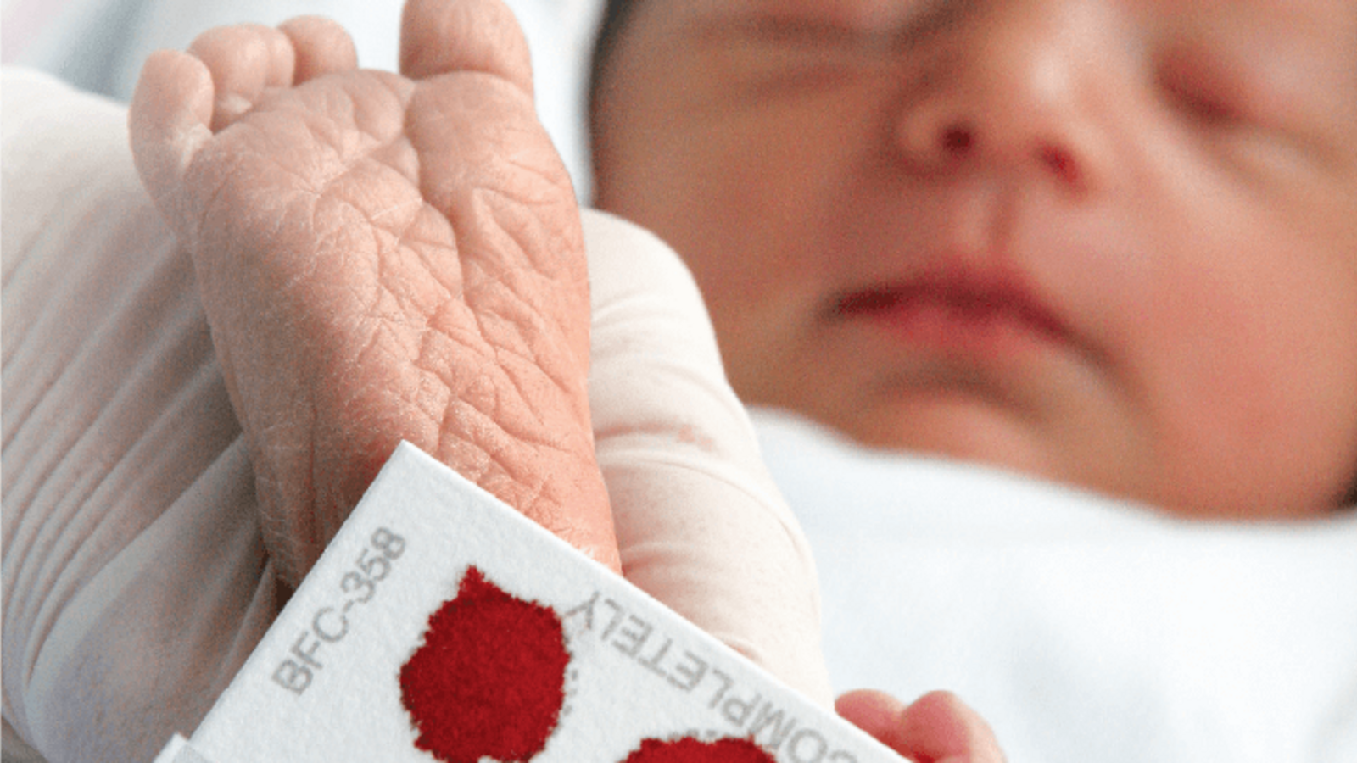
40 metabolites, 61 diseases
Recommended Uniform Screening Panel (RUSP)
Negatives
Positives
Second
Test
Diagnostic
Confirmation

Slide 3
40 metabolites, 61 diseases
Recommended Uniform Screening Panel (RUSP)
?
Negatives
Single marker
Positives
Second
Test
Diagnostic
Confirmation
~90% false positive
Long turnaround time

Slide 4
Our Solution (RUSPtools)
Personalized newborn screening
Incorporate important covariates (birth weight, gestational age, sex, ethnicity, age at blood collection etc.)
Accurate
Fast
Online
Use all metabolite markers in analysis (AI/ML)
https://rusptools.shinyapps.io/RandomForest/
https://rusptools.shinyapps.io/dbRUSP/

Slide 5
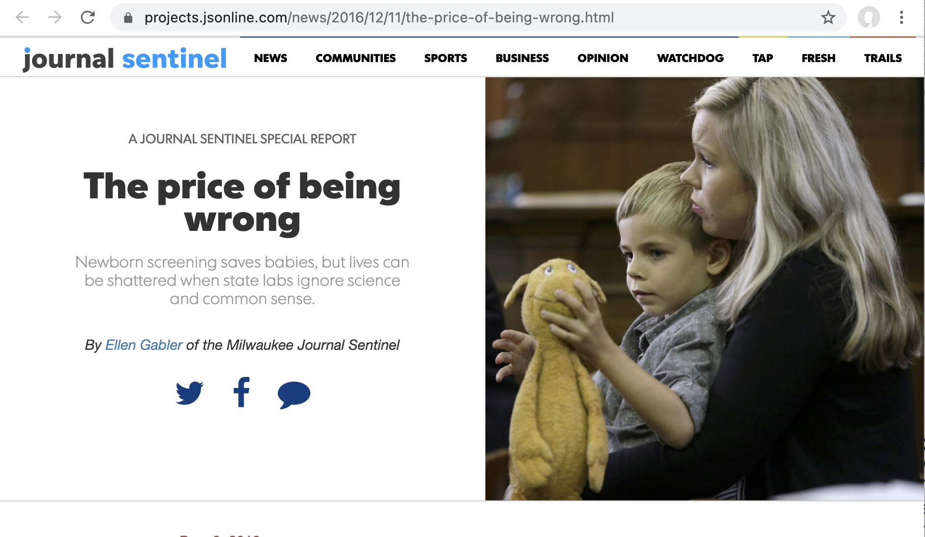
Functions of Software Suite
Influence of clinical variables on baby’s metabolic level
01
Birth weight, gestational age, sex, ethnicity, etc.
Peng, G., et al., Frontiers in Pediatrics, 2021.

Slide 6
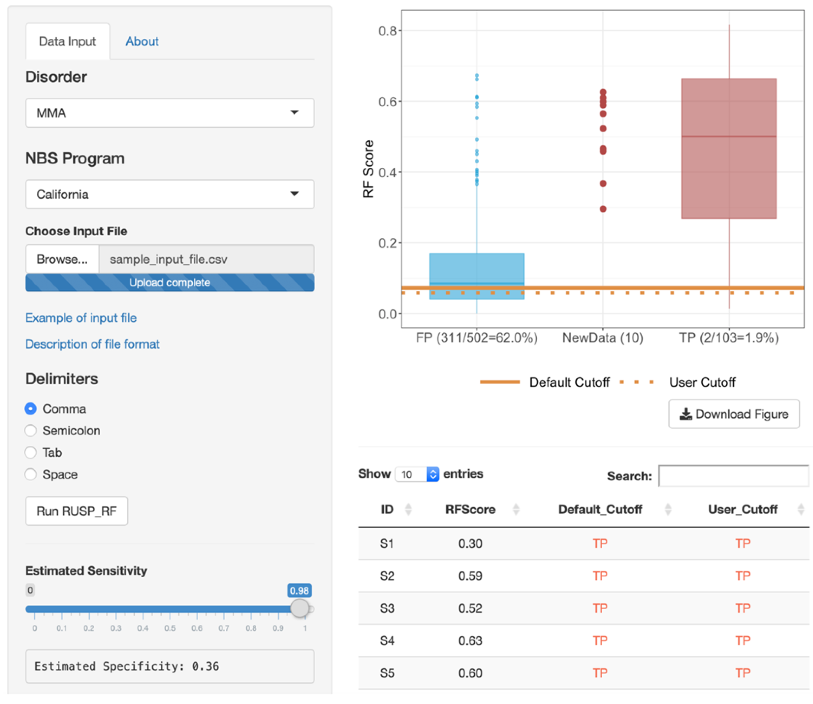
Functions of Software Suite
02
Use data mining (ML) to increase NBS accuracy by integrating a baby’s metabolic profile and clinical covariates recorded after birth
01
Peng, G., et al., Int J Neonatal Screen, 2020.

Slide 7


Beta Version of Software Suite
 | RUSPtools | CLIR*
Online
Easy to use
Multiple functions
Collecting user data
https://rusptools.shinyapps.io/RandomForest/
https://rusptools.shinyapps.io/dbRUSP/
*academic competitor
Peng, G., et al., Int J Neonatal Screen, 2022.

Slide 8
Market and Opportunities
~200,000 false positives and ~100 false negatives in NBS each year in the United States
  Reducing half of false positives could save tens of millions of health care dollars spend on laboratory and specialist services
PARTNERS
State Health Departments, NBS reference labs, CDC, Health care providers (Hospital & Clinics)
LICENSE
Companies providing NBS technology to State laboratories (f.e., Perkin Elmer)
Companies providing supplemental newborn screening (Mayo, Sema4)
INTERNATIONAL
China: only 2-5 metabolic disorders are currently screened, private NBS program, rapidly expanding
India: No universal screening, building NBS programs
Potential for direct to customer service

Slide 9
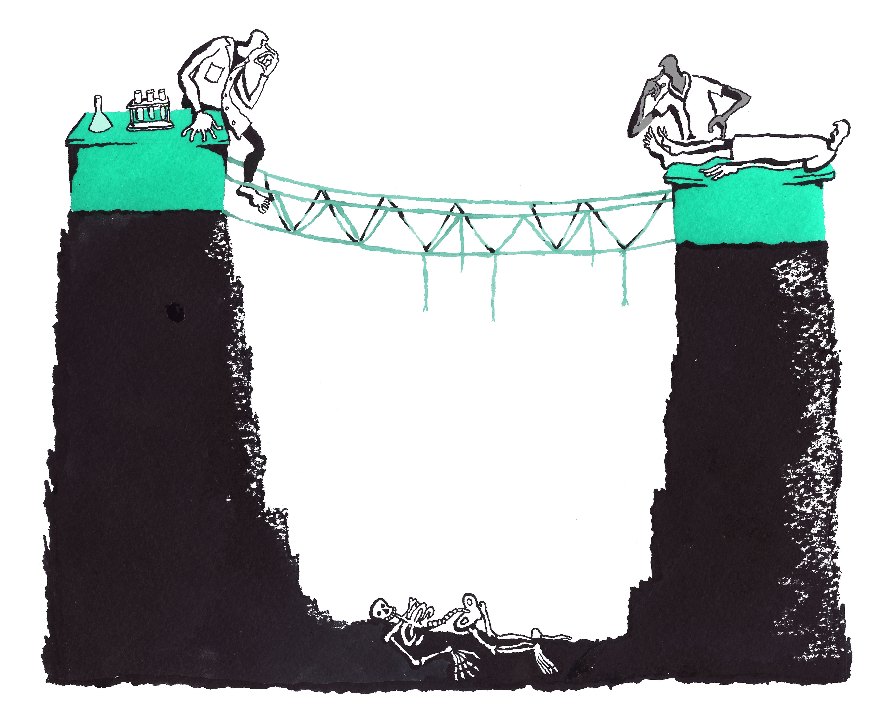
Blavatnik Aims
1. Continue RUSPtools development
> Add more NBS data to dbRUSP
> Integrate additional clinical variables
> Build model for more disease
> Develop iOS and Android apps
2. Build the next-gen NBS company
> IP protection
> Partner with NBS providers
> Technology licensing
The “Valley of Death”
Illustration by B. Mellor
Notes:
The “valley of death” illustrates the major challenges to TRANSLATE clinical R&D for improving patient care

Slide 10
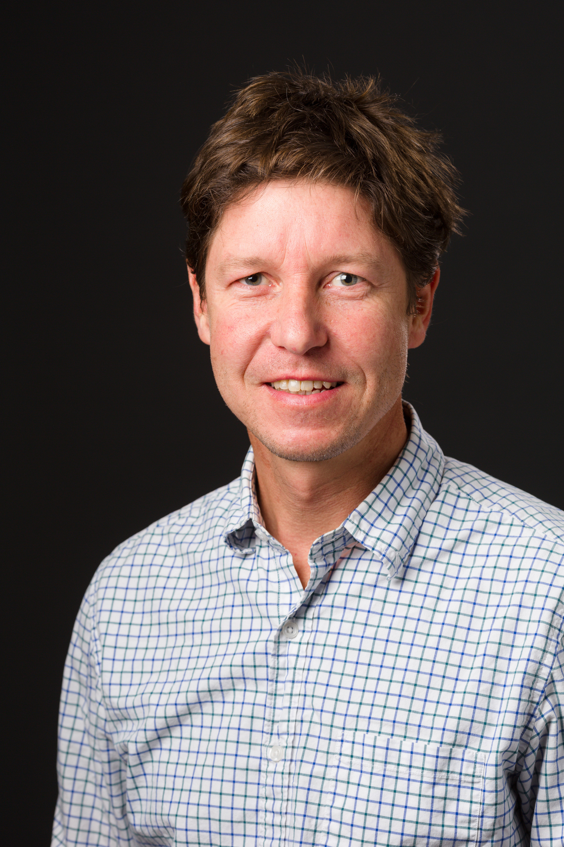
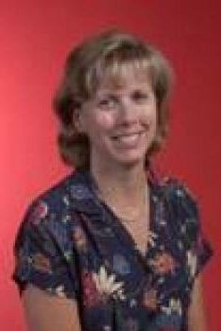
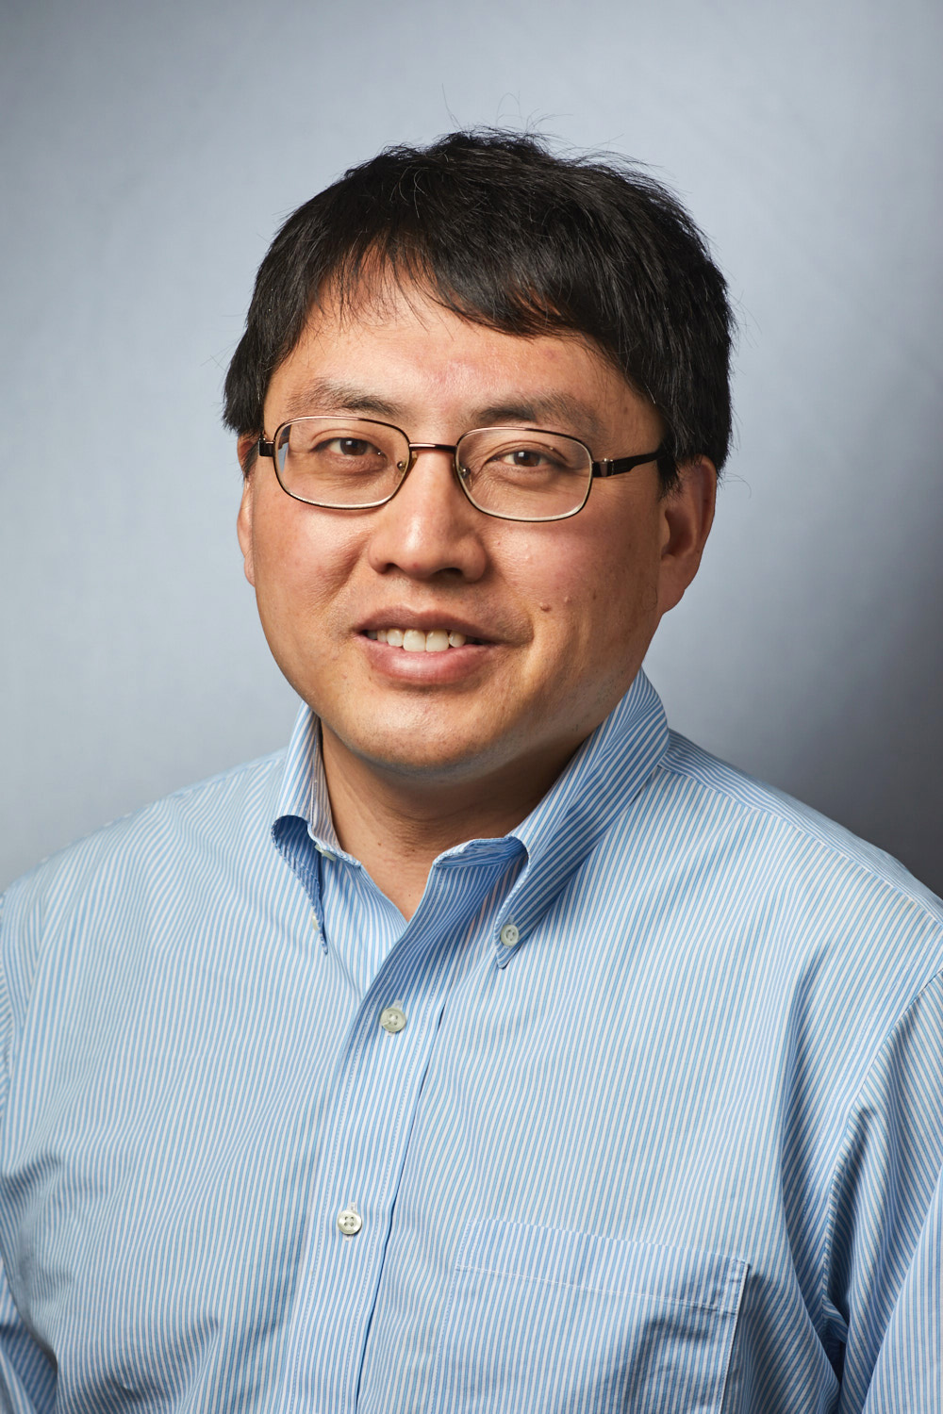
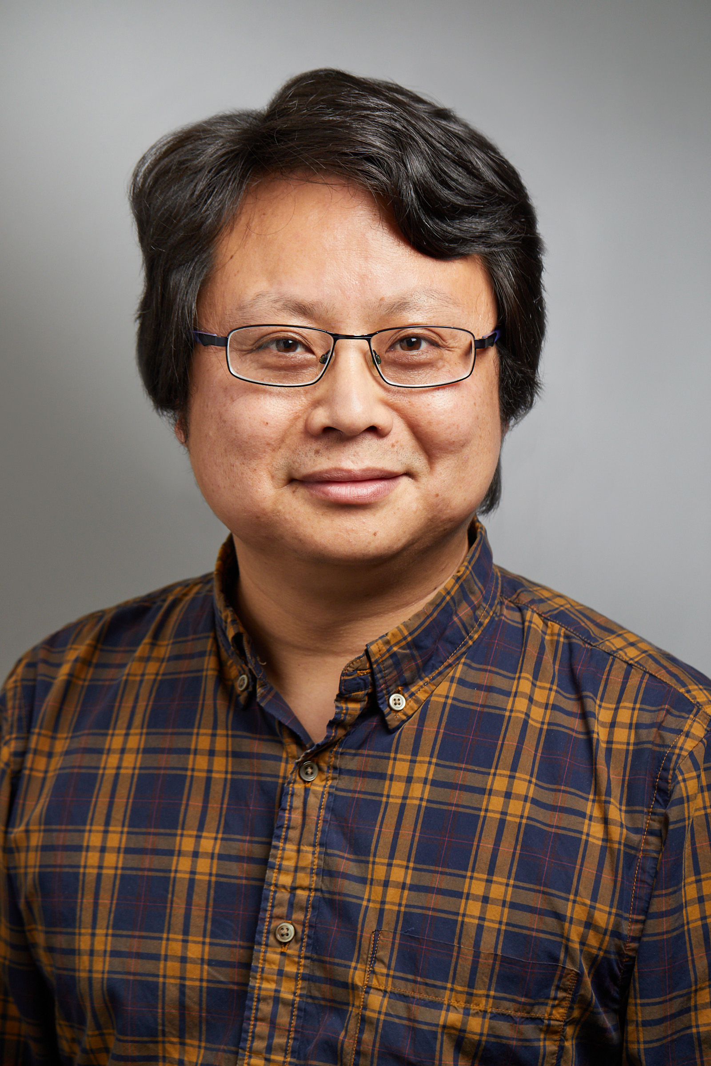
Team
Curt Scharfe, MD,PhD
Yale University
Medical genetics
Tina Cowan, PhD
Stanford University
Biochemical Genetics
Hongyu Zhao, Ph.D.
Yale University
Biostatistics
Gang Peng, PhD
Indiana University
Medical and Molecular
Genetics

