Slide 1
Mapping the New “Dark Matter” of Genomes
Siyuan (Steven) Wang, PhD
Assistant Professor of Genetics and Cell Biology
Yale School of Medicine
Notes:
Good afternoon and thank you for the opportunity. My name is Carol Hu. My PI Steven Wang is at an international conference so I’m giving this presentation in his place. Steven is an assistant professor of Genetics and Cell Biology at Yale, and co-founder of Translura. We are a spatial genomics company offering a novel technology for mapping the new “dark matter” of genomes.

Slide 2
3D genome is the new “dark matter” in genomics
DNA
Nucleosomes
Topologically
Associating
Domains (TADs)
A-B compartments
Chromosomal territories
Nucle-olus
Lamina
Lamina associated domains (LADs)
Nucleolus associated domains (NADs)
Control many essential genome functions
Cremer and Cremer, 2010; Misteli, 2013; Bickmore and van Steensel, 2013; Bonora, Plath and Denholtz, 2014; Gorkin, Leung and Ren, 2014; Levine, Cattoglio and Tjian, 2014; Dekker and Mirny, 2016; Yu and Ren, 2017; Lakadamyali and Cosma, 2020.
Intriguing dynamics and changes during development, aging, and many diseases
Notes:
Our genome is folded in 3D in a hierarchical manner across many length scales. These diverse 3D genome structures control many essential genome functions, and show intriguing dynamics and changes during development, aging and many diseases. However, the 3D genome organization is still much less understood than the 1D genome sequence, and the 3D genome is considered the new “dark matter” and a new frontier in genomics. Particularly, people largely don’t know...

Slide 3
Key limitations
What is the 3D folding path of DNA at length scales above the nucleosomes?
Previous techniques:
Yield DNA “blobs” rather than DNA folding traces
Not directly 3D
Population-averaging, not good for complex tissue
Notes:
what is the 3D folding path of DNA at length scales above the nucleosomes?
This was a long standing question largely due to technology limitation. Previous techniques give us DNA blobs rather than real DNA folding traces. The previous techniques are not directly measuring the 3D folding path of DNA, and are often based on population-averaging of many cells. So in a complex tissue, if there are cells with different 3D genome organization, the differences are lost and averaged away.
To tackle this decades long question, we invented chromatin tracing….

Slide 4
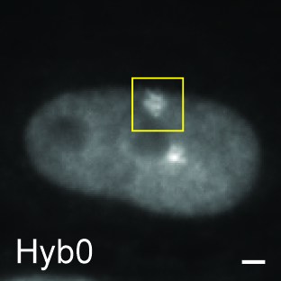
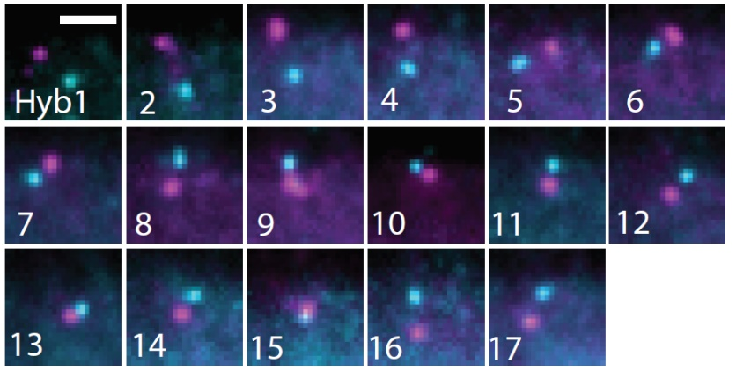
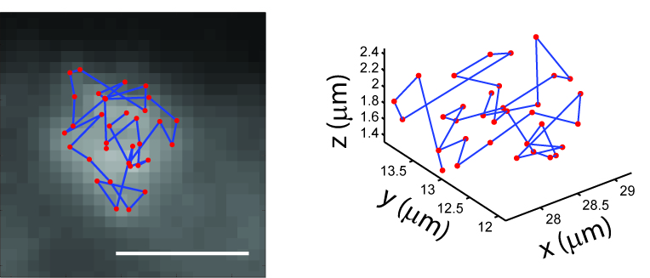
Chromatin tracing maps the 3D genome
Wang et al, Science, 2016
Sawh et al, Molecular Cell, 2020
Liu et al, Nat Commun, 2020
Hu et al, Trends in Cell Biology, 2020
Hu et al, Scientific Reports, 2020
Liu et al, Nature Protocols, 2021
Lu et al, Cell Discovery, 2021
Cheng et al, Genome Biology, 2021
Patterson et al, unpublished
Liu et al, unpublished
Yang et al, unpublished
Enabled direct tracing of the 3D folding organization of DNA in single cells in situ.
Notes:
A first in kind technology to directly image and distinguish numerous genomic regions along individual chromosomes in single cells, allowing the direct tracing of the 3D folding organization of DNA. This invention really opened up image-based 3D genomics as a field and have VERY broad application ...

Slide 5
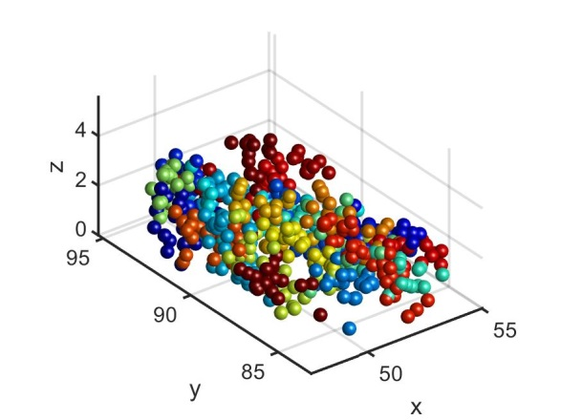
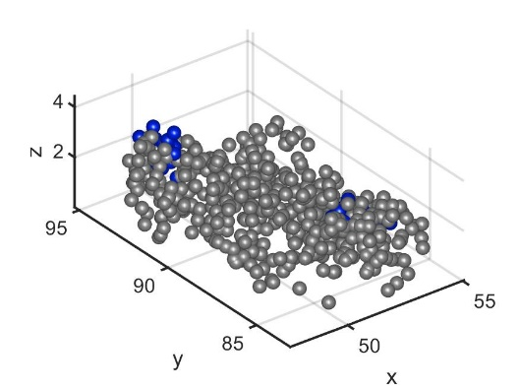
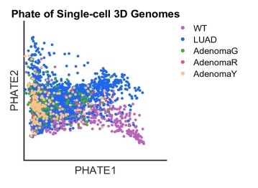
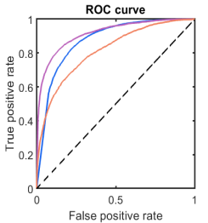
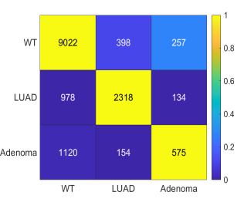
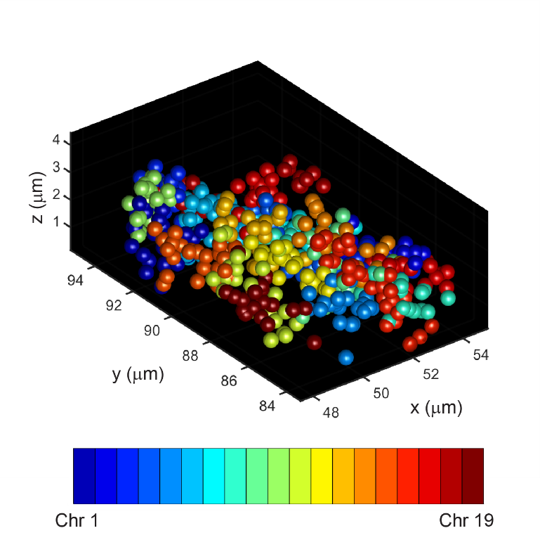
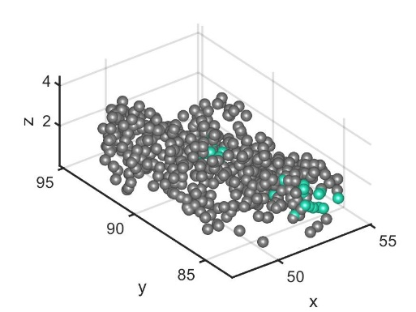
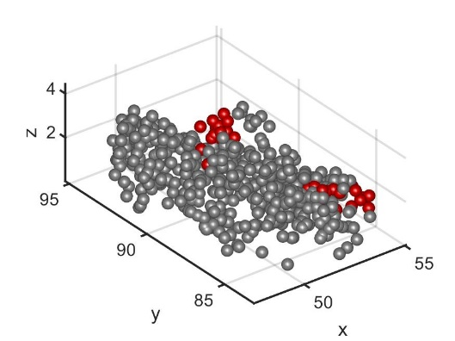
Genome-wide chromatin tracing in a mouse lung cancer model + machine learning of 3D genome
Broad applications in research, diagnostics, and drug target discovery
All
Chr3
True states
Predicted states
The 3D genome conformations of individual cells can encode and distinguish cancer states. (Diagnostics, precision medicine)
Chr8
Chr17
Identification of candidate progression driver/suppressor genes from 3D genome. (Drug targets)
The 3D genome changes precede cancer progression.
A conformational bottleneck at the adenoma stage, indicating an early stringent selection on 3D genome conformation during cancer progression.
Liu*, Jin*, Agabiti*, Muzumdar#, Wang#, unpublished
Notes:
…in research, diagnostics, and drug target discovery. As an example, in a recent work, we performed genome-wide chromatin tracing and mapped the 3D genome of numerous single cells in a mouse lung cancer model, and used machine learning to develop new diagnostic biomarkers based on 3D genome, to identify novel drug targets through 3D genome changes, and derived a list of important new insights in cancer biology.
One can easily imagine, this same platform and pipeline can be applied to many other biological and disease contexts. Wherever 1D genome sequencing techniques can be applied, likely the new 3D genome method can also be applied and reveal new and significant insights.

Slide 6
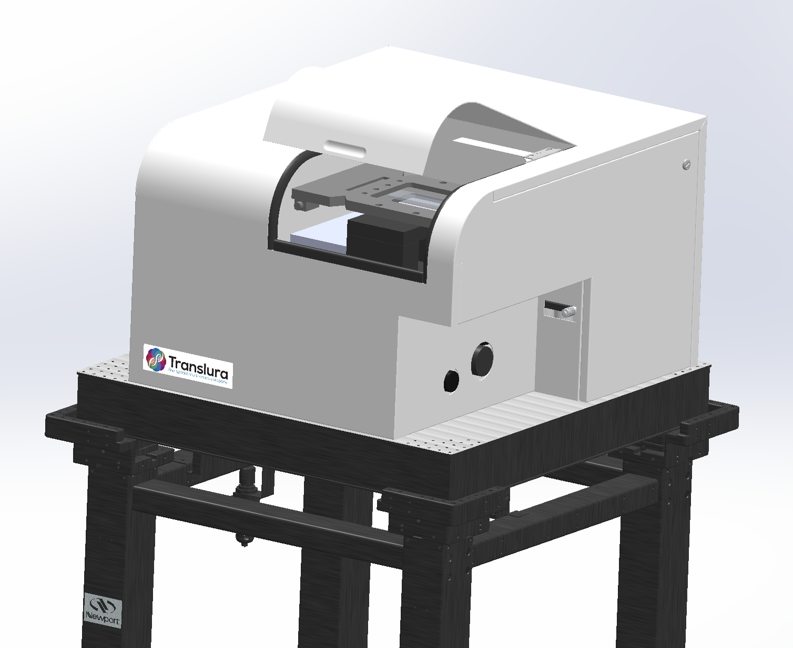
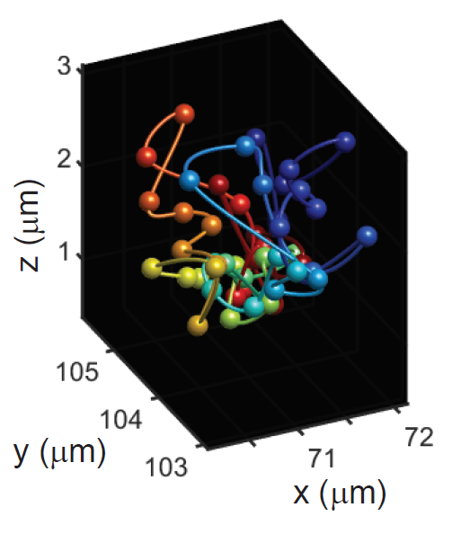
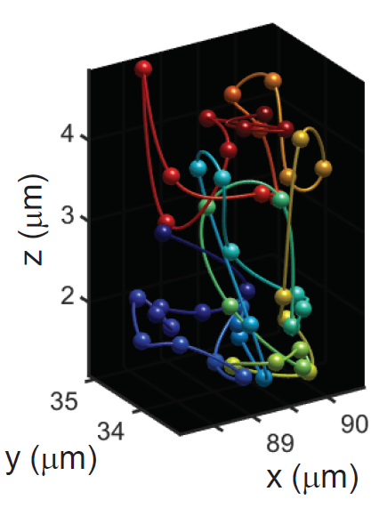
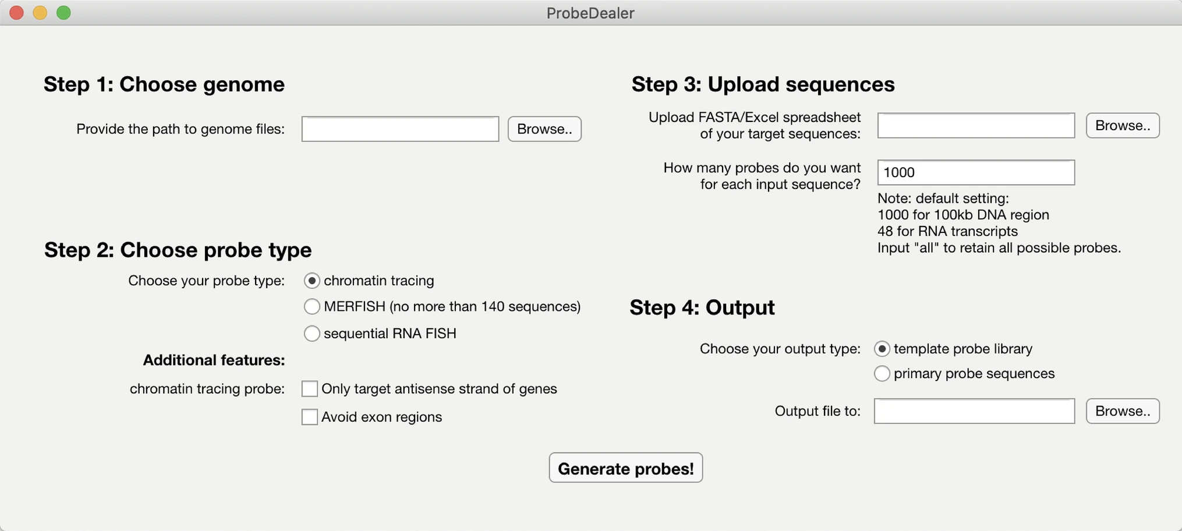
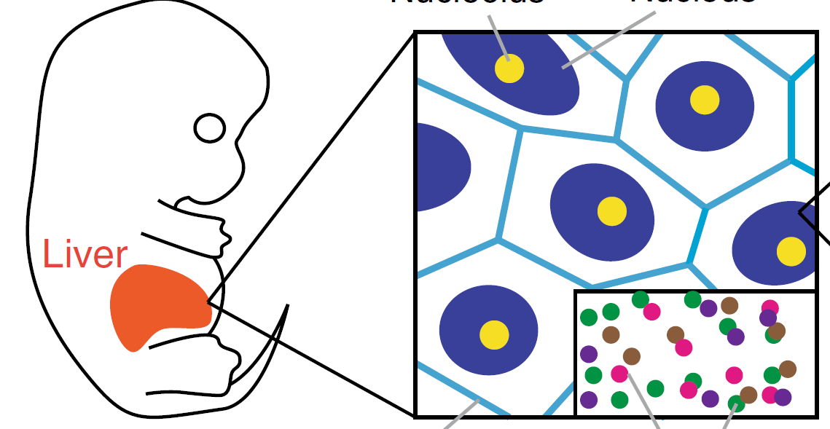
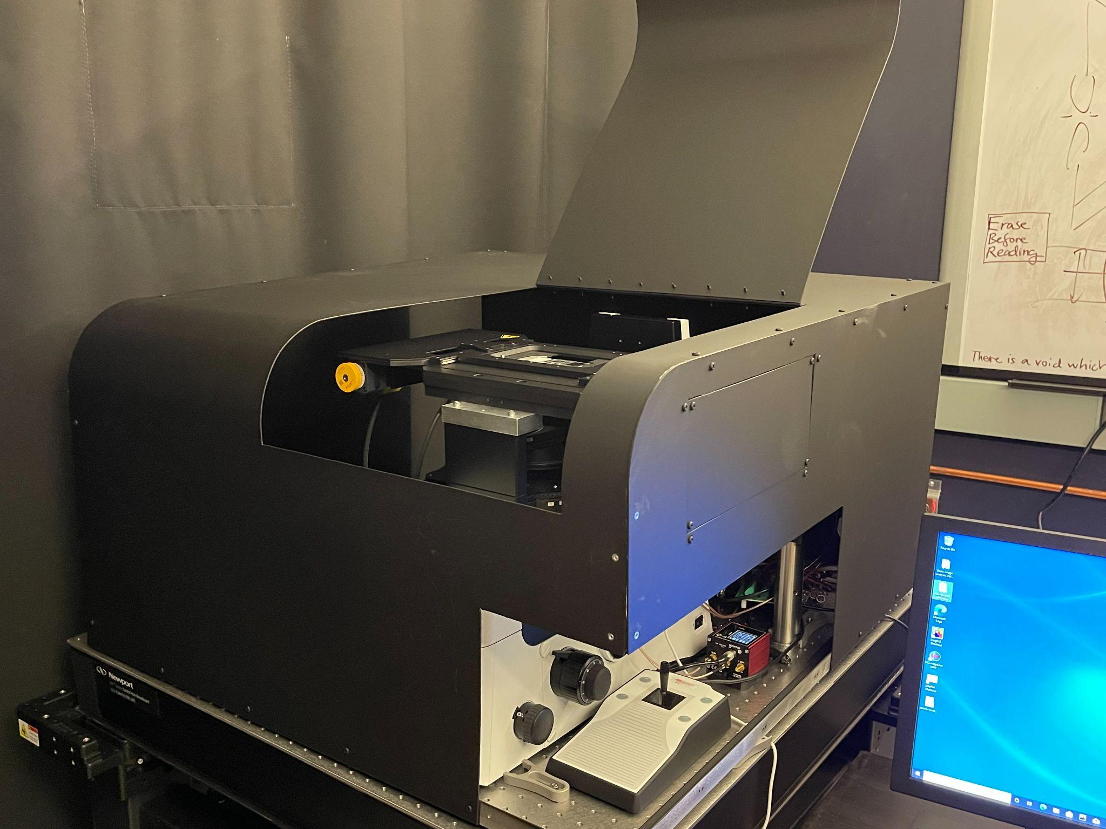
Translura current product – end-to-end 3D genomics solution
PROBE LIBRARY DESIGN & CONSTRUCTION
TISSUE SAMPLE
PREP
AUTOMATED IMAGING
DATA ANALYSIS
First instrument sold and installed at Yale YCGA in June 2021
Multiple pilot projects using this instrument
Continuous reagent and service revenue
How do we make money: instrument + reagent + service contract for instrument
Notes:
Our company Translura offers the chromatin tracing technology in an end-to-end fashion. Our product includes the probe design and construction pipeline, tissue sample prep protocols, automated instrument, and data analysis software. Our first instrument from Translura was sold and installed at Yale YCGA in June 2021 – this is independent of the 5 other machines in our own lab. On this sold instrument there are currently multiple pilot projects from different Yale teams. And our company has continuous reagent sales and service contract revenues associated with this machine. We make money by providing these three types of products and services.

Slide 7
Rapidly expanding spatial omics market
“Revenue forecast in 2028: USD 484.22 million” – Grand View Research
“Spatial Omics Solutions Market worth $587.2 Million by 2030” - InsightAce Analytic
“The global spatial OMICS market held a market value of USD 230.2 million in 2020 and is estimated to reach USD 506.6 million by the year 2028.” - Research and Markets
Notes:
The spatial omics field is entering a phase of rapid expansion, with multiple independent analyses projecting a half billion market size in a few years. In this market, our company Translura has very clear differentiation and competitive advantage.

Slide 8
Our differentiation and competitive advantages
Most companies in this rising field focus on spatial transcriptomics/proteomics.
Only two companies focus on direct 3D genome mapping.
Company name | Translura | Acuity, Bruker
Technology basis | Highly multiplexed FISH | In-situ sequencing
Genomic throughput | High | Low
Application in complex tissue | Demonstrated | Not demonstrated
Multi-omic measurements | Demonstrated | Not demonstrated
Product sales | Achieved | Not achieved
Translura has exclusively licensed 4 technologies from Yale.
Notes:
Most companies in the rising spatial omics field focus on spatial transcriptomics/proteomics. Only two companies including us focus on direct 3D genome mapping. Compared to the other company, Translura is clearly more advantageous in terms of genomic throughput, application in complex tissue, multi-omic capacity, and demonstrated product sales. We have also exclusively licensed 4 technologies at the PCT application stage from Yale.

Slide 9
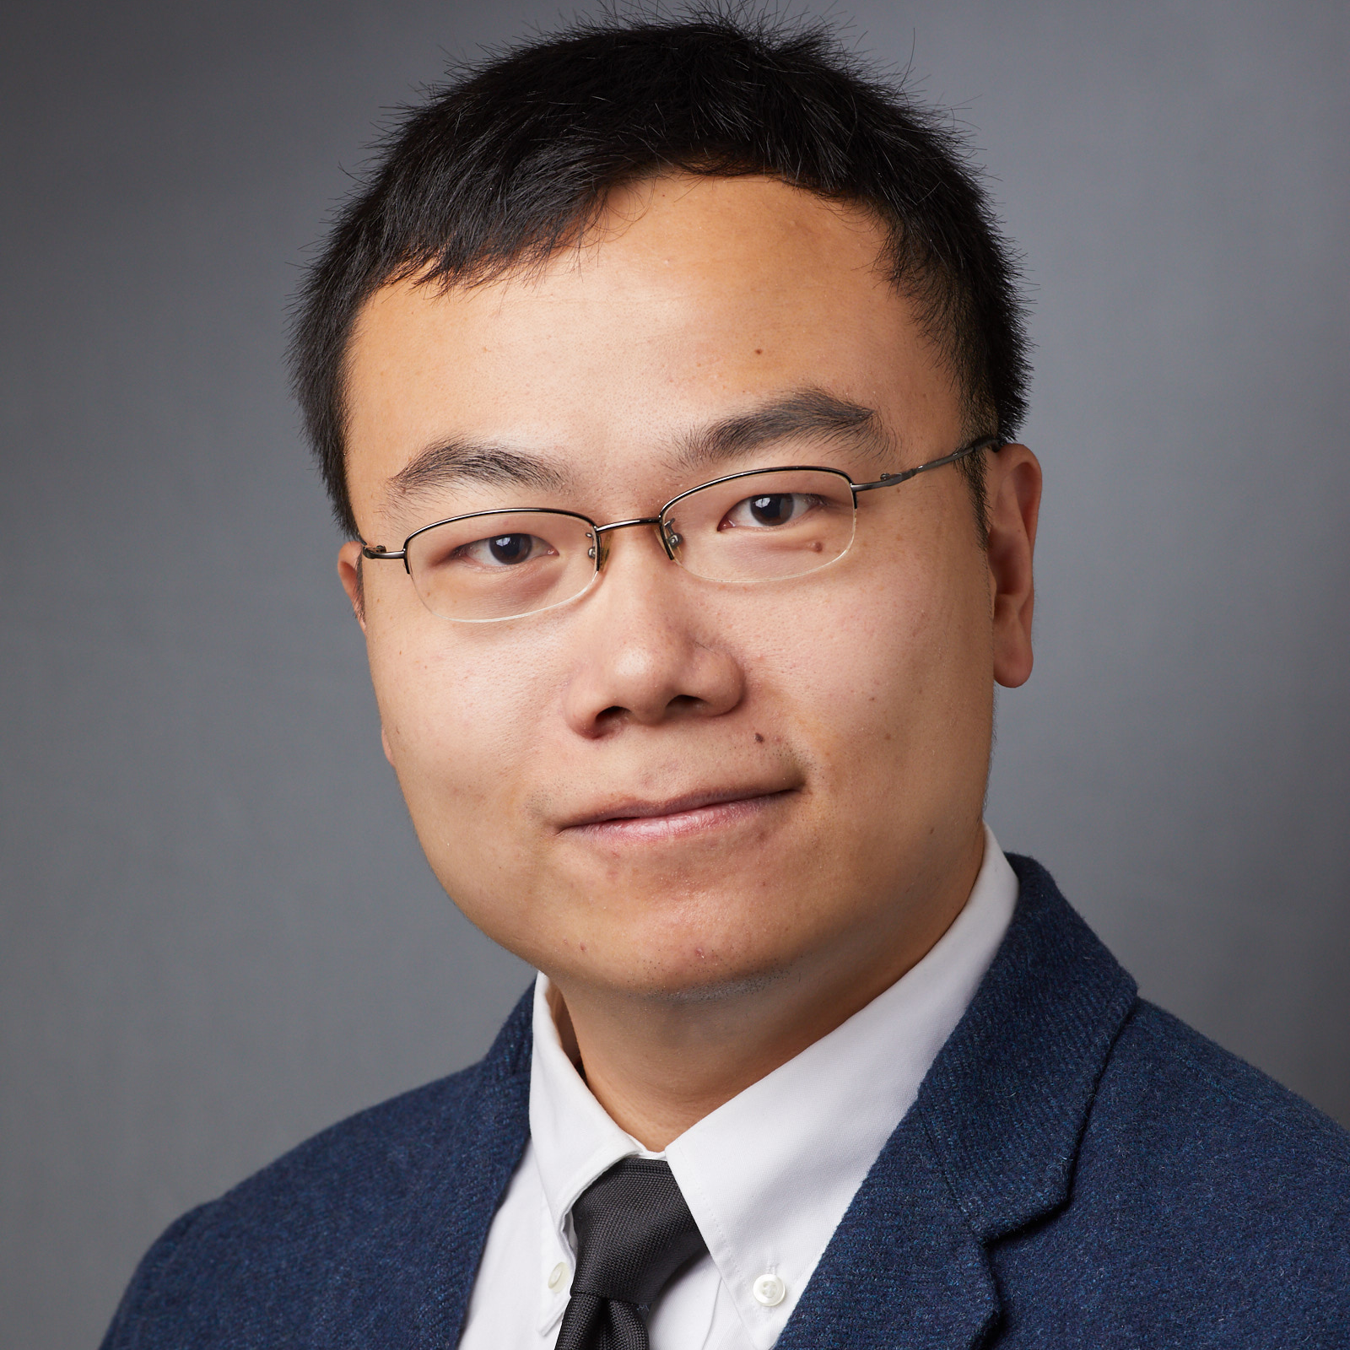
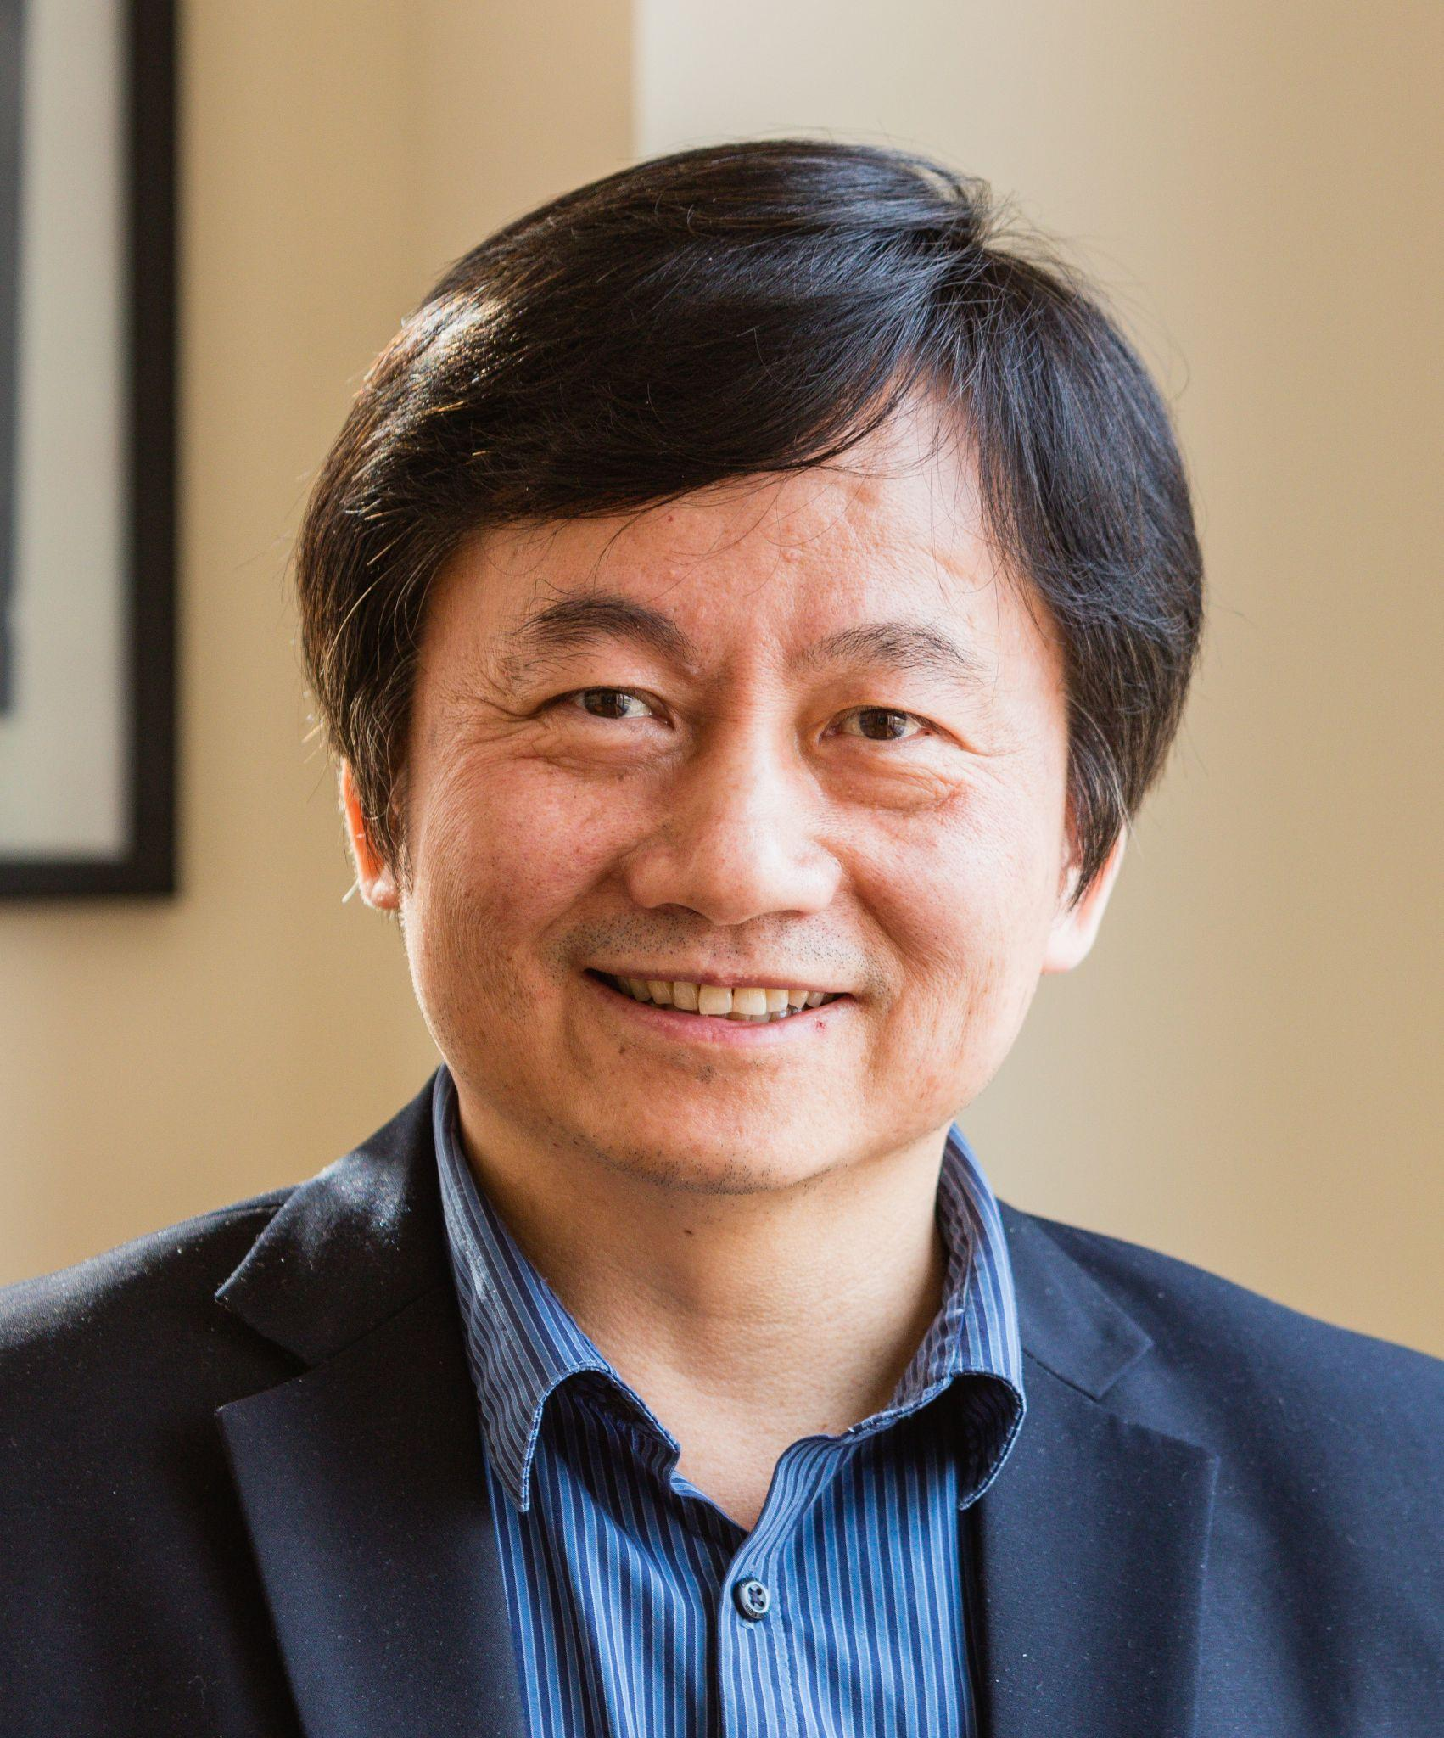
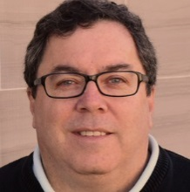
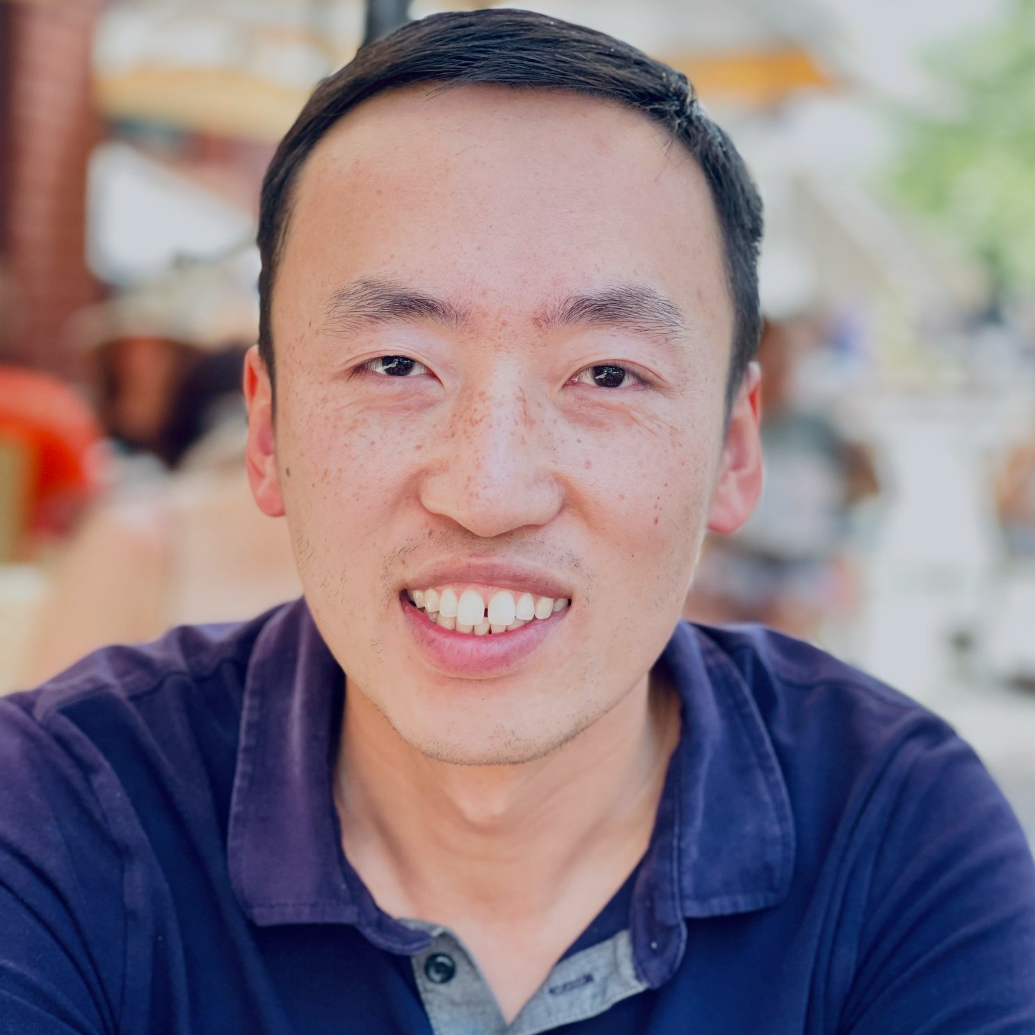
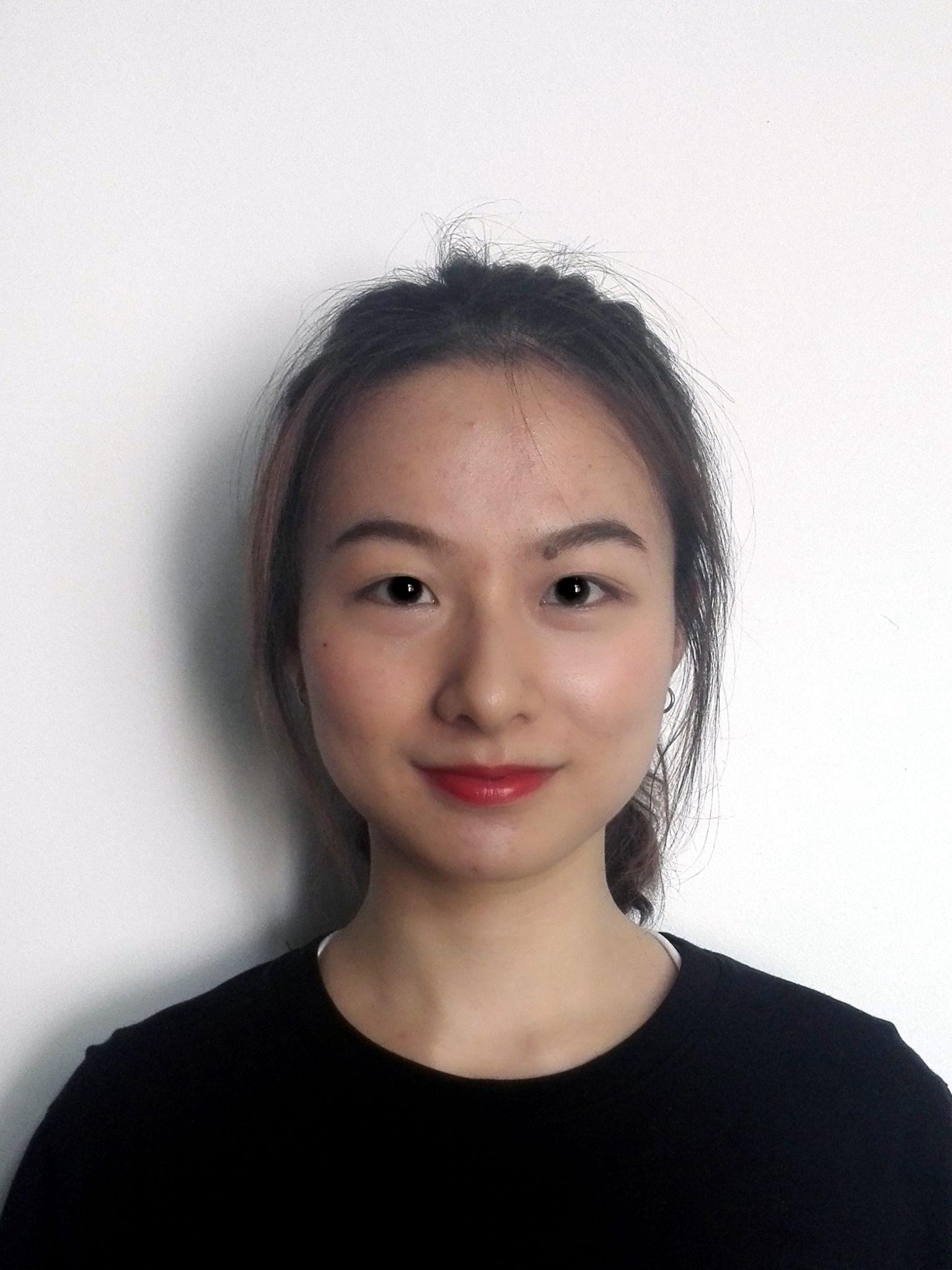
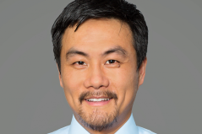
Team and funding
Siyuan Wang, PhD
Scientific Co-founder and Advisor
Haifan Lin, PhD
Scientific Advisor
Michael Weiner, PhD
BD advisor
Assist. Prof, Yale Univ.
Award-winning biotechnology inventor
Leader in 3D genomics and spatial multi-omics
Eugene Higgins Prof. of Cell Biology, Prof. of Genetics, of Obstetrics, Gynecology & Reproductive Sciences, and of Dermatology, Yale University
Founding Director, Yale Stem Cell Center
Member of US National Academy of Sciences
President of International Society for Stem Cell Research
Founder and CEO of Abbratech
Founder of Affomix (proteomics, acquired by Illumina),
Founder of AxioMx (proteomics, acquired by Abcam),
Founder of GnuBio (NextGen DNA sequencing, acquired by BioRad),
Founder of Encodia (NextGen protein sequencing)
Justin Shi, MD
Co-founder, Angel Investor, Interim CEO
>10 years industry experience
Equity Research Analyst, Cowen & Co.
MD, Peking Univ. Medical School
Carol Hu, PhD
Senior Scientist (expected)
Yi Wang, PhD, MBA
BD advisor
We have received $150k convertible note from Connecticut Innovations.
Yale PhD expected 2023
4 first author publications during PhD
CRISPR patent lead author
Yale Blavatnik Fellow
Vice President of Business Development at Isolere Bio
Angel investor
Notes:
We are a very strong team with experts on both the science and business sides. We have received $150k convertible note from Connecticut Innovations.

Slide 10
Plan with Blavatnik funding (Pilot Award $100k)
Aim 1: Develop a genome-wide human 3D genome tracing pipeline.
Aim 2: Adapt the pipeline to multiple human tissue types and preservation methods (e.g. FFPE).
Enable unbiased, genome-wide mapping of the human 3D genome in diverse biomedical contexts.
Notes:
We would like to request 100k pilot award of the Blavatnik funding, and with this fund we aim to first develop a genome-wide human 3D genome tracing pipeline. We have developed this pipeline for mouse genome already and we envision the human pipeline development to be highly feasible. And in Aim 2, we will adapt this new pipeline to multiple human tissue types and preservation methods, especially FFPE tissues which will allow application to archival patient tissue banks to facilitate broad disease applications.
Overall, these development will enable unbiased, genome-wide mapping of the human 3D genome in diverse biomedical contexts.

Slide 11
Mapping the New “Dark Matter” of Genomes
Siyuan (Steven) Wang, PhD
Assistant Professor of Genetics and Cell Biology
Yale School of Medicine
Notes:
We are Translura. We aim to transform the omics field and market by illuminating the new “dark matter” of 3D genomes. Thank you for your attention.

