Slide 1
First-in-Class Humanized Anti-DKK2 for Colorectal Cancer
Dianqing (Dan) Wu, Ph.D.
Gladys Phillips Crofoot Professor of Pharmacology
Vascular Biology and Therapeutic Program
Yale Cancer Center
Cofounder of Qx Therapeutics, Inc

Slide 2
Executive Summary
Strong association of clinical biomarker: elevated DKK2 correlates with poor CRC prognosis
Target validated in mouse CRC models
Multiple novel mechanisms of action
Works with CRC standard of care
Broad IP coverage of compositions of matter & uses until 2036-39
Use of Proceeds: IND-enabling studies

Slide 3
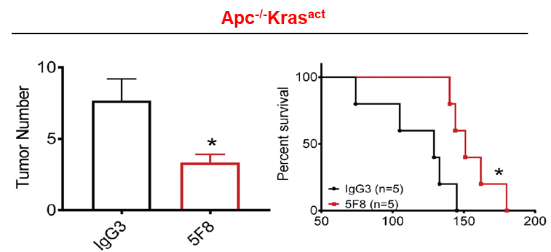
A first-in-class therapeutic for colorectal cancer (CRC)
Treatment options are limited in number and efficacy for the major MSS CRC type
Anti-DKK2 addresses many shortcomings of current options
Therapy Type | Median Survival
Standard chemotherapy FOLFIRI: 5-fluorouracil, folinic acid, and irinotecan | ~24 months
FOLFIRI + Targeted Therapy | 26-31 months
Bevacizumab | ~26 months
Cetuximab | ~31 months Only for non-Kras mutant subpopulation
Immune checkpoint inhibitors | No efficacy for the major type of CRCs (Microsatellite Stable or MSS)
Target MSS CRC
Multiple novel MOAs
Low risk for on-target side effects
Complements bevacizumab
Efficacy in Kras-mutant CRC model (~40% of advanced CRCs with more limited treatment options)
CRC is the third most common cancer in developed countries
1 million new cases and 500,000 deaths per year
One fourth are metastatic CRC (mCRC) with <10% of 5-year survival rate
5F8= mouse anti-DKK2

Slide 4
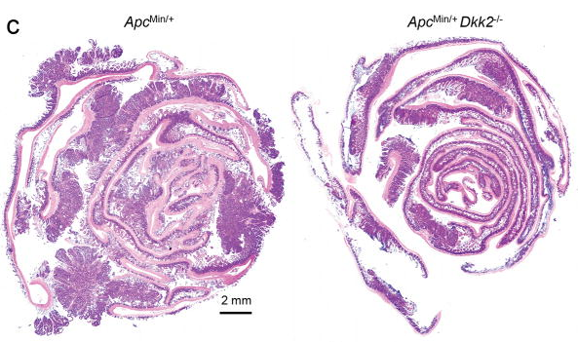
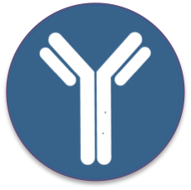
Validated Target with Three MOAs
1) Immune Enhancing
NK/CD8 cell activation
Tumoricidal
Tumor progression/
Metastasis
2) Anti-Angiogenic
Anti-DKK2
DKK2
Tumor angiogenesis
3) Anti-Stemness/Anti-metastatic
DKK2 knockout reduces intestinal tumor burden in a genetic mouse CRC model
LGR5
Cancer initiation/Stemness

Slide 5
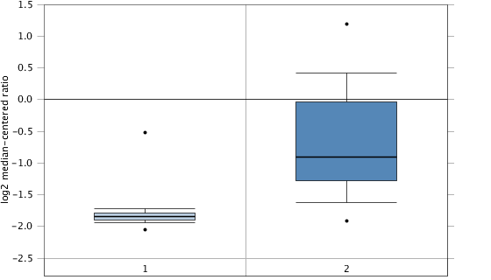
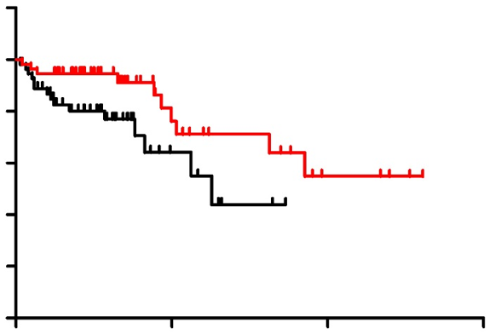
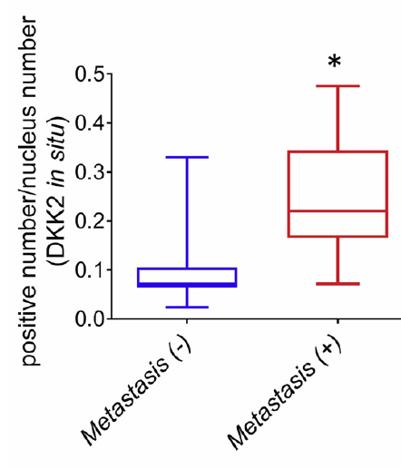
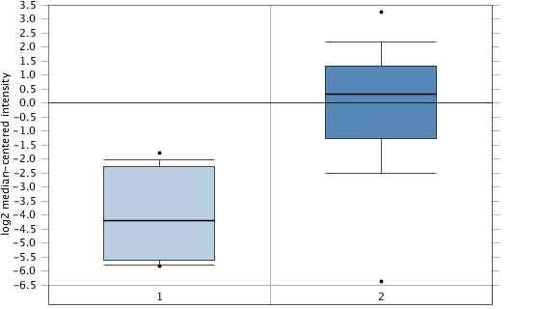
Clinical Biomarker
DKK2 expression is upregulated in human CRCs
DKK2 expression correlates with poor outcome for CRC patients and Increased CRC metastasis
Rectal Adenocarcinoma
p-value 2.37E-17
T-test 10.950
Fold change 2.130
Gene Rank top 8% (1406)
100
p=0.031
80
60
Overall survival (%)
40
20
0
0
50
100
150
Elevated DKK2 in CRC Correlates with Poor prognosis
Months
Rectum (65)
Rectal Adenocarcinoma (65)
Low DKK2 expression
High DKK2 expression
Colorectal Carcinoma
p-value 2.74E-7
T-test 7.754
Fold change 15.975
Gene Rank top 11% (2078)
Colon (12)
Colorectal Carcinoma (70)

Slide 6
Humanized Clinical Candidate
Humanized anti-DKK2 has the same affinity for DKK2 and activity as mouse anti-DKK2
Human anti-DKK2 is synergistic with Anti-VEGFR, a standard of care drug
The humanized anti-DKK2 antibody is not expected to show significant on-target toxicity
DKK2 is generally expressed at low levels in normal tissues in human and mice.
DKK2 knockout mice show little phenotypes including no hyperplasia
Kd=350 pM

Slide 7
Use of Proceeds
Blavatnik Funding for $300K Would Accomplish Two Major Pre-Clinical Milestones To Accelerate Towards IND Enabling Studies
1
Evaluation of the DKK2 biomarker in target CRC patients with recurring or non-response tumors to SOC ($200K)
Part 1: Dkk2 assessment method development ($100K)
Plasma DKK2 ELISA
Anti-DKK2 immunostaining of biopsy materials
Quantitative RNAscope of biopsy materials
Quantitative proteomic analysis of biopsy materials
Part 2: DKK2 assessment of patient samples ($100K)
2
Optimization of clinical candidate humanized anti-DKK2 for affinity, efficacy (anti-drug antibody), and CMC by CRO ($100K)

Slide 8
Next Step through out-licensing or newco
1
IND-enabling Studies
Hybridoma banking
GMP scale up of clinical candidate
GLP safety and efficacy testing
Pre-IND Meeting
Complete in ~18 Months
2
Phase 1a/1b Human Study (Stage IV DKK2-positive patients)
Primary End Point:
Safety (Dose-limiting toxicities, DLTs)
Pharmacologically active dose (PAD)
Maximum Tolerated Dose (MTD)
Secondary End Points
Safety PK parameters
Overall response rate (ORR)
Target engagement
Complete in ~24 Months

Slide 9
Thank you!

Slide 10
Can Anti-DKK2 be used for other cancers?
Mechanistically anti-DKK2 should work for tumors with high expression of DKK2.
It also works in a PTEN-mutated melanoma model.
High DKK2 expression correlates low survival of kidney renal papillary carcinoma and bladder urothelial carcinoma
DKK2 is upregulated in Ewing sarcoma, gastric intestinal type adenocarcinoma, pancreatic ductal adenocarcinoma in addition to CRCs and some subtypes of melanoma.

Slide 11
Strong IP Position
Country | Status | Expiration Date | Patent Title/Claims Summary
China | Issued | 2035 | DICKKOPF2 (DKK2) INHIBITION SUPPRESSES TUMOR FORMATION Compositions of Matter: 5F8 CDRs & DKK@ Immunizing Peptide Methods of Use (Dx, Rx, Combinations)
China/HK | Pending
Europe | Issued/Validated (BE/CH/DE/ES/FR/IE/SE/UK) & Pending
Japan | Issued
United States | Issued/Allowed/Pending
Australia | Pending | 2036-2038 | HUMANIZED ANTI-DKK2 ANTIBODY AND USES THEREOF Compositions of Matter Humanized 5F8 No.1 Methods of Use (Dx, Rx, Combinations)
Canada | Pending
China | Issued
Europe/HK | Pending
Israel | Pending
Japan | Issued
South Korea | Pending
United States | Issued & Pending
China/HK | Pending | 2039 | Compositions and Methods of Using a Humanized anti-DKK2 antibody Compositions of Matter Humanized 5F8 No.2 Methods of Use (Dx, Rx, Combinations)
Europe | Pending
Japan | Pending
United States | Pending
Broad Coverage of Compositions of Matter and Uses of Two Humanized Preclinical Candidates until 2036-39

