Slide 1
Biofilm-inspired bioadhesives
Glue the world together
Jing Yan, Ph.D.
Assistant Professor, Department of Molecular, Cellular and Developmental Biology, Quantitative biology institute
Yale University

Slide 2
Executive Summary
We discovered a new class of peptides from bacterial biofilms that can be used as bioadhesives.
We plan to systematically test the range of applications of this new bioadhesive and to optimize the production process.
We request for 300K from the Blavatnik award to launch this project.

Slide 3
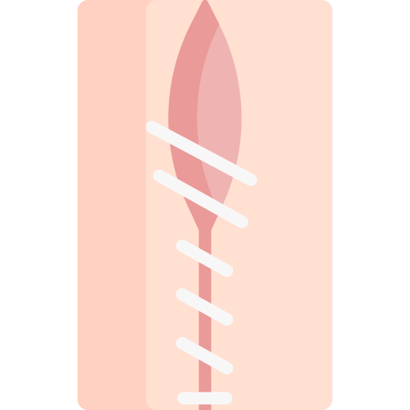
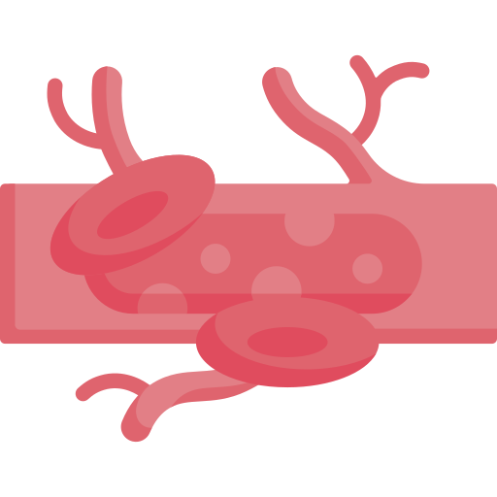
Applications of bioadhesives in medicine
Possible applications across the entire body
Three main categories of applications
Wound closure
Applicable to skin, brittle tissues and hard tissues
Sealing leakage
Including bleeding or other fluid/gas leakage
Immobilization
Wound dressing, drug delivery and medical device fixation
Duan, Wanglin, Xiangbing Bian, and Yazhong Bu. “Applications of Bioadhesives: A Mini Review.” Frontiers in Bioengineering and Biotechnology 9 (September 3, 2021): 716035. https://doi.org/10.3389/fbioe.2021.716035.

Slide 4
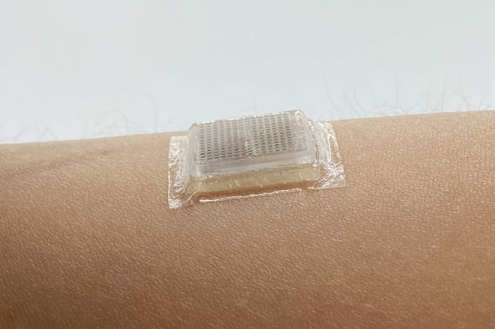
Bioadhesives: a 6.0 billion dollar market in 2020; 9.7 billion predicted in 2025
Major applications
Biomedical
Suture-less seal
Wearable electronics
Engineering
Underwater vehicles
Fishing industry
Sea transportation
…
Wu et al., Sci. Transl. Med. 14, eabh2857 (2022)
Wang et al., Science, 377, 517–523 (2022)

Slide 5
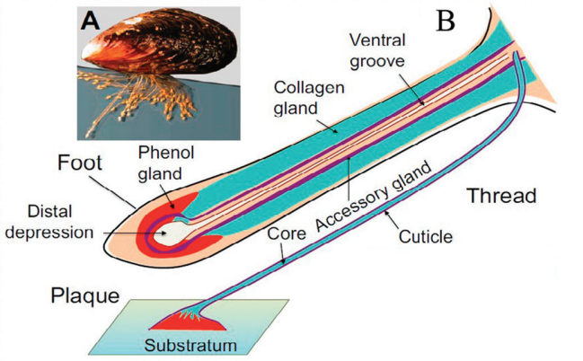
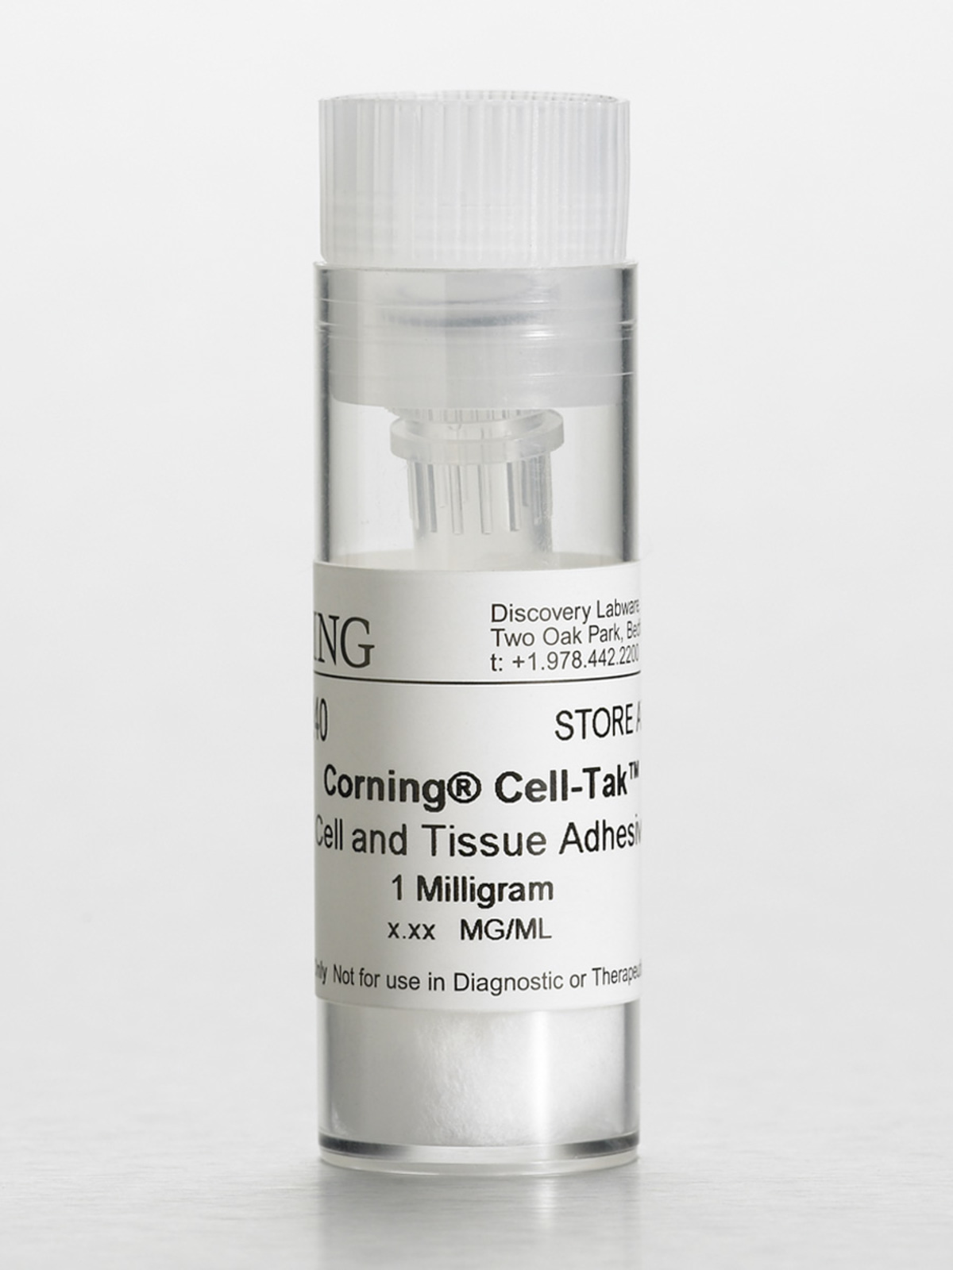
Example of current solutions: mussel-inspired glue
Corning® Cell-Tak™ Cell and Tissue Adhesive
(Product Number 354240)
Limitations:
Unstable
Sensitive to pH, salinity, etc.
Expensive
Molecular Weight: 110-140 kDa.

Slide 6
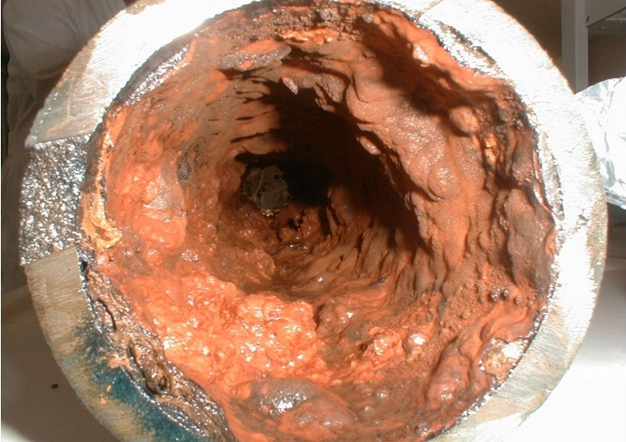
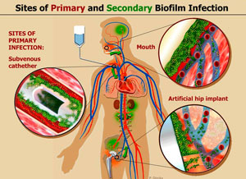
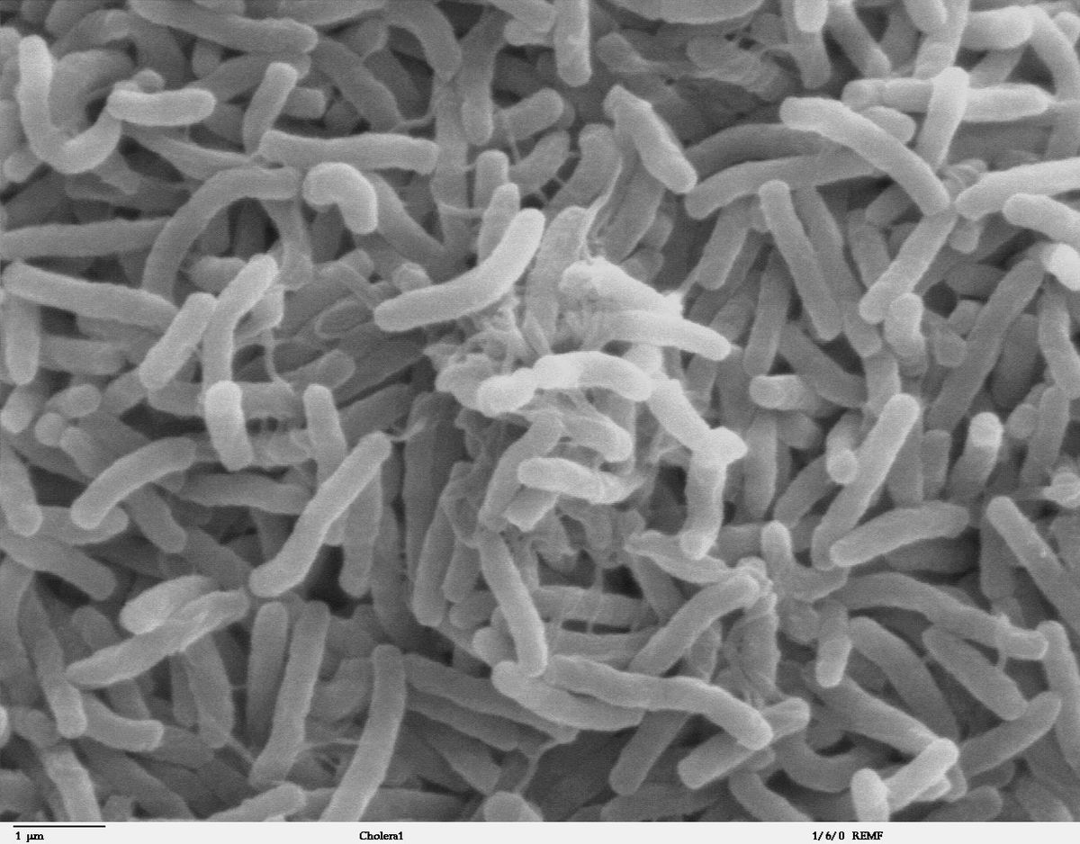
Our unique approach: inspiration from bacterial biofilms

Slide 7
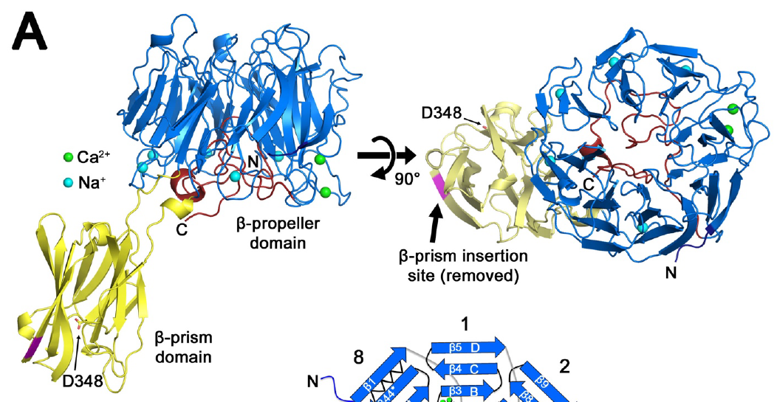
Vc biofilm produces unique glues to attach to various surfaces
y
Bap1
β-propeller
(blade 1-5)
β-prism
β-propeller
(blade 6-8)
β-propeller domain
57-aa insertion loop
β-prism domain
A

Slide 8
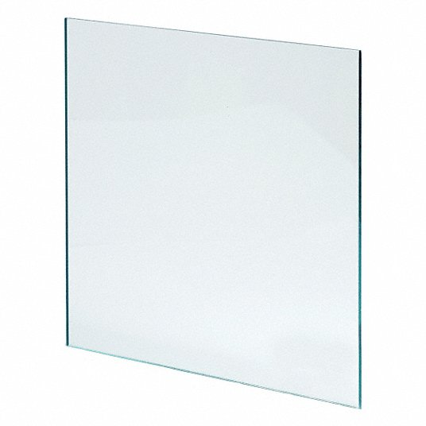
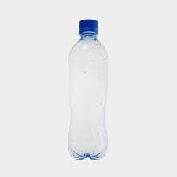
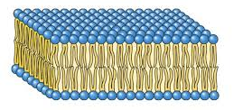
The secret of adhesion is in a short peptide
Surface of interest
Fluorescently labeled peptide
50 μm
On glass
On plastics
On lipids
50 um
On tissue
Notes:
On the last application, mention briefly that this is not toxic to the cells.
Our molecular weight is only 6792 Da.

Slide 9
The secret of adhesion is in a short peptide
Quantitative measurement of adhesion force with atomic force microscope:
Advantages
Stable
Broadly applicable
Scalable
Low MW (7 kDa)
Probe approach
Comparable to mussel proteins!
IP: 63/376,414
Probe retract
* This joint IP is under an IIA (inter- institutional agreement) with Wesleyan, the co-owner of the IP.
Notes:
Need to make it clear that we are making a more general solution rather than a specific problem.

Slide 10
Blavatnik Aims
Aim 1: Evaluate the range of applicability
Testing adhesive strength on various tissues
Testing adhesive strength between tissues and engineering surfaces
Testing cell cytotoxicity and immunogenic response
Aim 2: Scale up production
Expressing recombinant peptide through fermentation
Varying sequence for optimal adhesion
Optimizing process for low-cost production
Cost: $150,000.
Cost: $150,000.

Slide 11
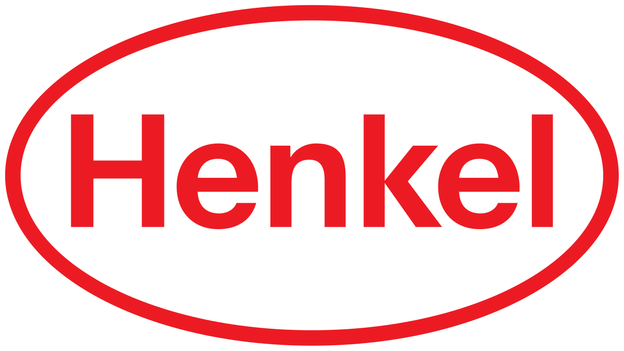
Potential interests

Slide 12
Our team
Jing Yan, Ph.D.
Assistant Professor
Department of Molecular, Cellular and Developmental Biology
Quantitative Biology Institute
Yale University
Xin Huang
Graduate Student
Department of Chemistry
Yale University
Sarvagya Saluja
Postgraduate researcher
Department of Molecular, Cellular and Developmental Biology
Yale University
Rich Olson, Ph.D.
Associate Professor
Department of Molecular Biology and Biochemistry
Integrative Sciences
Wesleyan University
Alex Hinbest
Graduate Student
Department of Molecular Biology and Biochemistry
Wesleyan University
Ranjuna Weerasekera
Graduate Student
Department of Molecular Biology and Biochemistry
Wesleyan University

Slide 13
Current market
Source: www.grandviewresearch.com
Major drivers: Increasing regulations/policies against use of petrochemical-based adhesives
Source: F&S Analysis and Market Participants

