Slide 1
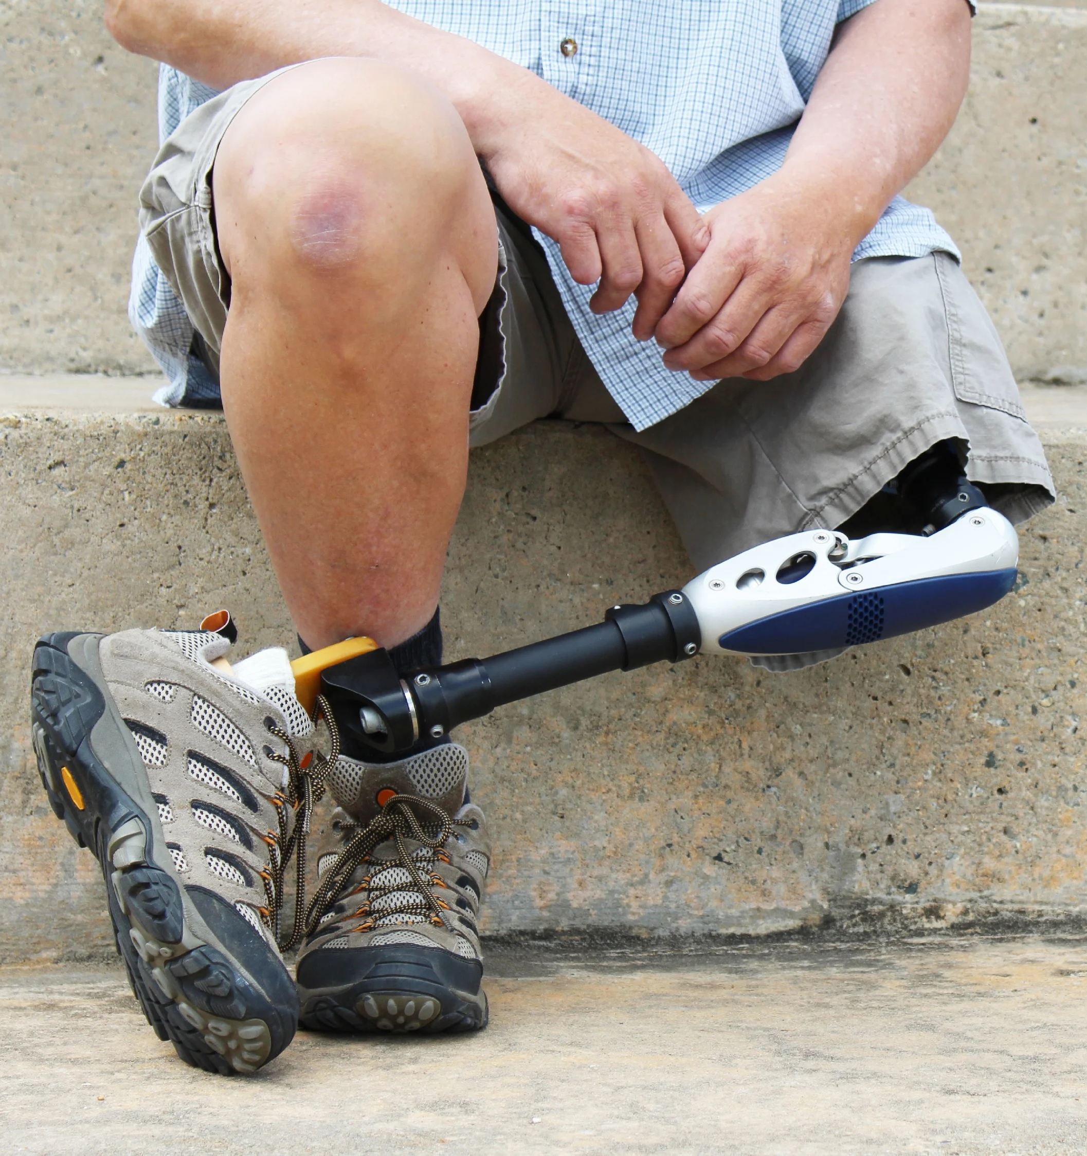
Novel Peptides for the Treatment of Peripheral Arterial Disease
Mehran M. Sadeghi, MD
Professor of Medicine (Cardiology)
Yale School of Medicine
VA Connecticut
https://blog.avinger.com/blog/13-fast-facts-amputation-peripheral-artery-disease
Jan-Otto, Credit: Getty Images/iStockphoto

Slide 2
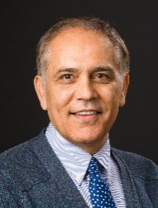
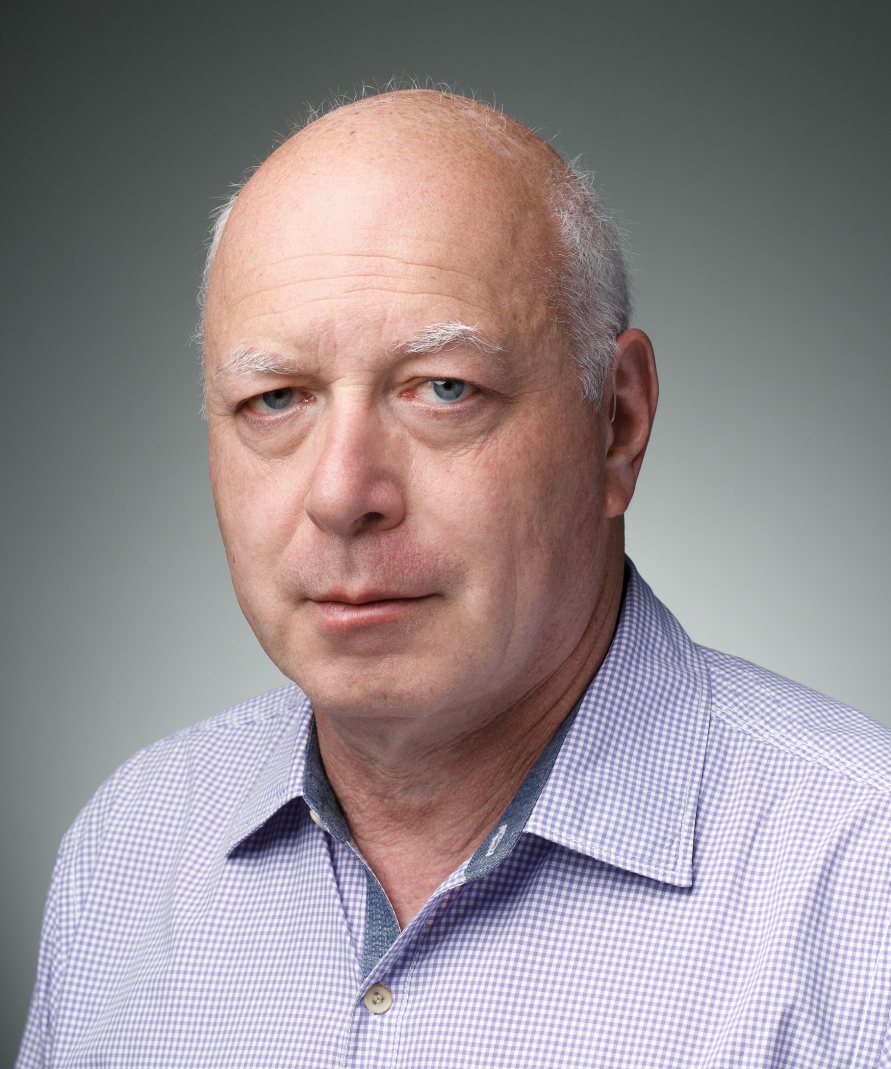
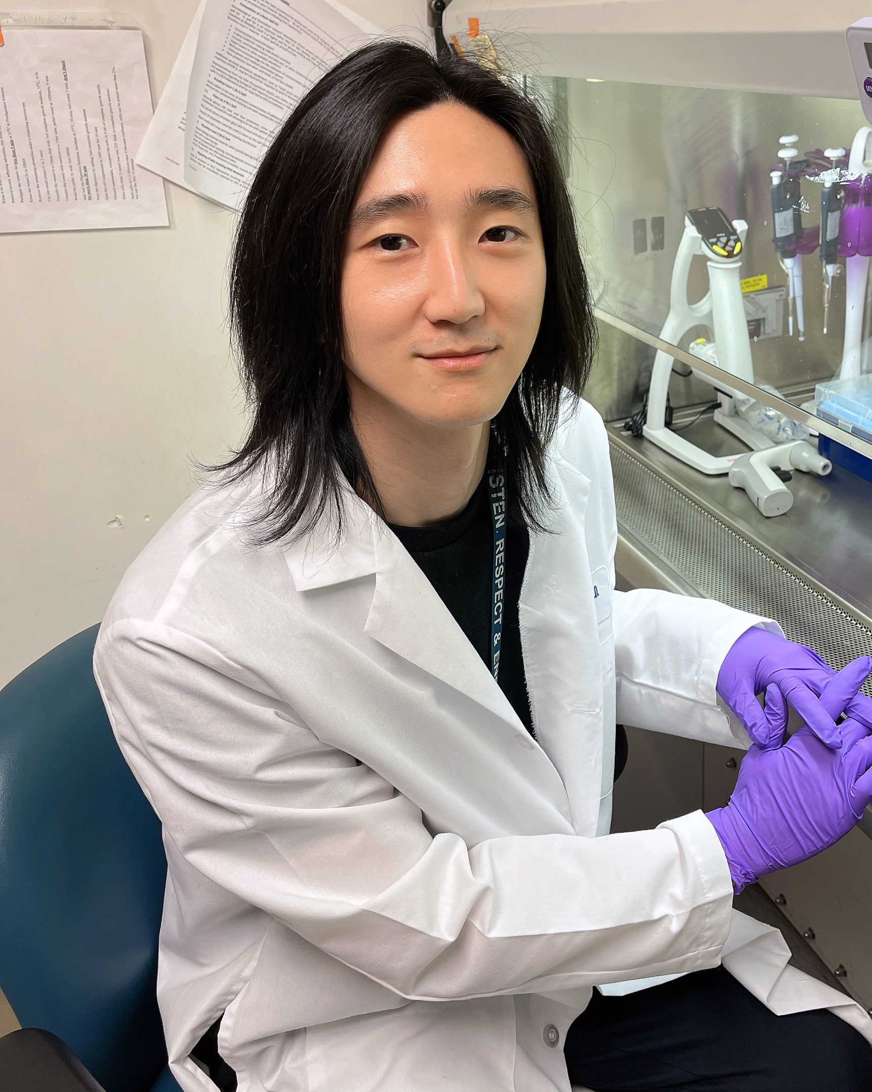
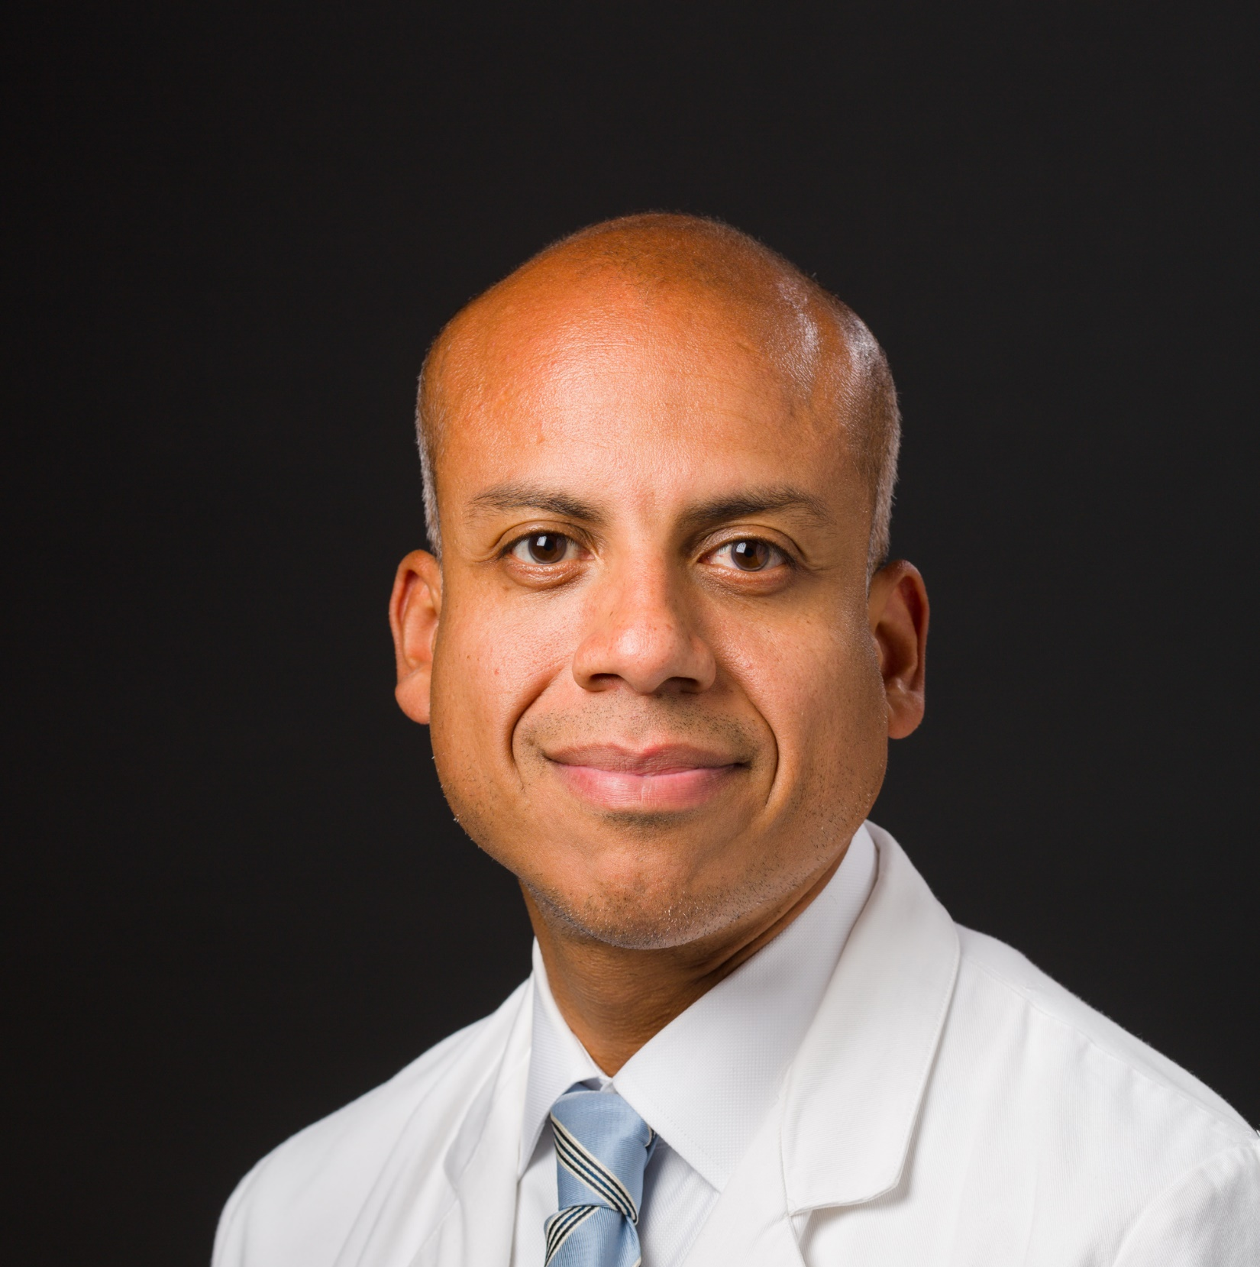
Core Team
Mehran Sadeghi, MD
Professor of Medicine
Cardiology, Vascular Biology, Molecular Imaging
Michael Simons, MD
Professor of Medicine
Cardiology, Vascular Biology
Mean Ghim, PhD
Associate Research Scientist
Vascular Biology
Carlos Mena-Hurtado, MD
Associate Professor of Medicine
Director, Vascular Medicine
Business Development and Licensing Support
David Lewin, PhD (David.Lewin@yale.edu)
Director of Business Development, Yale Ventures
Shannon Anderson, PhD (Shannon.Anderson@yale.edu)
Business Development Associate, Yale Ventures

Slide 3
PAD is a highly prevalent and costly disease
PMID: 34906615
Peripheral arterial disease (PAD) affects >200 million people worldwide
7% of people ≥40 years of age in the US have PAD
Symptoms range from claudication to critical limb ischemia (CLI)
CLI alone contributes ~$4B in annual US health care costs
PMID: 25439329

Slide 4
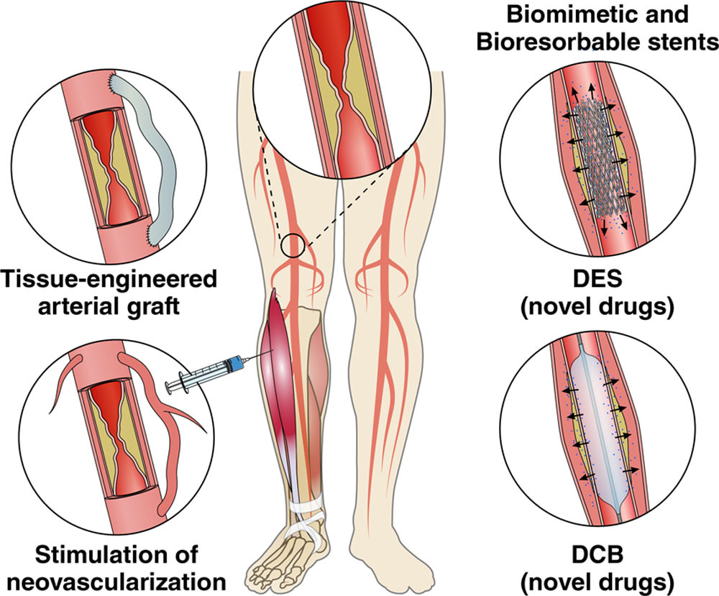
There is no effective medical therapy for PAD
PAD Standard of Care
The Future of PAD Therapeutics
Treatment depends on severity and stage of disease, ranging from:
Controlling risk factors
Exercise
Cilostazol (vasodilator therapy)
Balloon angioplasty or stent placement
Bypass grafting
Leg amputation
New therapies are needed for PAD
PMID: 34110904
Solutions should cost effectively improve blood flow and reduce ischemia

Slide 5
Human-derived peptide YV-8415-1 has advantages over key competitors in the clinical pipeline
Company |  |  | New Co.
Asset | NL003 | BGC101 | YV-8415-1
Indication | PAD | PAD with CLI | PAD
Phase | III* | I/II | Preclinical
Class | Gene therapy | Cell therapy | Peptide
The clinical pipeline is limited for novel therapeutics in PAD and CLI
Pipeline of PAD / CLI consists mainly complex and costly cell and gene therapies
Previous and current trials have established clinical endpoints
YV-8415-1 will succeed because it is a small peptide (~3 KDa) that targets several pathways involved in neovascularization
*In development in China only
YV-8415-1 provides a novel approach compared to key clinical competitors

Slide 6
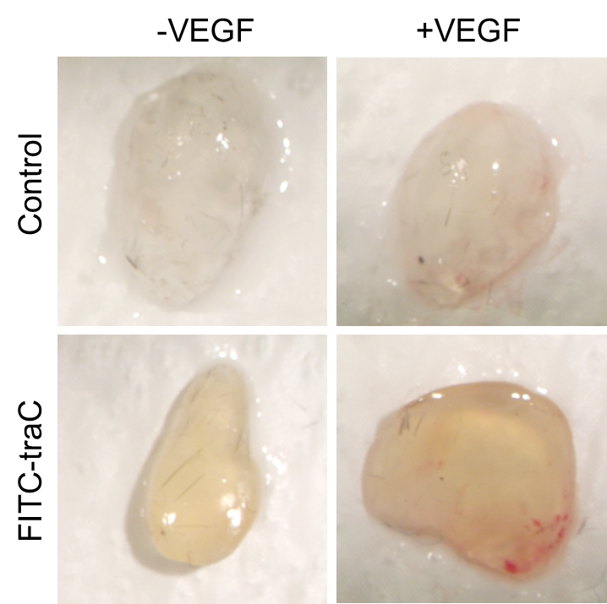
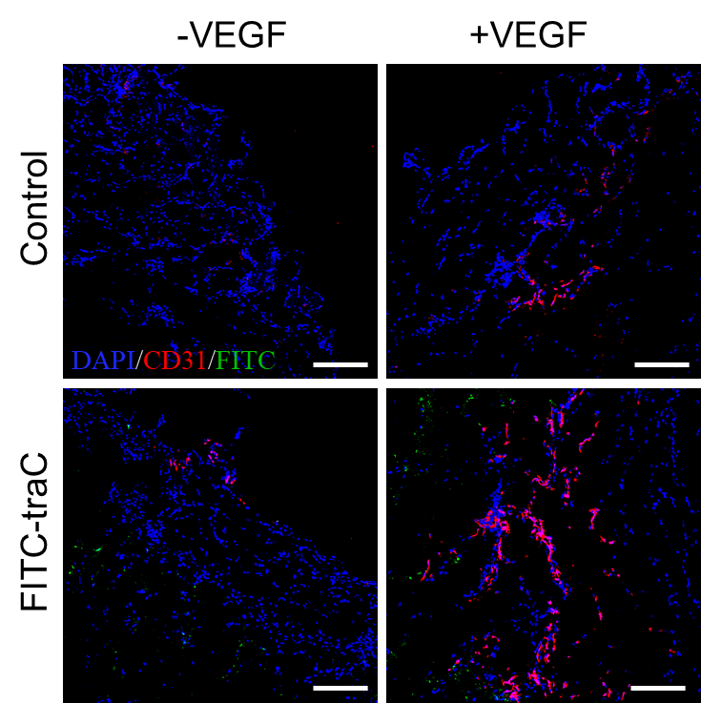
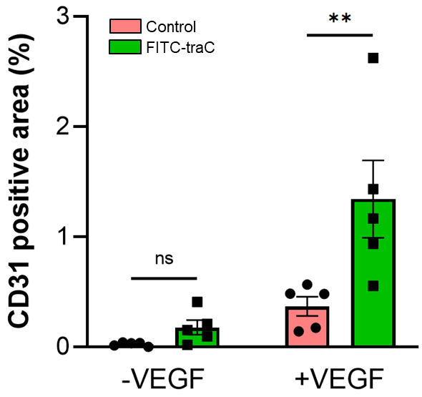
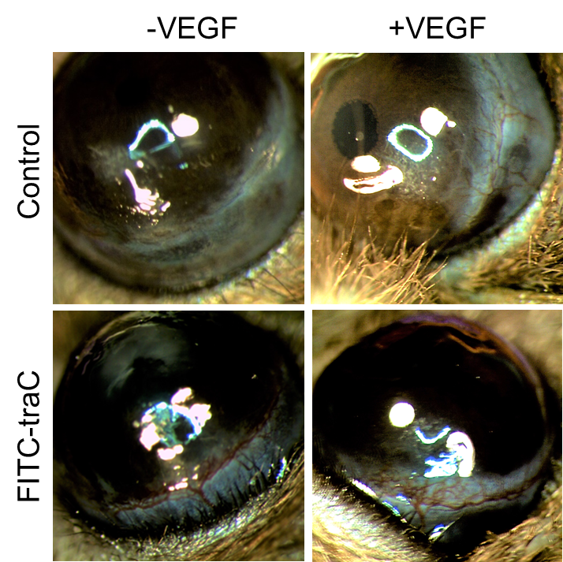
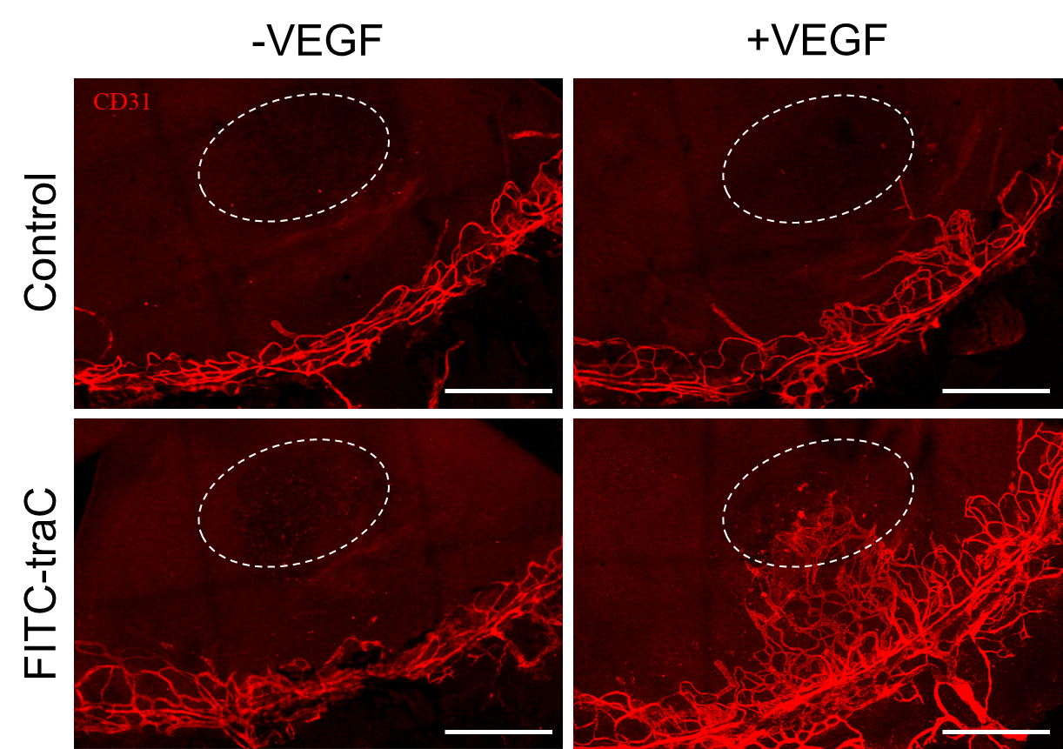
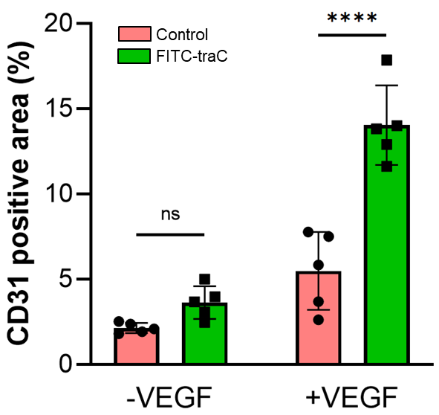
YV-8415-1 with VEGF significantly increases in vivo neovascularization over VEGF alone
YV-8415-1
Validated Model 1
YV-8415-1
YV-8415-1
YV-8415-1
Validated Model 2
YV-8415-1
YV-8415-1

Slide 7
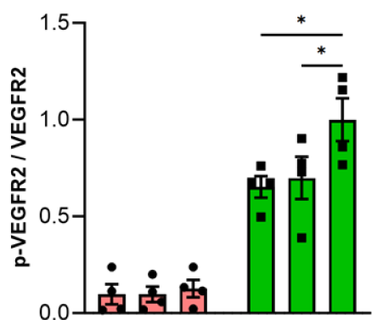
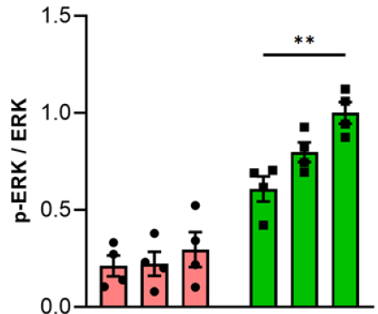
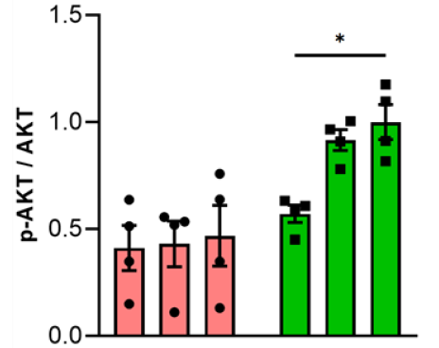
YV-8415-1 shows concentration-dependent effect on neoangiogenic signaling
VEGFR2
ERK
AKT
0
0.1
1
0
0.1
1
0
0.1
1
0
0.1
1
0
0.1
1
0
0.1
1
µM YV-8415-1
µM YV-8415-1
µM YV8415-1
YV-8415-1 in vitro dose dependence foreshadows in vivo dose dependency in validated PAD models

Slide 8
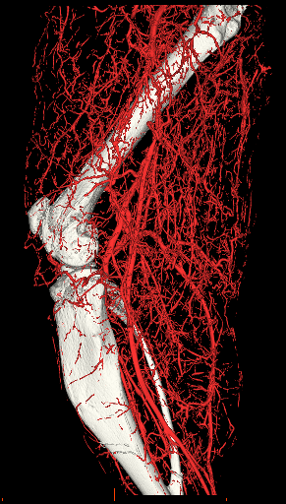
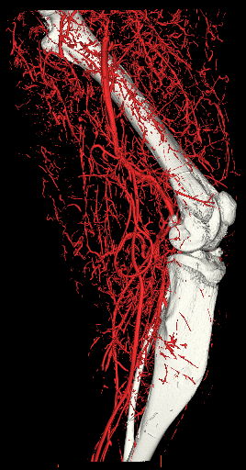
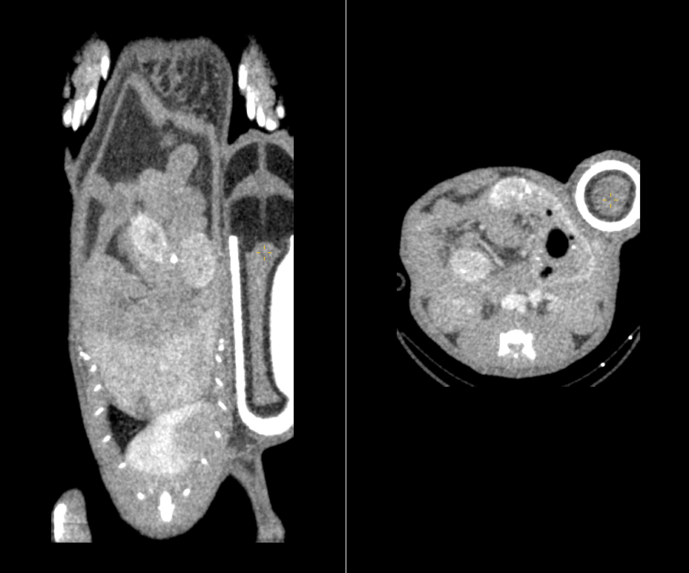
In an established murine PAD model, we will demonstrate that YV-8514-1 is efficacious
Femoral artery ligation
Minipump implantation for peptide delivery
R
L
Evaluation of neovascularization
Evaluation of flow recovery
Control
Ligation
Pre-surgery
Post-surgery
Day 3
Day 7
Day 14
WT
WT
KO
KO

Slide 9
Key
Current Status and Next Steps
Ongoing
Blavatnik Funds
 | 2023 | 2024 | 2025
IP Status | Provisional novel composition of matter patent application
Ongoing Research
Comparison Studies of YV-8415-1, -2, & -3 Human Peptides
In vitro validation
Mechanistic studies
In vivo YV-8415-1 vs. control testing
In vitro comparison
$60K
Optimization of assay for PK studies
$20K
Test efficacy in murine hindlimb ischemia model
$120K
Lead peptide in vivo dose-response study
$100K
Deliverable: Selection of the most promising agent for further development

Slide 10
Current Status and Next Steps
IP and Funding Status
Provisional patent filed
Several homologs identified
NIH funding for mechanistic studies and some in vivo studies
Use of Blavatnik Funds
Test the lead human peptides (YV-8415-1, -2, & -3) in a murine model of hindlimb ischemia – Budget $200K
In vivo dose-response studies with YV-8415 lead – Budget $100K
Deliverable: Selection of the most promising agent for lead optimization and pre-clinical toxicology and PK studies
Potential Next Steps
Partner with pharma company or spin out start-up

Slide 11
In a murine PAD model, a genetic knockout model had reduced flow recovery and angiogenesis
Pre-surgery
Post-surgery
Day 3
Day 7
Day 14
WT
KO
WT
KO
Control
Ligation
WT
These results prompted us to explore novel peptides to improve flow recovery in PAD through this pathway
KO
WT
KO

Slide 12
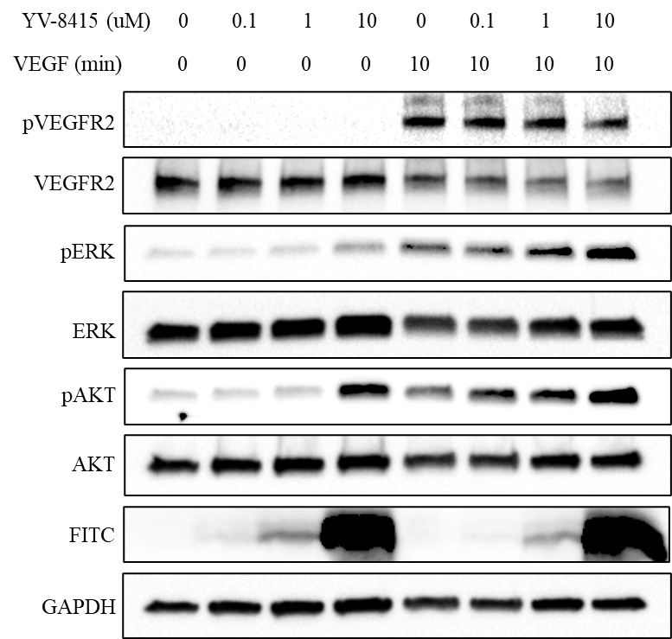
Novel peptide, YV-8415-1, has a concentration-dependent effect on angiogenesis signaling
0
0.1
1
0
0.1
1
0
0.1
1
0
0.1
1
µM YV-8415-1
µM YV-8415-1
0
0.1
1
0
0.1
1
µM YV8415-1

Slide 13
Competitive Pipeline
Company | Indication | Phase | NCT # | Drug | Class | Geography
Beijing Northland Biotech. Co., Ltd. | PAD | III | NCT05968118 | NL003 - HGF Gene Therapy | Gene Therapy | China
Mercator MedSystems | PAD (mod-Severe claudation or CLI) | II | NCT03942601 | Temisirolimus with or without Dexamethasone | Small molecule | US
NovoNordisk | PAD + Type II Diabetes | III | NCT04560998 | Semaglutide | Small molecule | US
MultiGene Vascular Systems Ltd. | Chronic CLI & PAD | I/II | NCT00956332; NCT00390767 | MultiGeneAngio | Cell therapy | Israel
BioGenCell Ltd. | PAD w/ CLI | I/II | NCT02805023 | BGC101 | Cell therapy | US
New Beta Innovation Ltd. | CLI | I/II | NCT04792008 | YQ23 | ? | Hong Kong
S.Biomedics Co., Ltd. | CLI | I/II | NCT04661644 | MSCs | Cell therapy | Korea
Source: ClinicalTrials.gov

