Slide 1


curIOS Therapeutics
Novel mRNA vaccines against virally-associated cancers
December 2023

Slide 2
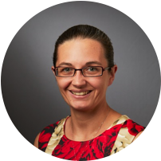
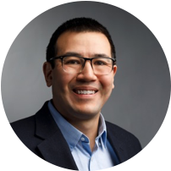










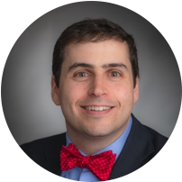
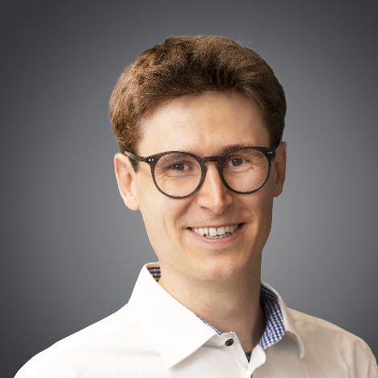










Team
Jeffrey Ishizuka, MD, DPhil
Physician-Scientist (Medical Oncology)
Yale Professor for Immuno-Oncology (IO)
Founder & SAB member for multiple IO companies
Kelly Olino, MD, FACS
Surgeon-Scientist (Surgical Oncology)
Translational & clinical expert in Merkel cell carcinoma, melanoma, sarcoma and squamous cell cancers
IO and clinical trial experience
David Braun, MD, PhD
Physician-Scientist (Medical Oncology)
Yale Professor Immuno-Oncology
Expert in neoantigen vaccine clinical trials
SAB member for multiple IO companies
Manuel Mohr, PhD
Molecular Biotechnologist
Yale Blavatnik Entrepreneurial Fellow
Expertise in Gene and Cell Therapy startups
Notes:
Motivation story

Slide 3
Now is the time – for an mRNA vaccine against MCC
mRNA vaccines have recently become available ^{1,2}
LNPs have recently been approved for the first time ^{1,2}
The combination of both technologies has enabled at will mixing of antigens and adjuvants for maximal effect
Cancer vaccines as a new promising tool to combat infection-driven cancers
Limited number of products – market still in its infancy
Recent development of mRNA vaccines
- 2020 COVID vaccine POC
Emergent therapeutic cancer vaccines
- POC in melanoma
and pancreatic cancer
New enabling MCC biology
- Identification of an immunogenic target essential to tumor survival
Prophylactic vaccines segment accounted for 85.2% of market share in 2020
Therapeutic vaccines have historically been a challenging spac for development
2016
2017
2018
2019
2020
2021
2022
2023
¹Houben et al., J Virol, 2010 ² Jing et al., Cancer Immunol Res, 2020
Bacillus Calmette-Guérin (BCG): a vaccine that uses weakened bacteria to stimulate the immune system; approved for patients with early-stage bladder cancer
Sipuleucel-T (Provenge®): a vaccine composed of patients’ own stimulated dendritic cells; approved for prostate cancer (~2019?)
2009 first mRNA vaccine tested in humans
2020 COVID vaccine authorized
Notes:
Motivation story

Slide 4
Viral MCC
–the ideal target
… a growing and deadly problem:
…underserved by current SOC:
Check-point inhibitors (~50% effective)
Chemotherapy (~30% success rate but low durability)
The most lethal skin cancer (stage-for-stage)
Rising incidence
20 % UV-induced
80 % Viral
(MCPyV)
87%
… an ideal target for mRNA vaccines:
Strong antigen dependence¹
Highly conserved antigens
Highly immunogenic antigens²
73%
65%
60%
37%
45%
¹Houben et al., J Virol, 2010
² Jing et al., Cancer Immunol Res, 2020
³ Schadendorf et al, J Clin Oncol, 2017

Slide 5





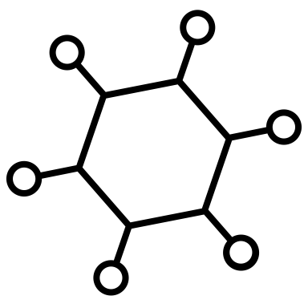




MCC: a growing market
$50 Bn
US cancer market⁴
10% of all cancers are virally-associated^{2,3}
2500-3000 new MCC patients annually in USA¹
~US$10 Bn by 2031 (9.4% CAGR)⁴
Human Papilloma Virus
Head and Neck,
Cervical, Penile, Anal cancers
Global market: US$ 3 Bn¹
US market: US$ 300 MM
Hepatitis B/C Virus
Hepatocellular Carcinoma
Epstein Barr Virus
Nasopharyngeal cancer
Burkitt & Hodgkin Lymphoma
MCC is a rapidly growing (3.6 % CAGR)¹
Kaposi Sarcoma Herpes Virus
Kaposi Sarcoma
Primary effusion lymphoma
Multicentric –Castleman’s disease
¹ Data Bridge Market Research + Knowledge Sourcing Intelligence
² Schiller, JT, Lowry, DR, Recent Results Cancer Res. (2014)
³ Plumer, M, et al. Lancet Global Health (2016)
⁴ BioSpace, Cancer Therapeutics Market - Global Industry Analysis,… (2023)
Human T-lymphotropic Virus 1
T-cell Leukemia
1/130,000 new MCC cases per year in USA → ~
~1 in 1625 chance to develop MCC during an 80 year live span
Notes:
Motivation story

Slide 6

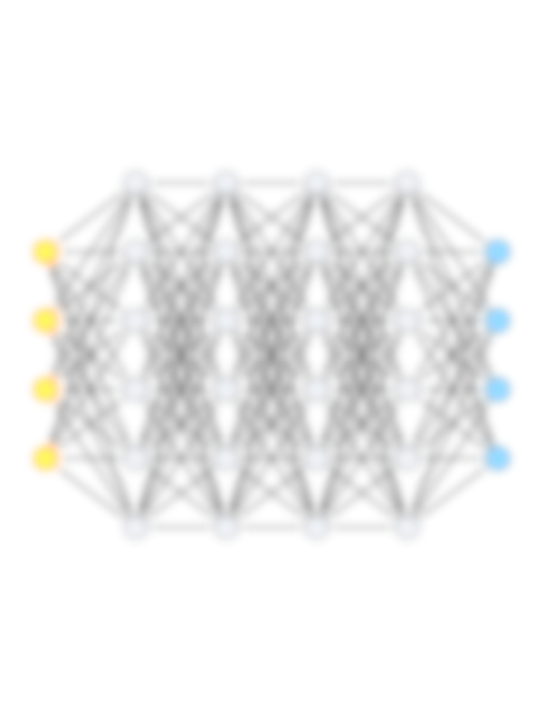

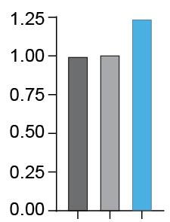
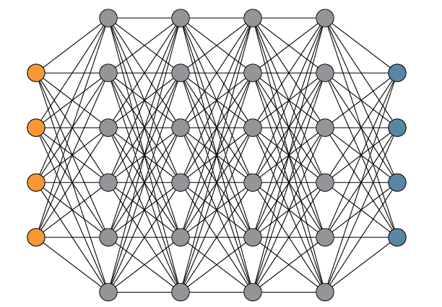
The curIOS difference
FUSION Platform
A.I. Antigen Discovery
COMET Platform*
Engineered immune expansion
Leverages deep neural networks to discover shared and private consensus antigens
Works for indication and antigen selection
COrdinated Multisignal Expansion of T-cells
Co-expression of proprietary “Signal”
Allows specific tuning of T-cell subsets
Improved infiltration and T-cell effector function
5’UTR
3’UTR
Prediction accuracy
[confirmed by IFNγ ELISpot ]
Antigen
Signal X
Signal Y
Proprietary A.I. engine
Tumor Volume d21 [mm³]
Competitor 1
FUSION
Competitor 2
Antigen+
Signal 1
* FTO established; Prov. patent application filed through Yale
Notes:
Motivation story

Slide 7
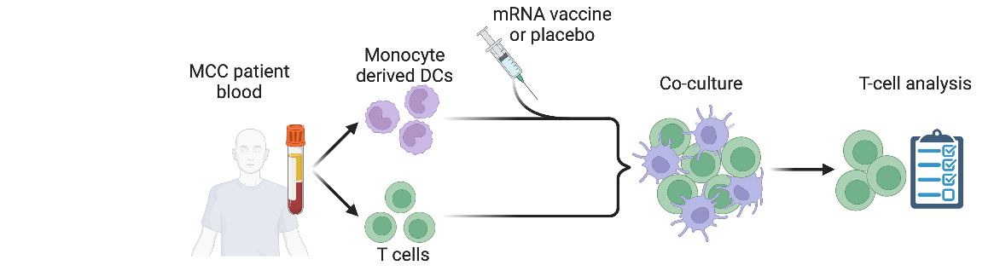
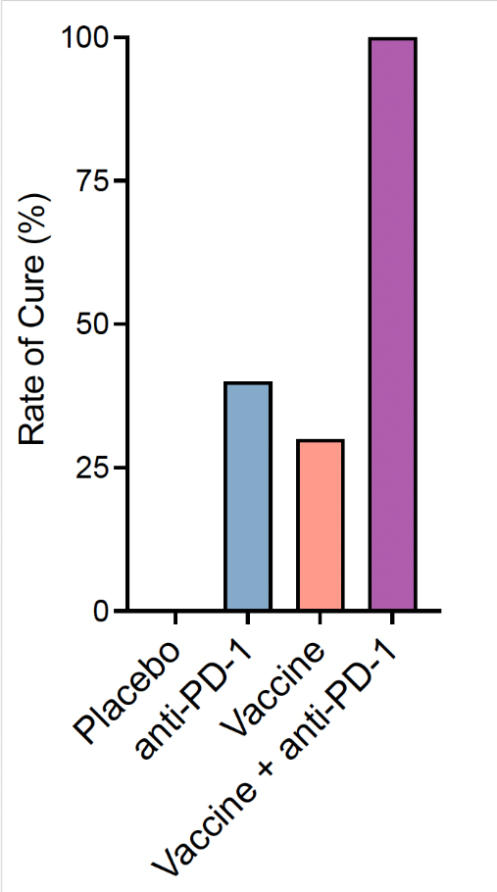
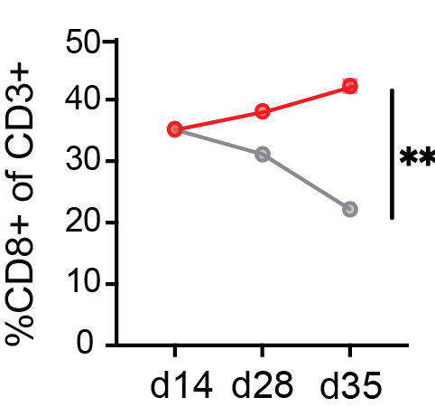
Preclinical validation
Ex vivo patient validation
human patient tissue
In vivo studies
syngeneic murine model
CD8+ T-cell expansion: ↑
Functionality (IFNγ ELISA): ↑
Tumor cell killing: ↑
cDC1 / T cell expansion: ↑
Monotherapy efficacy comparable to SOC
Combination therapy improves cure rate
cDC1
Expansion (Vaccine dLN)
T cell
Expansion
(Vaccine dLN)
Cure Rate:
T cell Expansion
IFN𝛾 Release
Tumor Cell Killing
Notes:
In both cases,

Slide 8






CurIOS’ competitive edge
Company | Stage | Modality | Targeting MCC | Targeted T-cell modulation
 | Phase 1 | DNA vaccine
 | Phase 2b | mRNA vaccine (+ mAB)
 | Preclinical | mRNA vaccine |  |  | Proprietary COMET platform
Notes:
https://www.labiotech.eu/best-biotech/cancer-vaccine-companies/

Slide 9
CurIOS’ budget
COMET –
platform optimization
Expansion of effectors ($ 30k)
Combinatorial testing ($ 30k)
MILESTONE: lead mRNA
Sub-total: $ 60k
Delivery optimization
mRNA manuf. ($ 45k)
LNP manuf. ($ 35k)
Delivery POC (mouse; $ 70k)
MILESTONE: lead LNP
Sub-total: $ 150k
In vivo efficacy POC
mRNA manuf. ($ 25k)
LNP manuf. ($ 25k)
Efficacy study / in vivo lead validation (mouse; $ 30k)
Ex vivo lead validation. (patient cells; $ 30k)
MILESTONE: lead candidate
Sub-total: $ 110k
COMET – evaluate combinations
In house
5 months
Delivery POC (mouse)
Manufacturing:
CRO:
Improved MCC mouse model
In house
3 months
Efficacy study /in vivo lead validation (mouse)
In vitro Lead validation (patient cells)
Grand total: $ 320k
 |  | 2024 |  |  | Q2 |  |  | Q3 |  |  | Q4 |  |  | 2025
 |  | Q1 |  |  | Q2 |  |  | Q3 |  |  | Q4 |  |  | Q1 |  |  | Q2 |  |  | Q3 |  |  | Q4
Platform dev. /lead nomination: | COMET – expand effectors/adjuvants
 | COMET – evaluate combinations
 | Improved MCC mouse model
 | Delivery POC (mouse)
Lead valid. | Efficacy study /in vivo lead validation (mouse)
 | In vitro Lead validation (patient cells)
IND enabling studies: | PK/PD
 | Rodent (rat) tox
 | NHP tox

Slide 10
CurIOS to learn more?
Jeffrey Ishizuka, MD, DPhil
Scientific & clinical strategy
Jeffrey.Ishizuka@yale.edu
Manuel Mohr, PhD
Business Development and partnering
Manuel.mohr@yale.edu

Slide 11
Phase 1 Trial Design
Inclusion:
Resectable, Stage II + III MCC
ECOG 0-1
Goal enrollment ~10 patients
Exclusion:
Solid organ transplant recipients
Active systemic immunosuppression, autoimmunity or pregnancy
Treatment:
Neoadjuvant vaccine d0, d10
SOC surgery w/in 3 weeks +/- radiation
Adjuvant vaccine (8 doses, q4weeks) + pembrolizumab (up to 1 yr)
Outcomes:
Primary: Toxicity
Secondary:
  Pathologic response
  Recurrence free survival
Exploratory endpoints:
  Cytokine array
  T cells from PBMC
  scRNAseq
D0
D10
D21
4wks XRT
6 week post op
q1month
Q1month…total 12
vaccine
vaccine
vaccine
biomarkers
vaccine
vaccine
surgery
XRT
Anti-PD1
Anti-PD1
Anti-PD1
tissue
Notes:
Ph 2--- Keynote-017, Non-randomized Ph2 trial with 50 patients of Pembrolizumab vs historical data with chemotherapy.

Slide 12








Building a Sustainable Future: An In-Depth Look into the Investment Breakdown of Costs
2023
2024
2025
Fully automated platform
2026
IND planning for indication 1
Indication-1 & platform advancement
4
3
2
Vaccine Development
Clinical Trails and Indication 2
Indication 1
1
Selecting Indications and Platforms
Clinical trial Phase 2
CMC
Regulatory and Compliance
Advancing pipeline assets
Clinical trial Phase 1
Potential indication study
Intellectual Property
POC data for Indications 2 and 3
2/3 Indication 1 study
1/3 Platforms Development
Target indications
Foundation platforms study

Slide 13


CurIOS is strategically positioned to succeed
Rapid path for clinical development for first indication (MCC)
Green marketing is a practice whereby companies seek to go above and beyond traditional marketing by promoting.
In-house platforms for mRNA vaccine development; murine and patient validation
Deep disease-specific and clinical development expertise at Yale
Estimated time to clinic ~18 months
Estimated time to pivotal efficacy trial ~3.5 - 4 years
Enables efficient development for ‘low hanging fruit’ targets
Innovative Platform positions us to shape the future of the field
  Proprietary technologies permit reimagining of adjuvant and antigen components
  Discovery and translational validation platform enables rapid innovation cycles
  Novel, fundamental insights in tumor immunobiology are efficiently applied to address unmet medical need

