Slide 1

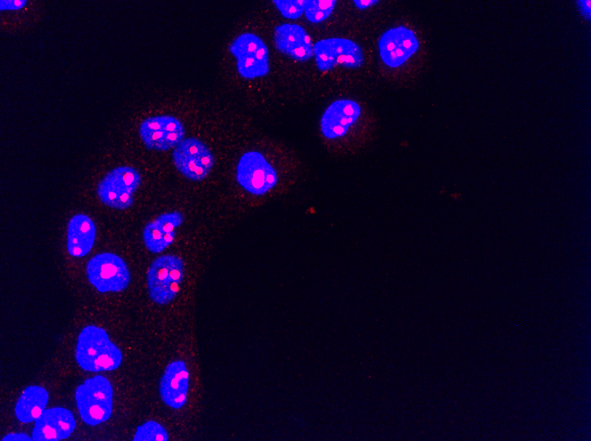
RiboRupt Biotech: Targeting RNA polymerase I for breast cancer therapy
Susan J. Baserga, MD, PhD
William H. Fleming MD Professor of Molecular Biophysics & Biochemistry
Professor of Genetics, Therapeutic Radiology
Yale University and the Yale School of Medicine
susan.baserga@yale.edu

Slide 2
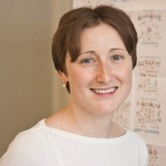
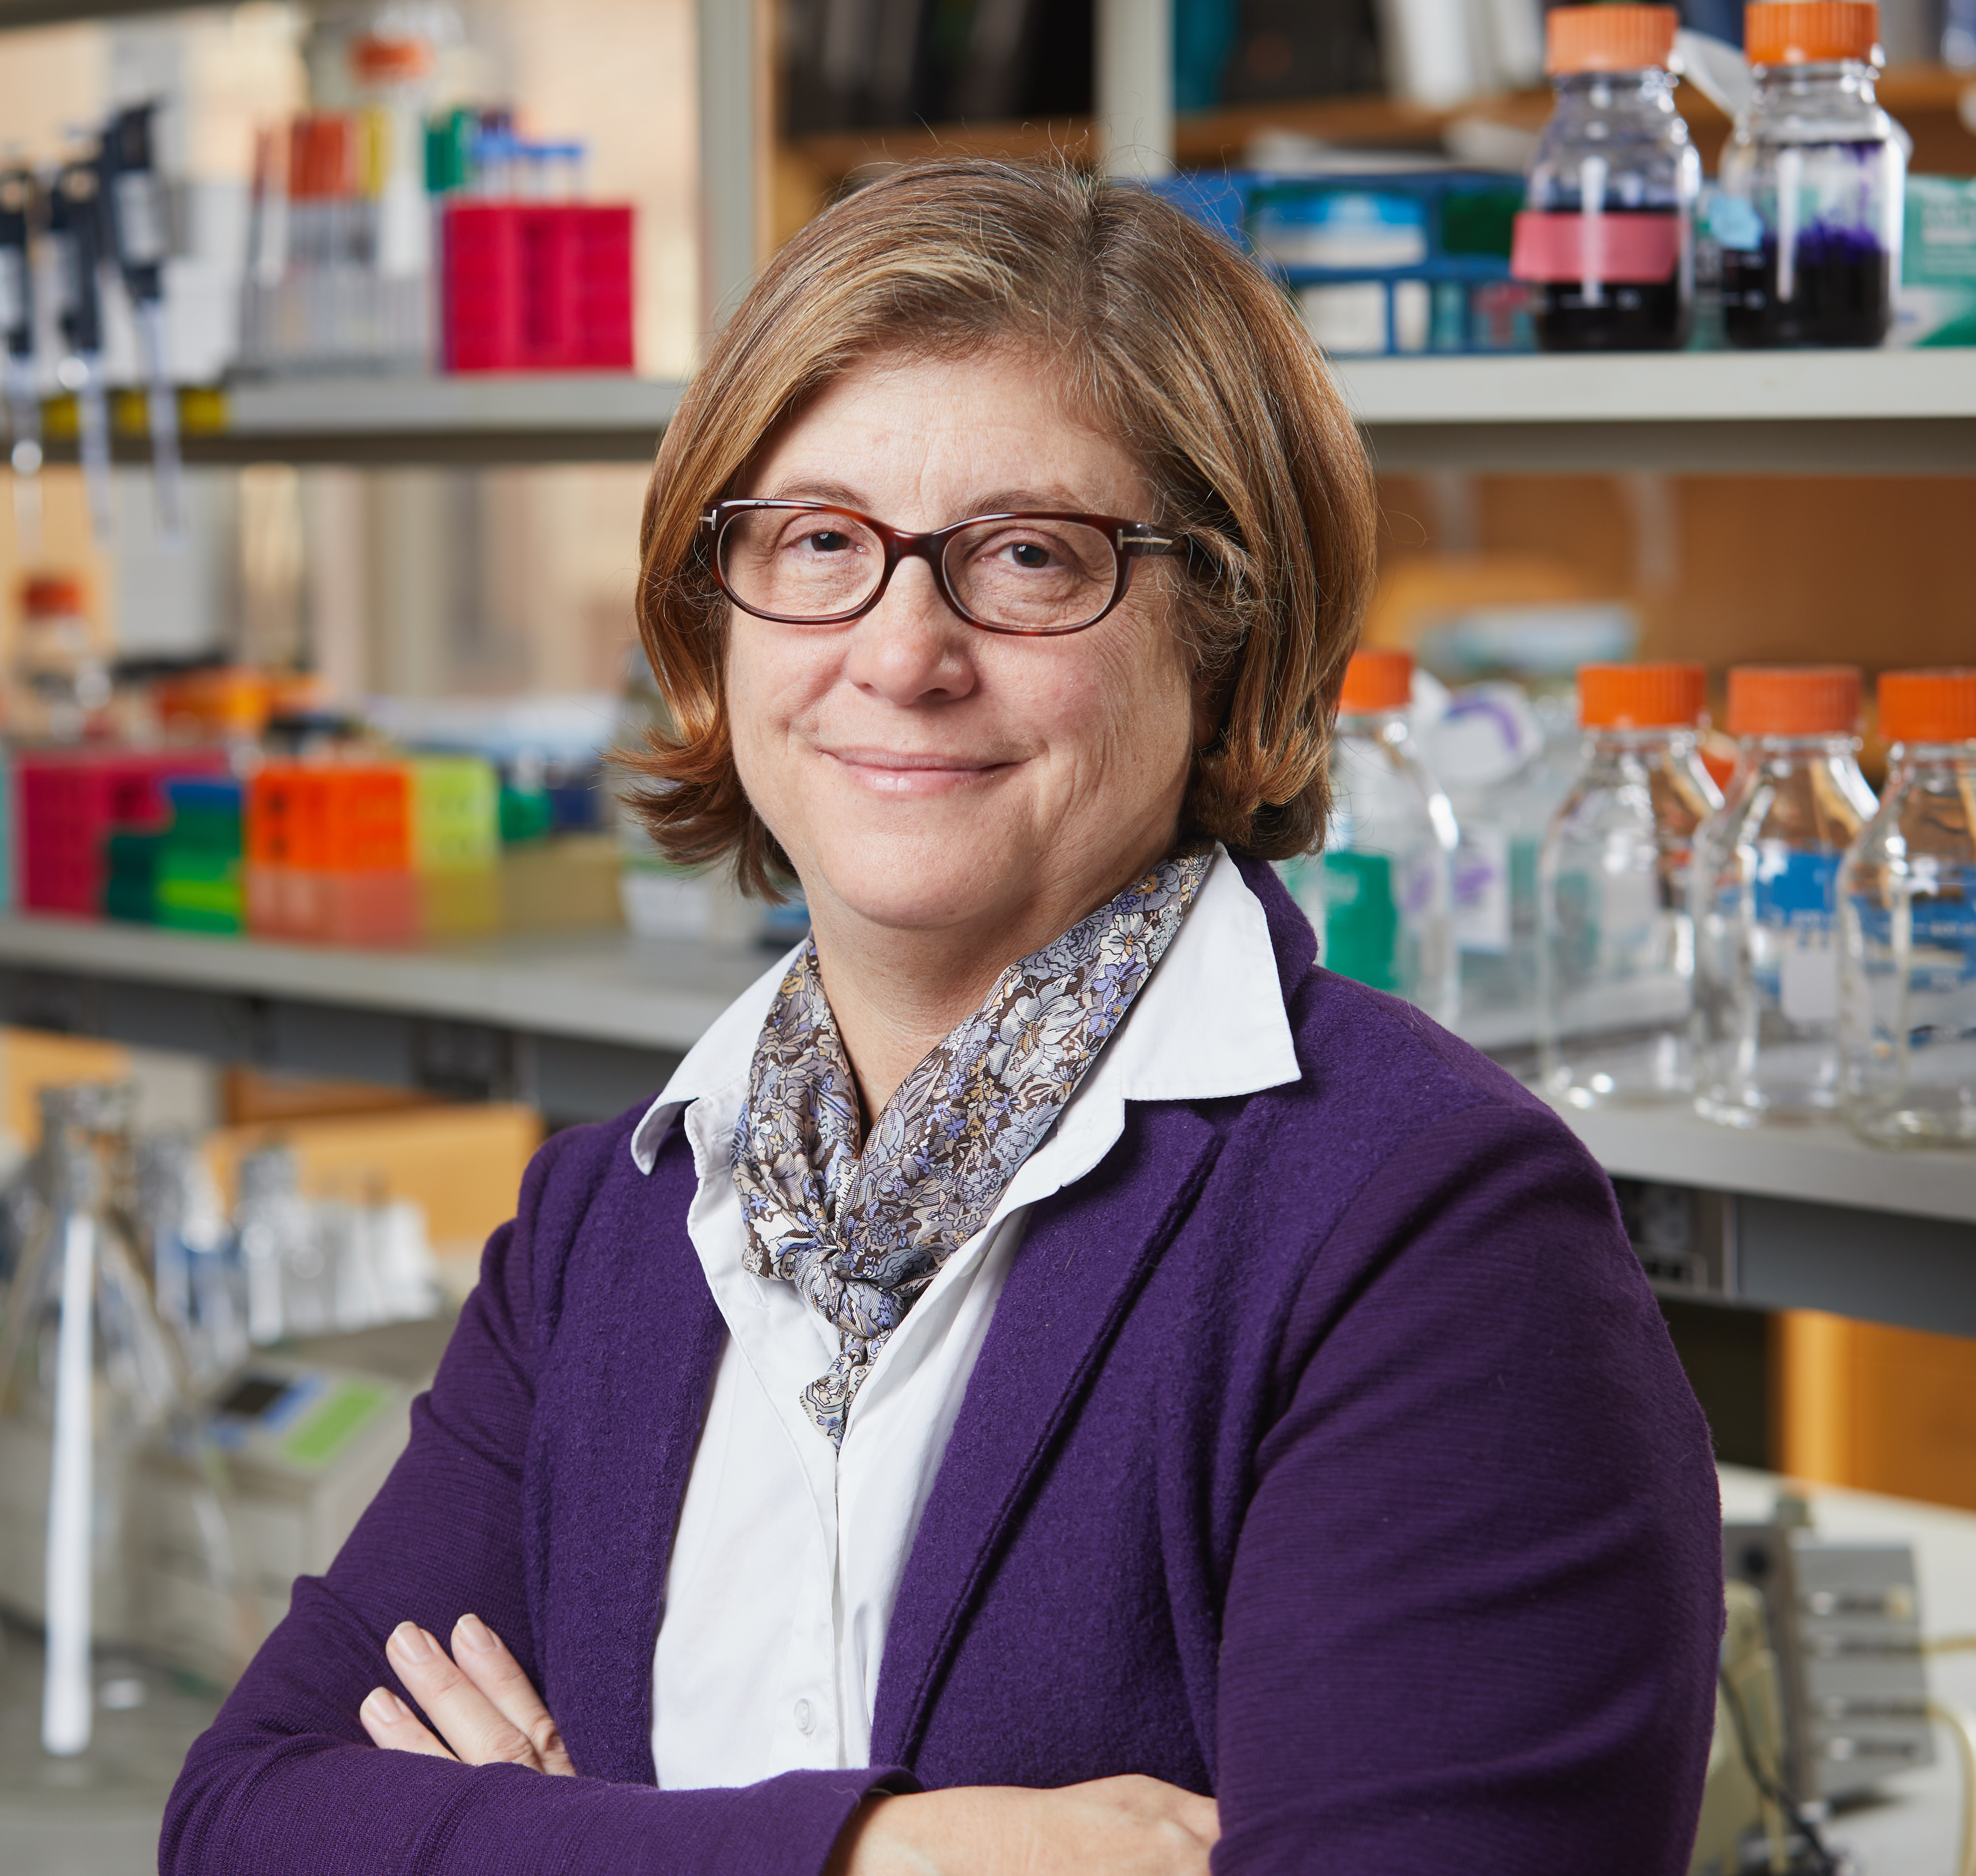

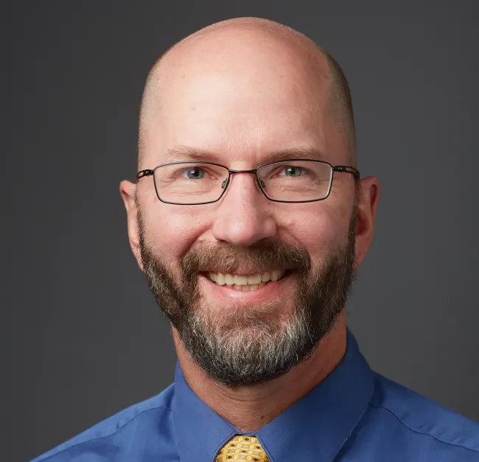

The RiboRupt Biotech Launch Team
Yulia Surovsteva, PhD
Director of Biology, Yale Center for Molecular Discovery
Vish Muthusamy, PhD
Research Scientist; Director, Center for Precision Cancer Modeling
Susan J Baserga, MD PhD
William H. Fleming MD Professor of Molecular Biophysics & Biochemistry, Genetics and Therapeutic Radiology at Yale
KOL in the cell biology and biochemistry of the nucleolus and ribosome biogenesis (108+ papers)
Licensed technology to 2 biotech companies and inventor on 3 patents.
Elected to the National Academy of Inventors in 2018.
Elected to the National Academy of Medicine in 2023.
&
David Lewin, PhD
Business Development and Intellectual Property Support david.lewin@yale.edu
Marcus Bosenberg, MD-PhD
Anthony N. Brady Professor of Dermatology, Pathology and Immunobiology
Director, Yale Center for Immuno-Oncology
RiboRupt Biotech

Slide 3
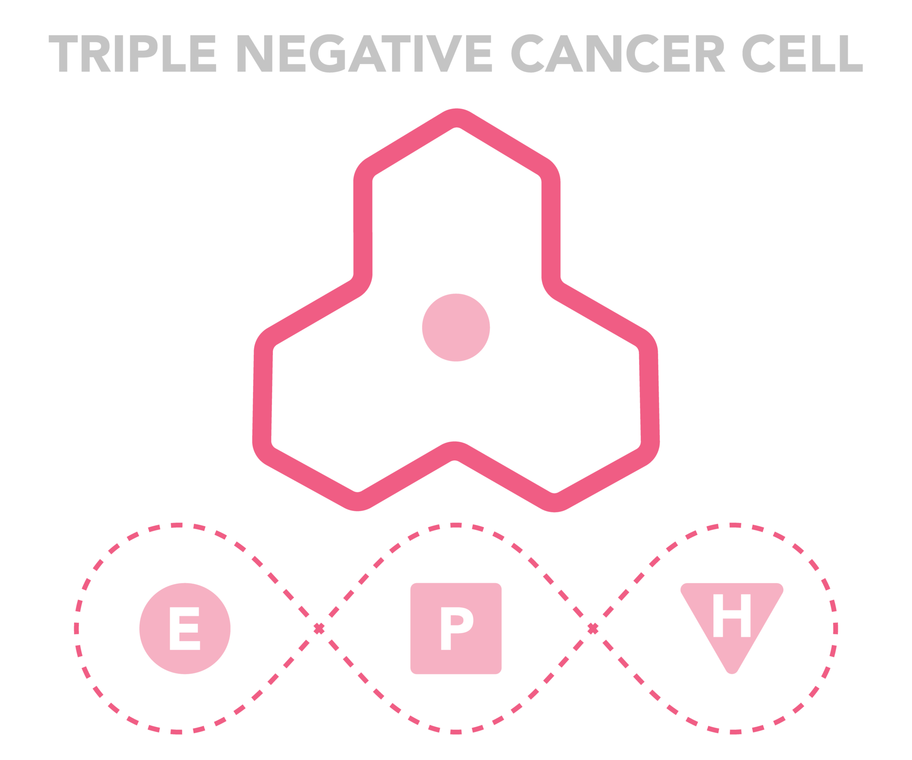

High unmet need – 15% of all breast cancers are TNBC
Triple negative breast cancer (TNBC)
Market Opportunity
TNBC Lethality Rate
2.1 million TNBC diagnosis world wide in 2018.
Incidence of TNBC is increasing.
Current treatment market is $614M and greater than $900M by 2033¹.
Estrogen
receptor
Progesterone receptor
HER2
RiboRupt Biotech
¹ Persistence Market Research
Notes:
Disparity: African American women are significantly more likely to die from TNBC than white women.
Source for numbers in bar graph: https://www.komen.org/breast-cancer/facts-statistics/breast-cancer-statistics/survival-rates/

Slide 4
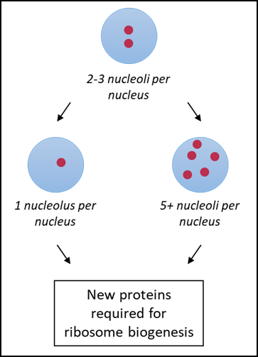
Why now? We have developed a novel screening platform for RNA polymerase I function in the nucleolus to discover new anti-TNBC drugs.
Robust, high throughput phenotypic (image-based) assay for nucleolar function in human cells.
Thoroughly validated.
siRNA screen published in Cell Reports, 2018
published in Mol.
Biol. of the Cell
March 2021
RiboRupt Biotech
With the Yale Center for Molecular Discovery

Slide 5
Solution. We have discovered new small molecules (screen actives) that target the nucleolus via our novel screening platform.
Screened 25,246 compounds from a Life Chemicals Fsp3 library at 10 μM
Average Z’ = 0.53
Average S/B = 3.2
Identified 202 active compounds
  Cut-off = Median + 3 SD
  137 compounds showed reproducible activity
  Most have anti-RNA polymerase I activity at 10 μM
  11 representative screen actives from structure clusters using DataWarrior software
    The majority are grouped in a cluster of heterocyclic sulfur-containing compounds
One nucleolus phenotype
Active compounds
Inactive compounds
RiboRupt Biotech
funded by the Breast Cancer Alliance
Lisa Ogawa McLean and the Yale Center for Molecular Discovery

Slide 6
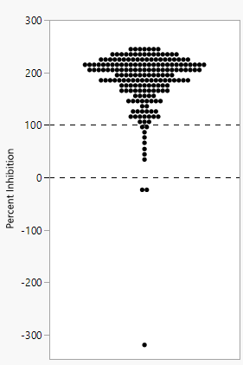
Solution. RNA polymerase I is the drug target for most screen actives.
RiboRupt Biotech representative 11 screen actives
BMH-21 (known inhibitor of RNA polymerase I
being developed at Johns Hopkins)
DMSO
190 unique compounds (FDA-approved drugs and Life Chemicals)
n = 3 biological replicates
48 h; Bryant et al; Open Biology 2022.
RiboRupt Biotech

Slide 7
Solution. Therapeutic index: screen actives preferentially kill a triple negative breast cancer (TNBC) cell line in vitro.
Screen active | Near normal MCF10A cells IC50 (μM) | Triple negative breast cancer MDA MB-468 cells IC50 (μM)
RRT-01 | 34 | 0.4
RRT-02 | 15 | 2
RRT-03 | 148 | 2.8
RiboRupt Biotech
With the Yale Center for Molecular Discovery

Slide 8
Competition. The limited targeting of RNA polymerase I, including drug in Phase l/II, validates our approach.
RiboRupt Biotech

Slide 9
Plan for use of Blavatnik Funds
3-4 months
5-10 months
11-18 months
19-24 months
$30K
$110K
$80K
$80K
Total ask: $300K
RiboRupt Biotech

