Slide 1
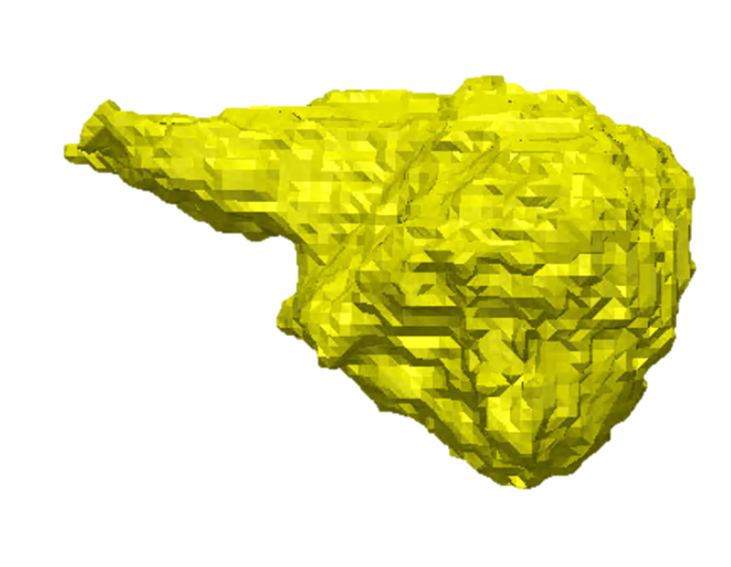
Dynamic 3D Morphometric Analysis
Analysis of tumor growth utilizing AI and chronological MRI imaging
Frank D. Buono, PhD
Notes:
MY team and I are ecstatic to present our software… Dynamic 3D morphometric analysis. We feel the innovative AI software that we have built at Yale will be groundbreaking for the field of radiology to evaluate cancerous and noncancerous tumors.

Slide 2
We have the clinical, scientific, and technical talent to change the future of tumor growth assessment
Core Team
Strategic Partners
Frank Buono, PhD
Yale School of Medicine
Co-Founder
Daniel Wiznia, MD
Yale School of Medicine
Co-Founder
Steven Tommasini, PhD
Yale School of Medicine
Co-Founder
Lisa Lattanza, MD
Yale School of Medicine
Mentor
Scott Plotkin,
MD, PhD
Mass General Hospital/Harvard Medical School
Neurologist
Jeff Hersh, MD, PhD
Former CEO of GE Health
Collaborator
Michel Kalamarides, MD
Pitié-Salpetrière Hôpital
Collaborator
Justin Jordan, MD
Mass General Hospital/Harvard Medical School
Neurologist
Notes:
We have developed a multidisciplinary team at Yale School of Medicine and developed collaborations with strategic patterner's at other academic institutions and in industry

Slide 3
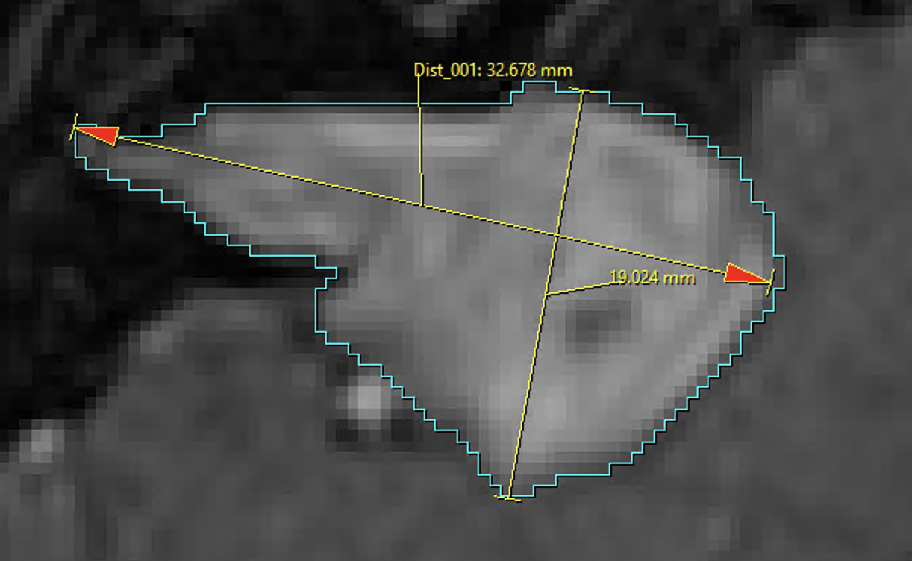
Radiologists need a faster and more accurate tool
Y
Limited Accuracy:
Tumors can have irregular shapes and forms in their structures, making it challenging to accurately assess their size and growth in 2D.
Time Intensive:
A Radiologist has < 10 minutes to review a single MRI
No Longitudinal Comparison:
Radiologists and clinical team struggle to accurately compare the growth of tumors over sequential MRIs
X
Real Patient Tumor Growth: from 2016-2022
Patient Brain Tumor (Year) | Yale Radiologist Report | Our AI Software
2016 | 1.5cm x 2.3cm | 989.9
2017 | 0.9cm x 1.1 cm | 1303.7
2018 | 1.5cmx 2.7cm | 1562.2
2019 | 1.5cm x 2.7cm | 2094.9
2021 | 2.1cm x 3cm | 2699.9
2022 | 1.9cm x 2.9cm | 2987.1
Notes:
There are three limitations to current approach:
FIRST, ACCUARACY. As seen on the figure to the right, the most common approach to measure tumors is called linear measurement, in which you measure the X and Y dimensions on MRI slice..
However, Linear measurement Lacks the ability to assess volume and the true 3D nature of the tumor.
Third, there is no longitudinal comparison between the current MRI and previous MRI reports.
To reinforce this, a patient at Yale School of Medicine was told by radiologists their tumor only minimally changed in size.
Our AI software demonstrated that this tumor tripled in size over the course of six yeas.
Advancements in imaging technologies, computational methods, and the integration of multi-modal approaches aim to overcome these limitations and enhance our ability to assess tumor growth more accurately and comprehensively.

Slide 4
AI breakthroughs have created an unprecedented opportunity for improving the assessment of tumor growth
Market Gap
Clinical Need
Value Added
Inadequacy of Traditional Imaging Techniques
No 3D tumor imaging available on market yet, despite recent tech breakthroughs
Need for Advanced Treatment Planning for Complex Tumors
Diagnostic Confidence to Improve Standard of Care
Rapid, Scalable Treatment Planning with Little Human Input
Early Tumor Detection and Intervention, Saving Lives
Notes:
AI breakthroughs have created an unprecedented opportunity for improving the assessment of tumor growth
Looking at the market GAP
Shifting to Clinical Need
- Need for Advanced Treatment Planning for Complex Tumors
- Diagnostic Confidence to Improve Standard of Care
Finally Value Added
An innovative 3-dimensional tumor assessment tool is imperative for advancing cancer diagnostics and treatment planning. Traditional imaging methods often provide limited insight into the complex spatial relationships within tumors, hindering accurate assessments of size, shape, and interactivity with surrounding tissues. The advent of a 3D tumor assessment tool would revolutionize oncology by offering a more comprehensive understanding of tumor architecture, enabling precise localization of abnormalities, and facilitating personalized treatment strategies. This tool has the potential to enhance early detection, optimize therapeutic interventions, and ultimately improve patient outcomes by providing clinicians with a more nuanced and detailed perspective on the intricacies of tumor biology.
Market Gap:
Inadequacies of Traditional Imaging Techniques: Current two-dimensional imaging methods often fall short in capturing the complete spatial complexity of tumors, limiting the accuracy of assessments. A market gap exists as there is a growing demand for more advanced tools that can provide three-dimensional insights, allowing for a more comprehensive understanding of tumor characteristics and behavior.
Rising Emphasis on Personalized Medicine: With the increasing emphasis on personalized medicine in oncology, there is a significant need for advanced tumor assessment tools that can provide detailed and individualized information about a patient's specific tumor profile. The lack of widely available, sophisticated 3D tools creates a market gap, as healthcare providers seek more precise diagnostic and treatment planning solutions tailored to the unique attributes of each patient's tumor.
Customer Need:
Enhanced Treatment Planning Precision: Customers, including healthcare professionals and patients, have a growing need for innovative 3D tumor assessment tools to improve treatment planning precision. The ability to visualize tumors in three dimensions provides a more accurate understanding of their size, shape, and relationship with surrounding tissues, enabling healthcare providers to develop more targeted and effective treatment strategies tailored to individual patient needs.
Improved Diagnostic Confidence: Customers seek innovative 3D tumor assessment tools to enhance diagnostic confidence. Traditional imaging methods may not fully capture the complexity of tumors, leading to uncertainties in diagnosis. A three-dimensional approach offers a more comprehensive view, aiding healthcare providers in making more confident and informed decisions about the nature of the tumor, potential metastasis, and overall disease progression. This increased diagnostic confidence is crucial for both healthcare professionals and patients facing critical decisions about treatment options.
Value Added:
Precision in Treatment Planning: Innovative 3D tumor assessment tools add substantial value by providing unprecedented precision in treatment planning. The detailed spatial information allows healthcare professionals to tailor interventions with greater accuracy, minimizing collateral damage to healthy tissues and optimizing therapeutic outcomes.
Personalized Patient Care: These tools contribute to the value chain by enabling a more personalized approach to patient care. By offering a comprehensive, three-dimensional understanding of tumors, healthcare providers can tailor treatment regimens to the unique characteristics of each patient's cancer, resulting in more effective and targeted interventions.
Costs/
Optimized Treatment Strategies: Innovative 3D tumor assessment tools contribute to improved outcomes by facilitating the development of highly optimized and individualized treatment strategies. The enhanced understanding of tumor architecture allows for more precise targeting, reducing the likelihood of under- or overtreatment and improving overall therapeutic efficacy.
Early Detection and Intervention: The use of 3D tumor assessment tools enables early detection of subtle changes in tumor morphology, fostering timely intervention. This early detection capability can lead to more successful and less invasive treatment options, ultimately enhancing patient outcomes by addressing malignancies at earlier, more manageable stages.

Slide 5
Our solution improves accuracy and saves time
**
Traditional Model
Dynamic 3D Morphometric Model
Accuracy:
Our Artificial Intelligence (AI) model is 95% accurate to the millimeter
Time:
Tumor models can be developed 5x faster
Clinicians can immediately decide on a treatment plan
Longitudinal Comparison:
Landmarking serial images to evaluate growth over time
Notes:
HIT RIGHT ARROW
Our software outperforms the traditional model.
Our Artificial Intelligence (AI) model is 95% accurate to the millimeter
Tumor models can be developed in 3 minutes
Clinicians can immediately decide on a treatment plan
Landmarking serial images to evaluate growth over time

Slide 6
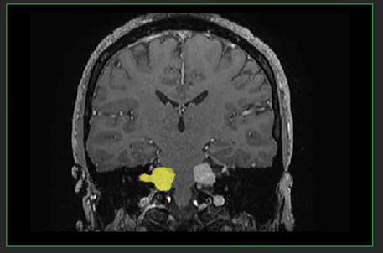
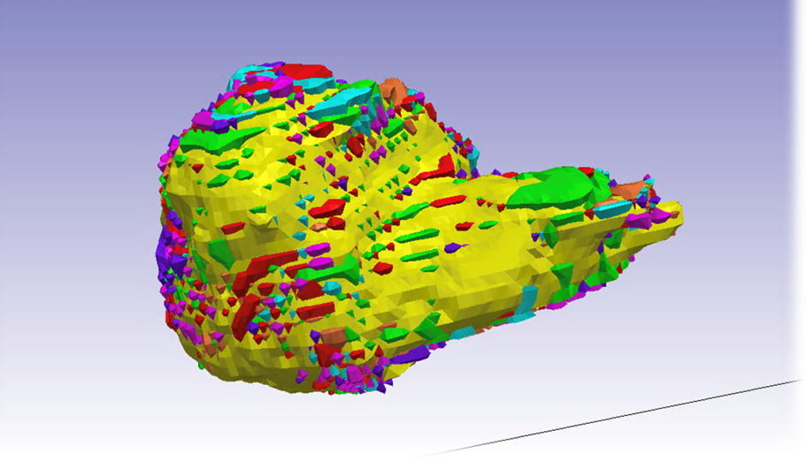
Our solution uses AI to conduct dynamic 3D morphometric tumor analysis
Inputs
Outputs
Stakeholders
Cancer Hospitals
Collect a series of tumor MRI images
Process the images using
our AI algorithm
Model how tumor has changed using morphometric analyses
Strategic Partnerships
IP Status: We are currently developing a patentable system that performs the analysis (working w/Yale Ventures)
Research Institutions
Notes:
So how our software works:
By partnering with cancer advocacy organizations, we collect MRI Images.
From there we process this images into ground truth databases, which builds our AI algorithm.
So that we can create the images you see here.
IP Status: We are currently developing a patentable system that performs the analysis (working w/Yale Ventures)

Slide 7
Our solution outcompetes anything else on the market in quality and accuracy
 | Yale Dynamic 3D Morphometric Analysis |  | CNN, Inc
Artificial Intelligence
Image Processing | 3D | 2D | 2D | 2D
Immediate Evaluation
Tumor Growth Over Time
DICOM Imaging
CNN.inc
Notes:
Our solution outcompetes anything else on the market in quality and accuracy.
We are the only solution that checks all the boxes, and we are the only solution to process images in 3D.

Slide 8
Dynamic 3D Morphometric Analysis has a $1.6B opportunity
# of patients MRI scanned for cancer in US each year | 8.9M
Imaging fee per patient | $8000
Total Addressable Market (TAM) | $72.1B
% of original imaging fees we can charge | 15%
% of cancer patients needing 3D longitudinal monitoring | 50%
Serviceable Addressable Market (SAM) | $5.3B
Estimated percent penetration | 30%
Dynamic 3D's Market Opportunity (SOM) | $1.6B
TAM:
$71.2B
SAM:
$5.3B
Dynamic 3D’s
SOM:
$1.6B
Notes:
Market Opportunity for this software is immense.
On average, 8.9M patients in the US are getting an MRI scanned for their cancerous tumor each year
Based on the average price of a MRI the total market is TAM 71.2 Billion
Based on estimated percent penetration of 30%, a minimum SOM should be 1.6 Billion within this market.

Slide 9
Blavatnik funding will help us deliver our market solution
Science- $120k
Formed Core Team
Image Processing
Sarcoma Data Set
Meningioma Data Set
Obtained NF BioSolutions Grant
Glioblastoma Data Set
Lymphoma Data Set
Obtained YCCI Grant
Algorithm Development - $130k
First AI Generated Tumor Model
Continued Development of Artificial Intelligence
Product Development - $50k
Complete Dashboard Design
Develop MVP
Determine
Regulatory Path
Testing Modality
Present
Q1’24
Q2’24
Q3’24
Q4’24
Q1’25
Q2’25
18 months
Notes:
Blavatnik funding will help us deliver our market solution
By supporting development of two new tumors
- sarcoma
- lymphoma
By refining our artificial intelligence and so we can own our IP. Each tumor AI model will have its own IP. 100 tumors 100 IPS.
By continuing to work with yale ventures business office on product development
Our goal is to actively licensing our technology and creating a start-up over the next 18 months.

Slide 10
Appendix

Slide 11
Our traction and ask
Obtained NF BioSolutions Grant
Obtained YCCI Grant
First AI Generated Tumor Model
Formed Core Team
2021
2022
2023
2023
Spending Category | Spending Amount
1. AI programming for lymphoma | $150,000
2. Hire post-doc for lymphoma dataset | $60,000
3. Hire post-doc for sarcoma dataset | $60,000
4. Consulting radiologist | $30,000
TOTAL: | $300,000

Slide 12
We have thought through several sources of ancillary revenue.
Consultancy services
Providing imaging services for individuals with specific tumors
Direct License
MRI Imaging Companies (e.g., GE Health, Toshiba)

Slide 13
Next cancers we will tackle with our solution:
Next Tumors | Incidence (per 100,000)
1. Lymphoma | 7.8
2. Sarcoma | 2.9
3. Meningiomas | 8.6
4. Glioblastoma | 3.2
5. Adenoma | 7.4

Slide 14
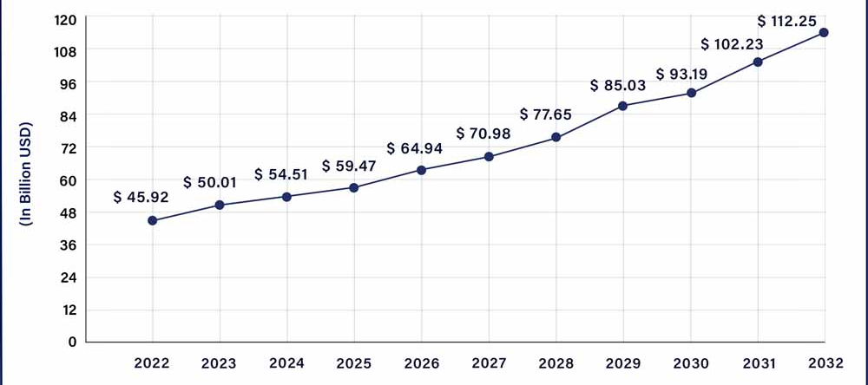
The cancer treatment market is growing.
The market need for imaging analysis tools has been confirmed with high level discussions with GE Healthcare Executive Leadership
Market Growth of Cancer
Compound annual growth rate (CAGR) of 9.40% between 2023 to 2032.
Notes:
Lee/Cortes-Briones, Fetal EEG (https://ventures.yale.edu/yale-technologies/non-invasive-fetal-brain-monitoring) – 0:12-2:25 – Another example of problem/competitive (Standard of Care) wrapped into one and sets up the solution itself. You get to the end of her personal stories and left wondering “well what can be done?”

Slide 15
Our solution is scalable and offers a promising path to revenue and profitability through software licensing.
Healthcare organizations
Academic institutions

