Slide 1
(“ROZIQuMAB”) a ROS1 biologic for invasive cancers
YALE PITCHFEST 2023

Slide 2
ROS1 Antibody Project Team
Daryl E. Klein, MD, PhD
Claudio R. Alarcon, PhD
Lajos Pusztai, MD, DPhil
Associate Professor of Pharmacology
Yale Cancer Biology Institute
Expert structural biology and antibody development
Assistant Professor of Pharmacology
Yale Cancer Biology Institute
Expert in mouse models, genetics and signaling
Professor of Medical Oncology
Yale Cancer Center
Expert Clinical Trialist for breast cancer

Slide 3
Unmet medical need: TREATMENT for Invasive cancers
Opportunity to Target Both Prevalent and Rare Cancers
Few available targeted treatment options for invasive cancers
ILC (Invasive Lobular Carcinoma) is 2nd most common breast cancer (~44K US pts/yr.)
Metastatic, Oral Squamous Cell Carcinoma is the most common cancer of head and neck (~61K US pts/yr.).
Hereditary Diffuse Gastric Cancer (HDGC) is a rare malignancy.
FDA’s Oncology Center of Excellence supports rare cancer (<40K US pts/yr.) programs

Slide 4
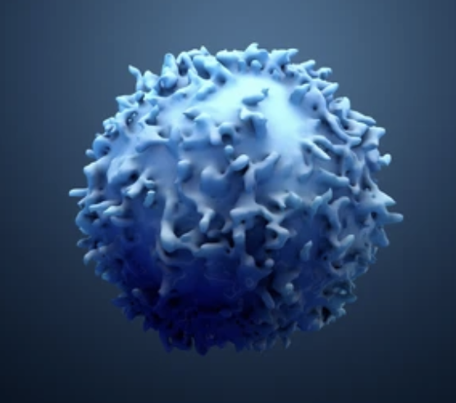
ROS1 A precision target for invasive cancers
Urgent Need for an ROS1-specific Therapeutic
The RTK ROS1 is selectively expressed on the surface of invasive cancers including ILC, HDGC and metastatic SCC
Knockdown or inhibition of ROS1 in invasive cancers leads to cell death
2 clinical trials underway to test efficacy of ROS1 inhibition
-But no specific ROS1 inhibitors available
ROS1-focused clinical trials with non-specific ROS1 inhibitors pave the way for design of ROS1-specific agents
ROS1
Rochester Sarcoma Virus Oncogene
A receptor tyrosine kinase (RTK), similar to other RTK oncogenes (e.g. EGFR, ErbB, HER2 et cetera)
“there are also rare subsets of some more common cancers, such as lung cancer or breast cancer. These subsets can be defined based upon molecular subtype (such as ROS-1 positive lung cancer)” – FDA’s OCE Home Page

Slide 5
Why are there no ROS1 Biologics?
No commercial or pre-clinical ROS1 antibodies available
ROS1 is extremely large and difficult to produce
No structures are available for ROS1, leaving its regulation a mystery
No bone-fide ligand known that stimulates ROS1
No cellular system to study ROS1 activity

Slide 6
Why are there no ROS1 Biologics?
No commercial or pre-clinical ROS1 antibodies available
ROS1 is extremely large and difficult to produce
No structures are available for ROS1, leaving its regulation a mystery
No bone-fide ligand known that stimulates ROS1
No cellular system to study ROS1 activity
Over the past 7 years we have overcome each of these roadblocks
We produced high quality pure ROS1
We solved high resolution structure of ROS1
We solved high resolution structure of ROS1 with ligand bound revealing critical epitopes
We developed the first ROS1 cell-based system

Slide 7
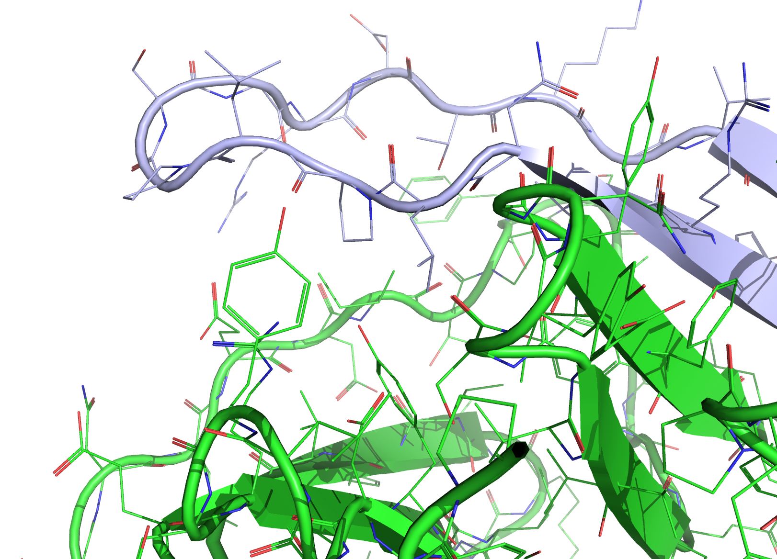
Novel Structural Insights for anti-ROS1 Discovery & Design
High resolution view of ros1
& ros1 bound to activating ligand
Klein Lab – Unpublished Results

Slide 8
A cell-based system to study ros1 activity
Novel Structural Insights for anti-ROS1 Discovery & Design – In Vitro Activity Assay
High resolution view of ros1
& ros1 bound to activating ligand
ligand
Klein Lab – Unpublished Results
Klein Lab – Unpublished Results

Slide 9
Introducing the World’s first ros1 biologic (“ROZIQUMAB”)
Conception to Activity – Yale’s “ROSIQUMAB” Designed for the Clinic
Antibody framework
based on the blockbuster
mAb Herceptin (Trastuzumab)
Target: ErbB2, HER2

Slide 10
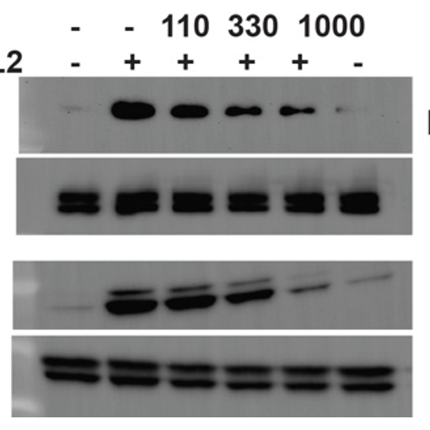
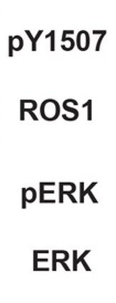
Introducing the World’s first ros1 biologic (“ROZIQUMAB”)
Conception to Activity – Yale’s “ROSIQUMAB” Designed for the Clinic
Rosevix Fab
ligand
Antibody framework
based on the blockbuster
mAb Herceptin (Trastuzumab)
Target: ErbB2, HER2
Klein Lab – Unpublished Results

Slide 11
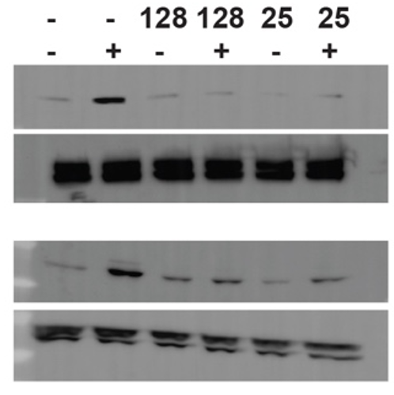
Introducing the World’s first ros1 biologic (ROZIQUMAB)
Conception to Activity – Yale’s “ROSIQUMAB” Designed for the Clinic
Rosevix IgG
ligand
Antibody framework
based on the blockbuster
mAb Herceptin (Trastuzumab)
Target: ErbB2, HER2
Klein Lab – Unpublished Results

Slide 12
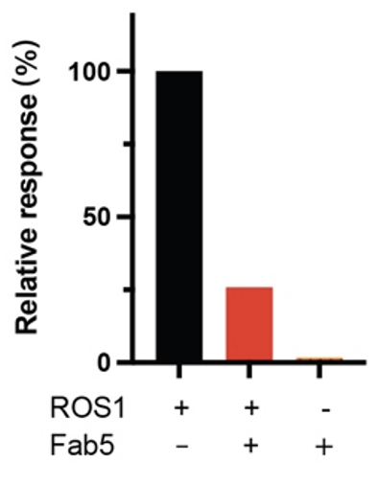
Introducing the World’s first ros1 biologic (ROZIQUMAB)
Conception to Activity – Yale’s “ROSIQUMAB” Designed for the Clinic
Antibody framework
based on the blockbuster
mAb Herceptin (Trastuzumab)
Target: ErbB2, HER2
Mechanism of action
similar to the blockbuster
mAb Erbitux (Cetuximab)
Target: EGFR
Rosevix Fab
Klein Lab – Unpublished Results

Slide 13
Blavatnik support for translation
Translational Support and Deliverables – Setting the Stage for Pre-Clinical Development
Months 1 – 9
Months 9 – 12
ILC mouse
ADC
ILC results
ADC results
Step 1: $100K to enable ILC mouse model study of antibody efficacy
Goal: <9 Months
Step 2: $100K to enable antibody drug conjugate (ADC) ILC mouse model study
Goal: <3 Months from completion of Step 1
Next Steps & Fund-raising/partnership (Goal: 12-18 Months from Blavatnik Funding with Partner/Funding)
Expression Optimization and Scale-up
Pre-IND Meeting
IND-enabling Studies

Slide 14
Current clinical trials with non-selective kinase inhibitors
Based on the extensive preclinical work supporting the therapeutic potential of ROS1 inhibition in E-cadherin deficient cancers, clinical trials are now in Phase II investigating ROS1 inhibitors.
ROLO (NCT03620643) trial will investigate the kinase inhibitor crizotinib (Xalkori®) for invasive lobular breast cancer.
ROSALINE (NCT04551495) trial will investigate entrectinib, a potent ROS1 inhibitor, in combination with letrozole.

Slide 15
Advantages of Biologics over kinase inhibitors
Specificity: Biologics often have higher specificity for their target, reducing the likelihood of off-target effects compared to small molecules.
Reduced Drug Resistance: Biologics may be less prone to resistance mechanisms, such as mutation of the target kinase, a common issue with small molecule inhibitors.
Lower Toxicity: Due to their specificity, biologics can have lower general toxicity, improving patient tolerance and quality of life.
Modifiable Properties: Biologics can be engineered to have desired properties like longer half-life or enhanced tissue penetration.
Multiple Mechanisms of Action: Biologics can be designed to act through various mechanisms (e.g., antibody-drug conjugates (ADC), CAR-T), whereas small molecules usually have a single mode of action.
Immunomodulatory Effects: Some biologics can modulate the immune system to enhance anti-cancer effects, a feature not typically seen with small molecules.
Large Targets Accessibility: Biologics can target large and complex proteins that are difficult for small molecules to interact with effectively.

