Slide 1

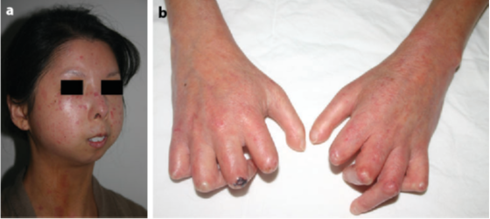

Biotherapeutic for Systemic Sclerosis (SSc)
(Tmem273)
Raymond Johnson, M.D., Ph.D. Yale Physician Scientist / Mucosal Immunologist
300,000 Americans have SSc
Highest mortality rheumatologic disease
Standard-of-care lymphotoxic drugs: [not effective]
Stem cell transplantation (AHST): [effective but 10% associated mortality]
SSc = progressive scarring of skin and internal organs including lungs (breathing), esophagus (eating), kidney (dialysis), and heart (living).
Affected individuals slowly scar themselves to death due to pathologic CD8γ13 T cells.
Notes:
Examples:
ConsultUS (https://ventures.yale.edu/pitch/consultus-your-digital-addiction-consultants) –0:32 – 1:31
Medzhitov, Inflammatory (https://ventures.yale.edu/pitch/identify-new-class-therapeutics-inflammatory-diseases) – 0:30-2:17
Lee/Cortes-Briones, Fetal EEG (https://ventures.yale.edu/yale-technologies/non-invasive-fetal-brain-monitoring) – 0:12-2:25

Slide 2

What is Tmem273?
Biomarker on CD8γ13 T cells… for eliminating CD8γ13 T cells
  Identified 10 years ago
  At that time, a hypothetical protein of unknown validity or function
Notes:
Tran, MIF – D-DT (https://ventures.yale.edu/yale-technologies/bispecific-mif-d-dt-targeting-enhance-immunotherapy-responses) – 0:15-0:36
Manifest (https://ventures.yale.edu/yale-technologies/manifest-technologies-inc) – 0:45-1:00

Slide 3
Team
Saga Yale
Saga Bio, Inc. formed in May of 2022, headquartered in BioLabs New Haven.

Slide 4

Moving Quickly
Since 2022 we successfully:
(1) Formed Saga Bio, Inc.
(2) Humanized anti-human Tmem273 mAb (the drug)
(3) Murinized an anti-mouse Tmem273 mAb (the animal model)
(4) Did preliminary mouse toxicology: no overt toxicity
(5) SSc sort/RNAseq human experiment that supports the CD8γ13 biomarker
Notes:
Tran, MIF – D-DT (https://ventures.yale.edu/yale-technologies/bispecific-mif-d-dt-targeting-enhance-immunotherapy-responses) – 0:15-0:36
Manifest (https://ventures.yale.edu/yale-technologies/manifest-technologies-inc) – 0:45-1:00

Slide 5
THE OPPORTUNITY
SSc demographics from:
Curr Opin Rheumatol. 2020 May; 32(3): 228–237 Rheumatology (Oxford). 2021 Jul; 60(7): 3121–3133
300,000 patients (US)
Based on US healthcare claims, 23% of SSc patients are on lymphotoxic drugs.
Tmem273 depleting Ab is a direct competitor for lymphotoxic drugs.
33% market = ~25,000 US patients with ~1000 new patients every year.
Lymphotoxic drugs are neither safe nor effective.
Market Modeling
“real IMT” = lymphotoxins
[Rheumatol Ther (2020) 7:89–99]
Humira®-for-SSc (but safer)
  $30,000⁺/yr/pt = Annual revenue >$900 million per year (US)
Notes:
Examples:
ConsultUS (https://ventures.yale.edu/pitch/consultus-your-digital-addiction-consultants) – Problem setup 0:32 – 1:31
Medzhitov, Inflammatory (https://ventures.yale.edu/pitch/identify-new-class-therapeutics-inflammatory-diseases) – 0:30-2:17
Lee/Cortes-Briones, Fetal EEG (https://ventures.yale.edu/yale-technologies/non-invasive-fetal-brain-monitoring) – 0:12-2:25

Slide 6
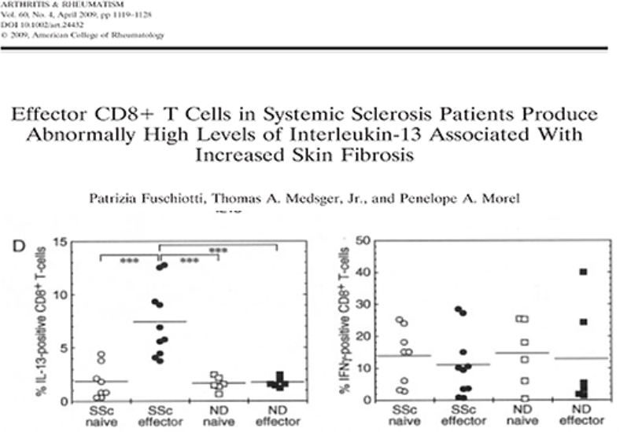
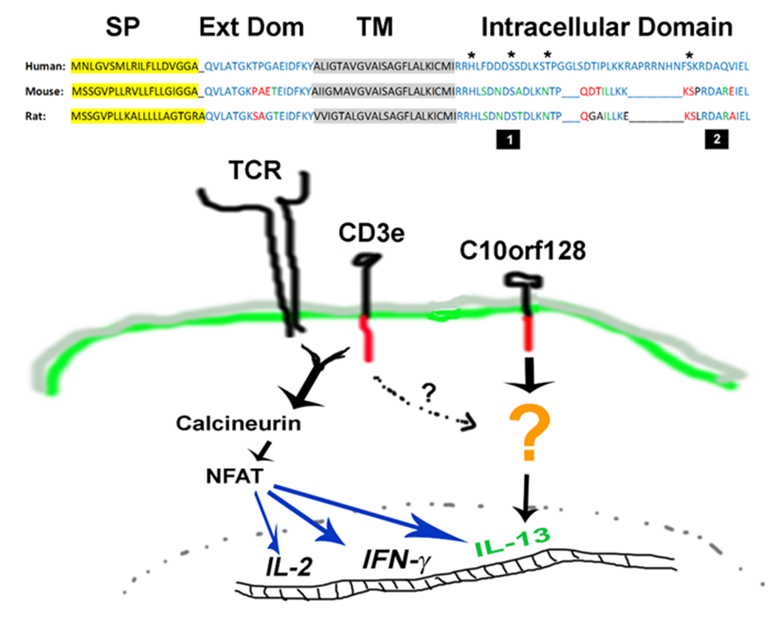

LOT OF SCIENCE- listen don’t read
Johnson lab:
Tmem273 = CD8γ13
J Infect Dis. 2020 May 11;221(11):1895-1906
(5)
(1)
(3)
Humanized and Murinized Tmem273 mAbs
(patent application pending)
Original paper identifying CD8 T cells producing IL-13 as likely cause of SSc Arthritis Rheum 2009 Apr;60(4):1119-28.
(6)
Toxicology
murinized Tmem273 mAb (patent pending)
(2)
(4)
Johnson lab:
Chlamydia specific CD8γ13:
Immunology. 2014 Jun;142(2):248-57.
Johnson lab:
Tmem273 mAbs
&
IL-13 in CD8γ13
(patent application pending)
SSc treatment strategy:
Deplete pathologic CD8γ13 with humanized Tmem273
monoclonal antibody.
Notes:
Examples:
ConsultUS (https://ventures.yale.edu/pitch/consultus-your-digital-addiction-consultants) – Problem setup 0:32 – 1:31
Medzhitov, Inflammatory (https://ventures.yale.edu/pitch/identify-new-class-therapeutics-inflammatory-diseases) – 0:30-2:17
Lee/Cortes-Briones, Fetal EEG (https://ventures.yale.edu/yale-technologies/non-invasive-fetal-brain-monitoring) – 0:12-2:25

Slide 7

COMPETITIVE LANDSCAPE
Agent | Safety | Efficacy | Tolerability | Acquisition cost/yr (generic)
Methotrexate* | fair | fair-poor | good | (~$200)
Mycophenolate* | fair | fair-poor | fair | (~$200)
Rituximab | good | fair | good | $10,000/dose (2-4 doses per yr)
Tocilizumab | fair | fair-poor | good | $5000/month
CD8γ13 depletion (anti-Tmem273) | [good] | [excellent] | [good] | $30,000/yr
* Excluding safety monitoring labs. Generic cost from mail order pharmacy website (HealthWarehouse.com) [ ] efficacy is theoretical based on depletion of pathologic T cells driving SSc disease. Safety and tolerability based on single mouse experiment in the setting of an infection without any obvious adverse effect.
Competitive advantages:
  1st in class therapeutic agent
  Likely Safe
Strength/Weakness - Highly novel target/validation underway
Notes:
Examples:
ConsultUS (https://ventures.yale.edu/pitch/consultus-your-digital-addiction-consultants) – Problem setup 0:32 – 1:31
Medzhitov, Inflammatory (https://ventures.yale.edu/pitch/identify-new-class-therapeutics-inflammatory-diseases) – 0:30-2:17
Lee/Cortes-Briones, Fetal EEG (https://ventures.yale.edu/yale-technologies/non-invasive-fetal-brain-monitoring) – 0:12-2:25
A few questions you could ask yourself, among others:
Who are your competitors?
Are they local, regional, national or global?
Are there any product alternatives to your product?
What about their IP / technological advantage?

Slide 8
ANIMAL MODEL
  Preclinical mouse model to demonstrate safety and biologic effect of CD8γ13 depletion
  Largest item in upcoming BUDGET
  Chlamydia not the right model
  Murine Chronic Asthma Model:
  (1) Already exists [J Immunol 2004; 172:2549-2558]
  (2) CD8γ13 T cells drive lung pathology
  (3) CD8γ13 depletion predicted to have dramatic biologic effect
  (4) Identifies a second larger patient group who would logically benefit from anti-Tmem273 therapy
Notes:
Examples:
ConsultUS (https://ventures.yale.edu/pitch/consultus-your-digital-addiction-consultants) – Problem setup 0:32 – 1:31
Medzhitov, Inflammatory (https://ventures.yale.edu/pitch/identify-new-class-therapeutics-inflammatory-diseases) – 0:30-2:17
Lee/Cortes-Briones, Fetal EEG (https://ventures.yale.edu/yale-technologies/non-invasive-fetal-brain-monitoring) – 0:12-2:25

Slide 9
BUDGET
Components
(IP) Sequencing Tmem273 mAbs [already have mAb] $8,000
(Safety/Efficacy) Affinity determination (Grn Mtn Antibodies) $18,000
(Safety/Efficacy) Affinity maturation of mouse mAb [if needed] (GenScript) $60,000
(Safety/Efficacy) Ab production (conventional / recombinant) $35,000
(Efficacy) Murine chronic asthma depletion model $100,000
(Efficacy) SSc clinical investigation with Dr. Hinchcliff $30,000
        Total>>>>>>>>>>>>> >>> $251,000
Humanized h6G1, in its current form, is the depleting biologic that would go into humans
18 months 6 months 12 months
Phase I human clinical trial
FT = fast track
Preclinical toxicology Production & FT FDA IND
Notes:
Examples:
ConsultUS (https://ventures.yale.edu/pitch/consultus-your-digital-addiction-consultants) – Problem setup 0:32 – 1:31 – the problem setup is great, and particularly like 1:30-2:00 where the solution is described to fit into the problem
Medzhitov, Inflammatory (https://ventures.yale.edu/pitch/identify-new-class-therapeutics-inflammatory-diseases) – 0:30-2:17 – both setup and introduction the solution is good, in both problem and solution Medzhitov simplifies for the audience so they can understand a highly scientific/mechanistic solution
Lee/Cortes-Briones, Fetal EEG (https://ventures.yale.edu/yale-technologies/non-invasive-fetal-brain-monitoring) – 0:12-2:25 – Another example of problem/competitive (Standard of Care) wrapped into one and sets up the solution itself. You get to the end of her personal stories and left wondering “well what can be done?”

