Slide 1
Overcoming TKI-resistance by Targeting a Novel Epigenetic Mechanism in Oncogene Amplification
Short-term Goal: Targeting a novel epigenetic mechanism in TKI-resistant lung cancers, overcoming the common bottleneck for current therapeutics.
Long-term Goal: Apply this technology to other tumors that developed resistance to therapies, e.g. melanoma, prostate, glioma, pancreatic and breast cancers.
Solution: Developing a series of PROTAC compounds against this target (in progress).
Opportunity: A first in class target.
Notes:
Tran, MIF – D-DT (https://ventures.yale.edu/yale-technologies/bispecific-mif-d-dt-targeting-enhance-immunotherapy-responses) – 0:15-0:36
Manifest (https://ventures.yale.edu/yale-technologies/manifest-technologies-inc) – 0:45-1:00

Slide 2
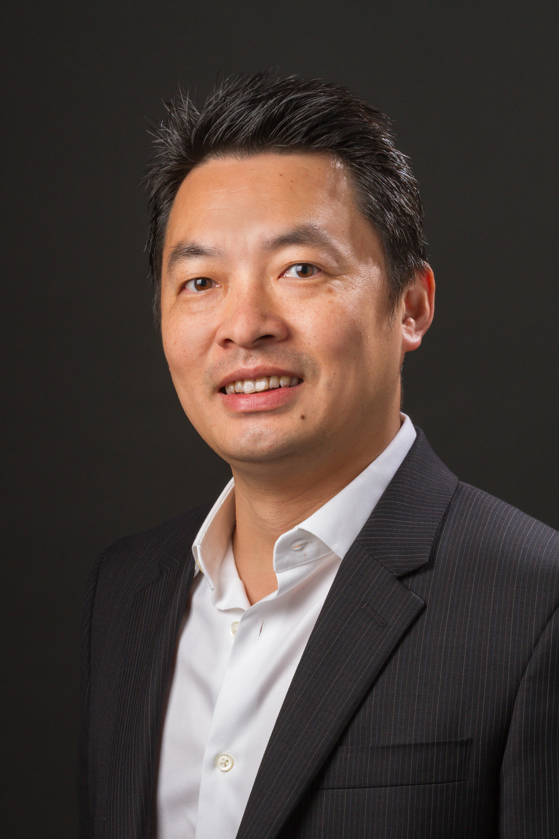
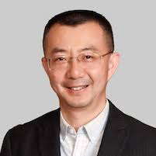
TEAM
Andrew Xiao, Ph.D(Yale)
Founder
Expertise:
Epigenetics
Cancer Biology
Stem cells and regenerative medicine
Jian Jin, Ph.D (MSSM)
Founder
Expertise:
Chemical biology
PROTACs and small chemical inhibitors
Entrepreneur

Slide 3
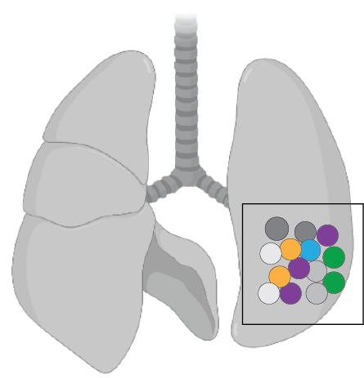
Overcoming TKI-resistance
The unmet need:
~100% resistance/relapse
Bottleneck: oncogene heterogeneity
oncogene amplicon 1
oncogene amplicon 2
oncogene amplicon 3
oncogene amplicon 4…..
Our Solution:
a novel, universal mechanism
controlling all amplicons.
Target: a protein complex specific for
the oncogene amplicons
Versality of PROTAC targeting
the whole complex.
Advantages:
multiple targets
robust “KO”
avoid off-target effects
a novel epigenetic complex
Notes:
Examples:
ConsultUS (https://ventures.yale.edu/pitch/consultus-your-digital-addiction-consultants) –0:32 – 1:31
Medzhitov, Inflammatory (https://ventures.yale.edu/pitch/identify-new-class-therapeutics-inflammatory-diseases) – 0:30-2:17
Lee/Cortes-Briones, Fetal EEG (https://ventures.yale.edu/yale-technologies/non-invasive-fetal-brain-monitoring) – 0:12-2:25

Slide 4
Overcoming TKI-resistance by targeting a novel epigenetic complex/factor
Osi:
No
+
P<2.2x10⁻¹⁶
WT
NS
Target
removed
genetically
Notes:
Examples:
ConsultUS (https://ventures.yale.edu/pitch/consultus-your-digital-addiction-consultants) – Problem setup 0:32 – 1:31
Medzhitov, Inflammatory (https://ventures.yale.edu/pitch/identify-new-class-therapeutics-inflammatory-diseases) – 0:30-2:17
Lee/Cortes-Briones, Fetal EEG (https://ventures.yale.edu/yale-technologies/non-invasive-fetal-brain-monitoring) – 0:12-2:25

Slide 5
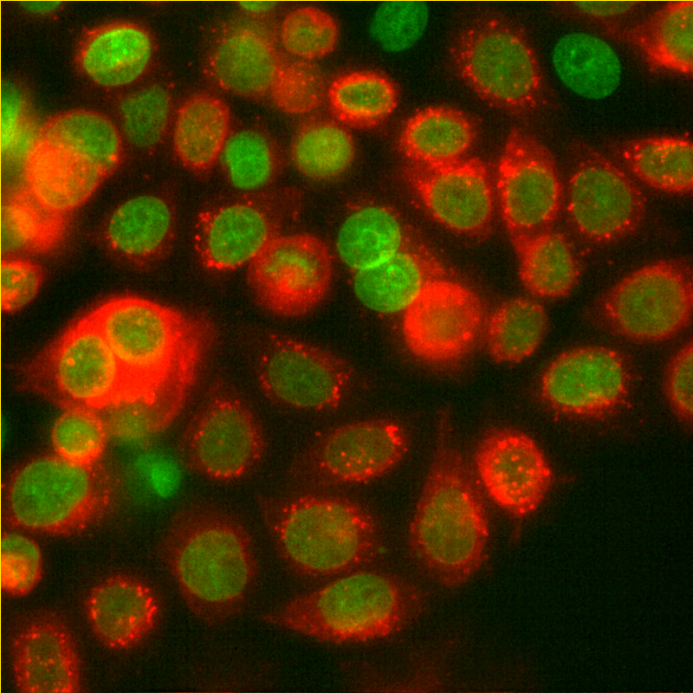
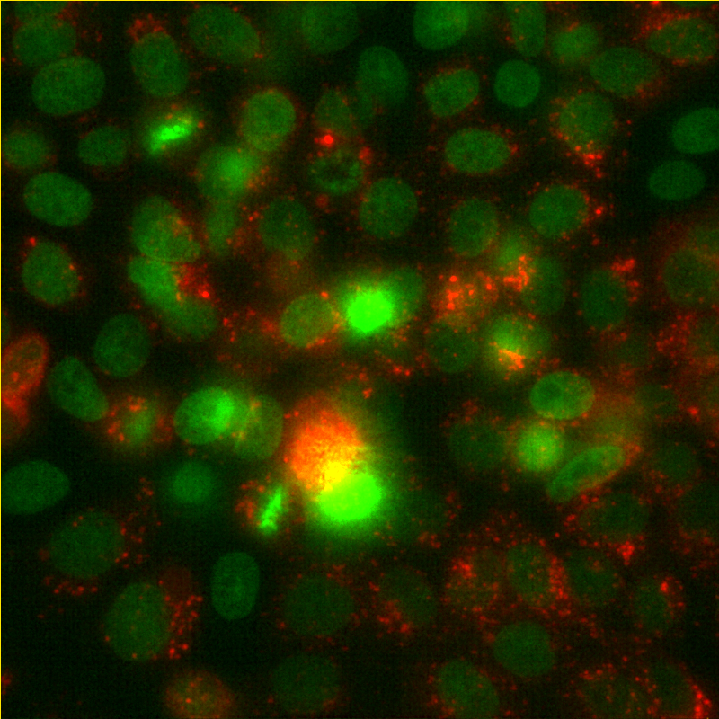
Developing Protacs against the novel target
Conditions:
compounds at 1uM
~20 hours
Target=red
protein level via live imaging
control
+PROTAC
Notes:
Examples:
ConsultUS (https://ventures.yale.edu/pitch/consultus-your-digital-addiction-consultants) – Problem setup 0:32 – 1:31
Medzhitov, Inflammatory (https://ventures.yale.edu/pitch/identify-new-class-therapeutics-inflammatory-diseases) – 0:30-2:17
Lee/Cortes-Briones, Fetal EEG (https://ventures.yale.edu/yale-technologies/non-invasive-fetal-brain-monitoring) – 0:12-2:25

Slide 6
BUDGET/MILESTONES
Year 1: 100K
Year 2 (100K)
Goals:
Identify lead compounds
Test efficacy in patient-derived cells
Budget:
70K Medicinal Chemistry, CRO
30K in-house, 0.25 FTE and reagents
Milestones:
1-5 compounds with efficacy at levels <1uM in vitro
Goals:
Improve lead compounds for in vivo use
Test efficacy PDX mouse models
Budget:
70K Medicinal Chemistry, CRO
130K PDX Mouse Models
Milestones:
identify lead compounds for in vivo use
Notes:
Examples:
ConsultUS (https://ventures.yale.edu/pitch/consultus-your-digital-addiction-consultants) – Problem setup 0:32 – 1:31
Medzhitov, Inflammatory (https://ventures.yale.edu/pitch/identify-new-class-therapeutics-inflammatory-diseases) – 0:30-2:17
Lee/Cortes-Briones, Fetal EEG (https://ventures.yale.edu/yale-technologies/non-invasive-fetal-brain-monitoring) – 0:12-2:25

Slide 8
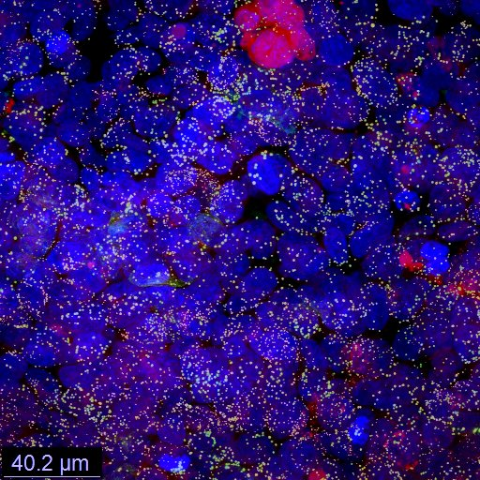
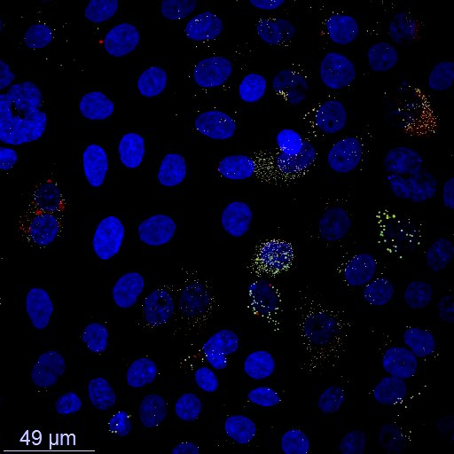
A biomarker for screen the target & evaluate PROTAC efficiency
An easy assay to test biomarker (two hours, $0.3 per sample):
Target
removed (24 hours)
WT
Notes:
Examples:
ConsultUS (https://ventures.yale.edu/pitch/consultus-your-digital-addiction-consultants) – Problem setup 0:32 – 1:31
Medzhitov, Inflammatory (https://ventures.yale.edu/pitch/identify-new-class-therapeutics-inflammatory-diseases) – 0:30-2:17
Lee/Cortes-Briones, Fetal EEG (https://ventures.yale.edu/yale-technologies/non-invasive-fetal-brain-monitoring) – 0:12-2:25

