Slide 1
EverShield: committed to protection over the long term
Our company: EverShield
Our vision: Long-acting, biodegradable implants for reproductive health and other applications
Venture Overview
November 2023

Slide 2
EverShield: committed to protection over the long term
The need:
Surgical sterilization (vasectomy or tubal ligation) is among the most popular method of male and female contraception in the US, despite the availability of other options.
Many individuals who are HIV positive are taking frequent medications to stay healthy.
Individuals at risk of HIV exposure are taking daily medications—or monthly injections—for pre-exposure prophylaxis (PrEP).
Many common reproductive health issues require chronic dosing of medications, and could benefit from long-acting drug delivery systems (i.e. endometriosis).
Beyond reproductive health, there are many potential applications for long-acting drug release including: intraocular therapy for glaucoma or macular degeneration, intra-articular administration for osteoarthritis, intrathecal administration for chronic pain, etc.

Slide 3
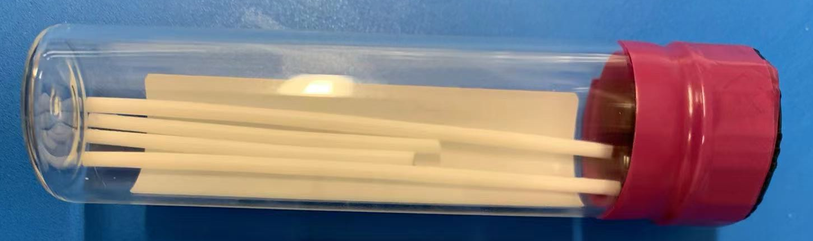
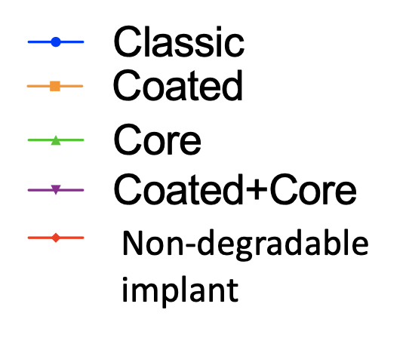
EverShield: committed to protection over the long term
The solution:
We have developed a tunable technology for reproducible, long-acting release of agents from a safe and degradable polymer implant, compatible with a range of APIs with different properties.
We have demonstrated the pre-clinical effectiveness of this technology for the administration of contraceptive steroids and anti-retrovirals.
API release (ug/day)

Slide 4





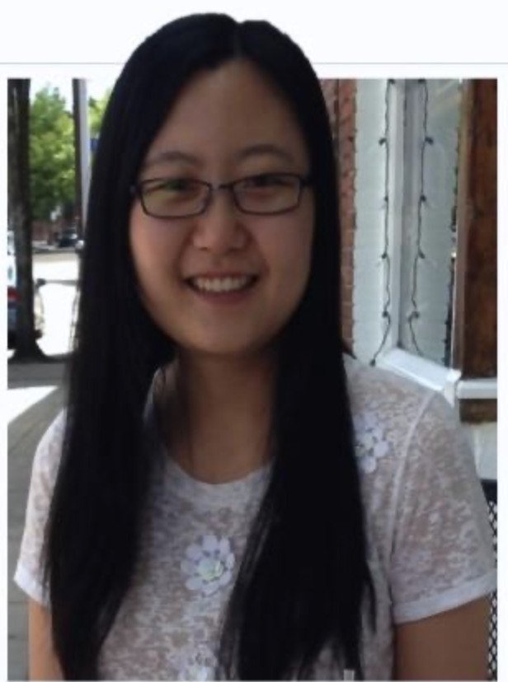

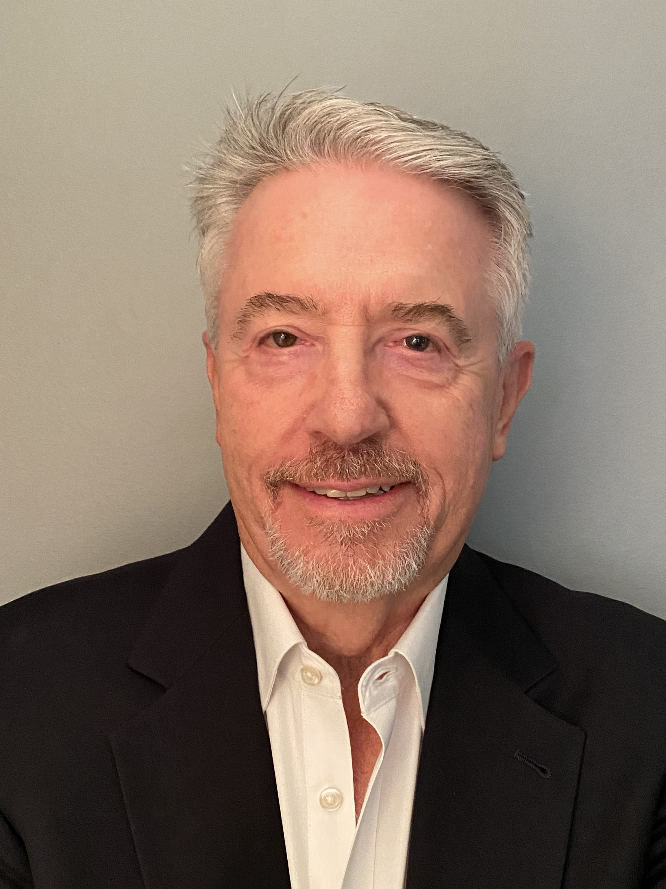
EverShield: committed to protection over the long term
The team:
Mark Saltzman
Goizueta Foundation Professor of Chemical and Biomedical Engineering
Jennifer Ayres, Ph.D.
Director, Pharmaceutical Development
Bruce Cao, Pharm.D.
Pharmaceutical Consultant
Gregory Kopf, Ph.D.
Director, Research & Development
Fan Yang
Research Associate in Biomedical Engineering

Slide 5
EverShield: committed to protection over the long term
What have we accomplished so far:
We have established the feasibility of implants from a novel degradable polymer with exceptional, unique properties for long-term delivery.
We have an issued patent (U.S. 11,766,400) describing our use of this polymer for long-acting implants, with elements of design to control release rate and duration.
With partners, we have developed scalable methods for polymer synthesis and implant manufacturing.
With consultants, we have completed an Integrated Product Development Plan, which suggest low risk for toxicology testing, with clear milestones for further development.
We now seek to develop this technology for testing in human clinical trials, to make it available to the communities that would benefit.

Slide 6
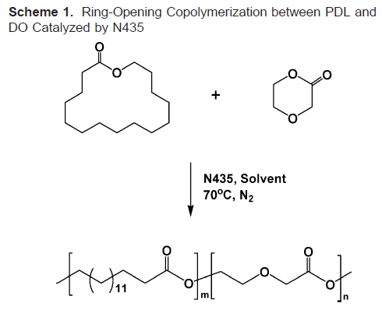
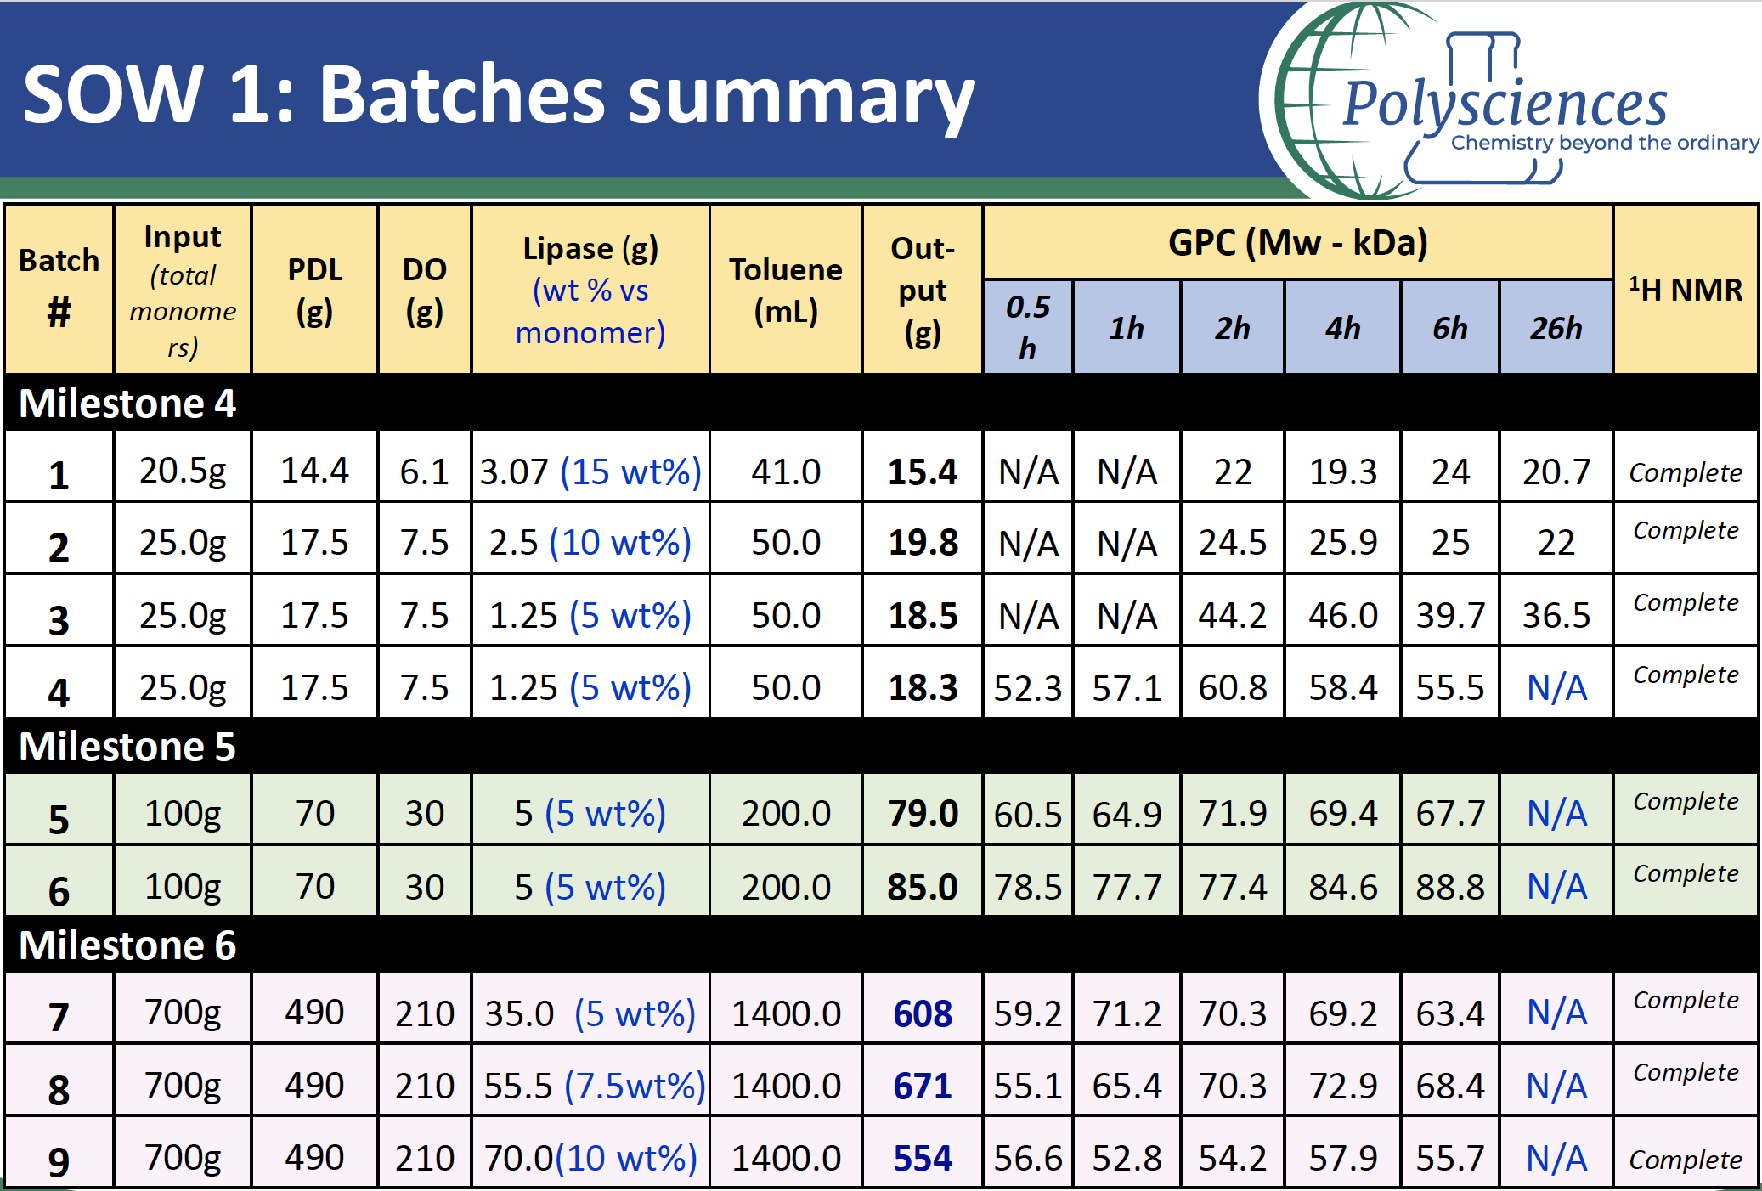
EverShield : committed to protection over the long term
Scale-up of the technology:
Unique properties of this co-polymer:
Enzyme-catalyzed synthesis
Degradable to safe components
Slow degradation
Semi-crystalline over entire composition range

Slide 7
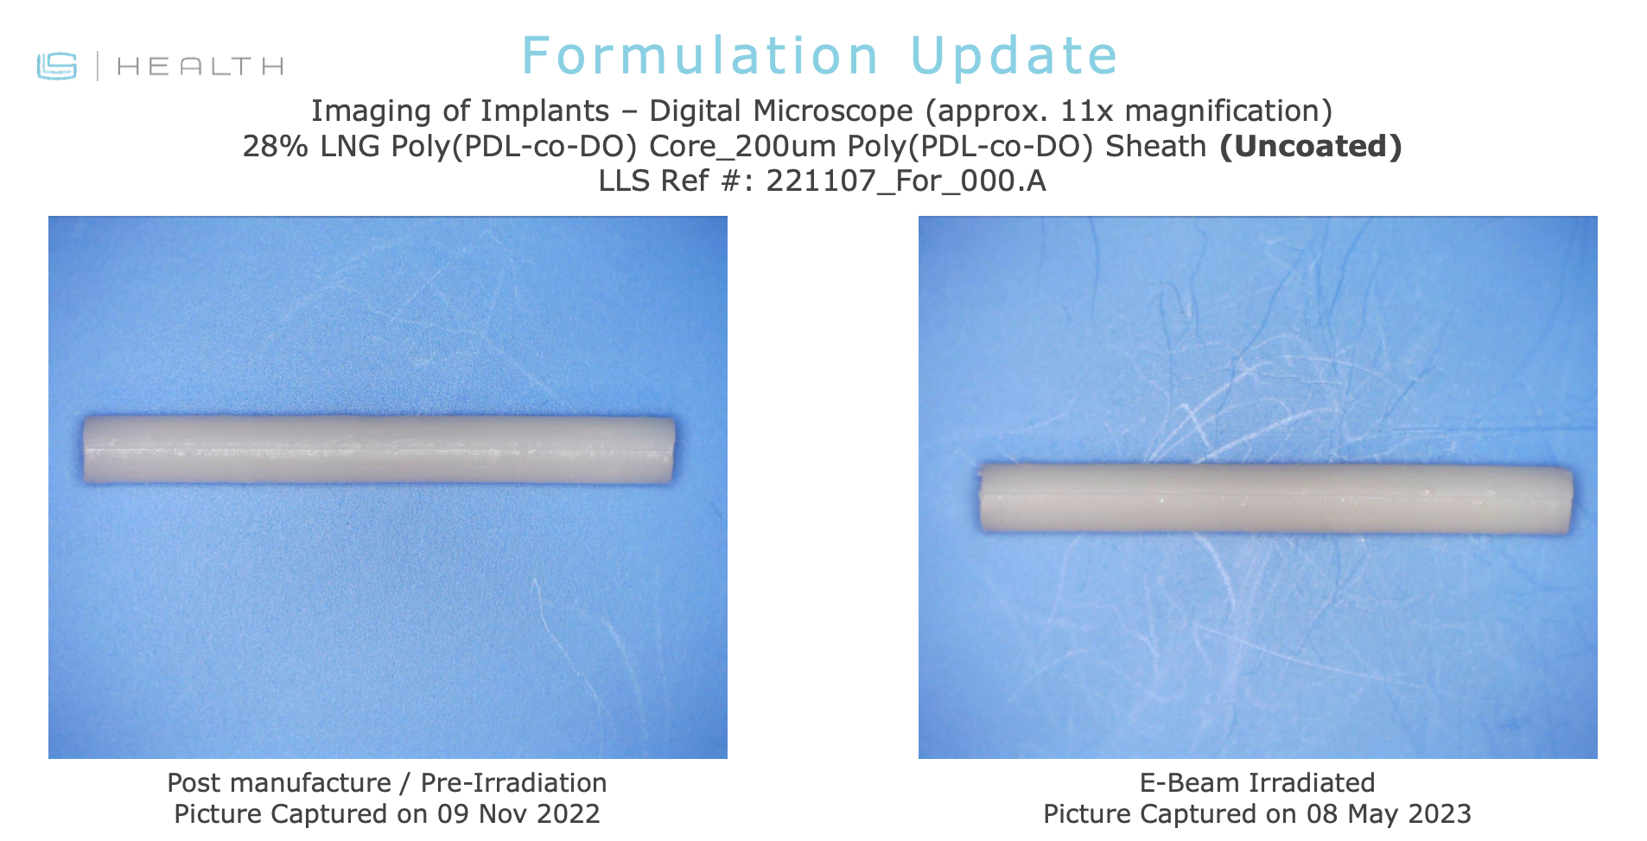
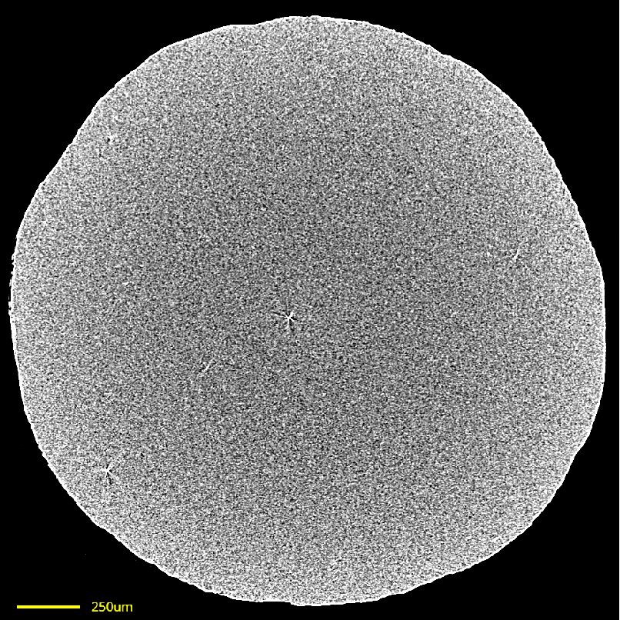
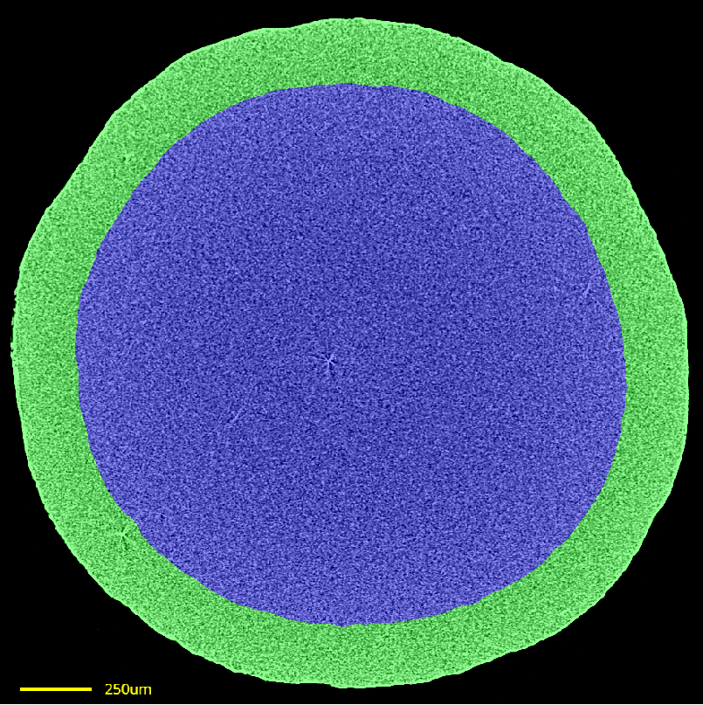
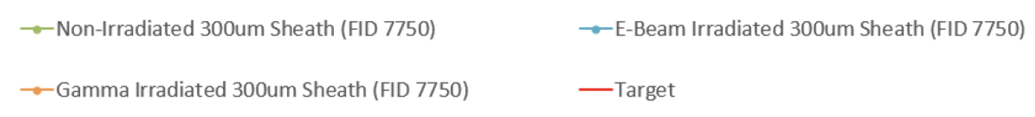
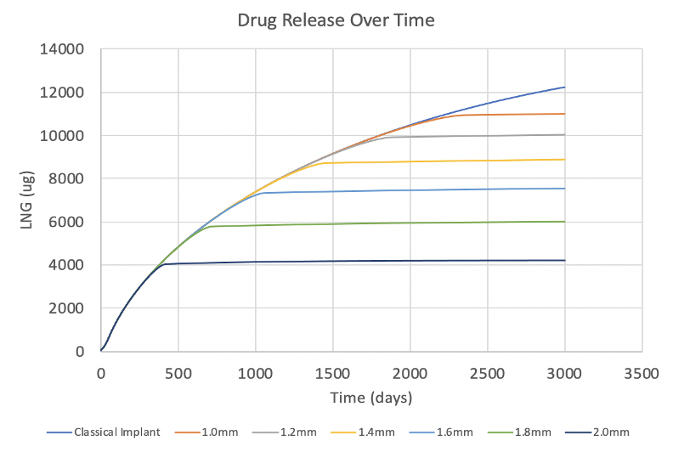
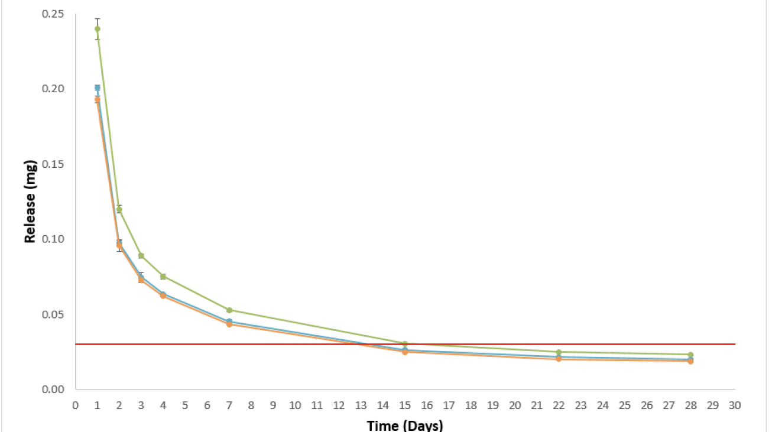
EverShield : committed to protection over the long term
Refinement of the technology:
Manufacturing of implants (Lubrizol) using a scalable process
Confirmation of properties by advanced imaging (DigiM)
Core
Sheath
Resolution = 2.82 µm
Confirmation of release characteristics from manufactured, sterilized implants
Control of release duration by core-sheath structure
Mean daily LNG release (mg)

Slide 8
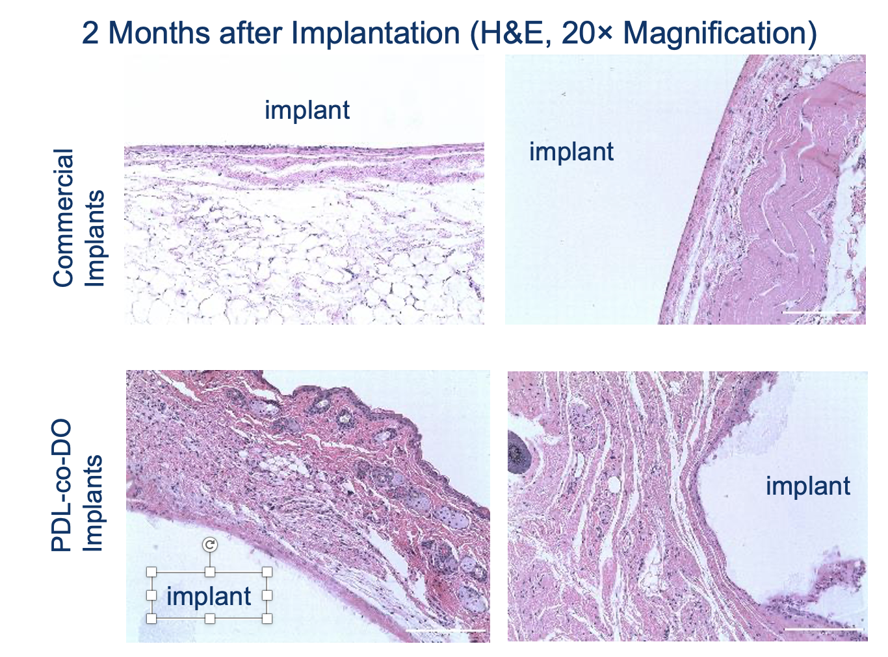
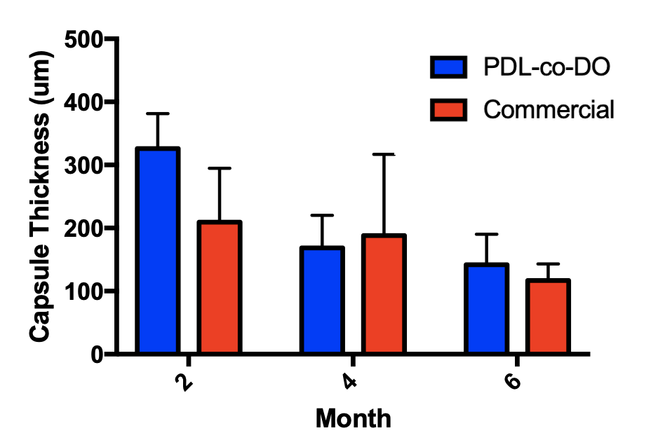
EverShield : committed to protection over the long term
The implants are well-tolerated, long-acting, and mechanically strong:
Non-degradable implant
200µm
200µm
200µm
200µm
Image of extruded implants after 5 month of dissolution at 50 °C (comparable to ~18 month at 37°C)

Slide 9
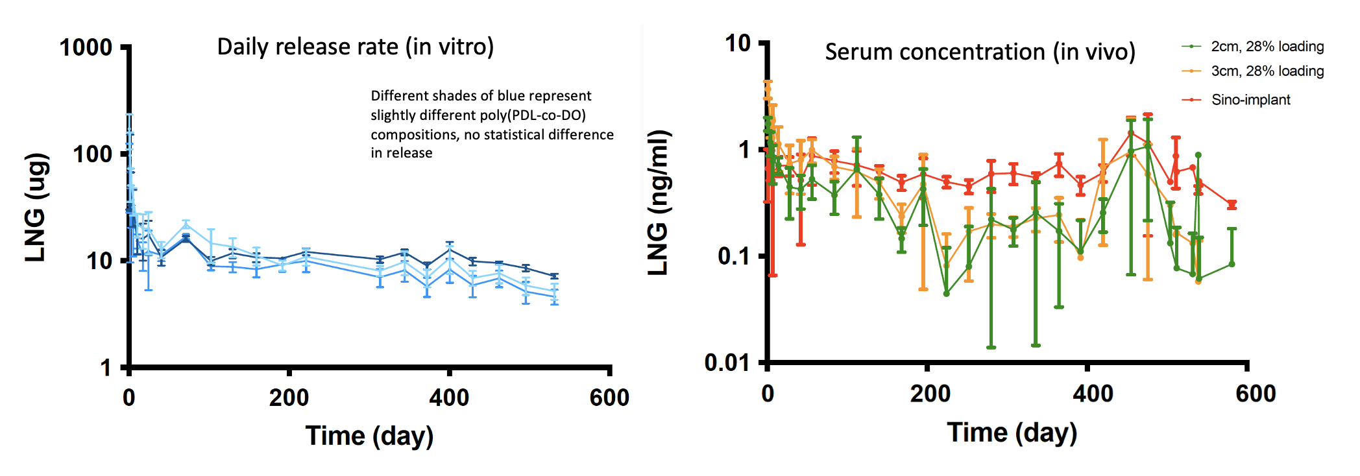
EverShield : committed to protection over the long term
Preclinical example 1
Levonorgestrel (LNG) release from our implants is sustained over time, with good in vitro: in vivo correlation

Slide 10
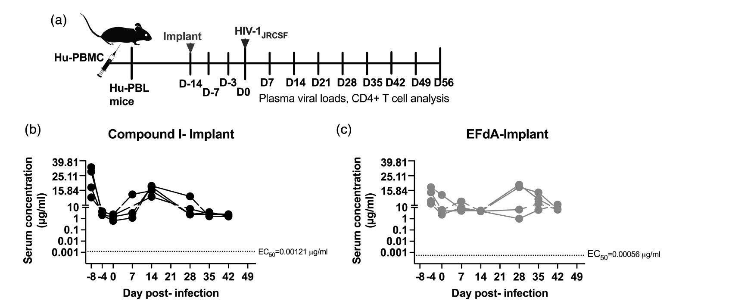
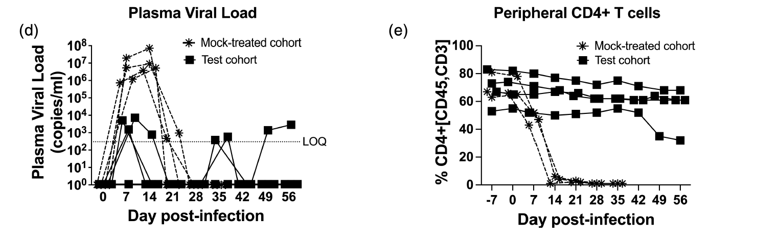
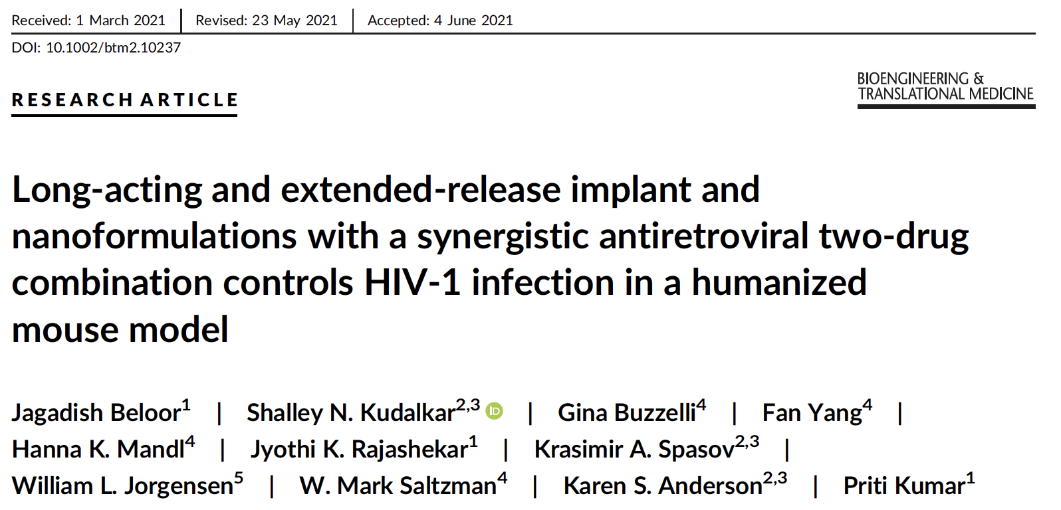
EverShield : committed to protection over the long term
Preclinical Example 2
Anti-retroviral agents are released from our implants over sustained periods with promising results in humanized mice
Demonstration of platform potential of the technology

Slide 11









EverShield : committed to protection over the long term
Evidence that we have a unique solution, which should be of interest:
Degradability
Non-degradable, medium-acting (1-6 month)
Degradable, short-acting (1-3 month)
Estring®, first approved by US FDA in 1996
Menopausal symptoms
Gliadel®, first approved by US FDA in 1996 Glioblastoma
Nuvaring®, first approved by US FDA in 2001
Contraception
Durysta®, first approved by US FDA in 2020
Glaucoma
LiRIS®, acquired in 2019
Cystitis
SCENESSE®, first approved by US FDA in 2019
Light sensitivity
SINUVA®, first approved in 1987
Nasal polyps
Non-degradable, long-acting (>1 year)
Norplant®, first approved in Finland in 1993
Contraception
EverShield
Long-acting, degradable implants
Jadelle®, approved by US FDA in 1996
Contraception
Duration
Nexplanon®, approved by US FDA in 2006
Contraception
Yutiq®, first approved in 1963 Uveitis
A wide range of conditions are addressable, including eye disease, hormone replacement, cancer, chronic pain.

Slide 12



EverShield: Market Overview
CAGR during forecast period to 2027²
$13.2B
6-8%
$10B
Use implants as their primary contraceptive method¹
$2.5B
3.5M
Of providers offer contraceptive implants to patients
Total Addressable Market
Expected U.S. drug delivery implant market size by 2027 ¹
Serviceable Available Market
Including intraocular applications and other long-acting therapies
Serviceable Obtainable Market
U.S. market for long-acting contraceptive implants
87%
Sources:
“A Review of Manufacturing Techniques for Subcutaneous Drug Delivery Implants.” Procedia CIRP, Elsevier, 8 July 2022
Global Implantable Drug Delivery Market, Strategic Research Solutions
Prepared with Sreesha Sivakumar, Yale Blavatnik Fellow.

Slide 13
EverShield : committed to protection over the long term
The ask:
Based on feedback from a Type C meeting with the FDA:
We propose to conduct GLP biocompatibility/toxicity testing on the LNG biodegradable implant
Testing will be conducted on materials manufactured during a second feasibility batch at Lubrizol
Testing will include cytotoxicity, intracutaneous irritation, sensitization, acute systemic toxicity, material-mediated pyrogenicity, and subacute/sub-chronic systemic toxicity.
To accomplish this, we estimate that we need:
$50,000 for scaled polymer synthesis at Polysciences
$100,000 for scalable co-extrusion of implants at Lubrizol
$100,000 for biocompatibility/toxicology assessment at a CRO
$50,000 for project management and tech transfer assistance at Yale/FHI360

Slide 14
EverShield : committed to protection over the long term
Thank You!

Slide 15
EverShield : committed to protection over the long term
Supplemental Material

Slide 16
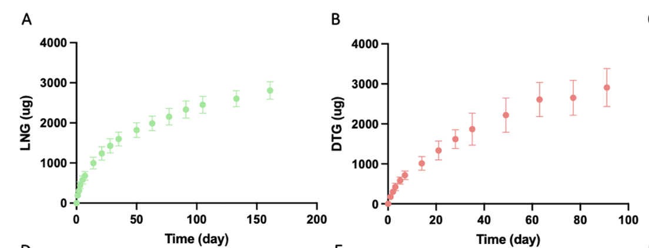
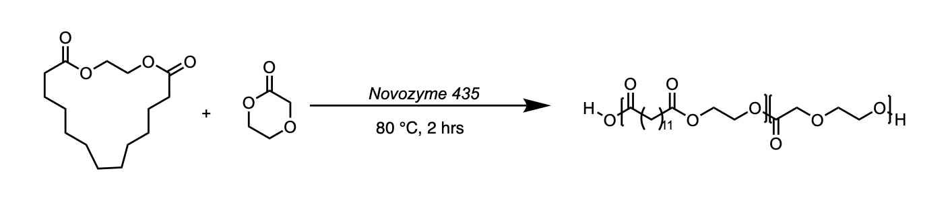
EverShield : committed to protection over the long term
Alternate polymers, poly(EB-co-DO), and agents
Degradable co-polymer with ethylene brassylate, a sustainable monomer

