Slide 1
Identification of small molecules tuning phase transitions to treat neurological disorders Christian Schlieker, MB&B
My Lab has studied congenital disorders caused by mutations in nuclear envelope proteins for > 10 years, with a focus on Dystonia and related movement disorders
We defined molecular defects, identified biomarkers, and established cellular pathology for DYT1 dystonia, the most severe and most common form of dystonia

Slide 2
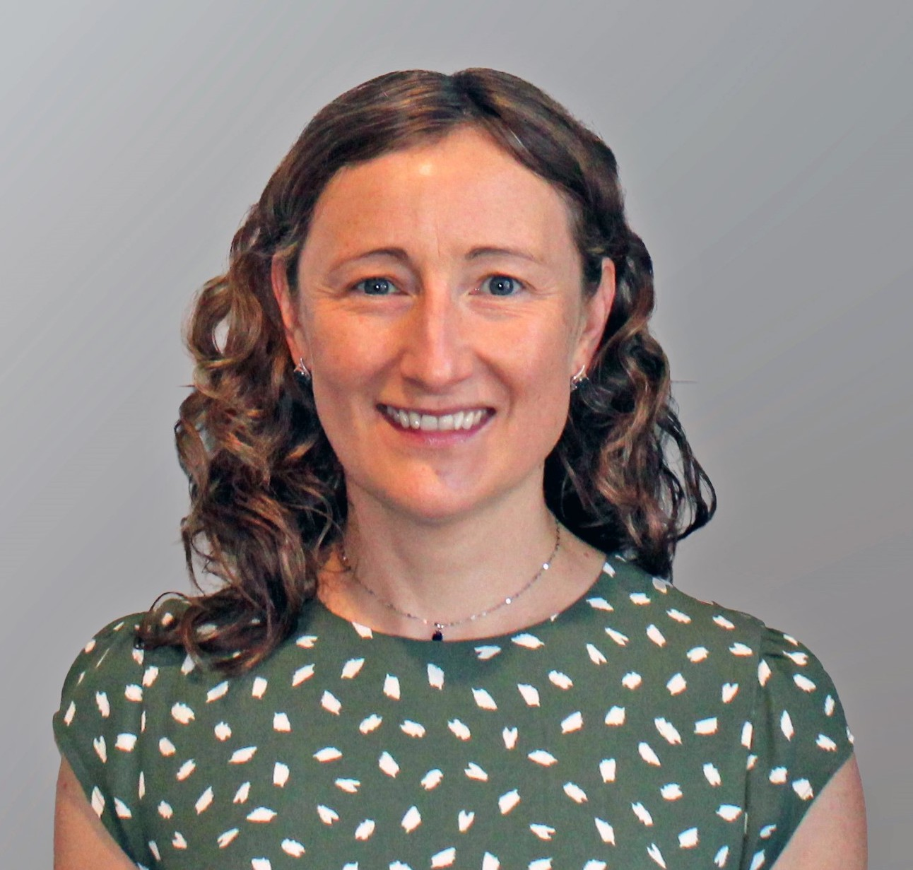
Research Team spanning HTS, MedChem and in vivo expertise
Christian Schlieker, PhD
Professor of Molecular Biophysics
and Biochemistry; Cell Biology
Dystonia Medical Foundation Advisory Board; Dystonia (journal) Ed. board
Member, Clinical Trial Neurological Disorders review panel (DOD/CDMR)
Dylan Poch, BSc (Chem)
PhD candidate
Schlieker Lab
Pioneered HTS pipeline
Yulia Surovtseva, PhD
Director, Yale Center for Molecular Discovery (YCMD)
Longstanding Expertise in HTS
Further support through Med. Chemistry expert at YCMD
Anthony Koleske, PhD
Professor of Molecular Biophysics
and Biochemistry
Professor of Neuroscience
Collaborator for primary neuron
models/mouse models
Yale Ventures contact: David Lewin, PhD david.lewin@yale.edu

Slide 3
PROBLEM / INDICATION
Dystonia is the third most frequent movement disorder
affecting ~250,000 US citizens
The most genetically prevalent form of dystonia (DYT1 dystonia) is
highly debilitating: spasms, twisted postures, involuntary contractions

Slide 4
What is the opportunity?
Global prevalence of Dystonia is 16.43 / 100,000 (Mov Disord (14):1789-96) with a drug market estimated at $1 billion by 2028 with > 5% compound annual growth rate.
For DYT1, a drug may qualify under the orphan drug act
“Standard of care” (Botox/Deep brain stimulation) is inadequate w/ significant side effects
Drugs we seek to develop:
Need to be taken over decades for therapeutic benefit
Likely have utility for a wider range of neurodegenerative disorders (e.g. Huntington’s)

Slide 5
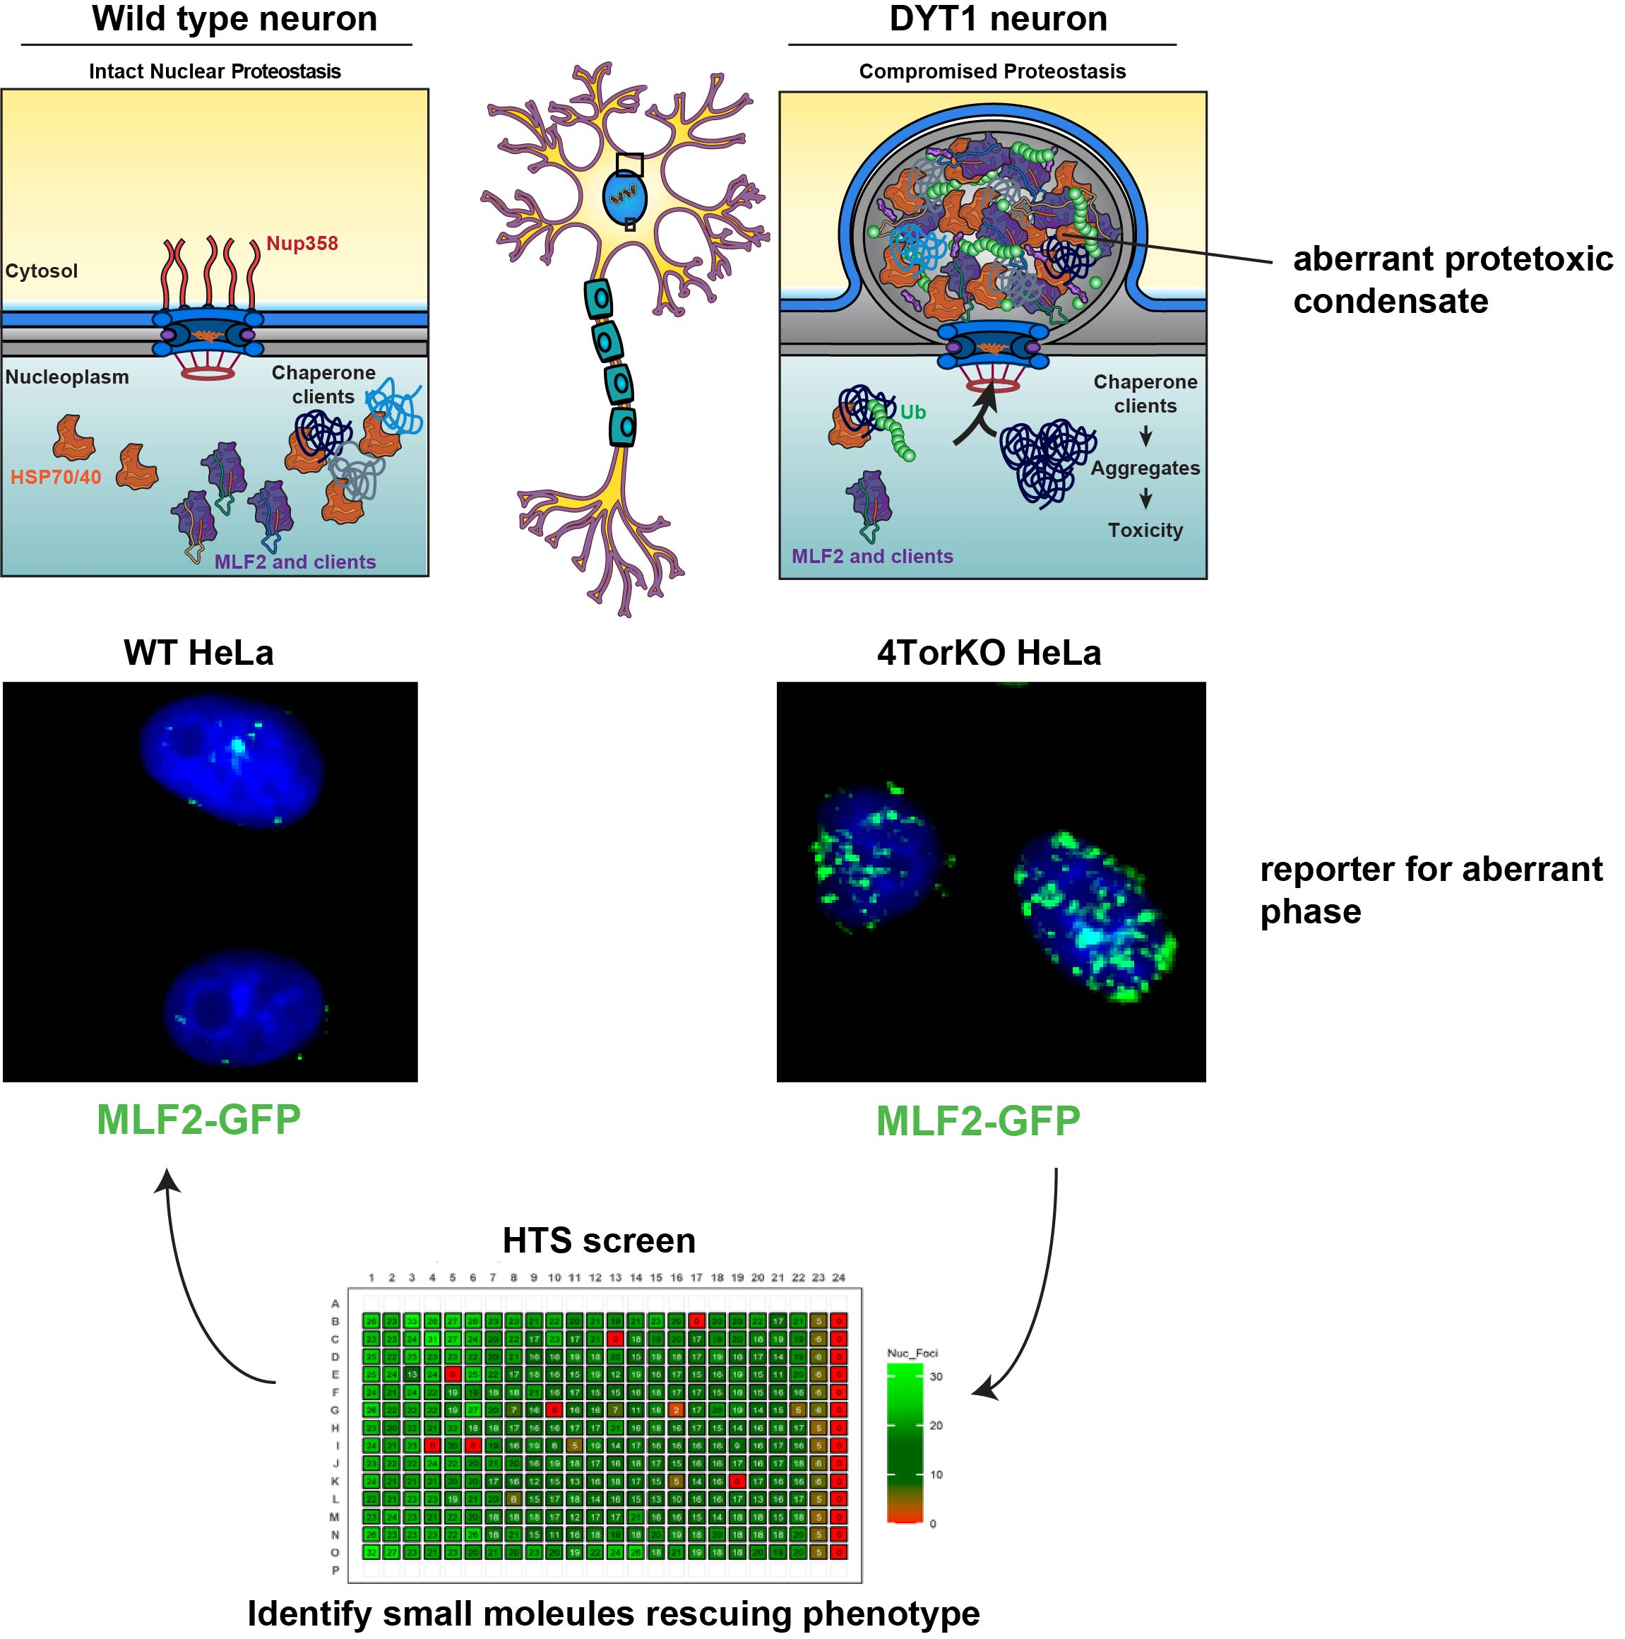
Discovering small molecule therapeutics to prevent disease onset or modulate severity
Advantage:
Unbiased/phenotypic screens are proven to be more successful than target-directed screens for first-in-class new drugs, accounting for 7 out of 8 FDA-approved drugs in the clinic for neurological disorders

Slide 6
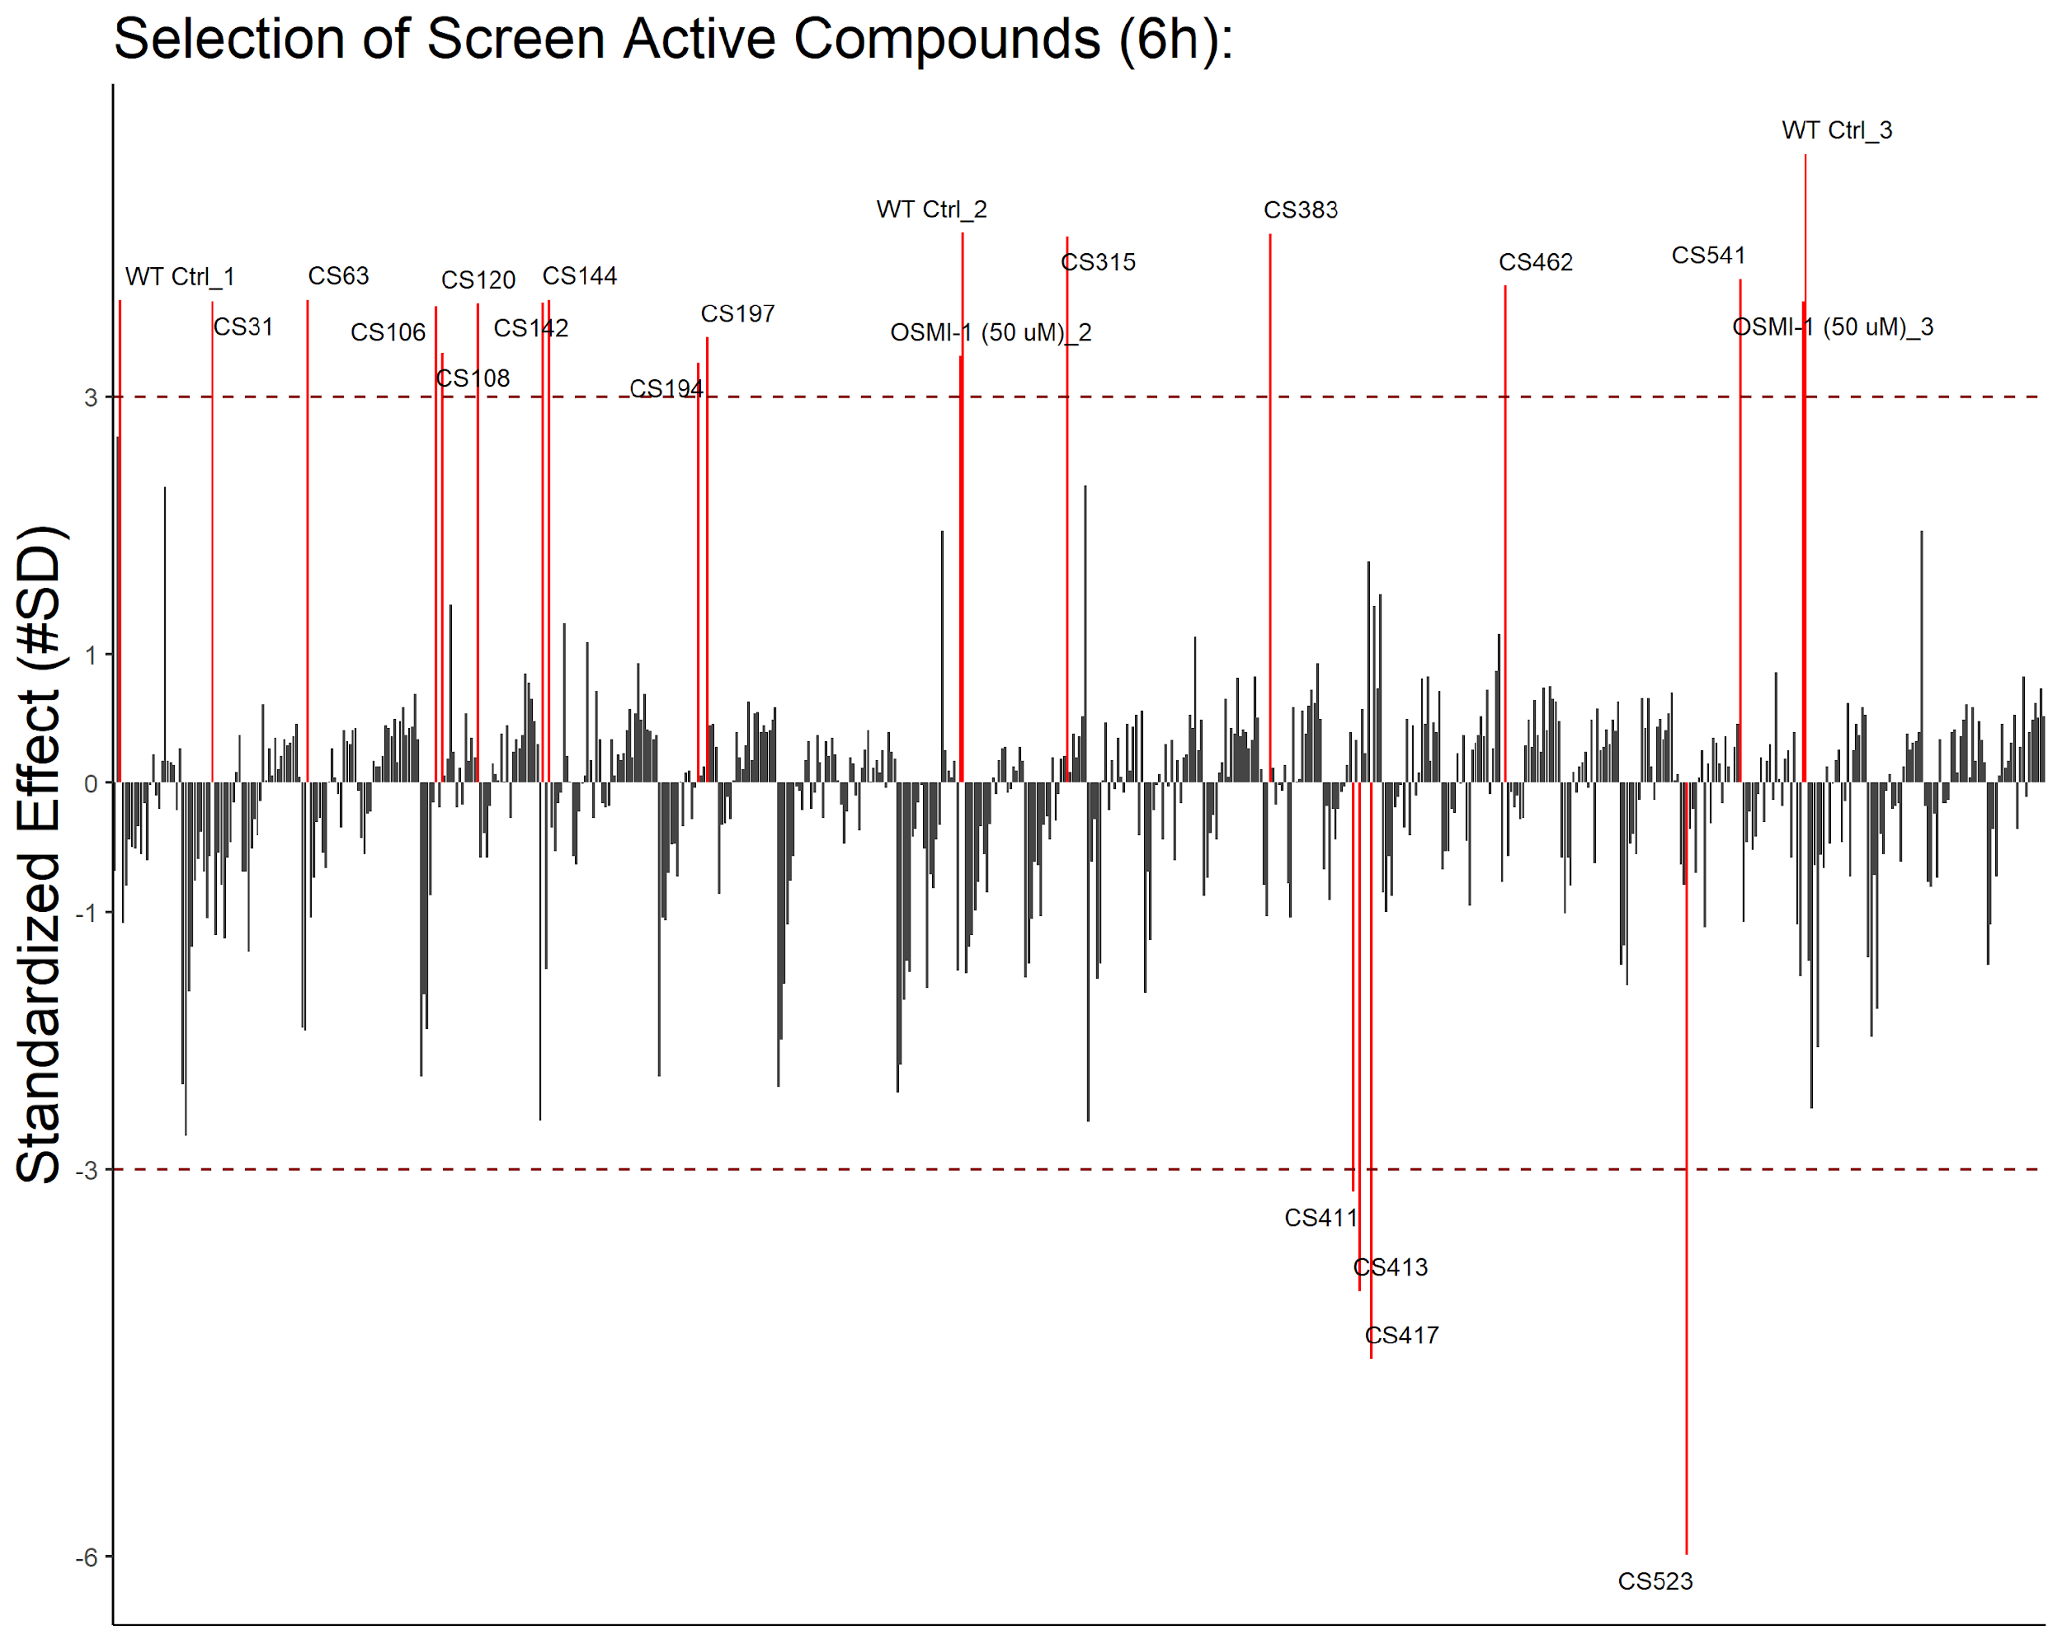
Successfully completed a pilot screen of FDA-approved drugs
robust pilot screen established - shovel-ready for HTS!
Target Identification efforts will include:
DARTS (Drug Affinity Responsive Target Stability)
TPP (Thermal Proteome Profiling)
Biotin-tagged affinity pulldowns and mass spectrometry
parallel, genome-wide CRISPR/Cas9 screens
validated to support ongoing target ID/MOA
efforts (supported through $2M grant support)
Z’ score = 0.78
High chemical diversity - most candidates Tanimoto similarity coefficient < 0.4
Notes:
Figure: The standardized values of the % effect of each normalized compound. Red labeled lines indicate compounds that passed our screening threshold (± 3 SD).
Structures: 6 of the compounds we are following up. All show high chemical diversity and decrease MLF2-GFP foci (except Vinblastine that increases it)
May want to mention the OGT inhibitor as a pharmacological control if it comes up.

Slide 7
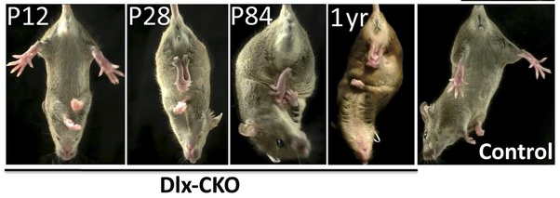
Animal Models for DYT1 dystonia recapitulate phenotypes
Dlx5/6-Cre⁺;Tor1a^{flx/−} mice
Pappas et al., eLife https://doi.org/10.7554/eLife.08352

Slide 8
MILESTONES and use of funds
Phase Ia (6 months, $80k)
Phase Ib (6-12 months, $20k)
Phase II (200k)
Validate screen-active
compounds in cells
Determine efficacy
Expand pilot screen to
50,000 Compounds
Source & validate hits,
clustering/SARs
Establish dose/response & toxicity
in cell-based Dystonia disease model
Determine if leads can rescue
cellular pathology in neurons
Perform functional assays in cells and in vitro
Validate in established animal model
Milestones 6 mo
Milestones 12 mo
Goal:
Complete large-scale screen
& validate screen actives
Goal: validate hits reducing cellular
pathology in neurons
Validated first-in-class lead(s) to treat dystonia & related disorders

Slide 9
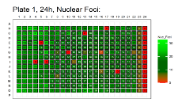
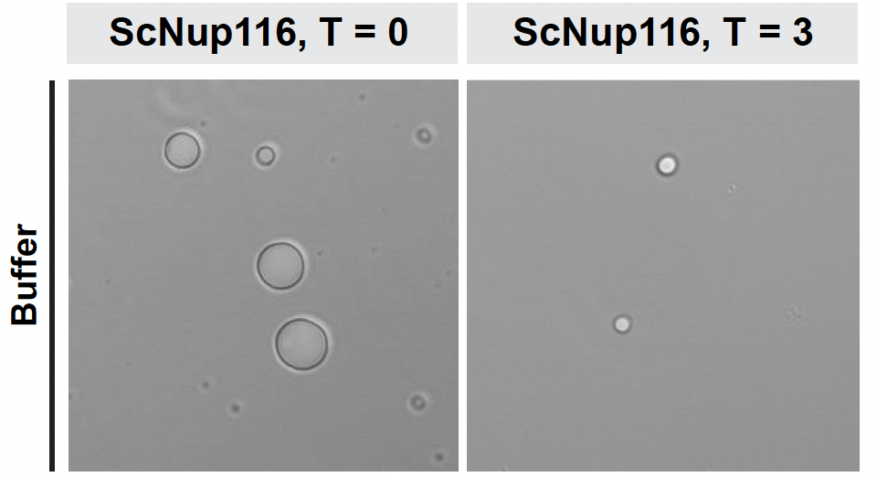
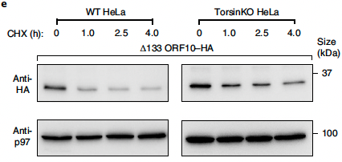
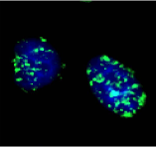
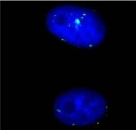
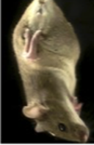
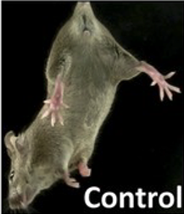
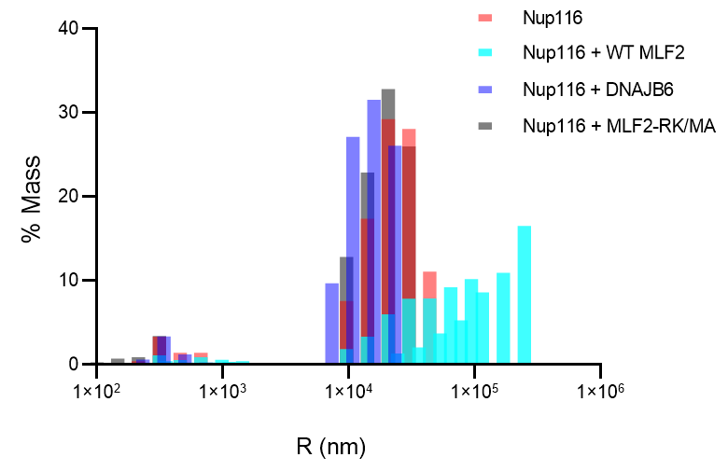
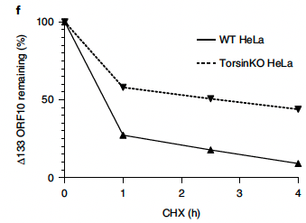
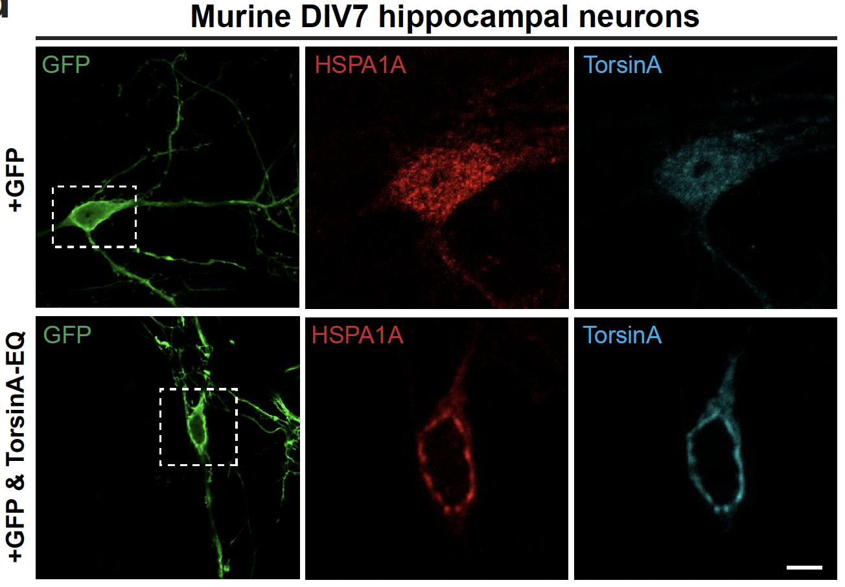
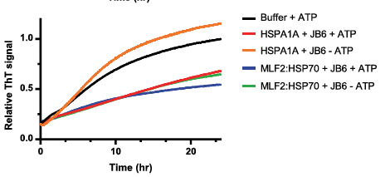
Validation and follow-up in cells, in vitro, and animals
Validate screen-actives:
3) Functional assays:
Prevention of nucleoporin aggregation
or amyloid formation?
Restoration of nuclear quality control?
1) dose response, toxicity using original assay
?
4) Mitigation of dystonic
symptoms in mouse model?
?
b
DLS
?
2) Restoration of chaperone localization in neurons?
?
?
Final Goal:
orally bioavailable drug
?
Thioflavine fluorescence
?
For details see:
Prophet et al. Nature Cell Biol 2022*
*Note: most assays can be done in multi-well format

Slide 10
Why now?
v
Until recently, the cellular pathology of Dystonia was poorly understood, and no reliable biomarkers existed
Unlike previous studies narrowly focused on pathways related to Dystonia mutations in single models, our approach targets conserved, fundamental phenotypes across Dystonia models.
We identified MLF2 and DNAJB6 as groundbreaking Dystonia biomarkers. Their chaperone and reporter activity provide a cutting-edge system for precision monitoring of phase transitions within cellular and in vitro environments (see our Nature Cell Biology Paper, Prophet et al. 2022)
Phase transitions have recently emerged as drivers for many neurological disorders including ALS and Huntington’s - our strategy timely addresses an unmet need to modulate these transitions for therapeutic application

Slide 11
Key Publications from our lab
Key publications from my lab of relevance to this proposal:
Definition of molecular defect underlying primary (DYT1) dystonia:
Zhao et al. PNAS 2013
Brown et al. PNAS 2014*
*editorially highlighted by Nature Structural and Molecular Biology
Identification of biomarkers and cellular defects
Laudermilch et al. MBoC 2016
Rampello et al. J Cell Biol 2020
Discovery of aberrant phase separation/proteotoxicity as key driver for cellular pathology
Prophet et al. Nature Cell Biol 2022*
*editorially highlighted by NCB and Movement Disorders

Slide 12
Competitive Landscape
v
 | DBS | BOTOX | Investigative Candidate drug
Geographically Unrestricted access:
Sustained & prolonged treatment:
Non-invasive:
Curative:

Slide 13
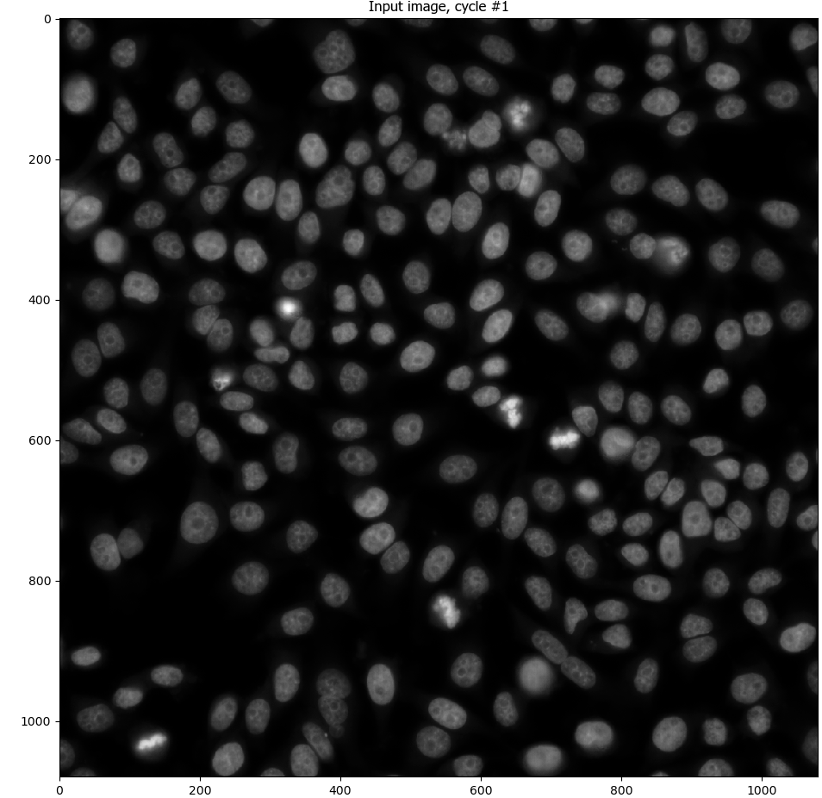
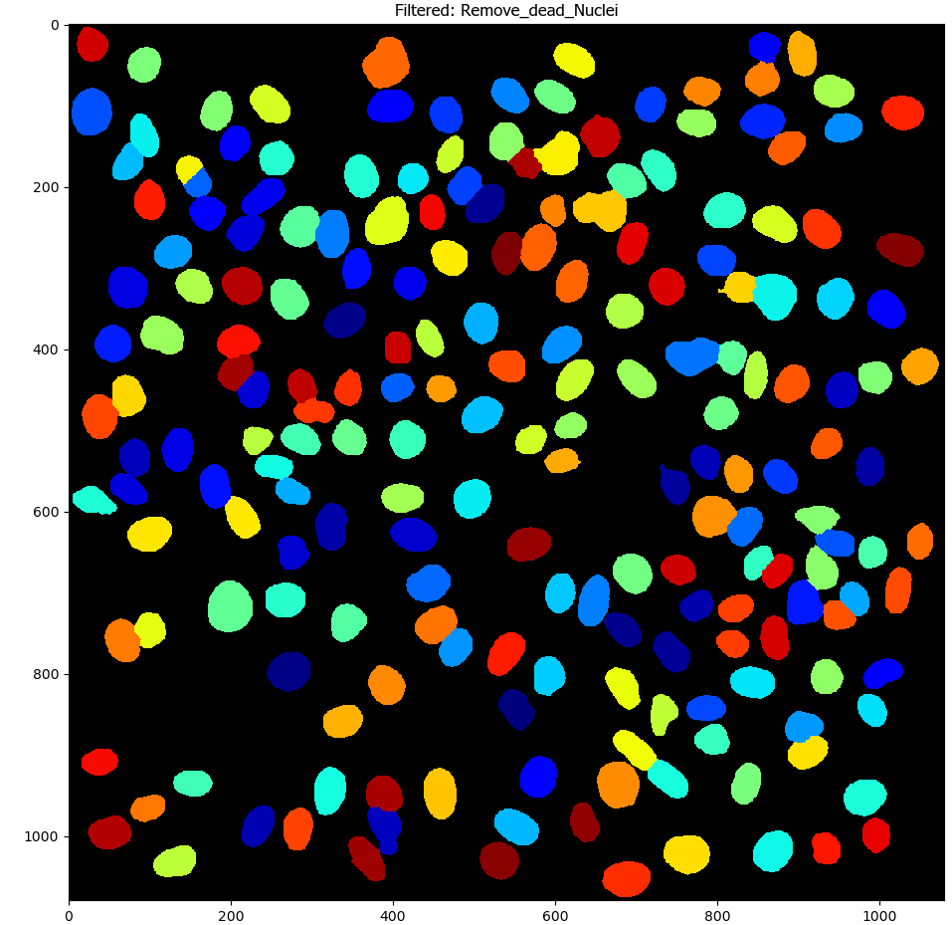
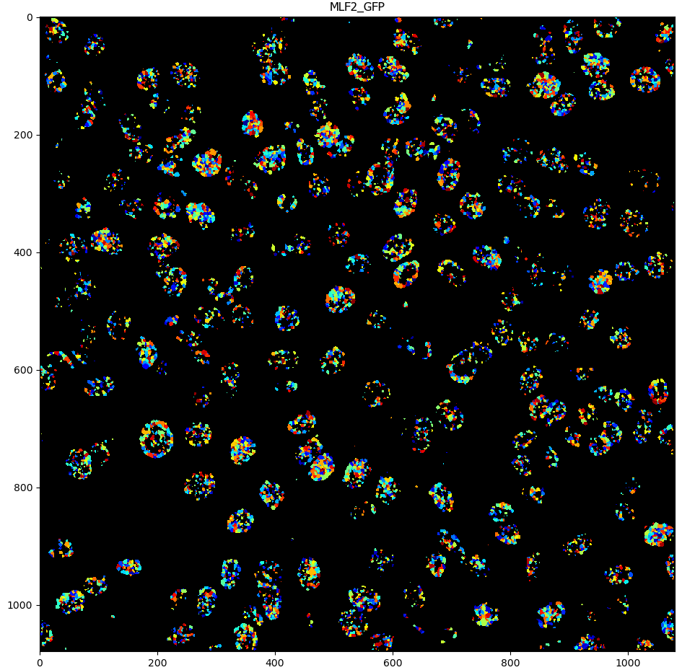
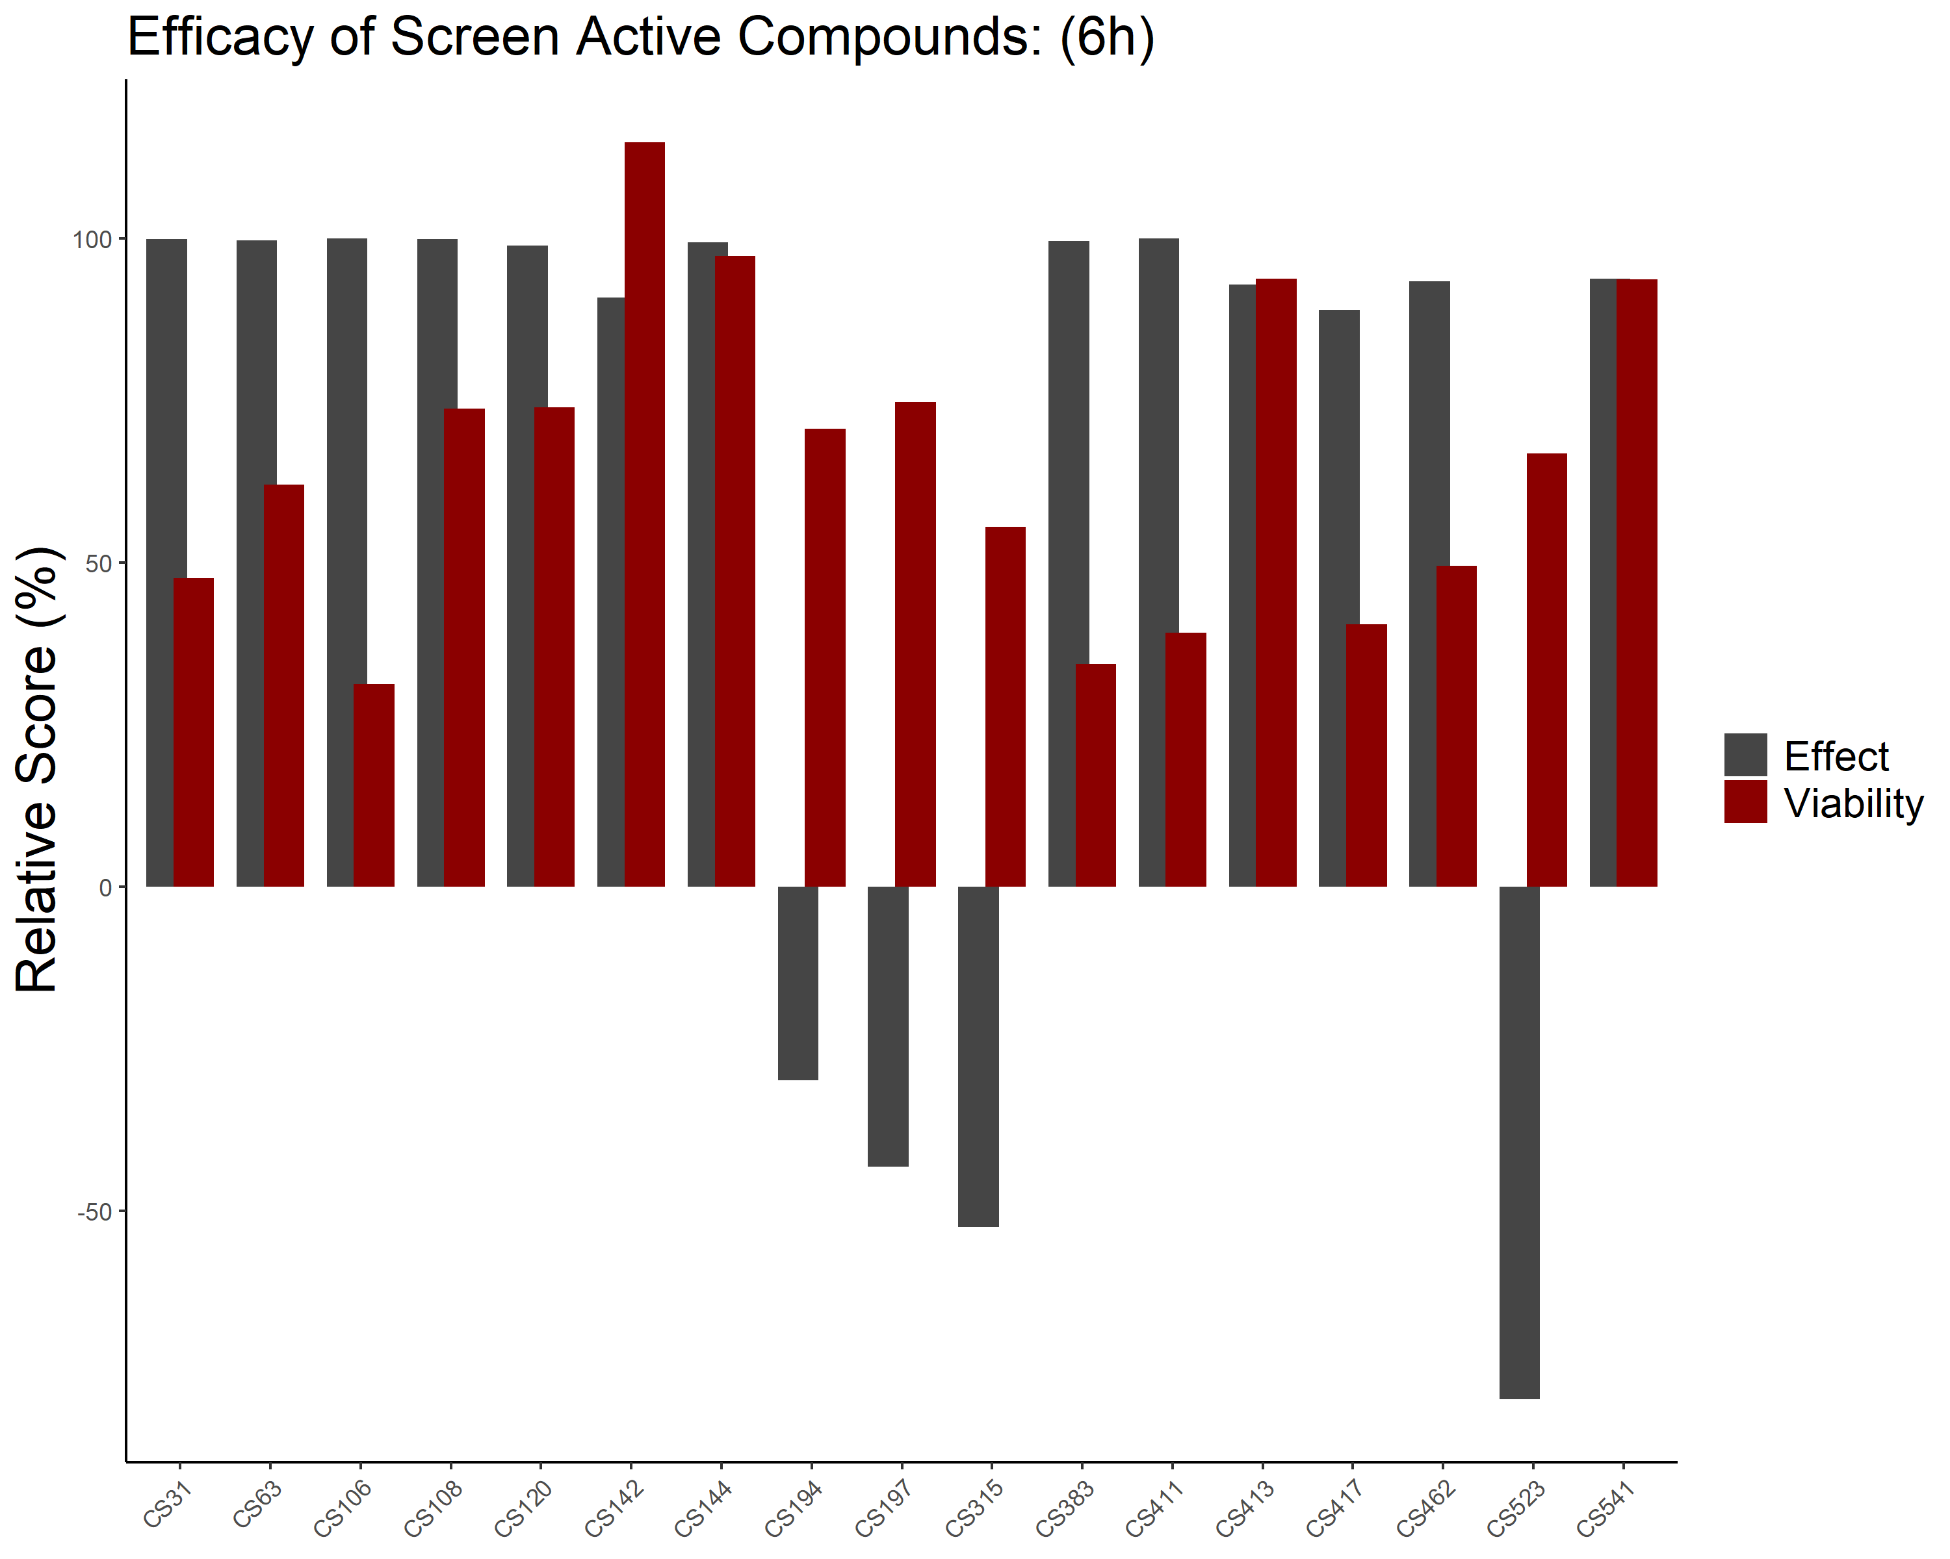
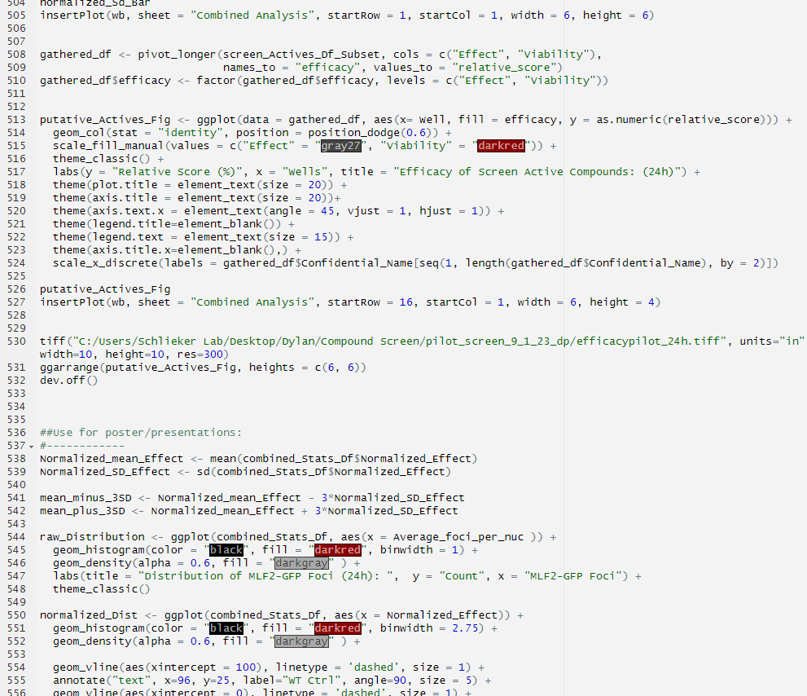
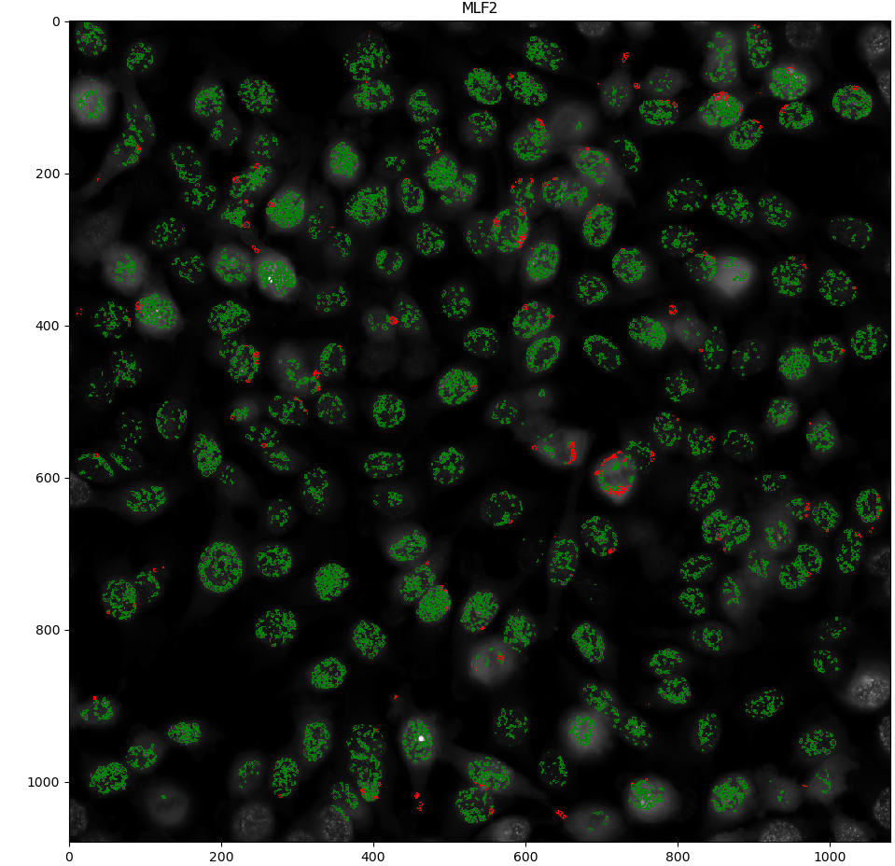
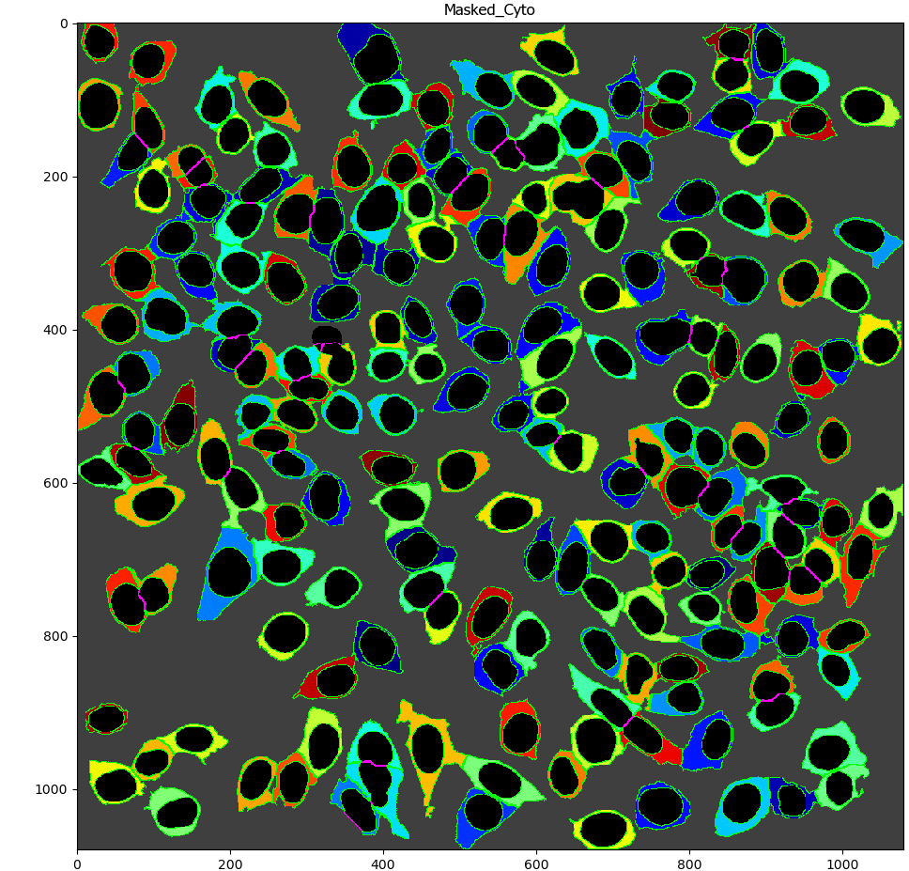
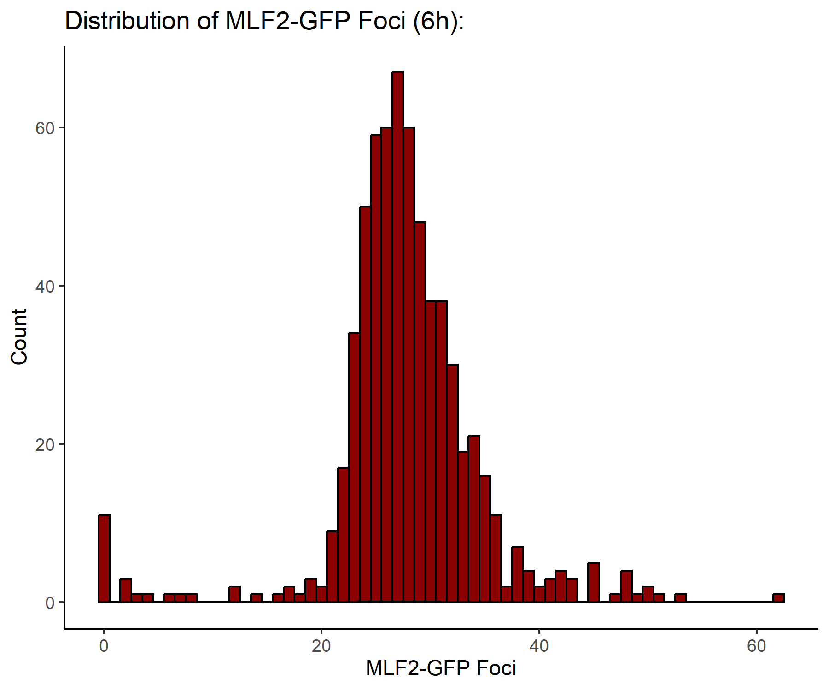
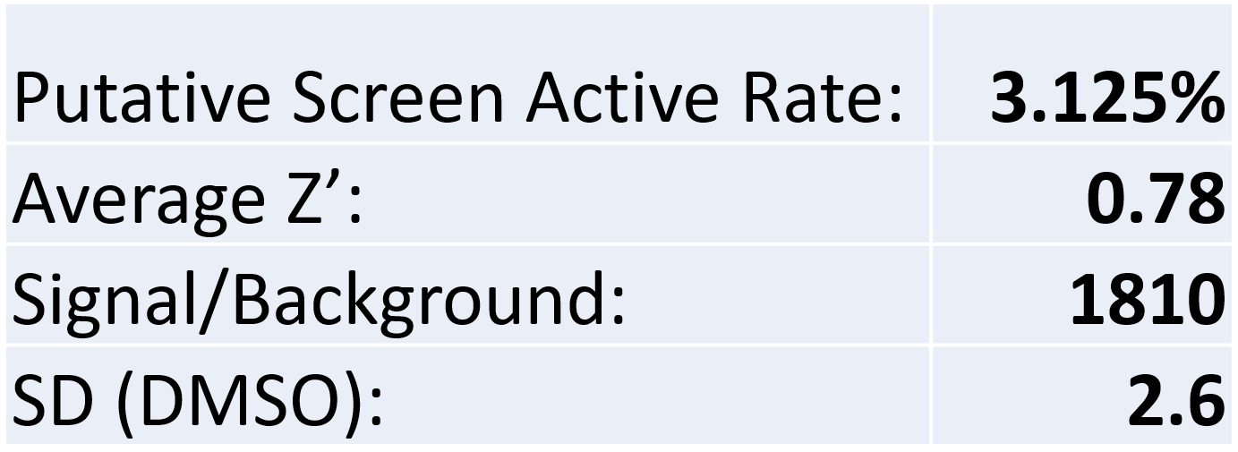
Screening pipeline & workflow
v
A
B
Detect Nuclei
Count nuclear MLF2-GFP Foci
Define Cytoplasm
Nuclear Foci (green) Cytoplasmic Foci (red)
R Script Analysis
Graphical Representations
Screen Statistics
a, Analysis pipeline consisting of Cell Profiler (CP) detection (nuclei, cytoplasm, MLF2-GFP foci), statistical analysis using R, and graphical generation.
b, Drug efficacy as determined by the relative % change to MLF2-GFP foci (gray) and cell viability (red) for each putative screen active
Notes:
HTS

Slide 14
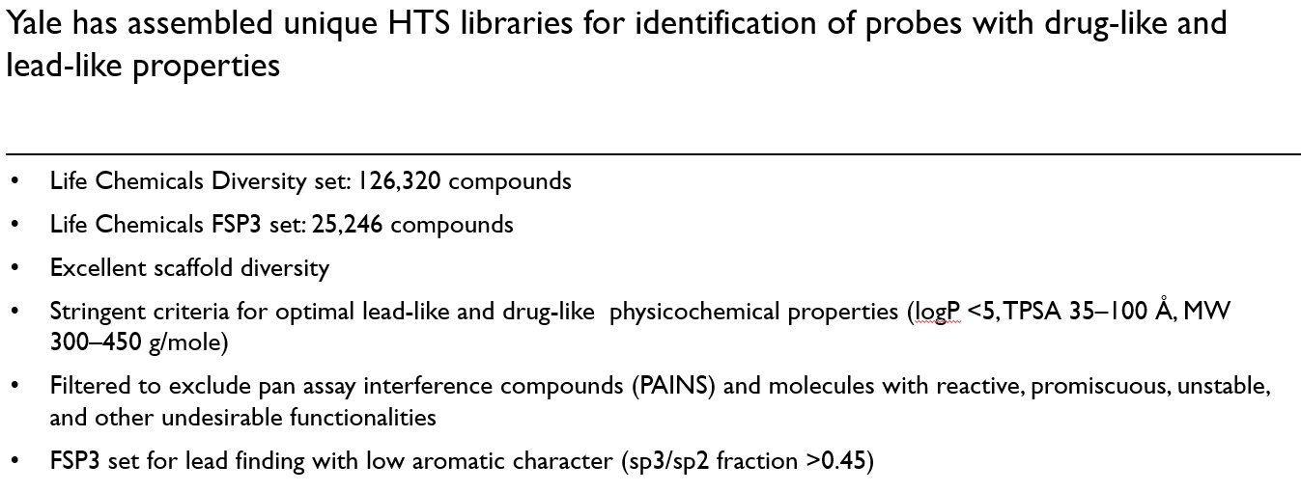
HTS library capabilities at YCMD
v
Notes:
HTS

Slide 15
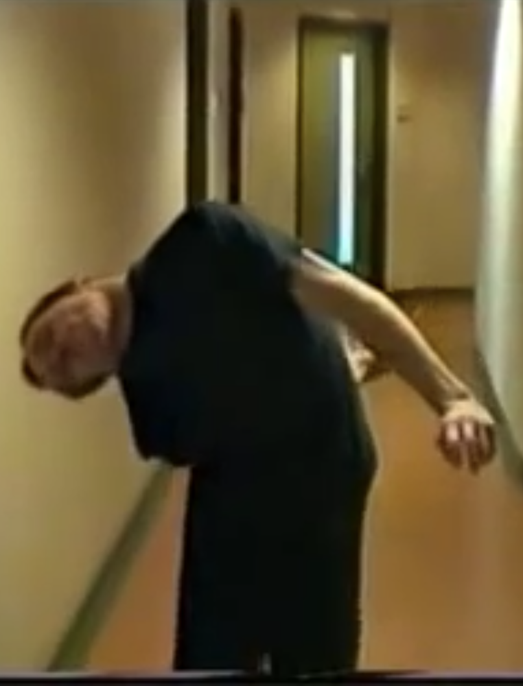
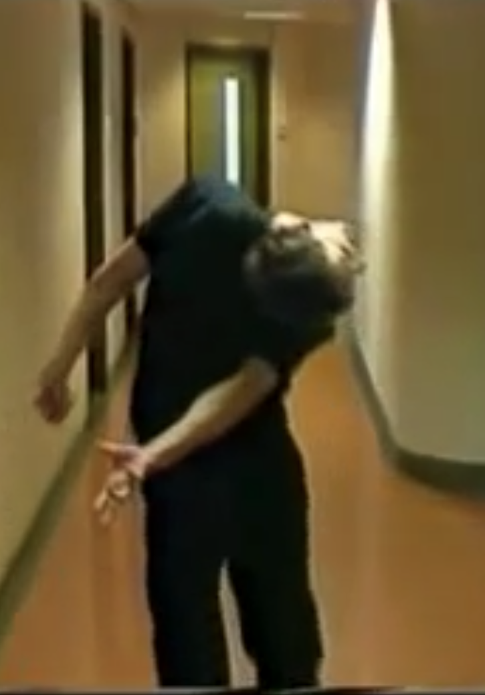
PROBLEM / INDICATION
Dystonia is the third most frequent movement disorder
affecting ~250,000 US citizens
The most genetically prevalent form of dystonia (DYT1 dystonia) is
highly debilitating: spasms, twisted postures, involuntary contractions

Slide 16
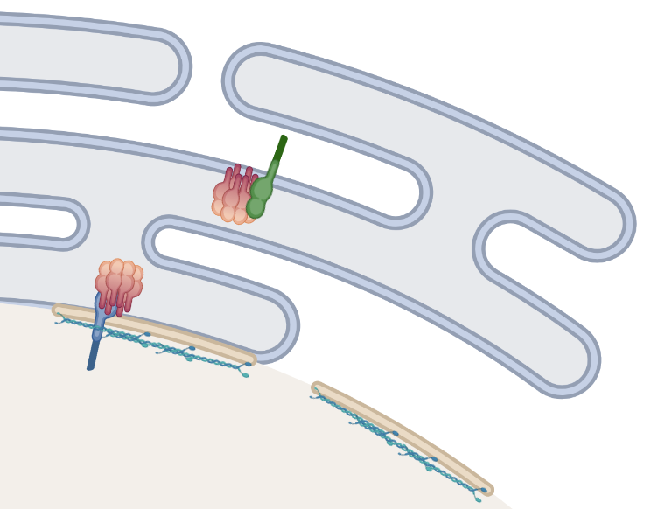
Mutations in TOR1A and TOR1AIP1 cause a variety of human pathologies
v
Cytoplasm
ER lumen
Torsin
LULL1
LAP1
Nucleoplasm
Rampello et al. Biomolecules 2020
Notes:
HTS

