Slide 1
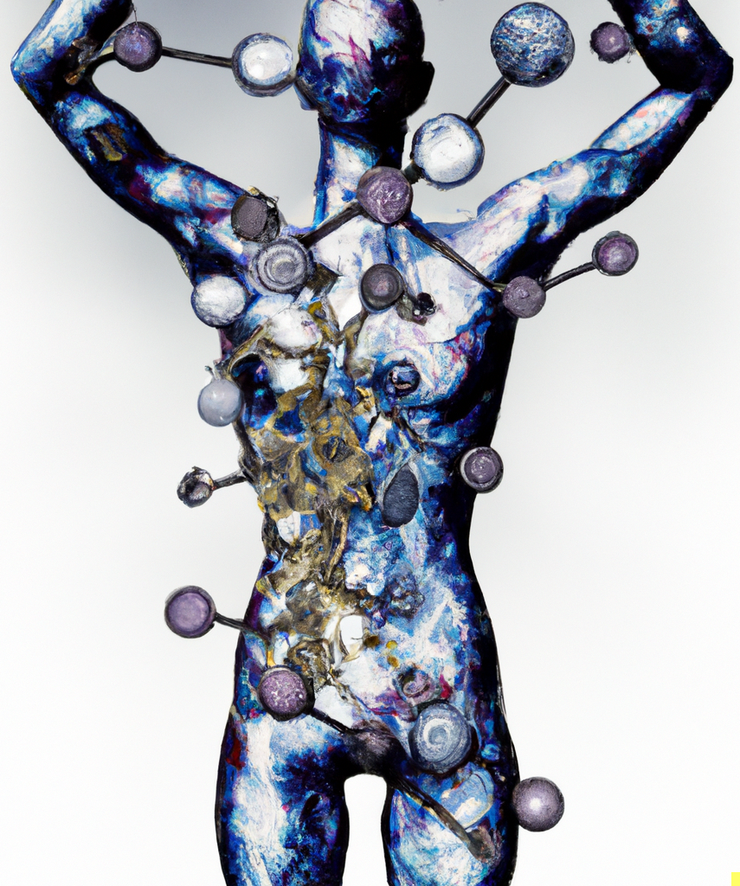
First in Class Small Molecules for Cancer Cachexia
Winner of May 2023 $30k Blavatnik Accelerator Award
Yingqun Huang, MD, PhD

Slide 2
Our Team Combines Biology & Chemistry Expertise
Informed by Clinical Oncology & Palliative Care Physicians
Advisory Board
Local & National Leaders in Medical Oncology & Palliative Medicine
Tara Sanft, MD (Chief Patient Experience Officer & Medical Director of Smilow Cancer Survivorship Clinic
Andrew Kennedy, PhD
Associate Professor of Chemistry & Neuroscience
Synthesized Bobcat339
Yinqqun Huang, MD, PhD
Professor of OB/GYN & Reproductive Sciences
Notes:
Our team combines biology and chemistry expertise.
I am a molecular biologist and Andrew Kennedy is the original creator of small molecule Bobcat339 and its derivatives.
We also have advisory board to help us as our projects develops.

Slide 3
>1.3 Million Cancer Survivors Suffer from Cachexia Each Year
Cachexia is characterized by extreme weight loss, muscle wasting, and anorexia, and is associated with depression, anxiety, and poor quality of life
No FDA-Approved Therapy for Cachexia
Notes:
Each year, more than 1.3 million cancer survivors suffer from cachexia.
Cachexia is characterized by extreme weight loss, muscle wasting and anorexia, and is associated with depression, anxiety and poor quality of life.
Currently, there are no FDA-approved drugs for treating cachexia.

Slide 4
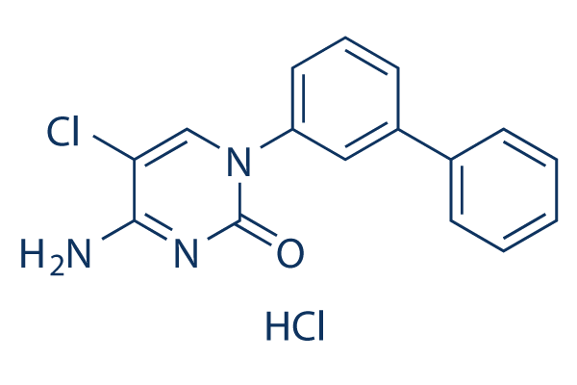
Our Small Molecules Activate AGRP Neurons in the Hypothalamus
AGRP Neurons Control Appetite, Energy Expenditure & Mood
Inactive AGRP
Active AGRP
Bobcat339 (Bc)
Appetite
Appetite
Energy Expenditure
Energy Expenditure
Mood
Notes:
We have developed a novel method to treat cachexia.
Our method activates a specific subset of neurons in the hypothalamus, called AgRP neurons.
These neurons control appetite, energy expenditure and mood.
When these neurons are inactive, you experience decreased appetite and increased energy expenditure, and this is what you would see in a cachexic patient.
When the neurons are active, you have increased appetite, decreased energy expenditure and good mood.
We have a small molecule, called Bobcat339 or Bc, which activates AgRP neurons.

Slide 5
Bobcat339 is a Small Molecule Degrader of TET3
Functionally Degrades TET3 & Activates AGRP Neurons In Vivo
TET3 in AGRP Neurons
AGRP Activation
TET3
AGRP
We have an exclusive patent on Bobcat339 and its derivates
Lv et al. PNAS 2023
Notes:
Bobcat specifically degrades a protein, called TET3, in AgRP neurons thereby these neurons.
We hold an exclusive patent on Bobcat and its derivates.

Slide 6
Bobcat339 Reduces Depressive & Anxiety-Like Behaviors and Increases Appetite & Lean Mass
LLC Cancer Cachexia Model
Food Intake (g)
Lower Stress Hormone
Effective in Three Common Behavioral Tests for Depression & Anxiety
Lv et al. PNAS 2023
Notes:
We have validated our molecule in multiple animal models. For example, in an anorexia mouse model, we show that Bobcat is effective in reducing depression and anxiety using three common behavioral tests. In addition, Bobcat decreases stress hormones. In a lung cancer cachexia model, we show that Bobcat increases food intake, increases body weight and especially muscle mass.

Slide 7
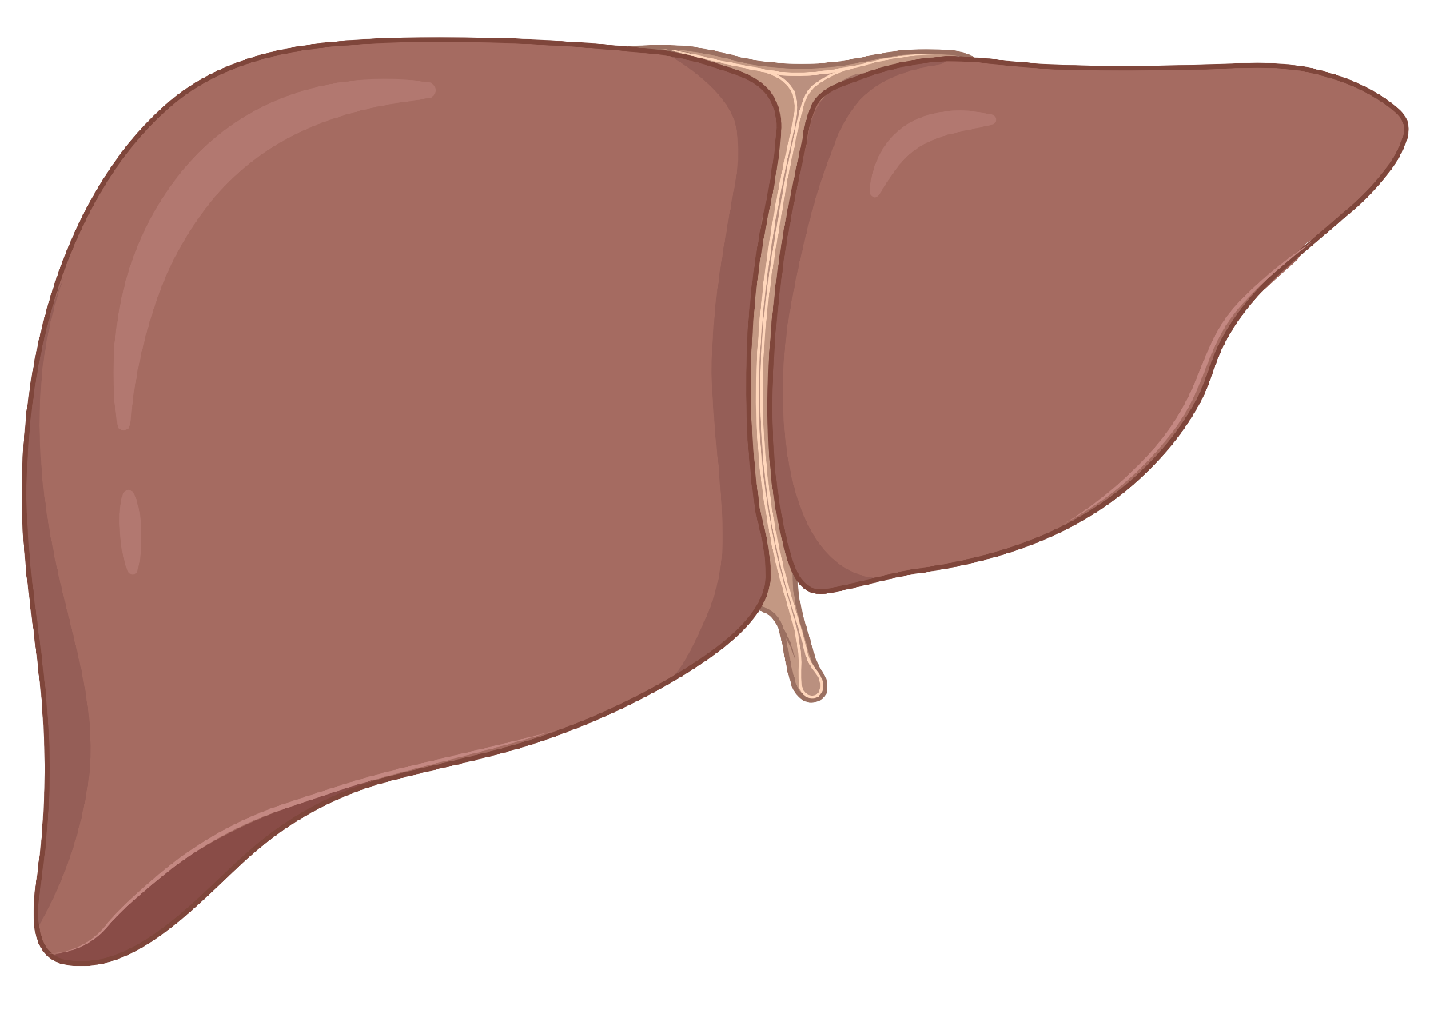
Preliminary Toxicology Studies Demonstrate Liver & Kidney Safety
Lv et al. PNAS 2023
Notes:
Importantly, Bobcat does not show discernible side effects.

Slide 8
Bobcat339 Can Serve a Significant Unmet Need for Millions of Patients Experiencing Cachexia
Unique Advantages
Beneficial effects on mood in addition to lean mass is unlike other molecules in pipeline
Cost-effective & scalable manufacturing (small molecule vs. biologic)
Numerous additional candidates in pipeline (in-team chemistry expertise & patented derivatives)
“We need better treatments, also with mood support would be amazing for patients.”
-Yale Medical Oncologist
Notes:
So, Bobcat can serve a significant unmet need for millions of patients suffering from cachexia.
Bobcat has unique advantages: It improves appetite, increases lean mass and also improves mood. Other molecules in the pipeline cannot do these.
Bobcat is cost-effective
We have additional candidates in the pipeline.

Slide 9
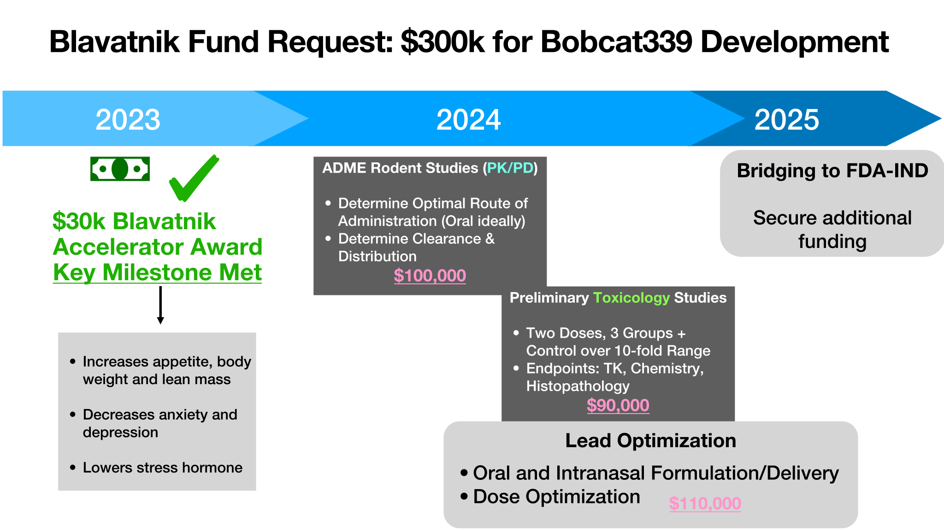
Platform Development Plan
PK and PD of BOBCAT339
Efficacy and Safety
CRO run
In vivo PK
Optimization of dosage
Optimization of delivery
CRO run efficacy and preliminary toxicology studies
Notes:
For the Blavanik accelerator award I have met key milestones. The next step is to secure funds to perform PK, PD and detailed toxicity studies of Bc. The ultimate goal is to develop Bobcat339 (or its derivatives) into a drug to treat cancer cachexia.

