Slide 1
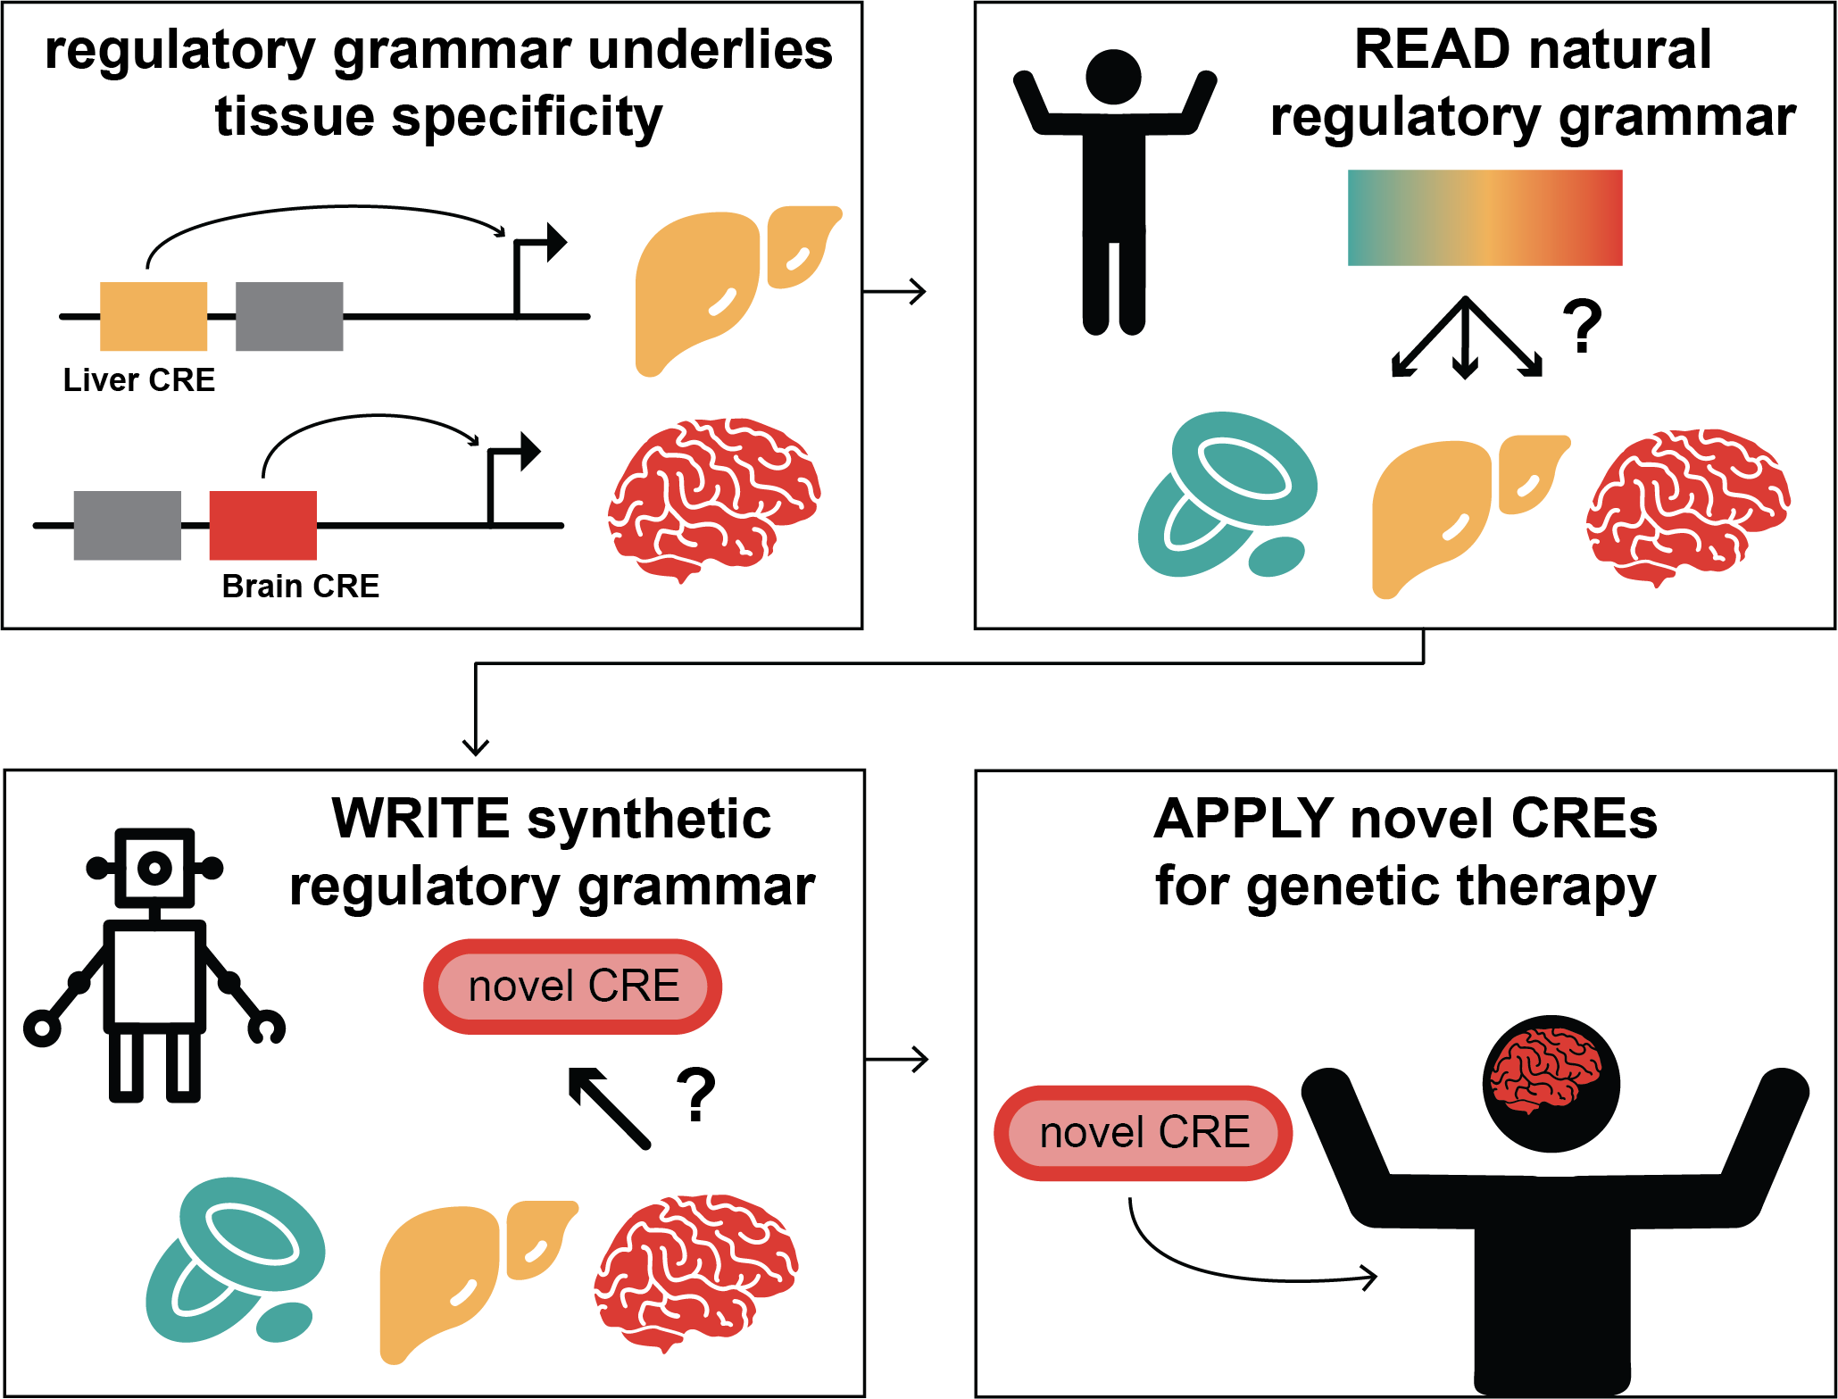



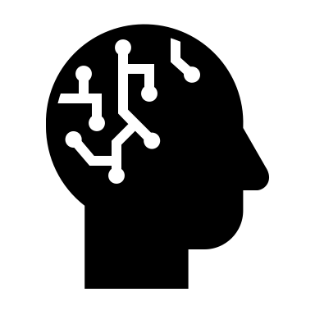
CODA – Bringing specificity to gene therapy
Regulatory grammar underlies
tissue specificity
READ natural
regulatory grammar
Computational
Optimization of
DNA
Activity
can ‘read’ and write’ the genome’s code to highly-specific promoters and enhancers
WRITE synthetic
regulatory grammar
Apply novel CREs
for genetic therapy
in revision at Nature
Notes:
Hi Everyone I’m Steve Reilly from Yale Genetics
I’m going to tell you about CODA, which an Innovate AI solution to bring speficity to gene therapy
We were inspired by the fact that DNA elements called enhancers and promoters elements regulatae gene expression to control cell identiy, in our example becoming a liver or a brain cell,
But the code underlying these promoters and enhancers is complicated and not yet solved
We wondered if we could develop new experimental and machine learning platform to read this regulatory code, could we WRITE synthetic promoters with desired fucntions and combine them with genetic therapies to offer that same tissue specificity
CODA, or computation optimization of DNA Acivity, has solved this currently challenging problem

Slide 2
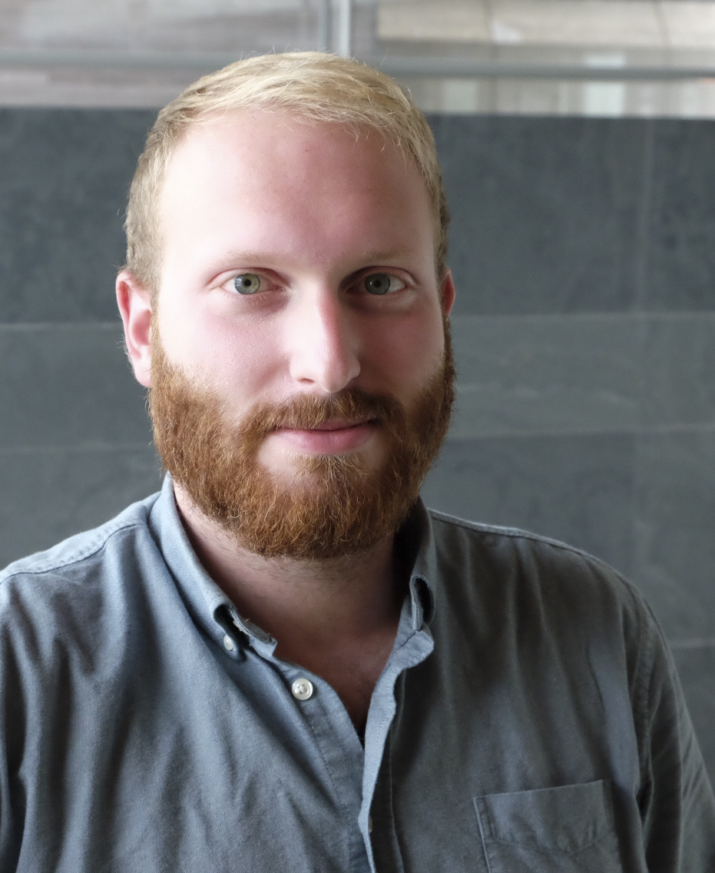
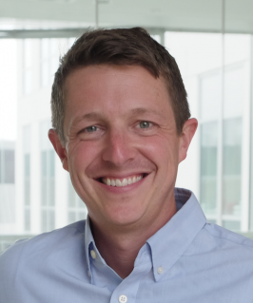
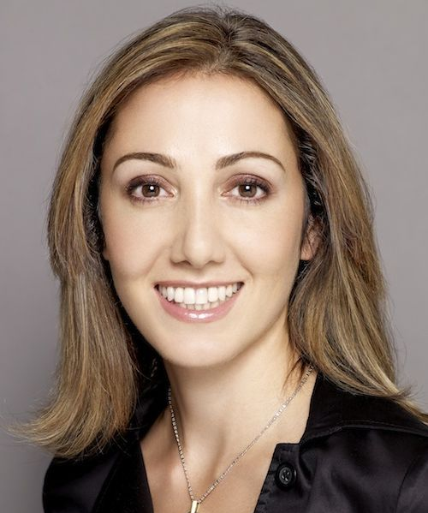
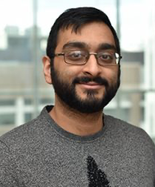
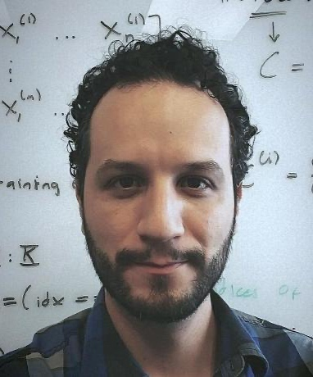
The CODA Team – Experience across Genomics + ML
Steven Reilly, PhD
Co-founder/ scientific advisor
Assistant Prof. Genetic Yale
3 patents
Regulatory biology, evolution, high-throughput CRISPR
Ryan Tewhey, PhD
Co-founder/ scientific advisor
Associate Prof. Jackson Laboratory
5 patents
Regulatory biology, genomic tool-building, human-genetics
Pardis Sabeti MD, PhD
Co-founder/ scientific advisor
Prof. Harvard, Broad Institute, HHMI
10+ patents, SHERLOCK co-founder
Vision, clinical & startup experience
Sager Gosai, PhD
Co-founder
3 patents
Generative AI, big data, functional characterization
Rodrigo Castro, PhD
Co-founder
1 patent
Interpretative ML, synthetic regulatory biology
Notes:
We have a great team spanning Yale, JAX, and the Broad, with experience in patenting multiple genomic technologies and other startups. Our experience spans regulatory biology, high-throughput screen, and generative AI.

Slide 3
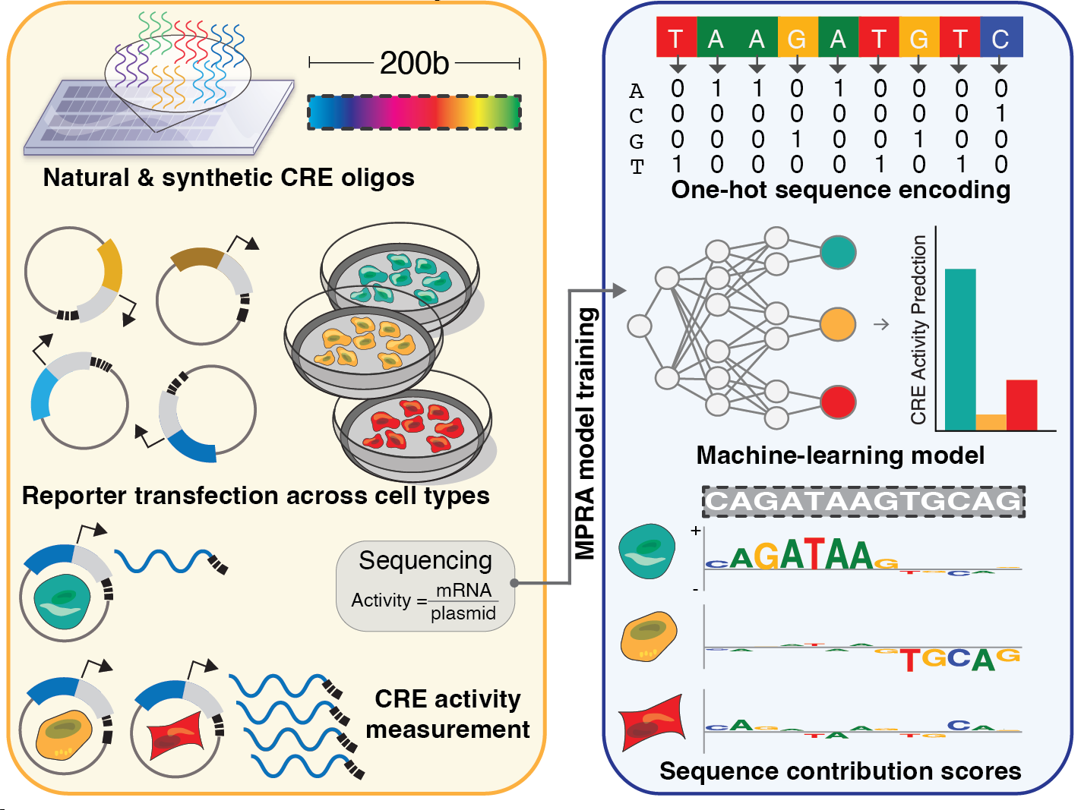
Why now? Massive-scale genomics + ML has cracked the regulatory code
New MPRA Tech
Machine Learning
We can now ‘read’ and ‘write’ regulatory code
(computational predictions match experiments)
Blood
Liver
Neuron
r = 0.88
r = 0.89
r = 0.88
Predicted log₂(FC)
Experiment log₂(FC)
800,000+ tested sequences
Notes:
So what did we do new?
First we’ve developed massively parallel reporter assays. These allow us to test the function of hundreds of thousands of enhancer and promtoers simultaneously, across multiple cell types
We then built advanced machine learning tools to understand the rules of the regulatory code.
You can see in these plots on the right theres incredibly high correlations between what an experiment shows and what we can predict from sequence alone.
This means we’ve cracked the regulatory code and have learned to both read anything new we might write

Slide 4
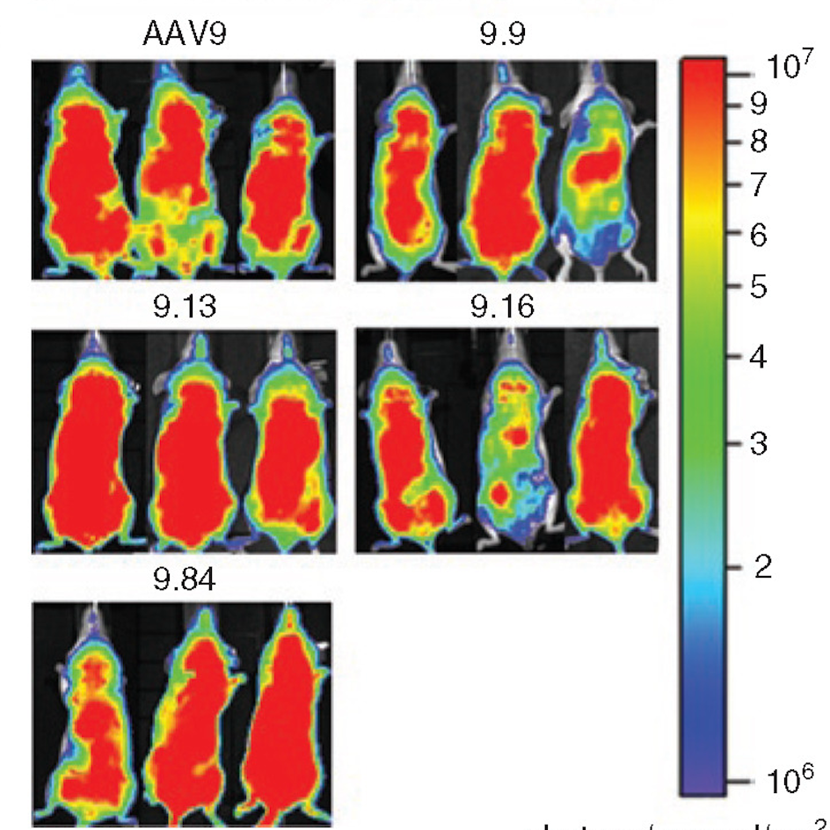
Problem: 10,000 genetic diseases impact 25-30M patients in the US alone
AAVs (especially for brain & muscle) are currently failing:
  Poor therapeutically-relevant targeting
  High off-targeting, especially liver/immune can lead to lethality
  Silencing of viral promoters
  Need small (<200bp) elements
  No combinatorial logic or inducible control
Brain/Muscle Targeting AAV9s in mouse
https://doi.org/10.1038/mt.2011.22
Notes:
Theres tons of applications for this, and thousands of genetic diseases that could be solved with genetic therapies.
Much of the work in this space uses AAVs, which are currently failing to deliver therapies with high specificity , and often have off-target toxicity.
This is a current best in class AAV9 that made huge leaps in targeting the brain, but also targets everywhere, often lethally in the liver.
CODA can solve this, and other problems with AAVs ive listed here

Slide 5
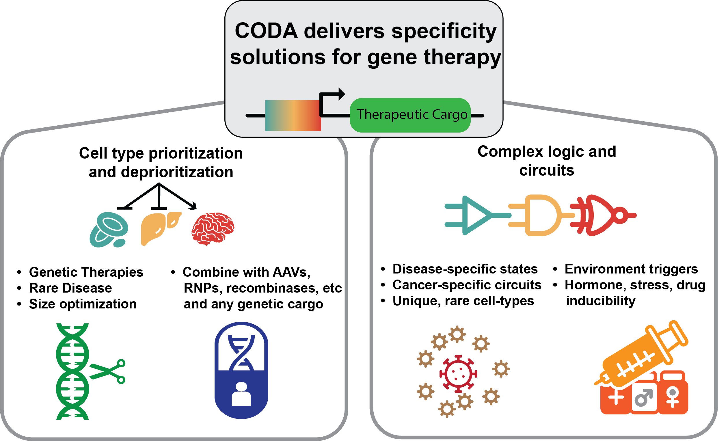
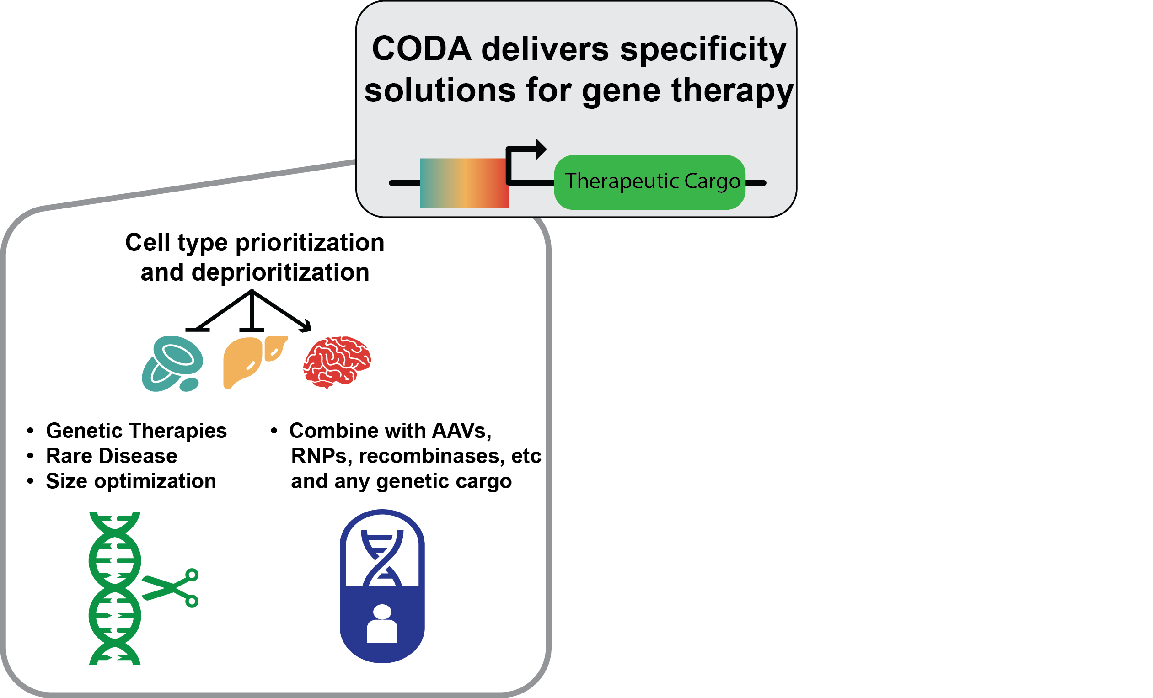
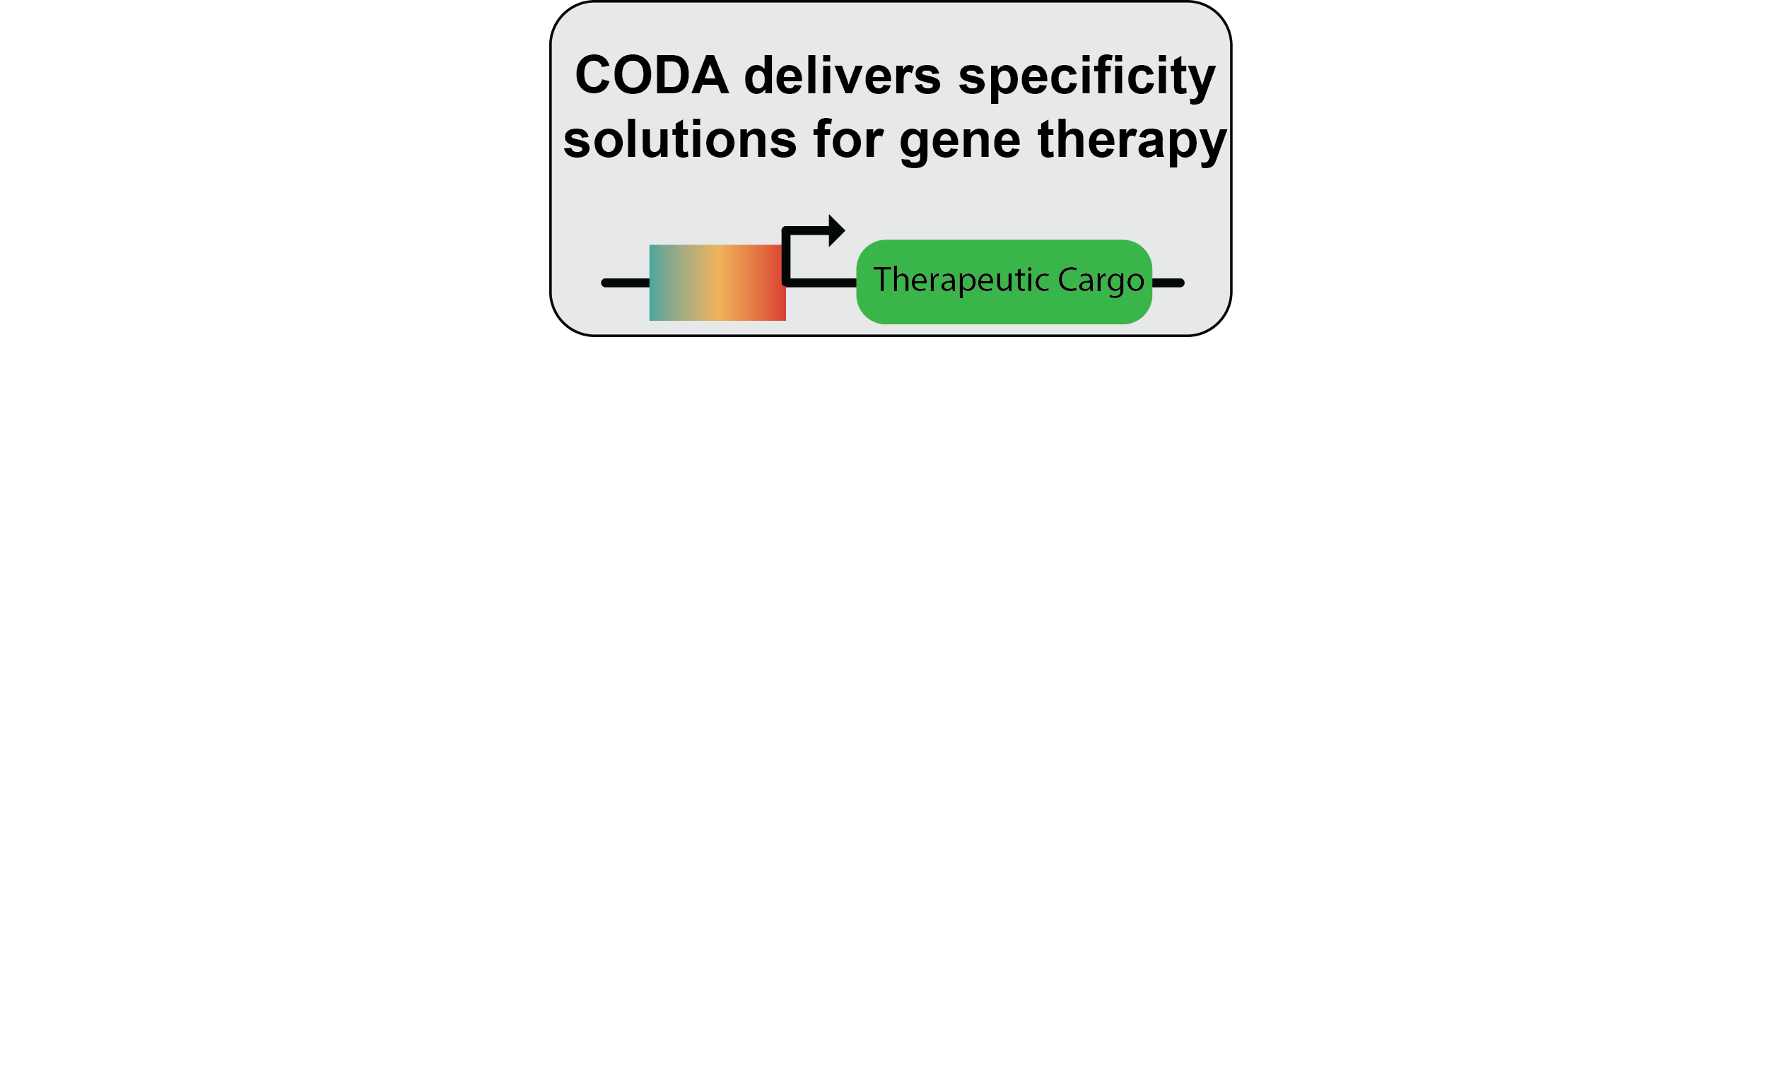
Opportunity: $5.2 billion gene therapy market is estimated to grow tenfold by 2031
  Platform based company.
    Current patents on AI methods and sequences
  First milestone: improve best-in-class AAV therapies in brain and muscle
  Future Yale PI from composition of matter copyrights on muscle/brain sequences
  Licensing agreements add non-dilutive revenue while improving datasets
  Copyright MPRA database
  Build new solutions and tools in longer-term
Notes:
The opportunity here is huge, gene therapy is a 5.2B market and is expected to grow to 50B in a decade.
We see CODA as a platform company making solutions for any genetic therapy. Our current IP is on AI methods and sequences
We’ll start out the most specific AAVs possible in brain and muscle, for any therpaetuic cargo, which with blavatnik funds would create new IP for Yale.
We see the company starting to then move into liscensing agreements for specific tissue/cell targets which builds up our dataset, which we can also copyright, with potentially large, non-dilutive revnue.
In the future, we plan to develop our own therapies and solve the other major problem of genetic therapies.
We add specificity, but could make the cargo only turn on in a disease state, or be responsive to a drug or hormone. And we can layer these all together now that we can predict the regulatory code.
I think of the AAV as delivering a package to the right zipcode, but CODA can make sure it gets to the right house, at the right time, and only after they’ve paid the bill. important layer on top

Slide 6
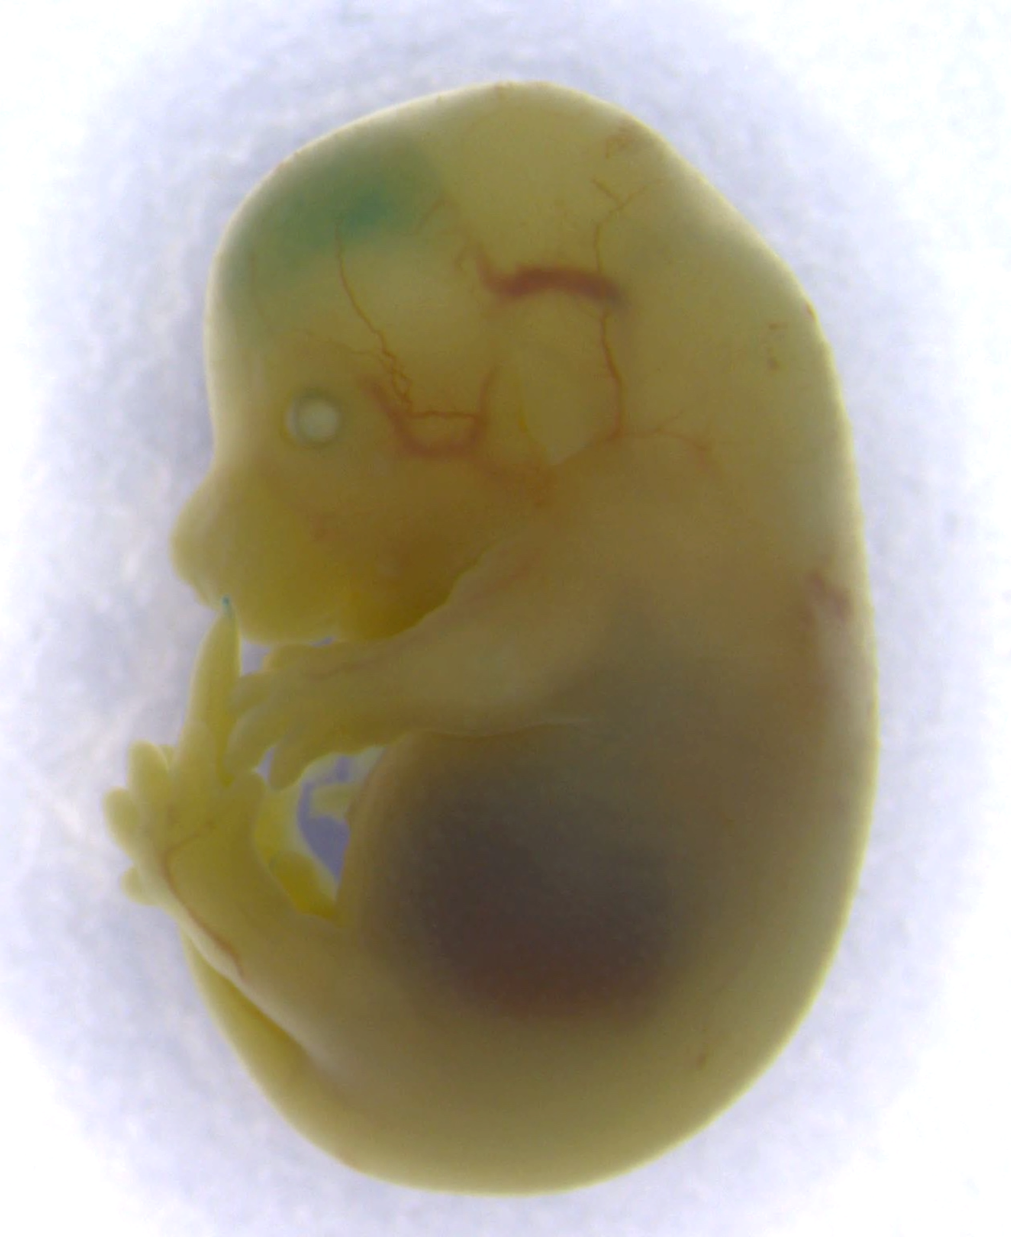
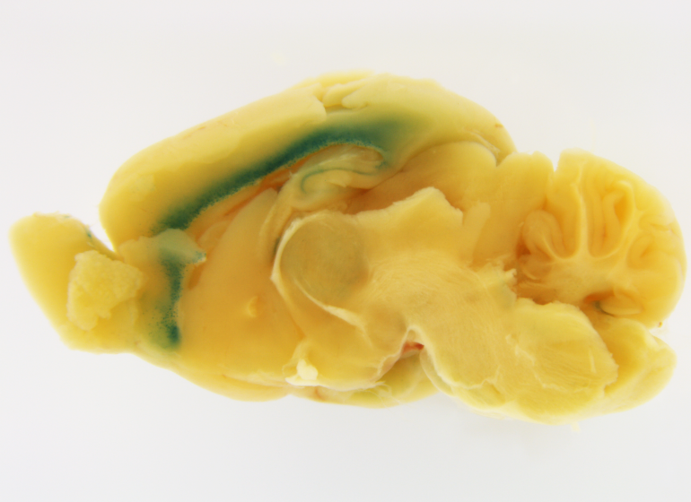
Solution: AI-designed ultra-specific promoters/enhancers for genetic therapies
Design Brain targeting
regulatory element
Activity
Natural
Reg. Elements
Synthetic
Brain specific CODA element
Notes:
So we’ve already used CODA in a proof of principle to design cell type specific promtoers in the brain.
When we looked to nature, we saw the specificity towards the brain wasn’t actually that strong. But CODA could deisng synthetic elements that were much more spefic.
When we took one of these completely synthetic sequence and put it into a mouse, you can see in blue, they work exactly where theyre designed in the brain. actually just one specific layer of the cortex.
You can compare this to AAV9 I showed before, which was active nearly everywhere.

Slide 7

Sparse Competitive Landscape
Patch Biosciences and Asmiov are only players in market
  Patch has managerial issues
  Asimov lacks high-quality MPRA data/analysis
AAVs (75% of gene therapy space) focus on capsid
Pharma contacts (5+) want better promoters in current AAVs…but lack in-house expertise to build them
Generative AI companies want into this space, but lack large-scale functional genomics and MPRA datasets
Notes:
We think theres a sparse competitive landscape, with only two similar companys, that dont have our underlying tehcn
ere are AAV engineering companies, but they all focus on engineering the protein capsid, rather than the cargo.

Slide 8
Budget/Milestones: Use CODA to improve best-in-class
AAVs in muscle and brain
Expand MPRA in brain and muscle iPS derived cells
Generative AI for specific sequences in new cells
Triage top-50 sequences in model organisms
Proof of concept in NHP
1
3
(9 months - $115,000)
(5 months - $50,000)
2
4
(4-months - $45,000)
7 - months ($120,000, each)
Notes:
So in two years we plan to sprint to show our synthetic promtoers can improve specificity to make the best in class AAVs in muscle and brain as
First we’ll expand our MPRA and dataset in muscle and brain relevant stem cells
We’ll retrain CODA and expand our generative Ai to make even better models.
We’ll triage 50 of our best candidates first in model organism,
And then we’ll take our top candidates and test them as AAVs in primates which is the current gold standard in the field
The entire time we’ll continue to do market research and identify potential partnerships.
We think this is just the start to solving a lot of current prblems in AAVs and beyond.

