Slide 1
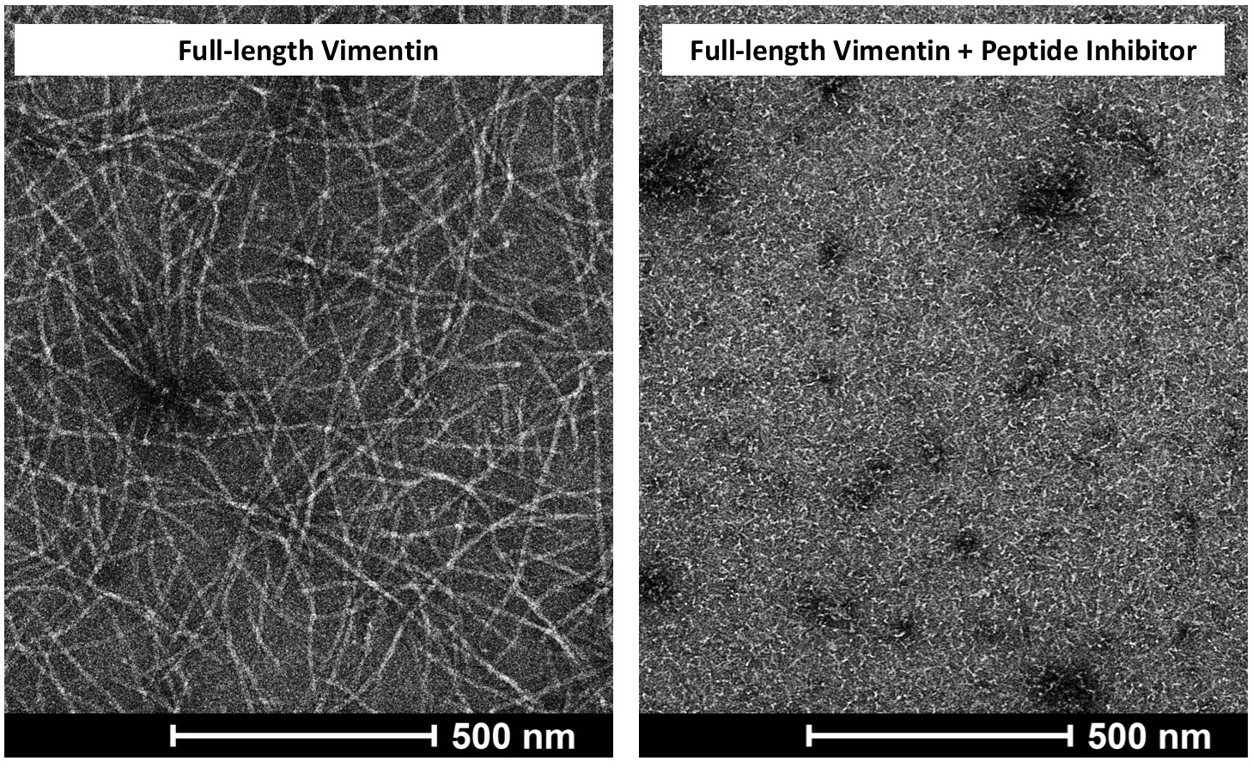
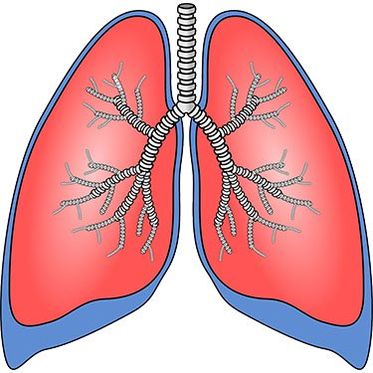
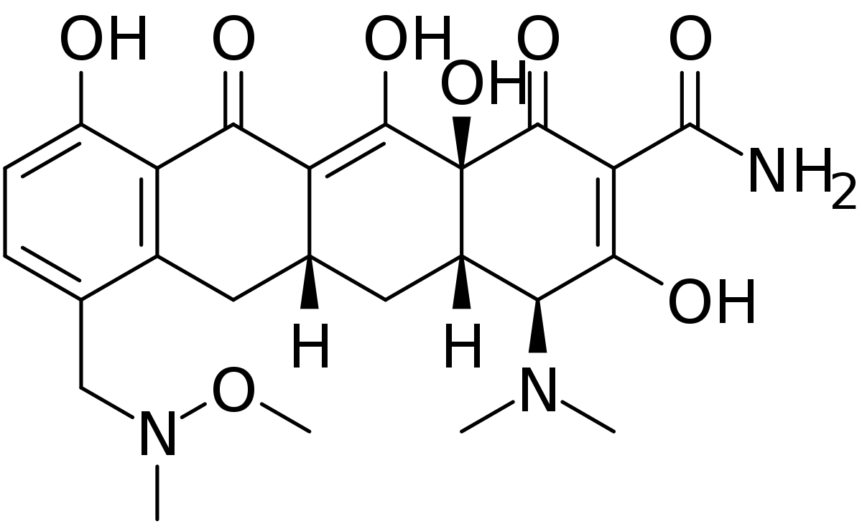
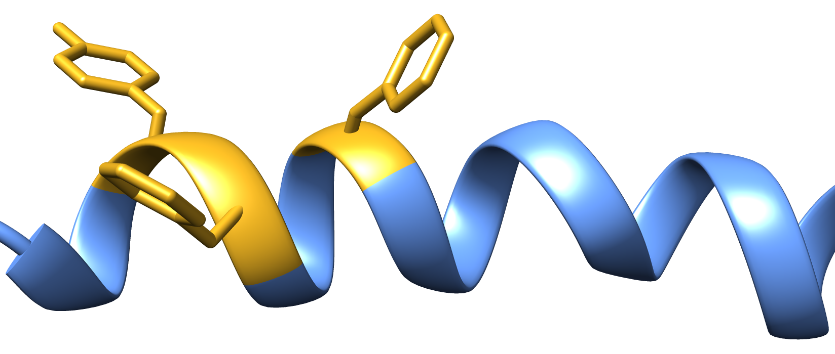
VIMENTIN TARGETED THERAPY
First-in-class small molecule inhibitor
of vimentin to treat lung cancer
10 µm
Discovered Mechanism
of Intermediate
Filament (IF) assembly
First-in-Class
Small Molecule
Inhibitor
Restore patient sensitivity to TKIs and reduce NSCLC progression
Block Vimentin IF assembly
Christopher G. Bunick, MD, PhD
Associate Professor, Yale Department of Dermatology
Yale Program in Translational Biomedicine

Slide 2
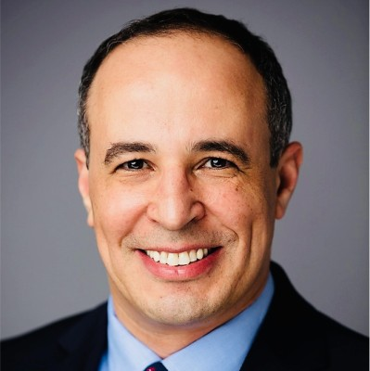
The Team
Experts in biochemistry and medicinal chemistry with a track record of entrepreneurship and bringing drugs to market
PI/Team Leader:
Dr. Christopher G. Bunick, MD, PHD
Associate Professor of Dermatology
333 Cedar St., LCI 501
PO Box 208059
New Haven, CT 06520
(p) 203-577-1050
Christopher.bunick@yale.edu
Dr. Victor Batista, PhD
and laboratory
Professor of Chemistry, Yale
Expert in MD-AI drug design
Minh Ho
Research Associate II, Bunick Laboratory
Will assume control (CSO) of day to day scientific operations of company.
Expert in intermediate filaments, cell biology,
cell signaling, biochemistry, structural biology.
Dr. Mark Nelson, PhD
Medicinal chemist with track record in designing and bringing drugs to market
Dr. Ayman Grada, MD
Case Western University
Industry-experienced advisor with
drug development and
entrepreneurial record
Dr. Ivan Lomakin, PhD
Associate Research Scientist
Biochemist, Structural biologist

Slide 3
First-in-Class Opportunity Overview
1
Vimentin
2
3
X-ray crystal structures of intermediate filament tetramers
Eldirany, Ho, Hinbest, Lomakin, & Bunick. EMBO J 38(2019).
New druggable target
in Vimentin that molecularly differentiates our approach
Vimentin is a Key
Cytoskeleton Protein
Guo et al. Biophys J. 105(7) (2013).
Armageddon Approach:
Blow up Vimentin from Inside
4
5
Address an Unmet Medical Need
We will disrupt vimentin
at its earliest assembly step
Lung Cancer
Progression and Metastasis:
$26B globally by 2023
BCC Research

Slide 4
The Clinical Problem We Will Overcome: NSCLC
Subset of non-small cell lung cancer (NSCLC) patients have EGFR activating kinase domain mutations (EGFR-mutant)
The Problem:
acquired resistance
Current standard of care for EGFR-mutant NSCLC patients is Tyrosine Kinase Inhibitors (TKIs) [e.g., 3rd gen. osimertinib]
TKI-resistant EGFR-mutant NSCLC inevitably occurs leading to disease progression
Therapeutic Unmet Need
The Solution: targeting vimentin
TKI resistance related to Vimentin overexpression in up to 40% of patients.
No anti-cancer drugs currently target vimentin or other intermediate filaments in medical practice.
Inhibiting vimentin can restore NSCLC sensitivity to TKIs.

Slide 5
Vimentin Intermediate Filaments Play A Critical Role in Lung Cancer
Vimentin imparts resistance to TKI
New Study Links Vimentin to Lung Cancer Progression and Metastasis
Vimentin reduction restores sensitivity to
TKI
Oncogene. 2023 May 9.
Vimentin is an excellent drug target
because it has a direct role in:
1. acquired chemoresistance
2. epithelial-mesenchymal transition
3. invadopodia function in cell migration
4. cancer metastasis
Mice lacking vimentin develop and reproduce without an obvious phenotype
Colucci-Guyon et al. Cell. 1994 Nov 18;79(4):679-94.
TKI-sensitive lung cancer
TKI-resistant lung cancer
Zhang et al. Nat Genet.
2012 Jul 1;44(8):852-60.

Slide 6
Proven Approach with Peptide Inhibitors, into Clinic with Small Molecule Inhibitors
In vivo action of inhibitory peptide
AI-driven in silico small molecule
screening completed
U.S. Provisional Patent Applications:
No. 62/742,484 (10/08/2018)
No. 62/833,883 (04/15/2019)
Claim = multiple modalities for the therapeutic disruption of intermediate filament cytoskeleton networks via knob-pocket assembly mechanism.
D
In vitro action of inhibitory peptide
1M compounds screened
Top hits selected based on binding properties
Currently filing a provisional patent application claiming these small molecule compounds and their uses. The details will be made available after filing and under a CDA.

Slide 7
Small molecule vimentin assembly inhibitor to treat lung cancer
Lung cancer: $26B global market in 2023 (BCC Research).
Global metastatic cancer treatment market: ~$98.24 billion by 2025.
The anti-cytoskeleton industry is ~$3-5B/year.
Paclitaxel alone has generated ~$1.5B/year.
Therefore, the potential market opportunity for first-in-class Vimentin inhibitor is expected to be similar to paclitaxel around $0.5-1.5B USD/yr with opportunity for growth to $3-5B/yr.
The Market
Our Advantage
Blowing Up NSCLC From the Inside-Out at the Protein Level
Knob-Pocket Inhibitor
Competitors
Compounds Targeting Vimentin | FDA Approval | Specifically Disrupts Assembly | Currently Used Clinically | Complications
Withaferin-A | No | No | No | High off-target toxicity
FiVe1 | No | No | No | Unknown
Knob-Pocket Inhibitor | No | YES | No | Low toxicity to cell viability
Competition
We have competitive advantage and mechanistic differentiation

Slide 8
Timeline, Milestones, and Budget
Objective 1: $50,000
CROs Identified
Goal: Test in silico hits for inhibitor activity.
How: Top 10 distinct small molecule scaffolds (judged by properties including binding strength and LogP) will be chemically synthesized for use in Objectives 2 and 3.
Quality control testing of synthesized inhibitors using a cell-free filament assembly assay.
Milestone: Validated chemical inhibitors for cell-based and mouse studies.
Q3 2024
Q4 2024
Q1 2025
Q2 2025
PRECLINICAL
Objective 3: $200,000
Objective 2: $50,000
Goal: Demonstrate efficacy of top inhibitor in tumor xenograft mouse model of NSCLC.
Desired endpoints: (i) decreased tumor size; (ii) decreased spread/metastasis; (iii) prolonged survival of treated mice; (iv) increased sensitivity of TKI-resistant EGFR-mutant NSCLC to osimertinib; (v) PK studies.
Goal: Characterize validated hits on NSCLC cell behavior.
Milestones:
Disruption of NSCLC proliferation, apoptosis, cell migration, and/or cell invasion.
Restoration of TKI sensitivity to TKI-resistant EGFR-mutant NSCLC cells.

Slide 9
Summary
Dr. Christopher G. Bunick, MD, PHD
Associate Professor of Dermatology
333 Cedar St., LCI 501
PO Box 208059
New Haven, CT 06520
(p) 203-577-1050
Christopher.bunick@yale.edu
VIMENTIN TARGETED THERAPY
https://medicine.yale.edu/dermatology/people/christopher_bunick.profile
Discovered Mechanism
of IF assembly
First-in-Class
Small Molecule
Inhibitor
Block Vimentin IF assembly
Restore patient sensitivity to TKIs and reduce NSCLC progression/metastasis
Blavatnik Funding will enable our Team to:
evaluate and optimize a first-in-class small molecule inhibitor of vimentin for treatment of lung cancer.
generate POC data and allow for planning IND-enabling studies.

