Slide 1




Development of Vitamin D Receptor Agonists to Treat Obesity
Mireille Serlie, MD PhD
Professor of Endocrinology
Department of Endocrinology
Yale School of Medicine
Sabrina Oussaada
MD PhD student
Ralph DiLeone, PhD
Professsor of Neuroscience and Psychiatry
Department of Psychiatry
Yale School of Medicine
Richard Trinko, PhD
Associate Research Scientist
Ethan Foscue
Research Associate

Slide 2
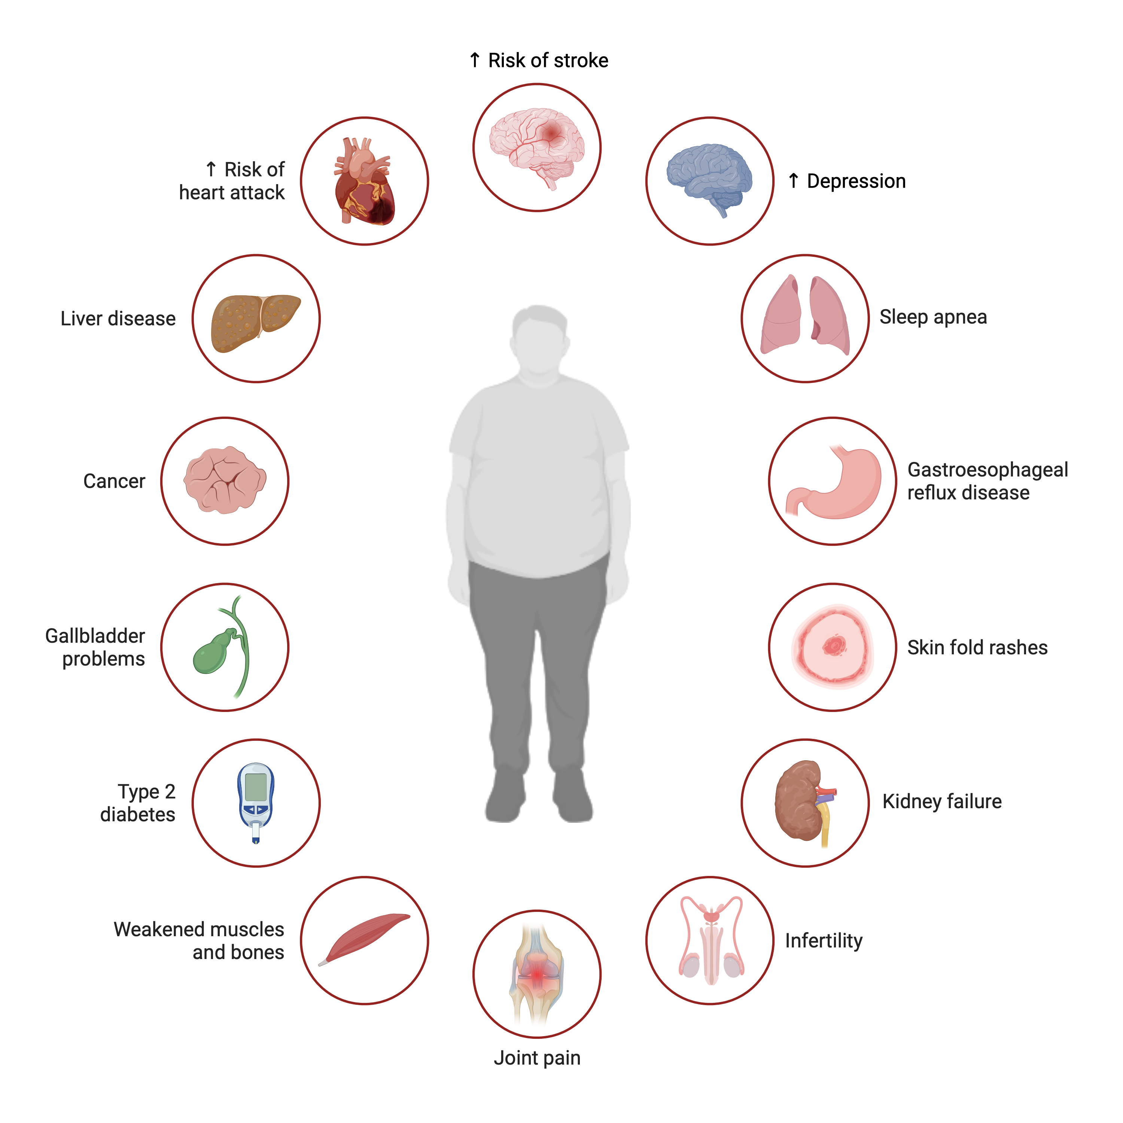
Obesity market lacks pathophysiological solutions
Our goal is to develop a brain-targeted, safe and effective obesity therapeutic
Obesity-Associated Comorbidities
42% of the adult US population has obesity
Medical costs of obesity 173 billion USD (2019)
Estimated obesity market 77 billion USD within 7 yrs
Obesity was classified as a disease in 2013
  Increased acceptance by patients, health care providers and policy makers to treat obesity
  Despite this attention, there is a lack of targeted treatments

Slide 3
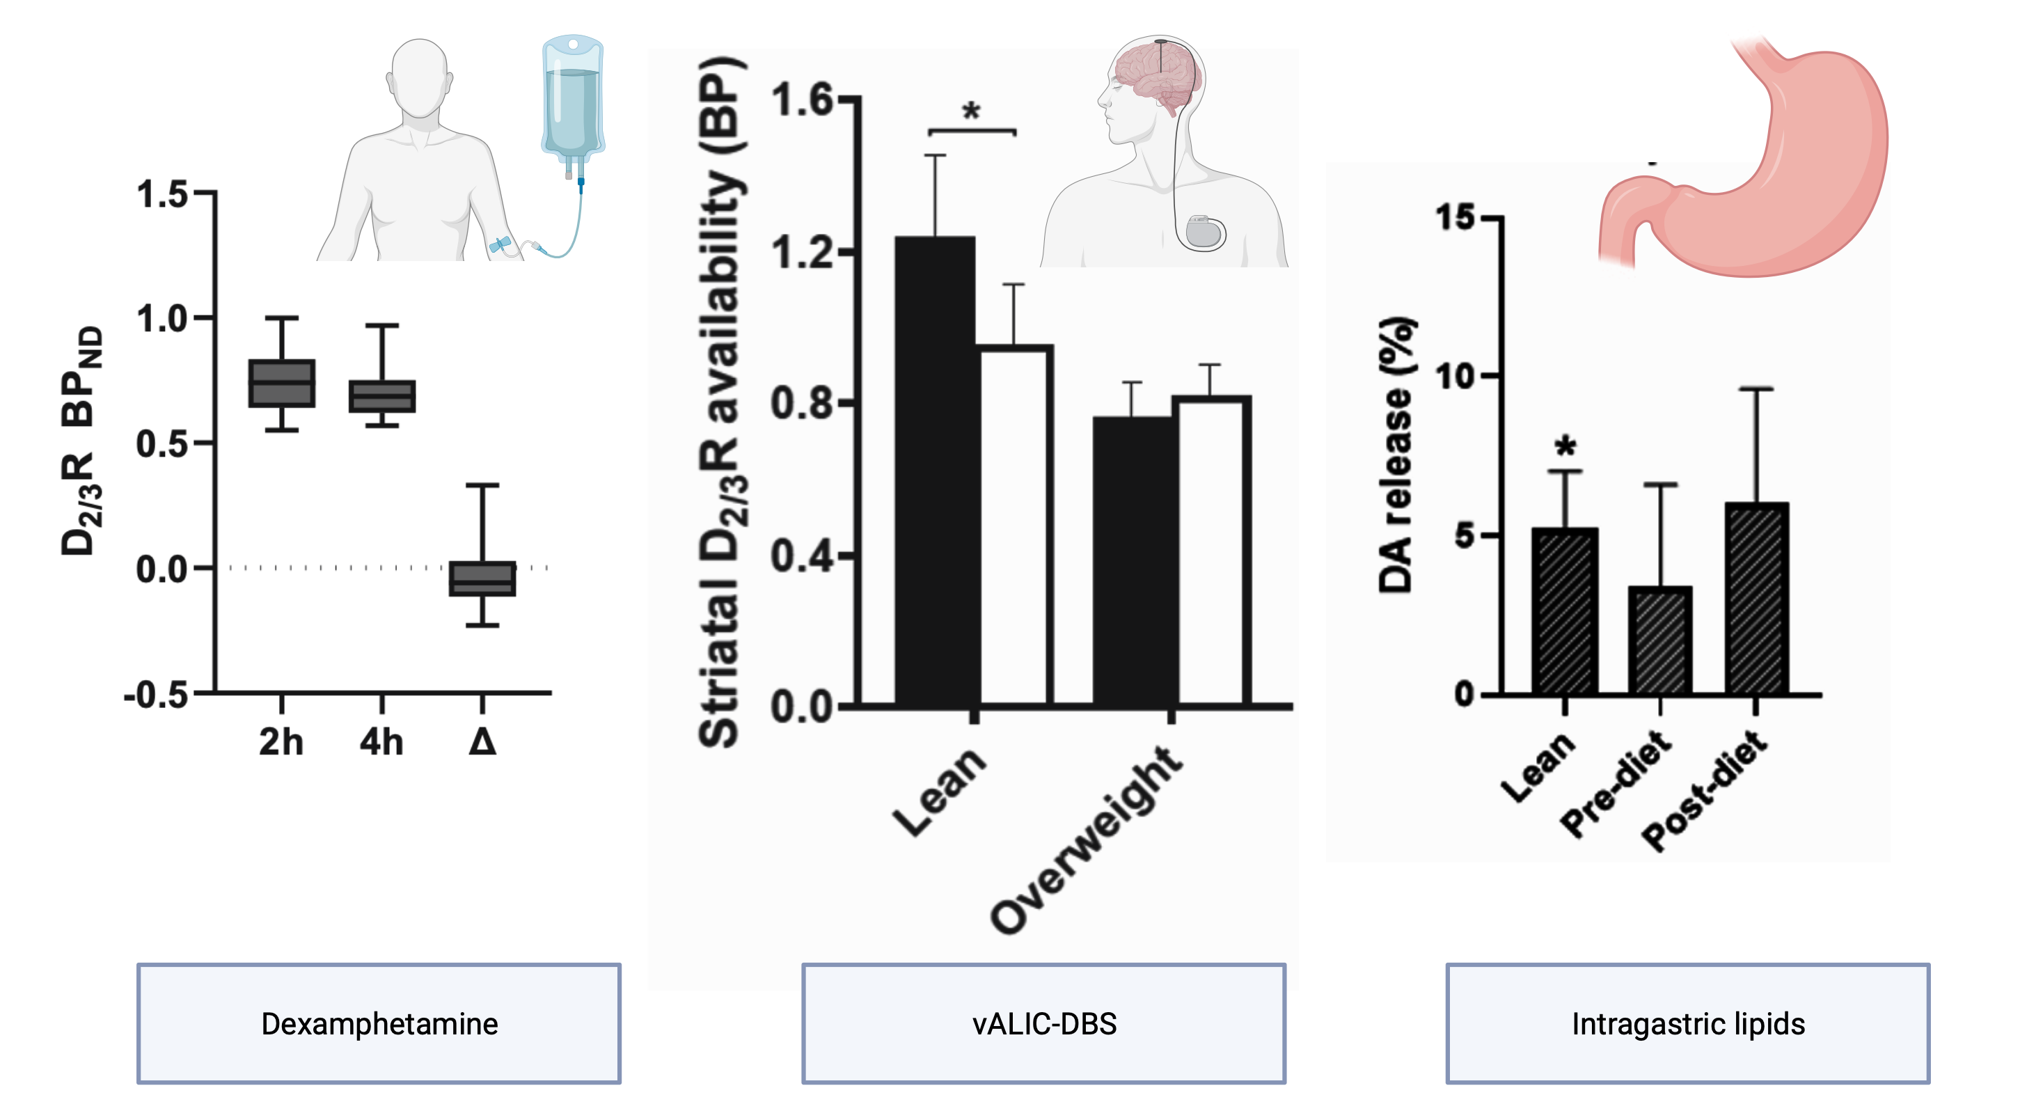
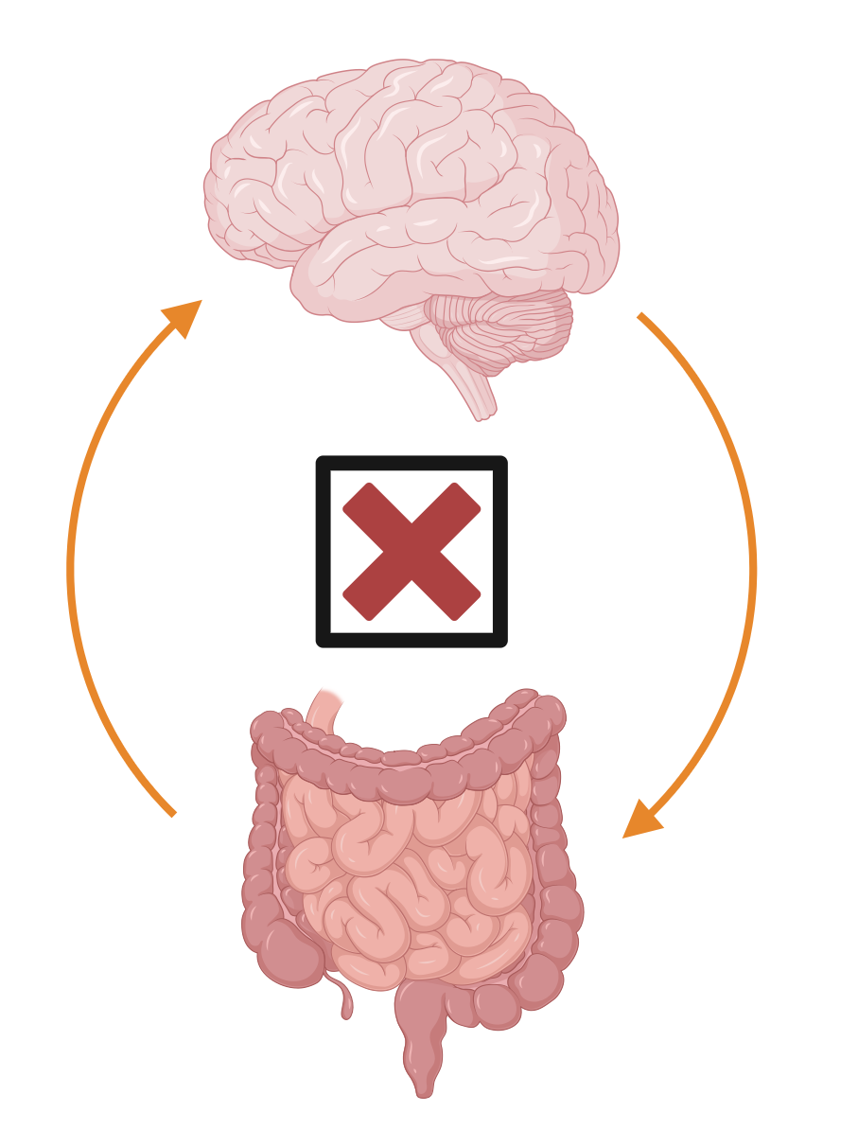

Striatal dopamine regulates food intake in humans
Our data demonstrate obesity is a hypodopaminergic state
Obesity Facts
Dopamine and Obesity
Energy in > Energy out
Disrupted regulation of food intake
Increased food intake beyond caloric need

Slide 4
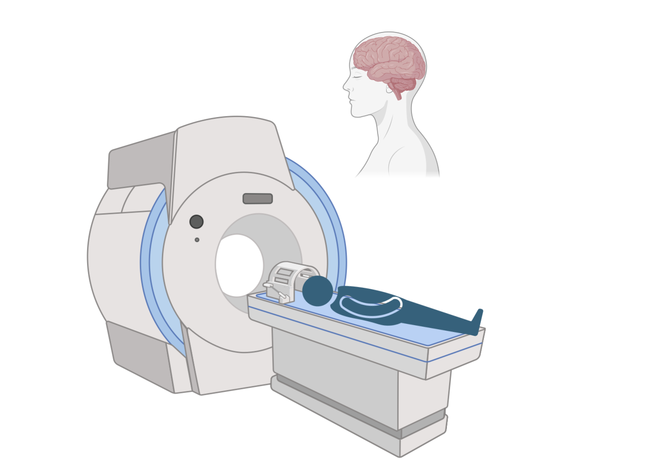
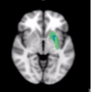
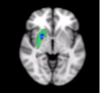
In humans, a vitamin D receptor agonist affects dopaminergic regions in the brain
Calcitriol, a vitamin D receptor agonist, increases functional connectivity and blood flow in the dorsal striatum in the human brain

Slide 5
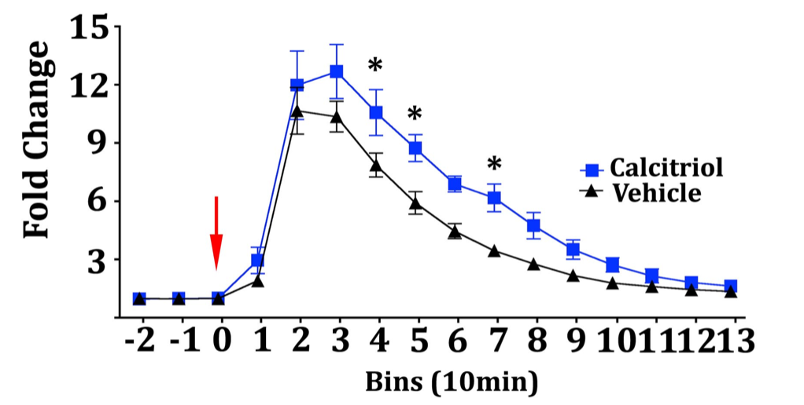
Calcitriol enhances brain dopamine levels in mice
Calcitriol increases dopamine synthesis (tyrosine hydroxylase, TH) and release

Slide 6
Calcitriol treatment normalizes body weight in chronically obese mice
*

Slide 7
Our current data show that vitamin D receptor agonism increases brain dopamine and induces weight loss
*
Calcitriol lacks specificity as a targeted obesity therapeutic

Slide 8

Vitamin D receptor agonists will address remaining unmet medical need in obesity
Calcitriol has been demonstrated to be amenable to medicinal chemistry
Ideal vitamin D receptor agonist profile :
High bioavailability
Modulates brain dopamine system
Minimal side effects
VDR agonists target the brain dopamine system
Dopamine is a therapeutic target in obesity
Adjunct/alternative to GLP-1/GIP therapy

Slide 9
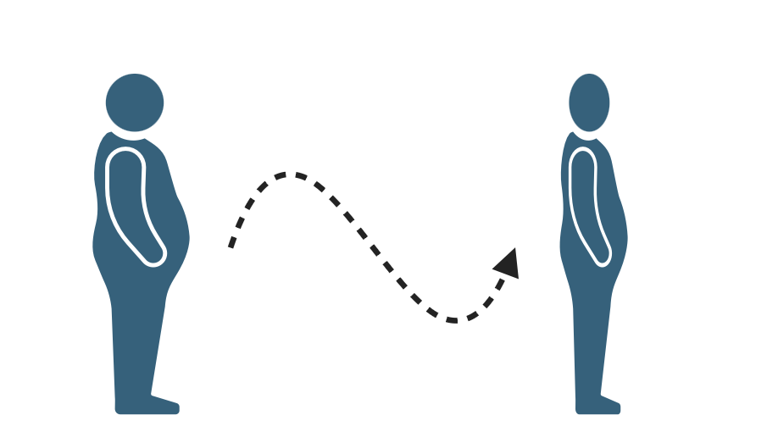
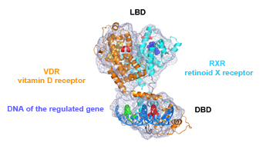

Our goal:
Screen and optimize vitamin D receptor agonist derivatives for brain dopaminergic effects and develop a safe and effective obesity therapeutic
Provisional Patent Filed: Uses of known VDR Agonists to treat obesity
Future Blavatnik-supported IP: Uses of novel VDR Agonists to treat obesity

Slide 10
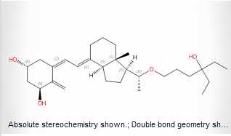
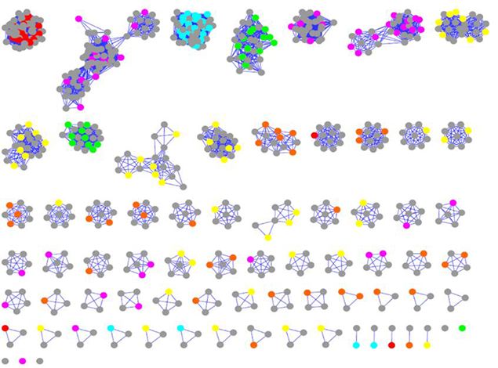
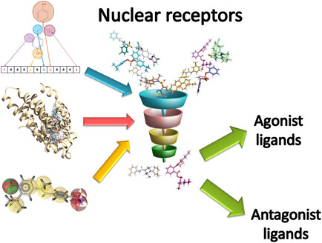


Timeline and budget
Screen calcitriol derivatives
Hit Expansion (YCMD/CRO)
Medicinal Chemistry/DMPK
Efficacy studies
$80K
$220K
Year 1 Year 2
$40K
$40K
$120K
$100K
Focused library screen
(T=4M)
Hit expansion
(T=12M)
Lead development
(T=16M)
In vivo efficacy
(T=24M)

