Slide 1
Engineering Therapeutic mRNAs
Notes:
Good AFTERNOON,
I'm excited to present our efforts in engineering therapeutic mRNAs to maximize mRNA stability, protein output, and tissue specificity.

Slide 2
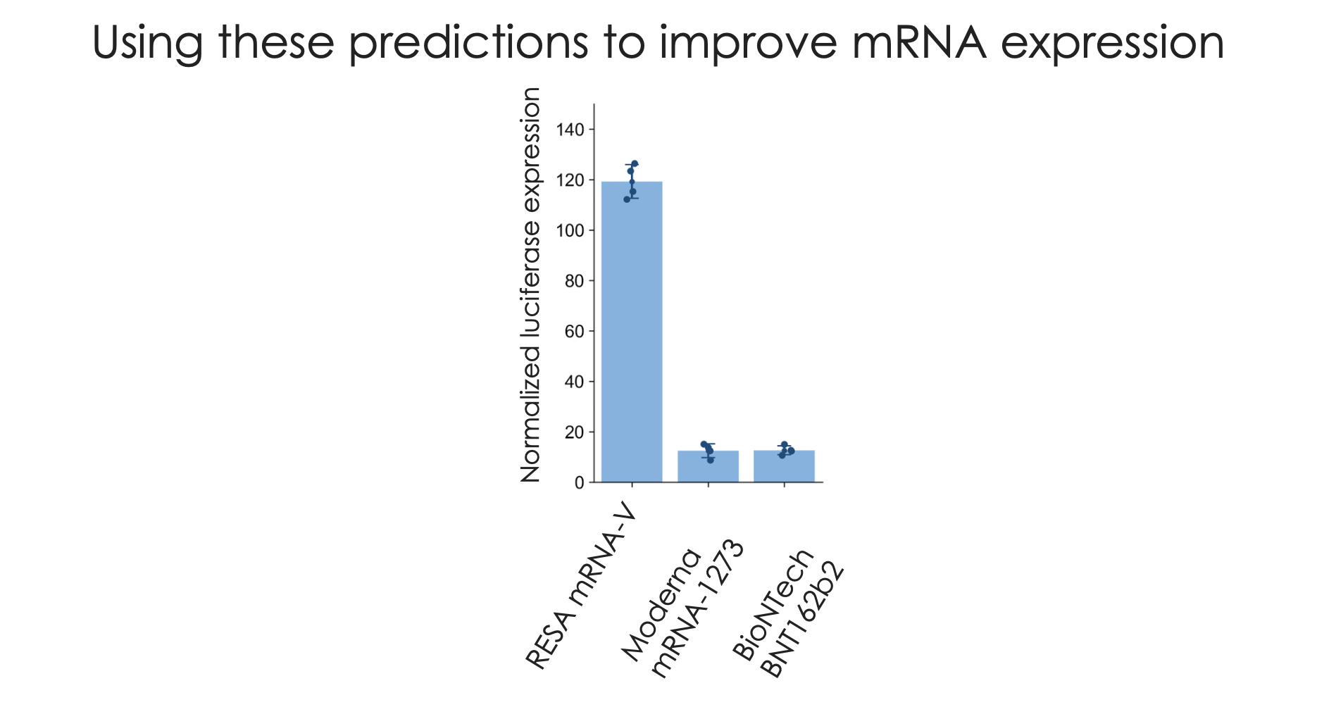
Data
Why ENGINEER THERAPEUTIC mRNAs?
Protein expression
Prot
DESIGN mRNAs
Notes:
Really short: and punchy :…here is what we achieved with out technology
Our platform has achieved a remarkable 12-fold increase in protein production compared to the leading Moderna and BionTech platforms.
Add stability over 0-72 hours
Imagine the cost and side effects improvement 90%
Just tested one: based on our design
Construction of manufacturing goes down
Receiving less RNAs

Slide 3
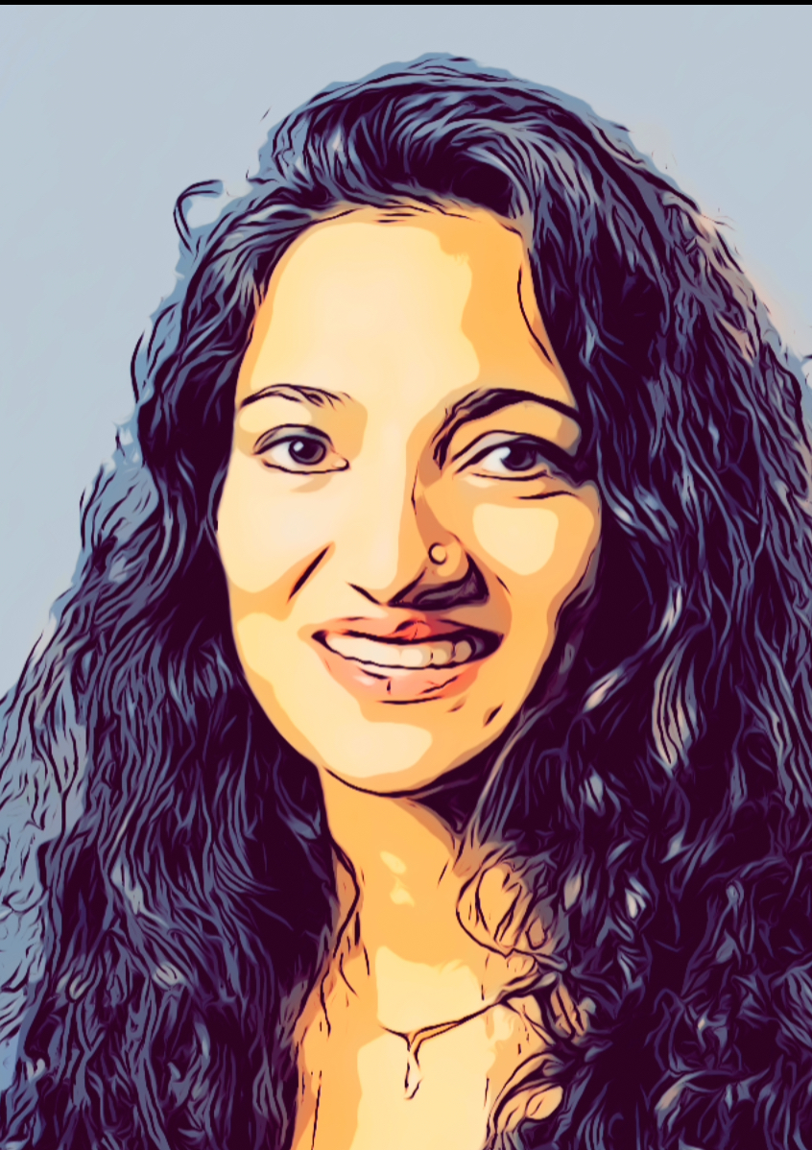
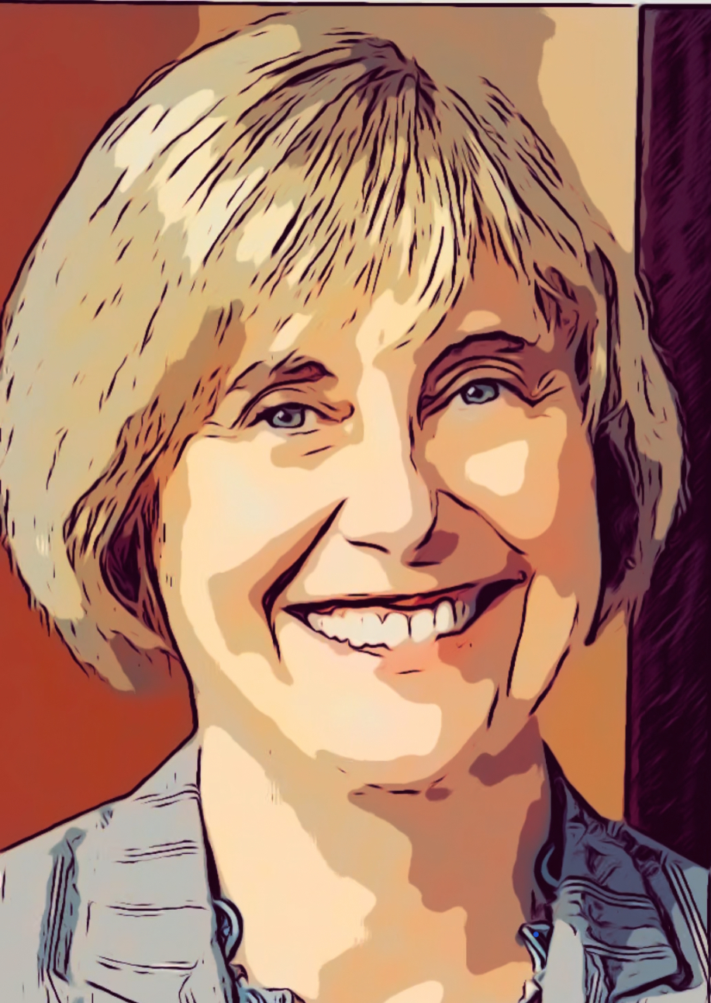
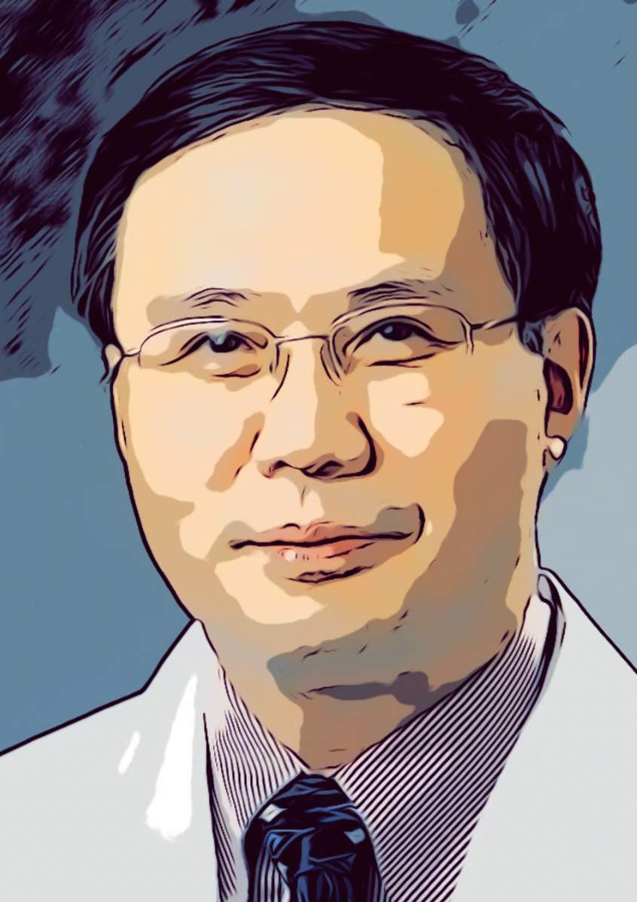
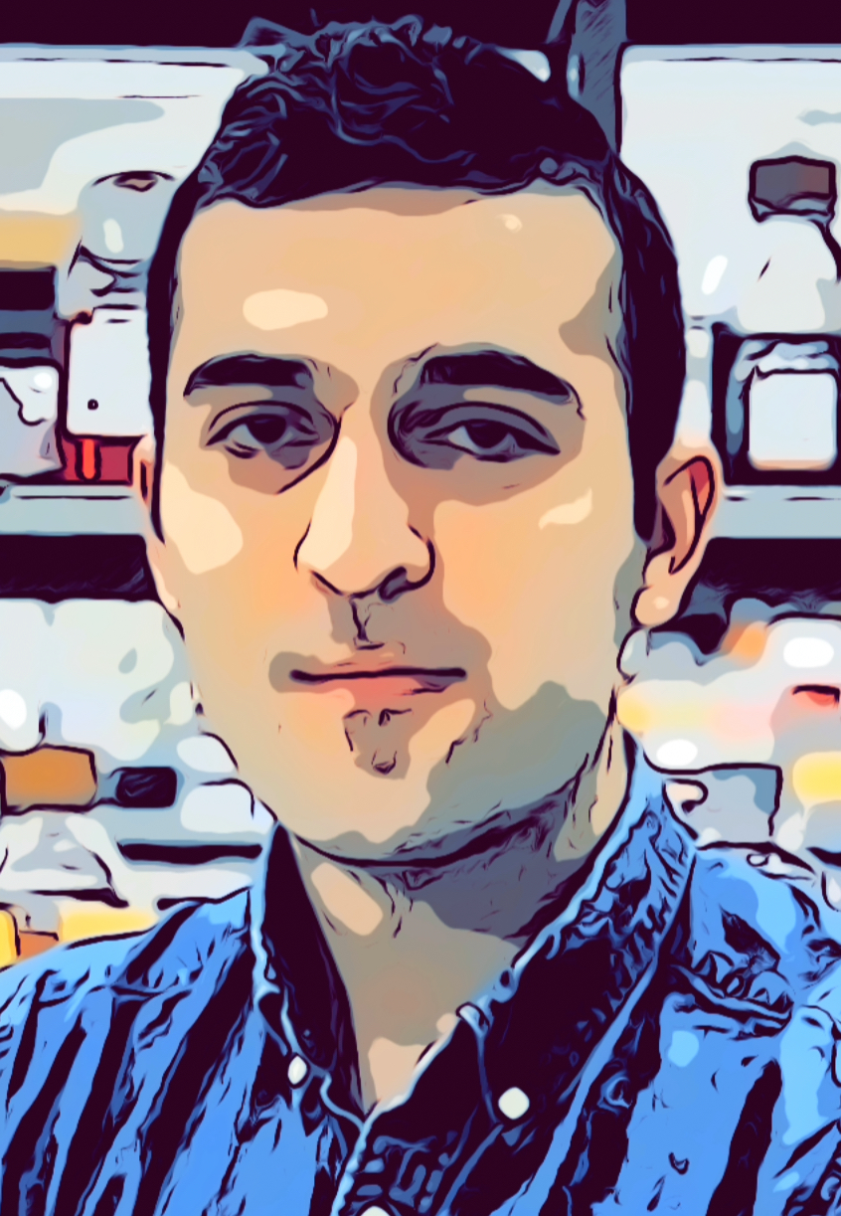
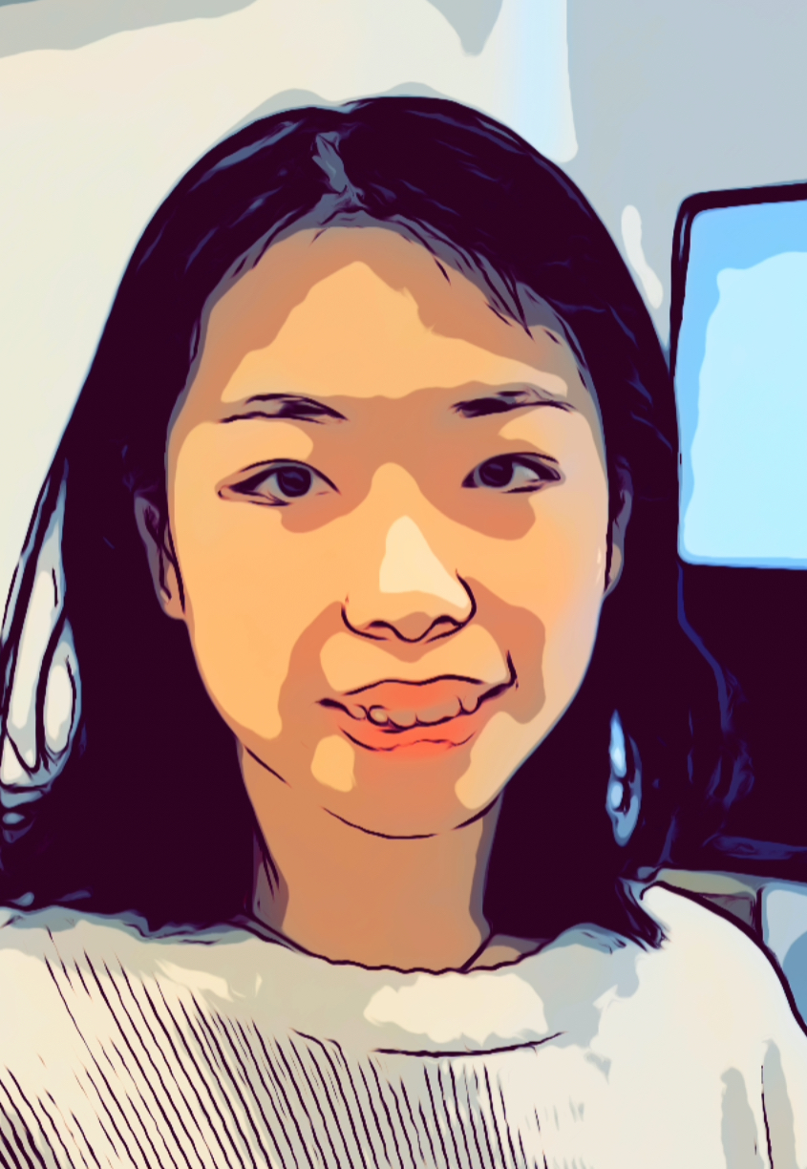
TEAM
Scientific Advisors
Smita Krishnaswami PhD
Anna Pyle PhD
Yong Hui Jiang MD PhD
Prof. Genetics and Computer Science
Prof. MCDB
Prof. and Clinical Chief of Genetics
Machine Learning
RNA Structure
Human Genetics
Antonio J Giraldez PhD
Wallace Professor of Genetics
Former Chair of Genetics
Yale University School of Medicine
Scientific team
RNA Biology
Srikar Gopinah PhD
Haejeong Lee
Damir Musaev
Ethan Strayer
Die Tang PhD
Notes:
Spend less time (20 seconds)
As the founder, I bring two decades of expertise in RNA biology as a professor of genetics and a leadership role as the chair of the genetics department. Complementing my background are Smita Khrishnasuami, a professor in genetics and computer science, specializing in manifold learning and regenerative AI. Anna Pyle, professor of molecular cellular and developmental biology, expert on RNA structure and interferon response, and Yong Hui Jiang, our clinical chief of genetics, expert in neuropschiatric disorders

Slide 4
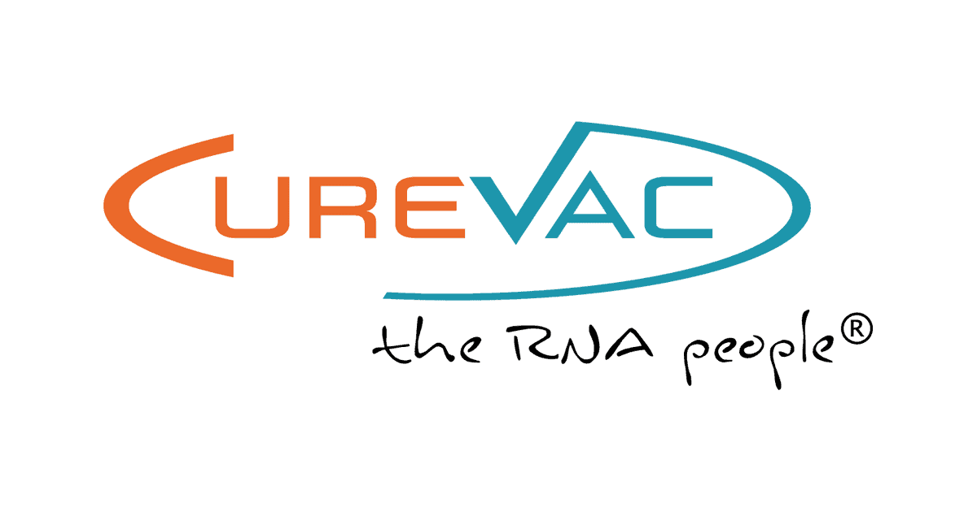
mRNA therapeutics
Vaccines
Cancer
GENE THERAPY
U.S. mRNA Therapeutics Market size ($ Billion)
mRNA market cap increased from 15 Billions in 2019 to $300+ Billions 2021
Prophylactic vaccines $800 million/per asset excluding covid vaccines
The market is expected to reach $23 Billions in 2035
RESA could have lowered Covid vaccine 12-fold, reducing side effects
RESA projected savings: $16 Billions in manufacturing cost to Moderna (61%)
$12.7B
2.2% CAGR
Prophylactic Vaccines
Cancer Vaccines
Gene Therapy
Industry Synergies
Notes:
1.- While RNA therapeutics are still in their infancy, the potential for growth across prophylactic vaccines, cancer therapeutics, and gene therapies is immense.
2.- The market capitalization of mRNA-focused companies exceeded $300 billion by August 2021, with estimates of peak sales per pipeline asset for reaching $800 million globally per year, excluding COVID.
3.- To put this into perspective, we estimate that the 8 billion COVID-19 vaccines would cost $25.9 billion, Intriguingly, with our RESA platform, it would cost 10 Billion and we would project $16 billion in savings. highlighting the economic impact of our platform.
Our platform also boasts strong synergies with other industry player such as BionTech, Moderna, Pfizer, CRISPR Therapeutics, and Sanofi amnong others.

Slide 5
Opportunities in mRNA therapeutics
SEQUENCES
IN HUMANS
SEQUENCES
ON EARTH
8 X 10 ¹² combinations
8.7 million SPECIES
POSSIBLE COMBINATIONS*
Stability
10³¹⁷
Protein output
~1000 nt mRNA
10⁸⁴
Tissue specificity
*Atoms in the universe
Notes:
The mRNA encodes for protein and is flanked by regulatory sequences. The sequence and the structure of the RNA offer the opportunity to address mayor challenges in mRNA therapeutics, such as mRNA stability, protein output and tissue specificity
Given the vast complexity of RNA, testing every combination is practically impossible, and the number of combinations would exceed the number of atoms in the universe
.

Slide 6
The RESA Solution
Tissue specificity
Stability
Protein output
Select
AAA
*
DESIGN mRNAs*
NOVEL IP GENERATED*
3 Novel composition of matter
and methods of use patents
Tissue specificity
Protein output
Stability
Notes:
We've developed a cutting-edge screening platform that combines experimental approaches for sequence selection with regenerative machine learning. This reduces the search space and enables us to identify the regulatory grammar, optimizing therapeutic mRNAs for tissue-specific effects, improving stability, and protein output
We have patented the screening platform and methods of use, and the composition of matter.
iP on the Discovery platform that I use here

Slide 7
Tissue specific targeting
mRNA degraded in off target tissues
mRNA
muscle
Tissue specificity
Notes:
Take a look at this example in zebrafish. With our RESA platform, we can achieve tissue-specific accumulation in the nervous system and selective degradation in undesired tissues, such as muscle.

Slide 8
Data
Why ENGINEER THERAPEUTIC mRNAs?
Protein expression
Prot
Stability
Protein output
DESIGN mRNAs
Notes:
We've utilized RESA to optimize the 5’UTR for protein production, comparing it to sequences used in the COVID vaccines by Moderna and Pfizer. We can see a remarkable 12 fold increase in efficiency. With this efficiency we could have addressed the vaccine shortage, and the just doses produced for the USA alone, would have been sufficient to vaccinate half the world—resulting in reduced manufacturing costs, lower mRNA levels injected in each arm and fewer side effects.
Imagine the cost and side effects improvement 90%
Just tested one: based on our design
Cost of manufacturing goes down
Receiving less RNAs

Slide 9
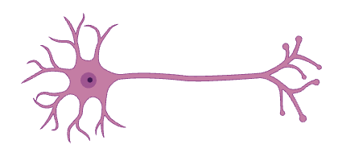
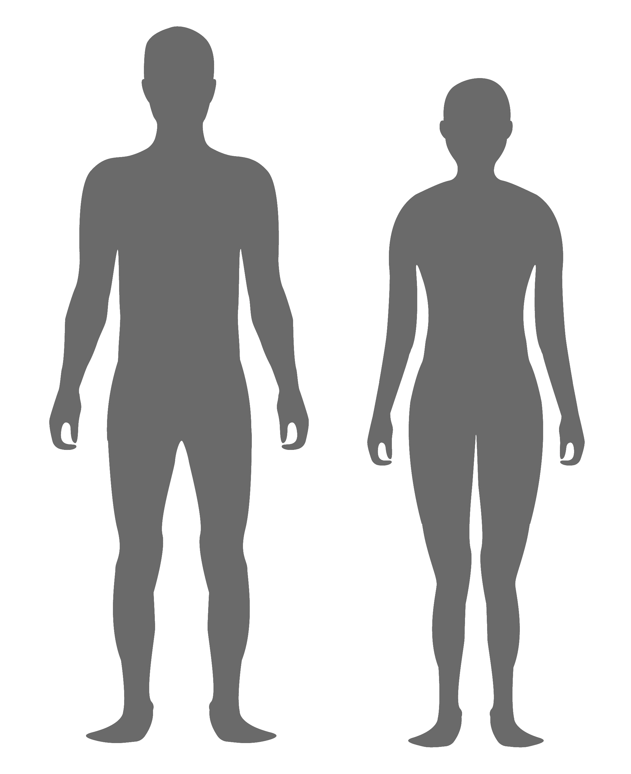
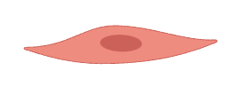
Goals and Milestones
Use of the Blavatnik Funds
Cell type specificity
Vaccine improvement
Gene therapy
Neuronal
Cardiac
Cancer
- SINGLE CELL
mRNA stability: 50K
- GENERATE optimal 5’
and 3’ UTR for
antigen expression: 40K
Developmental
-Indication Selection
- SINGLE CELL
mRNA translation: 50K
- Optimize CDS
in dendritic cells: 60K
- Rescue phenotype
In 2-3 genetic models
100 K
Time line: end 2024 may 2025 june 2026
Notes:
In summary, we've translated mRNA science into programmable RNAs, maximizing their therapeutic properties. Our in vitro and in vivo proof of concepts demonstrates the transformative potential of RESA in the RNA therapeutic landscape
With the support of the Blavatnik funds, we aim to further test our approach in vivo across multiple cell types. Our objectives include optimizing mRNA stability and translation in dendritic cells for vaccine optimization, rescuing loss of function phenotypes in 2-3 genetic models of human disease.

Slide 10
Goals and Milestones
Use of the Blavatnik Funds
Cell type specificity
Vaccine improvement
Gene therapy
Neuronal
Cardiac
Cancer
- SINGLE CELL
mRNA stability: 50K
- GENERATE optimal 5’
and 3’ UTR for
antigen expression: 40K
Developmental
-Indication Selection
- SINGLE CELL
mRNA translation: 50K
- Optimize CDS
in dendritic cells: 60K
- Rescue phenotype
In 2-3 genetic models
100 K
Time line: end 2024 may 2025 june 2026
Notes:
Think about how to integrate with the pyramid concept derisking or value
1-2 genetic models and then exploring partnerships.

Slide 11
Additional slides Q & A

Slide 12
COMBINATORIAL EFFECT OF CODONS REGULATE mRNA STABILITY
codon1
Amino Acid 1
codon2
Leucine codons
codon3
codon3
codon2
codon1
Leucine codons
Amino Acid 2
STABILIZING
DESTABILIZING

Slide 13
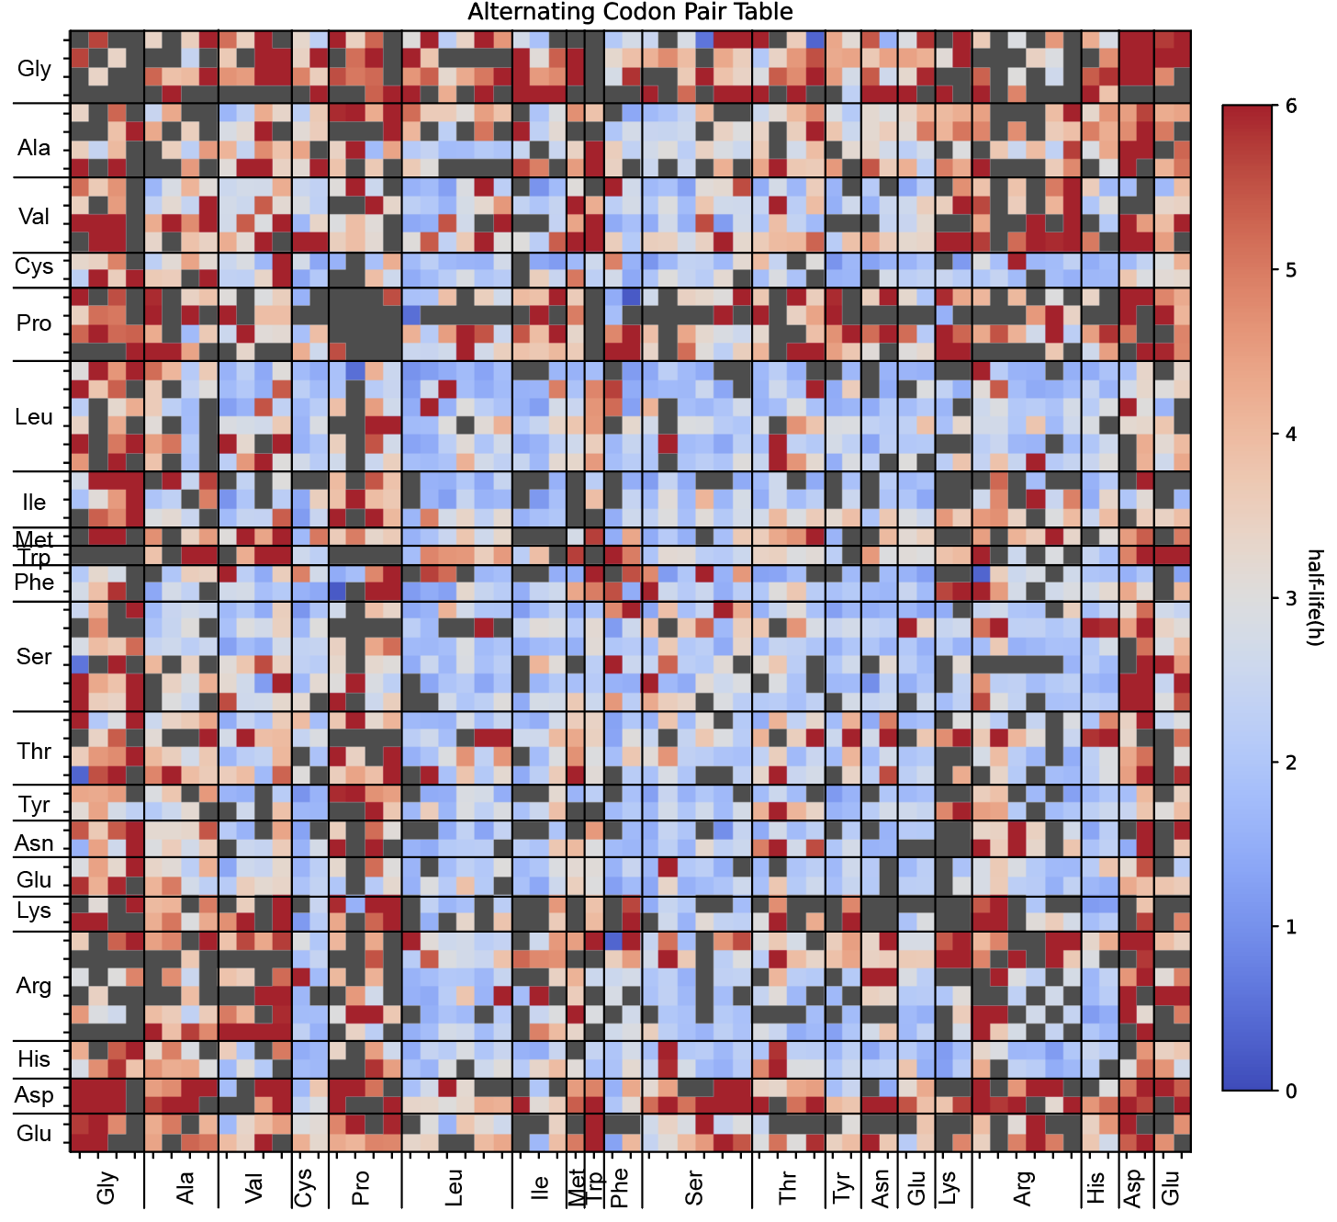
COMBINATORIAL EFFECT OF CODONS REGULATE mRNA STABILITY
codon1
Amino Acid 1
codon2
Leucine codons
codon3
codon3
codon2
codon1
Leucine codons
Amino Acid 2
STABILIZING
DESTABILIZING

Slide 14
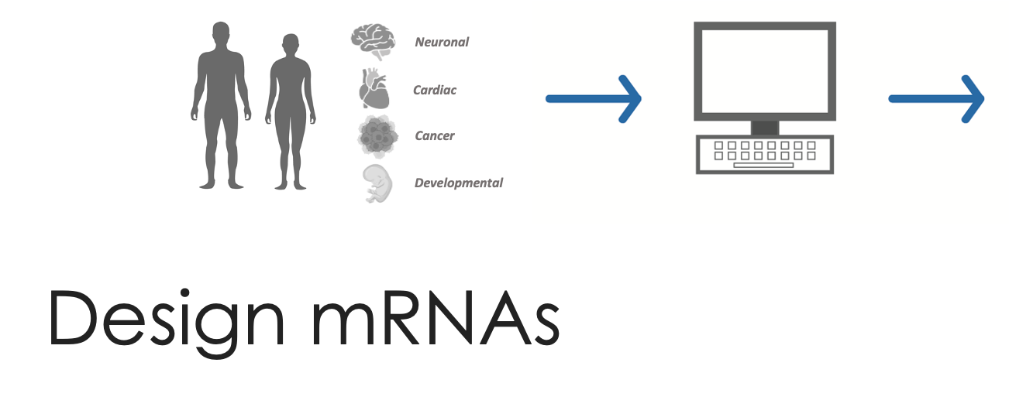
Data
DESIGN mRNAs

Slide 15
DESIGNED solutions
For therapeutic mRNAs
Leading platform translating mRNA science into ProgramMable mRNAs
Engineered mRNAs to maximize therapeutic properties
In vitro and in vivo proof of concept
Ability to transform clinical practice
Notes:
Non genome modifying!!!
Redosing and
The yellow makes it more difficult

Slide 16
Other platforms:
Flexible size, re-dosing, low toxicity
AAV: size limitations, no re-dosing, immunogenicity
no genome alteration
CRISPR: genome modification
mRNAs designed to maximize therapeutic properties
Toxicity: accumulation of therapeutic in liver or other tissues
Improve mRNA stability and protein production
Notes:
Appear.
Non genome modifying!!!
Mention these points in one place only
The yellow makes it more difficult

