Slide 1
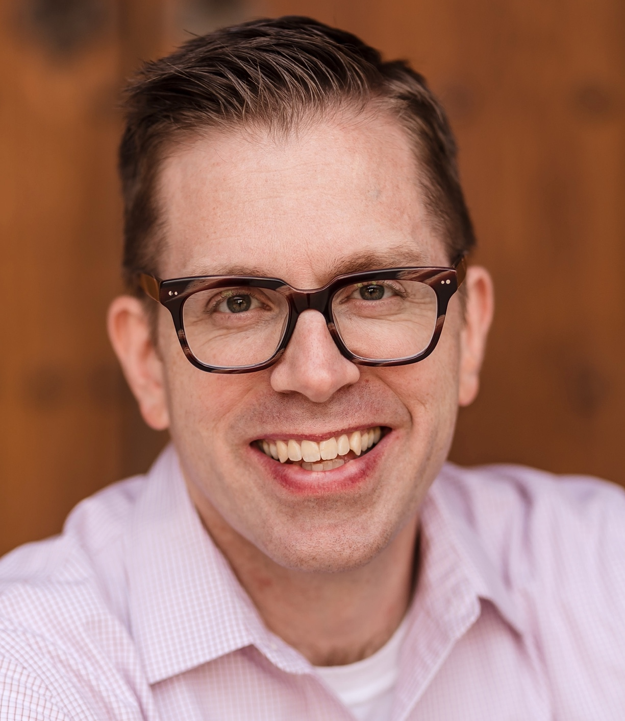
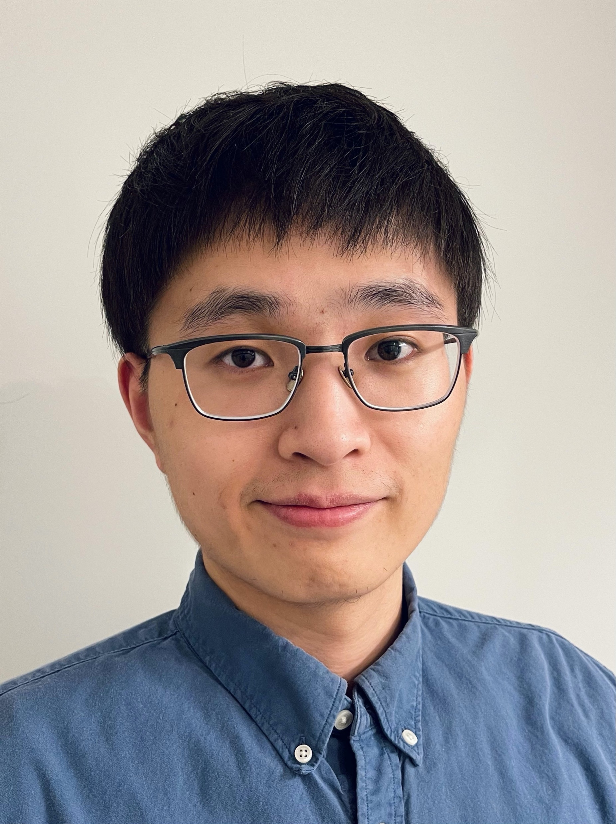
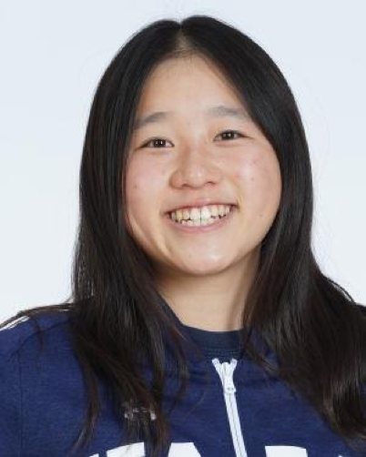
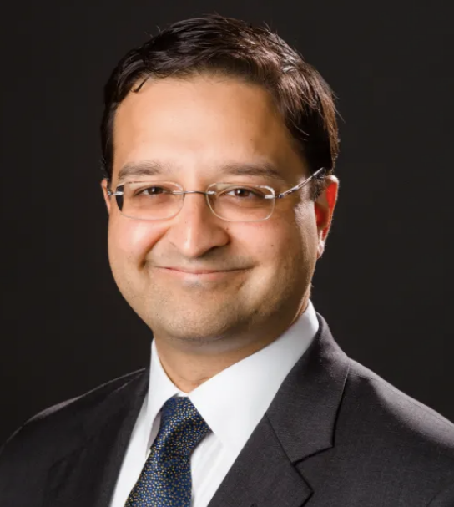
Innovative Administration of Heart Failure Medications
Stuart Campbell, PhD
Associate Professor
Yale Biomedical Engineering
Shi Shen, PhD
Former Graduate Student
Stephanie Shao
Undergraduate Student
Tariq Ahmad, MD
Chief of Heart Failure
Yale Cardiology

Slide 2
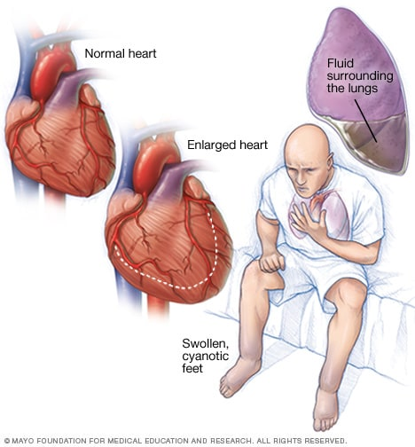
Problem: Heart Failure
Causes 1 in every 8 deaths
Affects ~6.2M Americans
No cures; current therapies have low efficacy

Slide 3


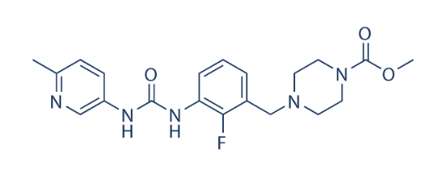
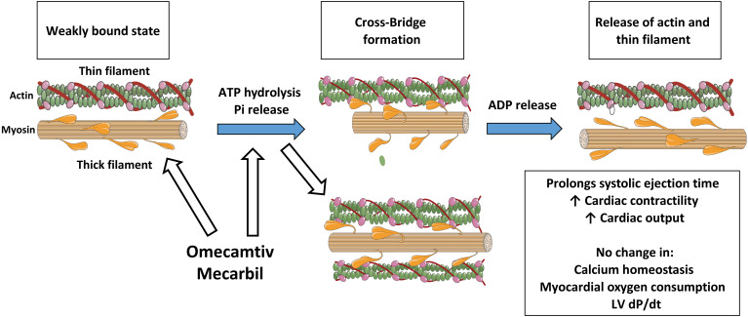
Attempted Solution: Drugs to Strengthen Contraction
Omecamtiv Mecarbil (OM)
High specificity
Enhances myosin motor activity
Increases contraction force
First-in-class (cardiac myosin activator)
Malik et al. Science 2011
Maynard C, et al. Side Eff. Drugs Annu 2017

Slide 4

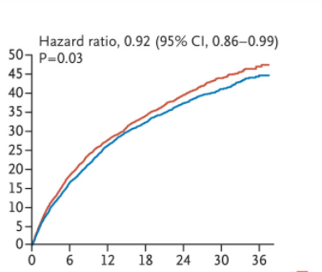
Phase 3 Trial: OM failed to improve patient mortality
Three-year study of heart failure patients
OM reduced hospitalizations by just 5%
Patient mortality was not reduced
FDA declined to approve OM (2023)
Cumulative Incidence (%)
Months
Teerlink JR, et al. N Eng J Med 2021.

Slide 5
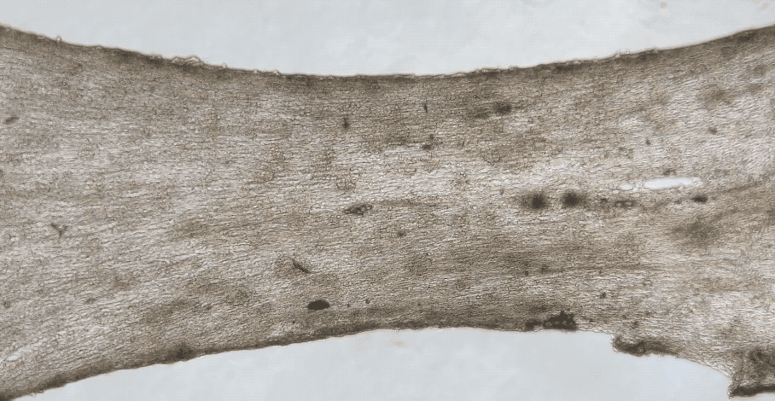
Why did OM fail?
Poor relaxation,
marginal benefit
Could we use OM in a different way?

Slide 6

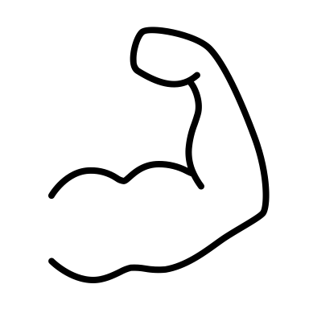
Our Idea:
Use OM intermittently to trigger muscle growth

Slide 7
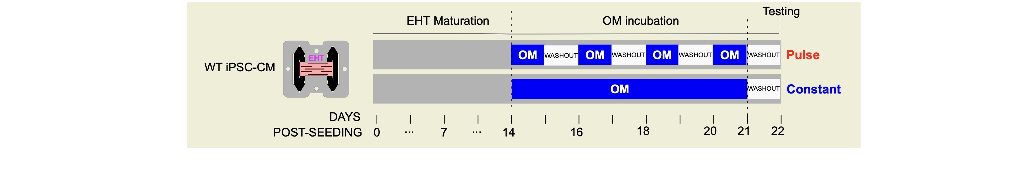
Intermittent Doses of OM
63% increase in force
Normal relaxation behavior

Slide 8
A New Dosing Paradigm
Cytokinetics Patent
Yale
Patent
Pending
(2023)

Slide 9
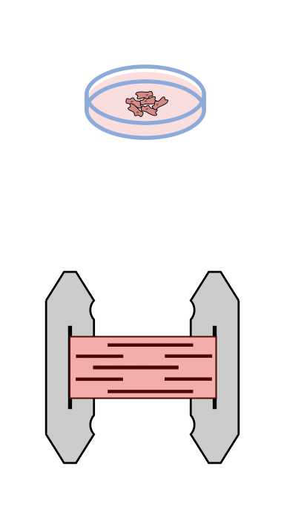
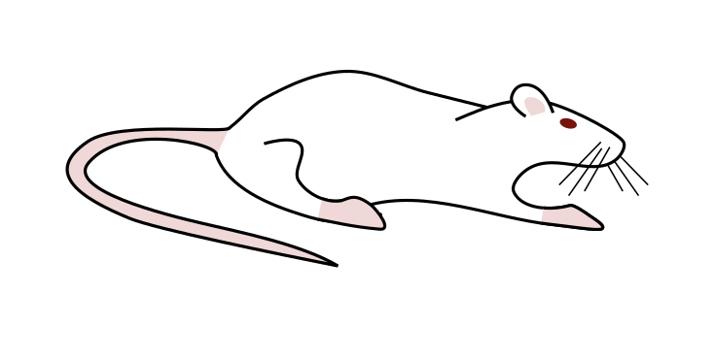



Blavatnik Development Award
EHT Studies
+ RNAseq & Proteomics
Initial EHT Studies
$28,000
New Clinical Trial
High-Impact Peer-Reviewed Publication
Validate in Rat Model of Heart Failure
$52,000
$$$ to Yale from licensing
Graduate Student
Researcher
$50,000
Total: $130,000

Slide 10

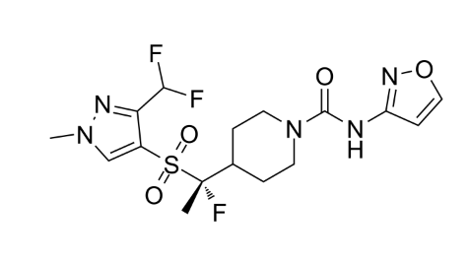
High-Impact Peer-Reviewed Publication
Omecamtiv Mecarbil (OM)
Danicamtiv
Programs at other companies?

Slide 11
Omecamtiv Mecarbil (OM)
Lackluster
Blockbuster!

