Slide 1
Dual MIF - D-DT Targeting to Enhance Immunotherapy Responses
Thuy Tran, MD, PhD
Assistant Professor in Internal Medicine
Medical Oncology
Yale Smilow Cancer Center
thuy.tran@yale.edu
Richard Bucala, MD, PhD
Waldemar Von Zedtwitz Professor of Medicine
Chief, Yale Rheumatology, Allergy & Immunology
richard.bucala@yale.edu
December 7, 2023
Notes:
Description of the project (75-100 words)
Macrophage migration inhibitory factor (MIF) and D-dopachrome decarboxylase (D-DT) are cytokines that share high sequence similarity, function, and ligands. MIF and D-DT are elevated in cancer; inhibition boosts immune therapy responses by increasing CD8 T cells and enhancing M1 macrophage polarization. We propose the development of a bispecific neutralizing antibody against MIF and D-DT for use in clinical trials to augment immune therapy responses and overcome resistance. Given overlapping functions, inhibition of both MIF and D-DT results in more robust anti-cancer responses. This drug would provide additional treatment options against immune-responsive cancers and address a gap in our treatment portfolio.

Slide 2
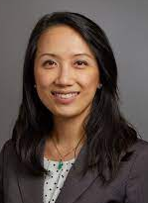


The Yale MIF/D-DT Team
Dr. Thuy Tran, MD, PhD
  Assistant Professor, Yale Cancer Center
  Expertise in melanoma and other skin cancers
  Principal investigator in multiple commercial melanoma clinical trials with IIT experience
  Research lead in MIF/D-DT preclinical studies in oncology
  Funded by the Yale SPOREs in Skin Cancer and Head and Neck Cancer
Dr. Richard Bucala, MD, PhD
  The first to clone and characterize MIF
  Developed the clinical anti-MIF (Imalumab)
  Waldemar Von Zedtwitz Professor of Medicine
  Professor of Medicine, Pathology, and Epidemiology & Public Health
  Chief, Section of Rheumatology, Allergy & Immunology
Dr. David Lewin, PhD
  Director of Business Development

Slide 3
The Problem - Melanoma Immune Therapy Remains Limited
Regimen | FDA-Approval | Mechanism | Objective response rate
Ipilimumab | 2011 | anti-CTLA-4 | 19%
Pembrolizumab | 2014 | anti-PD-1 | 34-40%
Nivolumab | 2014 | anti-PD-1 | 32-45%
Ipilimumab/nivolumab | 2015 | anti-CTLA-4 anti-PD-1 | 58%
Nivolumab/relatlimab | 2022 | anti-PD-1 anti-LAG-3 | 43%
Tebentafusp (uveal HLA 02:01 only) | 2022 | bispecific gp10-CD3 peptide | 46%
Large potential market – total revenue $60 billion in 2021
Targets largely restricted to a few pathways
Limited responses; best at ~58%
No standard options after treatment failure
Need remains to overcome immune resistance
Limited options for those who suffer toxicity to current agents
The Solution
Dual targeting of MIF & D-DT
as novel checkpoint inhibitors

Slide 4
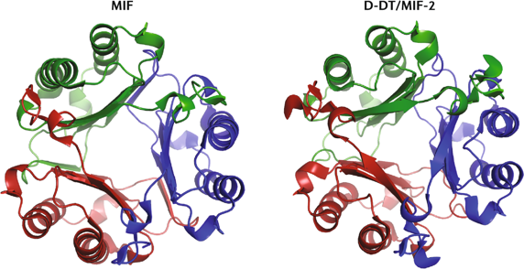
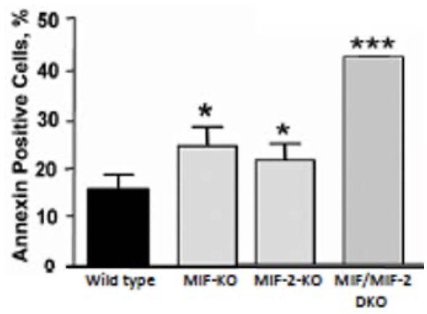
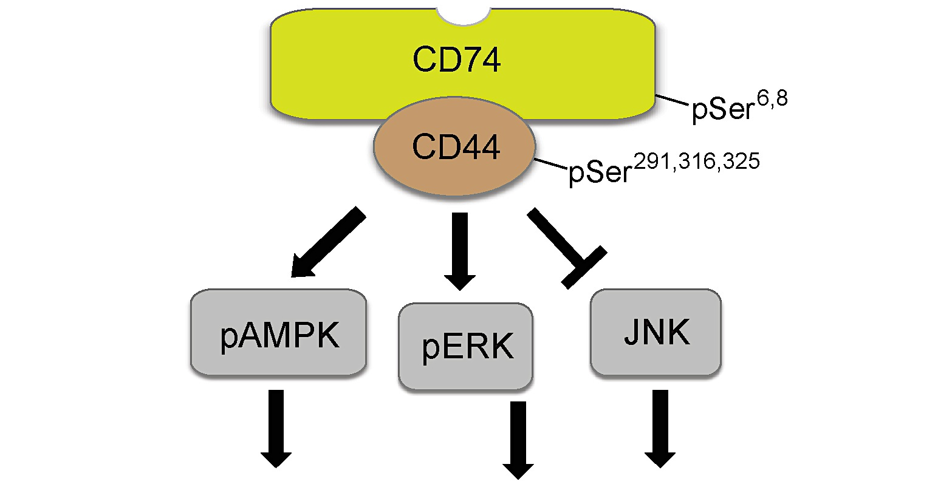
Targeting both MIF and D-DT (MIF-2) Is Critical for Pathway Inhibition
MIF
D-DT
Anti-MIF
Imalumab
Anti-D-DT
MIF
D-DT
Anti-CD74
Milatuzumab
CXCR2
CXCR4
Chemotaxis/ Migration Arrest
Wild type
MIF KO
D-DT KO
MIF/D-DT KO
Survival, Proliferation, Activation
Pathways
MIF
D-DT
Prior anti-MIF trials have shown modest responses but proved safe and tolerable
CD74 (one MIF receptor) not easily targeted (T cell immunity)
No prior attempt at D-DT clinical targeting
Rationale for a dual targeting antibody
  More efficient than developing two monospecific drugs
  Increases depletion of both targets with high affinity and enrichment within the tumor

Slide 5
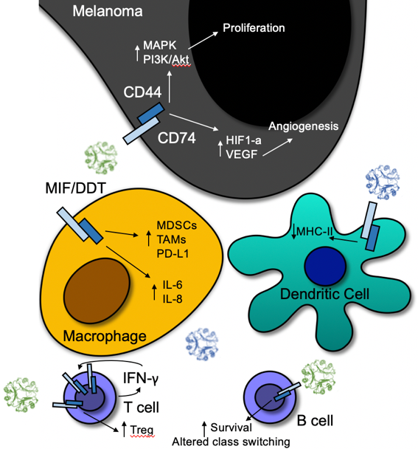
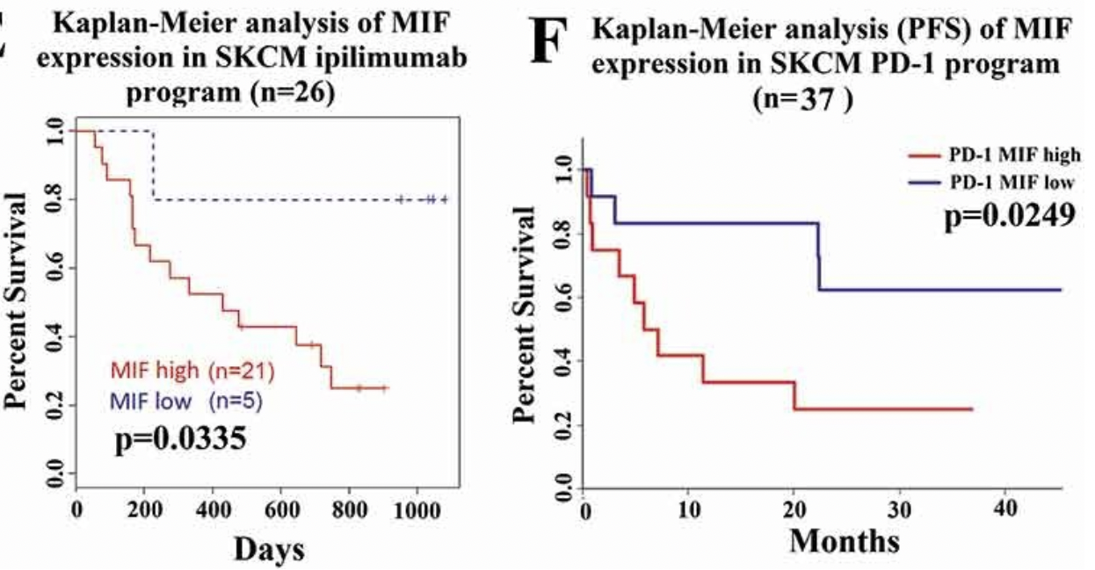
High Levels of MIF Result in Worse Cancer Outcomes
MIF signaling causes immune suppression and tumor evasion
Higher MIF levels are associated with poorer survival, worse disease responses and resistance to immune therapy in melanoma
Azevedo et al. Oncoimmunology, 2020.

Slide 6
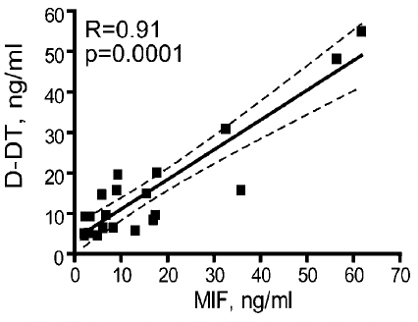
MIF and D-DT in Oncology
Ovarian Cancer Serum Protein
Yale Melanoma Patients Treated with Immune Therapy
CD74:MIF
Overall Survival
Progression Free Survival
Months
0
Months
500
Yale Melanoma Tumor mRNA
Yale Melanoma Tumor mRNA
R = 0.52
p = 1.8e-10
CD74:DDT
Progression Free Survival
Overall Survival
D-DT
Months
0
Months
500
MIF
Levels are not linked to mutational status in melanoma (i.e. BRAF, kit, or wild-type) or subtype (cutaneous, acral, mucosal, or uveal)
Lower levels are associated with partial and complete responses to immune therapy in melanoma

Slide 7
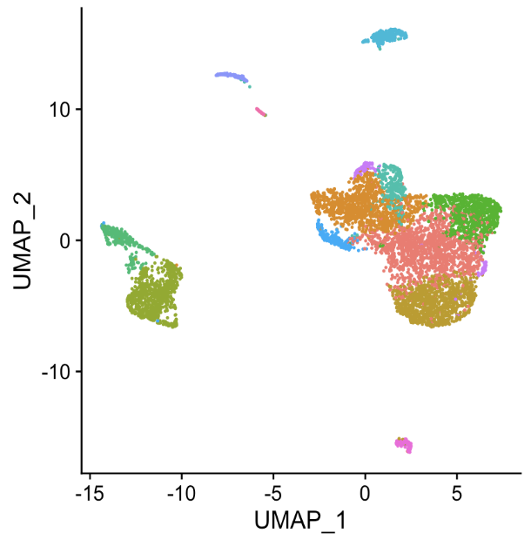
MIF and D-DT Targeting Enhances Immune Response
Intellectual property: specific and selective anti-MIF and anti-D-DT monoclonal antibodies
Treatment Stopped
Response
Response
pDCs
eosinophils
0%
22%
B cells
0%
33%
cDCs
NK cells
M1-like
Mϕ
0%
66%
17%
33%
T cells
60%
73%
M2-like Mϕ
Shorter Treatment (2 doses)
Longer Treatment (4 doses)
100
CD4
Dual MIF - D-DT inhibition targets known pathways of tumor response
Increased tumor infiltration of cDC1 and CD8 T cells
Increased intratumor Th1 cytokines and macrophage activation
Increased antigen presentation on scRNA tumor sequencing
Decreased tumor angiogenesis
Eomes high cytotoxic CD8
50
Percent of T Cells
Cd74 high DNT
Effector
memory
CD8
Central
memory
0
Numerous in vitro and in vivo assets developed for preclinical testing
Isotype
anti-PD-1
anti-PD-1/
anti-MIF/
anti-DDT
Isotype
anti-PD-1
anti-PD-1/
anti-MIF/
anti-DDT

Slide 8
The Grand Concept
Novel pathway targeting
Complementary to existing checkpoint inhibitors
Tumor agnostic immune response
Potential to turn “cold” tumors “hot”
Broad applications within oncology
  Pre-clinical data shows activity in melanoma, colorectal cancer, and GBM. Active studies in HNSCC.
Can extend beyond oncology
Wani, M.Y., Malik, M.A. (2021). Cancer. In: Gold and its Complexes in Anticancer Chemotherapy. Springer, Singapore. https://doi.org/10.1007/978-981-33-6314-4_1

Slide 9



Use of Funding
In vivo validated, high affinity CDRs in hand reactive to human/mouse MIF and D-DT
completed
In-progress
1
8 weeks
2
10 weeks
3
10 weeks
4
2 months
5
12 months
6
8 weeks
7
12 weeks
Phase I/II
Study
AI Based Ab Generation & Humanization
Generation of mAb Variants & BLI Testing
Lead Optimization; Stable Cell Line Development
Hybridoma Sequencing
Pre-clinical Validation
Toxicology
Bucala Lab & CRO
CRO
IND-enabling studies
$2,000
$10,000
$19,000
$50,000
$150,000
$100,000
External
Funding
External
Funding
Accelerator Award
Total Cost: $300,000

