Slide 1
CAR-mast Cell Therapy for Solid Tumors
Xiaolei Su
Yale School of Medicine
Blavatnik Fund
Thanks to Justin Kim (Yale Blavatinik Associate) for editing slides and doing market analysis
Notes:
Good morning! I’m Xiaolei Su, a faculty at Yale School of Medicine. Today I’m excited to present our efforts on developing a brand-new cell therapy, CAR-mast cell therapy to target solid tumors.

Slide 2
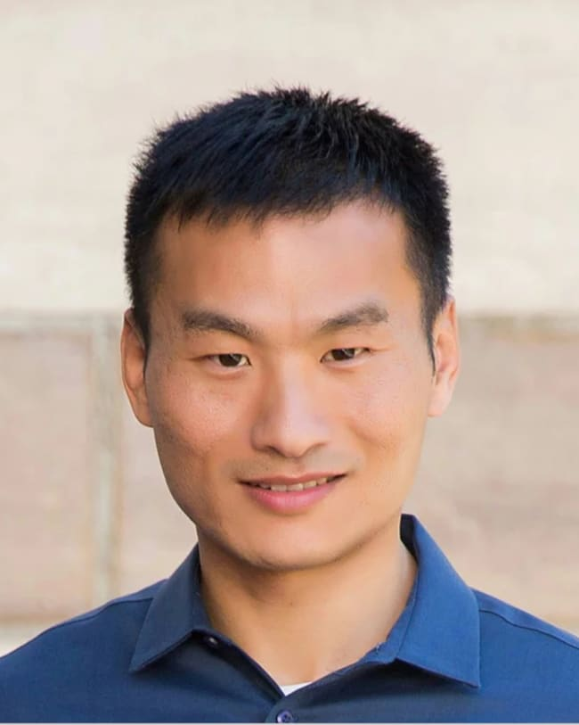
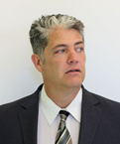
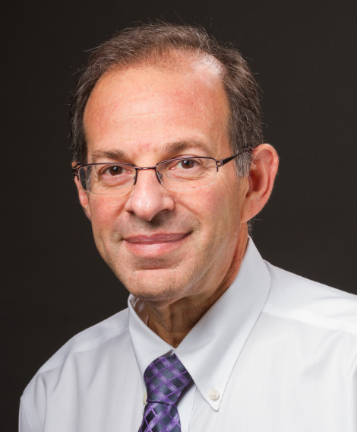
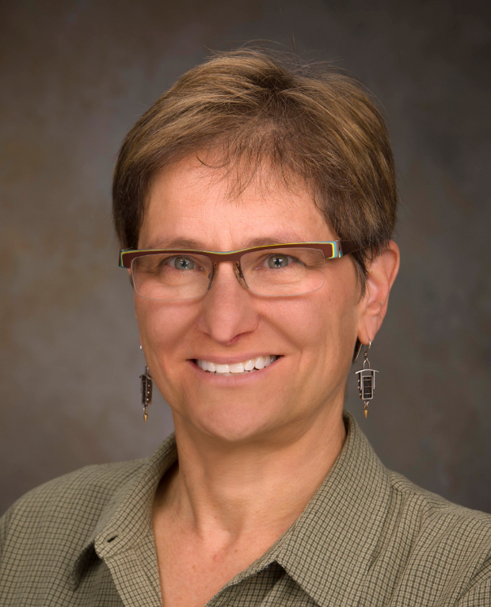
Team
Xiaolei Su, PhD
Leader
Faculty in Cell Biology Pioneering research in immunology and cell engineering
Chris Kepley, PhD, MBA
Advisor
Faculty in Immunology Over 30 years of research and translational application on mast cells
Mario Sznol, MD
Advisor
Co-Leader of Cancer Immunology Program
Conducted multiple clinical trials on immunotherapy
Diane Krause, MD, PhD
Advisor
Medical Director of Advanced Cell Therapy Lab Overseeing generation of cell therapy products
Notes:
We have assembled a team with comprehensive expertise, which covers both the scientific and clinical side. This includes myself, who will lead the scientific development with the input from Dr. Kepley who studies mast cells over 30 years. Dr. Sznol and Dr. Krause, who have rich experience on clinical trials of cancer immunotherapies at Yale.

Slide 3
CAR-mast cells: a breakthrough on cell therapy
Historic Excitement on Cell Therapy
 | CAR-T Therapies | CAR-mast Therapies
Tissue Infiltration | Low access to tumors | High tissue presence
Therapy State Over Time | Early exhaustion | Repeated activation and live for years
Immune checkpoint | High inhibition (PD1, CTLA-4) | Free of inhibition
CAR-T cell therapies:
high-profile M&A deals $12B acquisition of Kite Pharma $9B acquisition of Juno
6 FDA approved CAR-T for blood cancer
Low efficacy on solid tumors
CAR: Chimeric Antigen Receptor
Notes:
The comparable product of CAR-mast cell is CAR-T cell. In the past two decades, CAR-T therapy has attracted tremendous interest because of its astonishing efficacy on treating blood cancers, which results in a few high-profile MA deals and 6 FDA approved CAR-Ts. However, CAR-T encountered substantial obstacles when expanding to solid tumors. Major challenges include low tumor infiltration, exhaustion, and inhibitory signaling of t cells. Therefore, we decide to seek alternative cell carries for CAR. We focused on mast cells because they are tissue resident, can undergo repeated activation without exhaustion, and are resistant to inhibitory signaling. These features can overcome major challenges in CAR-T’s application to solid tumors.

Slide 4
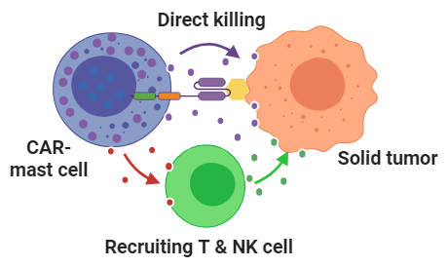
CAR-mast cells eradicate tumors in two ways
Targeted Antigen | Type of Cancer
Target 1 | Colorectal Ovarian Pancreatic Lung Prostate Skin
Target 2 | Lung Skin Brain Bone
1
Lead Indication
Potential Follow-On Indications
2
Notes:
We designed a new version of CAR for mast cells. This CAR not only enables the specific targeting of mast cell to tumors, but also triggers two orthogonal pathways to kill the tumor: one is by secreting chemokines that recruit cytotoxic T cell and NK cell to the tumor; and the other is through secreting toxic factors that directly kill tumors. We have verified the tumor killing by constructing CARs targeting two different antigens, both are commonly overexpressed on a variety of solid tumors. In this application, we focused on colorectal cancer because we have obtained preliminary data showing a good anti-tumor efficacy.

Slide 5
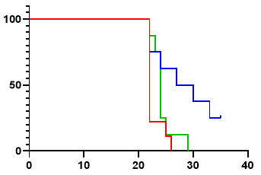
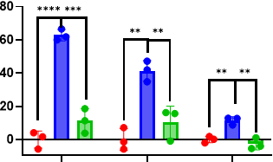
Validation: CAR-mast cells drive cancer antigen-dependent killing
Antigen 1-Directed CAR-Mast Cells Control Tumor Growth In Vivo
Antigen 1-Directed CAR-Mast Cells Selectively Kill Cancer Cells In Vitro
Control
Untreated
CAR-mast cell
Mast cell
Mast cell
Survival %
CAR-mast cell
Cell Lysis %
SK-MEL2
MELA
MELB
Days Post Injection
Similar efficacy results were obtained on Antigen 2
Patent application pending
SK-MEL2, MELA, and MELB are cancer cell lines
Notes:
Some details on the data: we showed that CAR-mast cells can specifically kill multiple cancer cell lines expressing antigen 1; In parallel. CAR-mast cells significantly delay tumor growth and improve survival in a mouse xenograft model. A similar result were obtained on antigen 2.

Slide 6
High unmet need entails opportunity for high efficacy, high durability treatment like CAR-mast
Current Treatment Landscape
153,000 New Colorectal Cases Annually in US Fourth Most Common Cancer in US
Frontline Treatment* | Keytruda | Erbitux + Braftovi | Avastin + Chemo
% Patients Respond to Treatment | 44% | 20% | 40-50%
Months Until Disease Progresses | 16.5 | 4.2 | 9
Most patients do not respond to standard of care, and their disease progresses relatively quickly
CAR-T were each first approved as follow-on therapies with meaningful efficacy and durability over traditional therapies
Colorectal Cancer Patients Whose Disease Progressed
Alternate, potent mechanism to treat patients high in Target 1
CAR-mast
* Treatments are split by patient-specific biomarkers (e.g., dMMR/MSI-H for Keytruda, BRAF for Braftovi + Erbitux)
dMMR: deficient mismatch repair; MSI-H: microsatellite instability high; BRAF: B-Raf
Notes:
On the market side, colorectal cancer is the fourth most common cancers in US. Only Less than half of patients respond to Frontline treatments, which suggested a large space for CAR-mast cell to enter the market.

Slide 7
Vision for CAR-mast cell therapy
First-in-class CAR-mast cell therapy on the market
Target multiple solid tumors with sustainable efficacies, breaking major hurdles that CAR-T encountered
Innovative design to enable a dual mechanism of eradicating solid tumors (direct killing and indirect killing by recruiting of T and NK cells)
Notes:
To summarize, this will be the first mast cell-based immunotherapy on the market, which targets a variety of solid tumors, with colorectal cancer as the leading target. we have filed a provisional patent on that. Our data suggested CAR-mast cells eradicate tumors by two independent mechanism: directing killing and indirect recruitment of T cells and NK cells. CAR-mast cells are expected to overcome some of the major obstacles that prevent CAR therapy’s application into solid tumors. The support from Blavatnik Fund will enable critical studies that move this project into clinical trials.

Slide 8
Request $300K Blavatnik Funding
Phase I Phase II
First Half | Second Half | First Half | Second Half | Future Experiments
Develop 2nd generation of CAR-mast cells with enhanced tumor survival and persistence
Colon Cancer Model: $70K
To demonstrate the superior anti-tumor efficacy of CAR-mast cells over CAR-T cells in a mouse colon cancer model
CAR-T + CAR-mast Combo: $110K
To investigate combinations of CAR-T and CAR-mast therapies in a mouse colon cancer model
Test safety of CAR-mast cells (e.g., cytokine storm and neuronal side effects)
iPSC Development: $120K
To generate iPSC-derived large quantity of human CAR-mast cells
Notes:
We would like to use this fund for three tasks, No.1, to demonstrate the superior anti-tumor efficacy of CAR-mast cells over CAR-T cells in a mouse colon cancer model; No.2, to determine the potential beneficial effect of combining CAR-T and CAR-mast therapy. No. 3 To establish a method for generating large-scale human CAR-mast cells from iPSC.

