Slide 1
Novel Mechanism for Treating Cutaneous Lupus: Topical Non-Steroid Treatment
Alicia Little, MD, PhD
Assistant Professor, Dermatology
Yale Department of Dermatology
Joseph Craft, MD
Paul B. Beeson Professor of Medicine, Professor
of Immunobiology
Director, Colton Center for Autoimmunity at Yale

Slide 2
Our Team
Alicia Little, MD, PhD
Asst. Prof of Dermatology at Yale University
Funded by NIH/NIAMS to study cutaneous lupus
Research lead in developing HIF1 inhibitor preclinical studies in cutaneous lupus
Joe Craft, MD
Paul B. Beeson Prof. of Medicine and Immunology at Yale
Director, Colton Center for Autoimmunity at Yale
Lupus Research Alliance Distinguished Innovator Award
Notes:
Ping-Min Chen, MD, PhD
Assistant Professor Institute of Biochemistry and Molecular Biology
Hong Peng, PhD, MBA (worked on filing provisional patent)

Slide 3
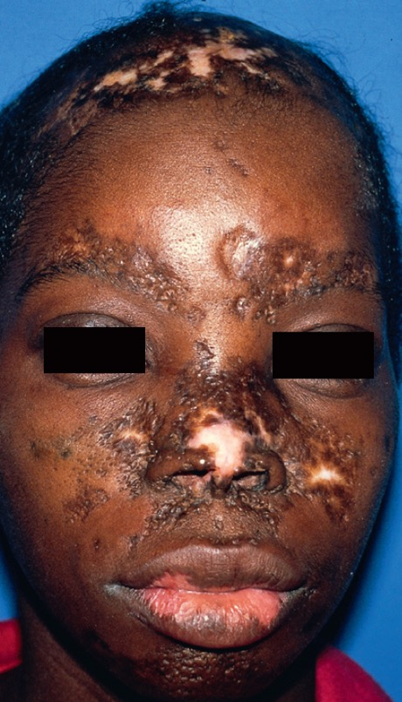
How can we treat CLE to prevent permanent disfigurement?
Estimated 225,000 affected individuals in US
DLE is the most common form of cutaneous lupus
Scarring, destructive
Disproportionately affects women
No CLE-specific FDA-approved treatments
James et al. Andrews’ Diseases of the Skin. (2011)
Notes:
Current standard of care:
Topical steroids, intralesional steroids → side effects preclude long-term use (skin-thinning, whitening of the skin, striae, and telangiectasias)
Systemic hydroxychloroquine → may not fully control skin disease, can cause irreversible retinopathy with prolonged use or higher dosing
Other existing treatments: immunosuppressants, which put patients at risk for severe infectious complications
Many are broadly immunosuppressive (e.g. prednisone, methotrexate, azathioprine, mycophenolate mofetil)
Targeted SLE therapies are also immunosuppressive (e.g. belimumab, inhibits B cells; anifrolumab, blocks type I interferon signaling).
The target was previously unknown, but has just been discovered → HIF1 inhibition shown to reduce cytotoxicity and tissue damage in pre-clinical model.

Slide 4
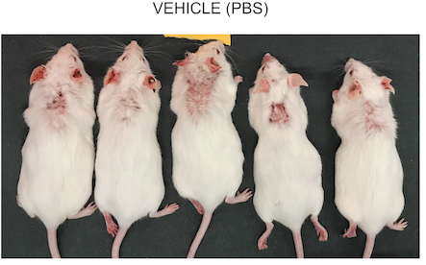
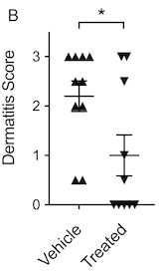
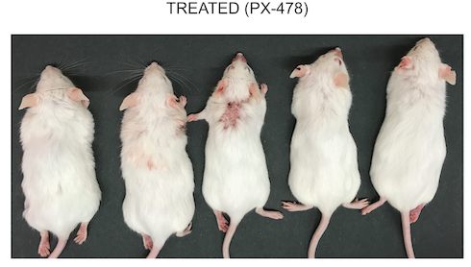
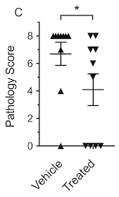
HIF1 Inhibition Abrogates the Development of Cutaneous Lupus
Little et al. JCI Insight (2023)
Notes:
Provisional patent application filed 7/28/2023 (serial number U.S.S.N. 63/516,446)

Slide 5
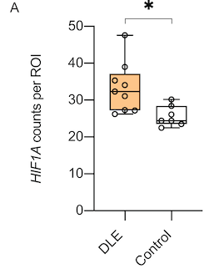
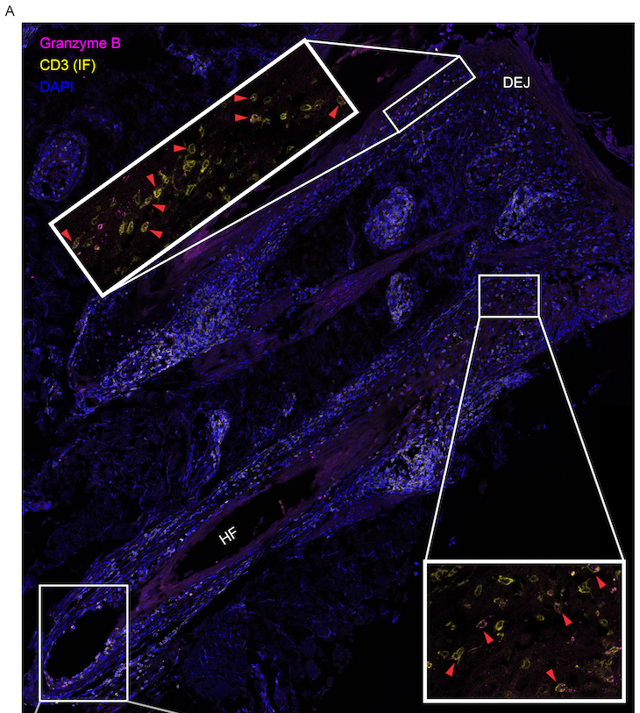
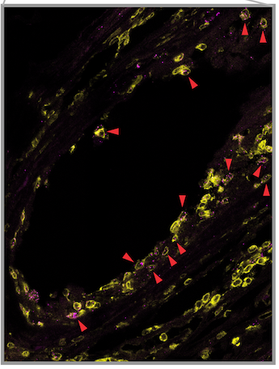
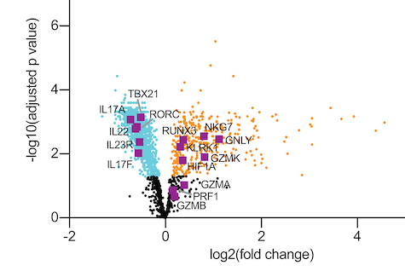
Skin T Cell From Patients With DLE Robustly Express HIF1 and Cytotoxic Molecules at Sites of Skin Tissue Damage and Scarring
Little et al. JCI Insight (2023)
Notes:
Cytotoxic T cells are implicated in skin tissue damage in many additional autoimmune skin diseases, suggesting possible therapeutic opportunity for HIF1 inhibition in additional diseases

Slide 6
HIF1 Inhibition: Significant Advantages Over Standard of Care
Not broadly immunosuppressive
Cheaper to manufacture, store and administer vs antibody-based treatment
Small molecule inhibitors may penetrate skin
Non-steroid topical anti-inflammatory therapies are in high demand
May be effective in other common cytotoxic-mediated skin diseases

Slide 7
Goals and Milestones: Funding to Engineer a Topical HIF1 Inhibitor
Phase I
Phase II
$100,000
$200,000
Medicinal Chemistry (candidate compound development) | Screen Phase I Compounds Optimize for Topical Delivery
Assay Development (Yale Center for Molecular Discovery)
Notes:
Patent application pending
Provisional patent application filed 7/28/2023 (serial number U.S.S.N. 63/516,446)

