Slide 1
Targeting thromboangioplasticity in tissue injury and ischemia
Jaime Grutzendler, MD
Professor of Neurology and Neuroscience
Vice Chair for Basic Research
Notes:
11:15-11:30 Jaime Grutzendler: Targeting thromboangioplasticity in tissue injury and ischemia
Notes:
Vascular occlusion has a vast market covering many different indications
Thrombus is encapsulated by endothelium and cleared
2 separate pathways leading to this occlusion -> they generated a fusion protein targeting both pathways
Feedback from Reviewers:
Rob B—is this an alternative to TPA?
Not an alternative but synergistic; but can only be given in the first few hours; the treatment can be given much later (nothing like this exists in the market)
Marc P—at what point when you have a severe blood clot, what’s the cut off point for the therapy vs. thrombectomy?
Complementary to stroke including thrombectomy; there is not a need to decide one verse the other
Roland W—proof of concept, can you spend a moment on this? You dramatically improve the lumen (Susan F had the same question)
The pathway 1, triggers the endothelial plasticity; pathway 2 much more efficient when you trigger the pathway; the peptide targets both
Reviewers seem very interested in this technology
Morag—what kind of protein engineering would you do?
Work with a CRO that can improve the protein. How isn’t very clear but a lot is known about the protein already.
Susan F—the making of the mutations. These proteins have been highly studied—are you concerned about sufficient IP if this area is protected already. One is naturally occurring; think we can generate new IP. 38 kDa, 68 kDa. Are fusion proteins stable?
Did see an effect in mouse, but haven’t done extensive studies of stability
Morag—any concerns about off-target effects?
It’s a naturally occurring protein, and haven’t seen other effects yet;
Marc P – massive clot, what’s the decision point for administration of this drug

Slide 2
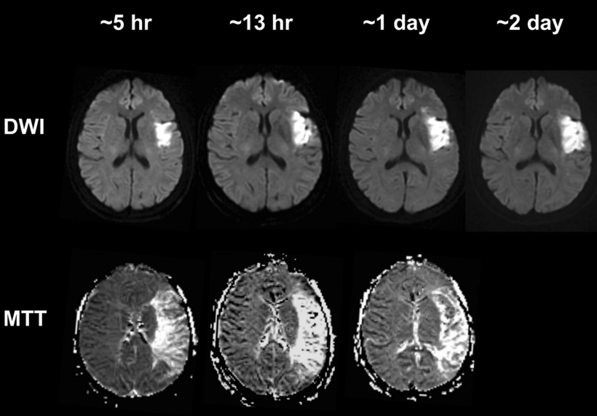
Thrombosis, microvascular occlusion and hemorrhage are major causes of pathology in brain, retina and other organs
Low perfusion salvageable tissue in stroke and TBI
Hemorrhagic conversion of stroke
Gonzalez et. al. Sci Rep, 2020
Notes:
Here is an example of hemorraging and of lack of reopening. BIG PROBLEM Whats missing form the current healing process and identify something that accelerate
Describe the problem and what the innovation is doing ,.. Motivating why we need a solution-mention examples of problems

Slide 3
Very large market size for disorders associated with thrombosis and microvascular occlusions
Stroke
Retina ischemia
Myocardial infarction
Pulmonary embolism
Traumatic brain injury (secondary injury mechanism- microvascular thrombosis)
Hypercoagulable states (i.e. Lupus, antiphospholipid syndrome).

Slide 4
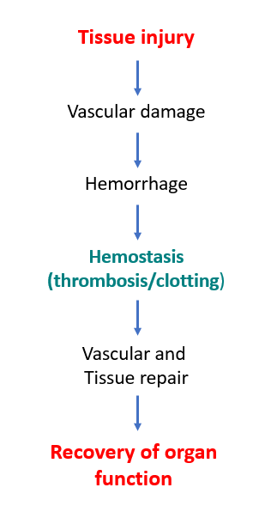
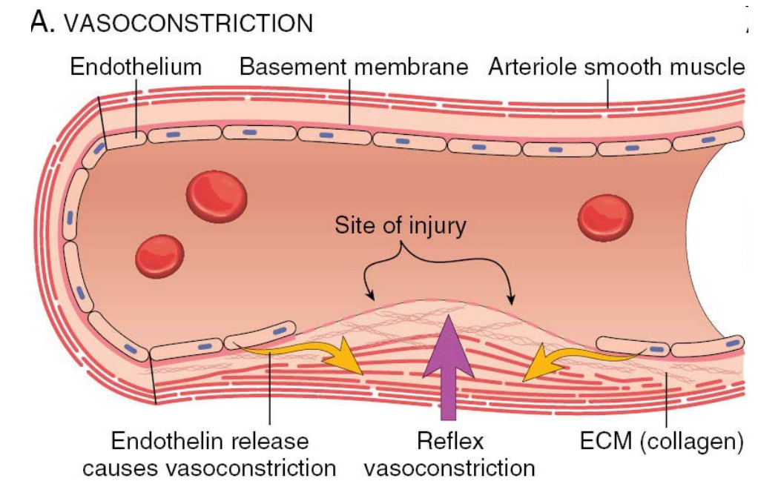
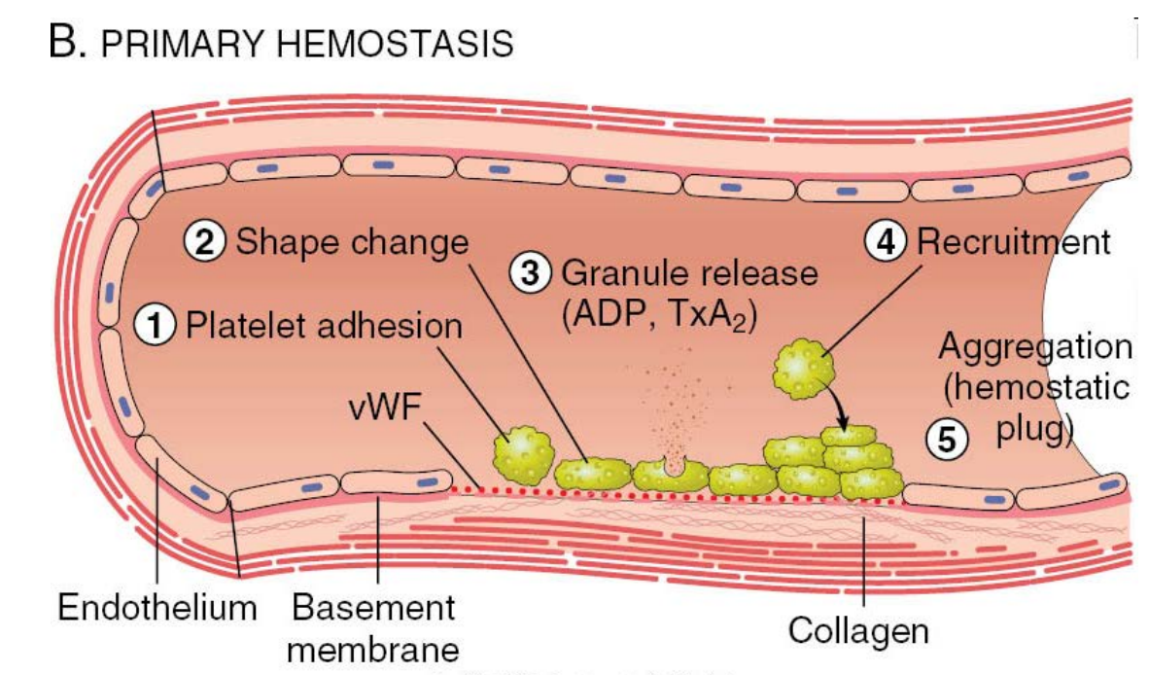
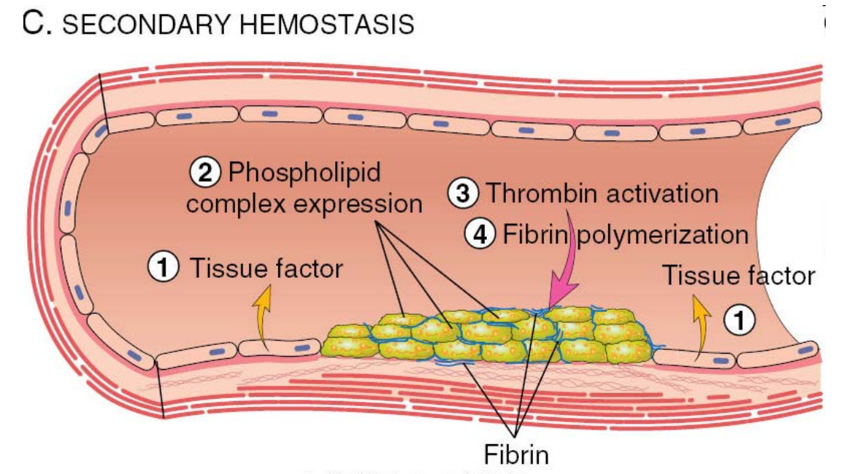
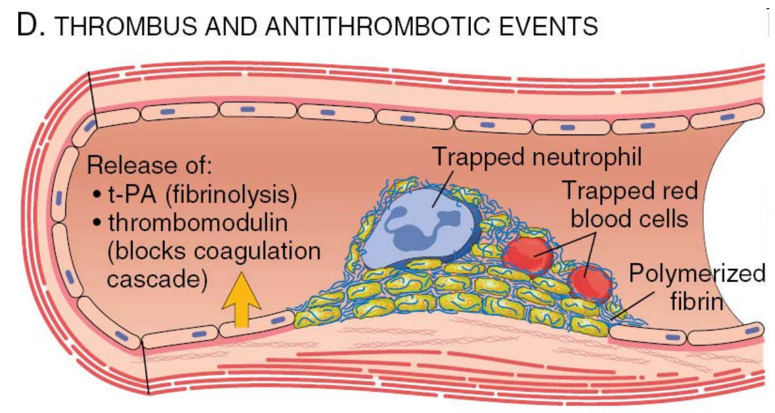
Current understanding of hemostasis
Notes:
But most classical studies really have focused on this mechanisms and have not paid enough attention to what happens to the vasculature during this process

Slide 5
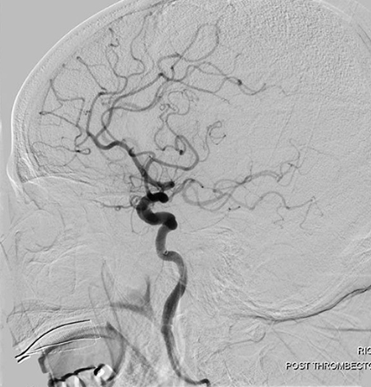
Current treatments for disorders with
thrombosis and microvascular occlusions
Stroke, Myocardial ischemia
Acute thrombolysis with tPA (early <24hrs)
Mechanical thrombectomy of large vessels
No treatments focused on reopening smaller vessels
Traumatic brain injury
No treatments focused on thrombosis and reopening of smaller vessels
Other organ ischemia (retina, lung, etc.)
- What if a therapy existed that could be administered over the first 7 days of injury
- Synergistic with current therapies
- Improve outcomes by promoting reperfusion of smaller blood vessels and reducing hemorrhage ?
Yeo et al Front in Neuro, 2021

Slide 6
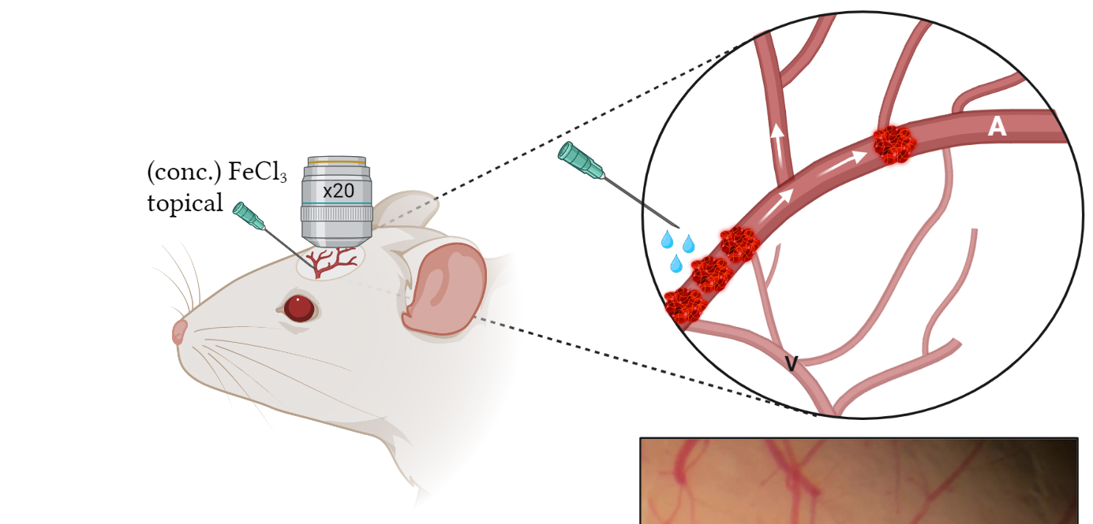
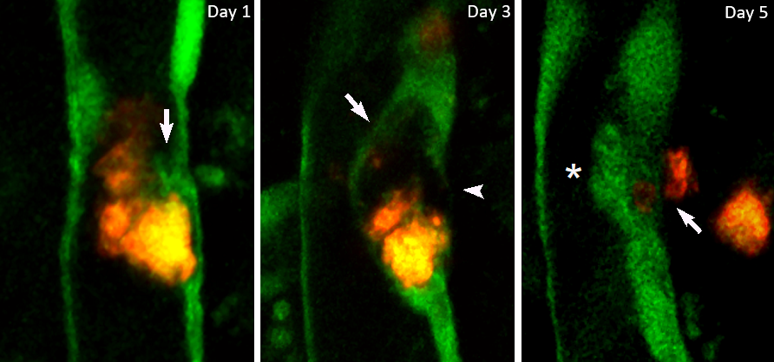
We discovered thromboangioplasticity-a mechanism at the interface between hemostasis and tissue repair in all organs
Phase 1: Early thrombus entrapment by
endothelial lamellipodia
Phase 2: Vascular remodeling, thrombus extrusion
and recanalization
Reestablishment of vascular lumen patency and flow
Endothelium Thrombi
Thrombus stabilization
Grutzendler et al. Science Trans Med, 2014
Lam et al, Nature 2010
Notes:
This is the discovery of an entirely new biology that we need to understand first before we wsee the value of the therapeutics

Slide 7
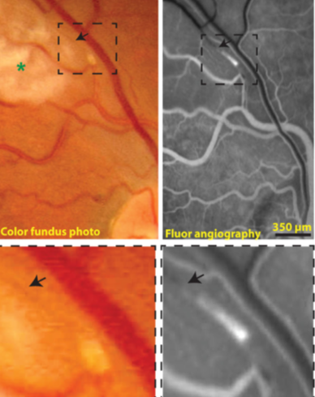
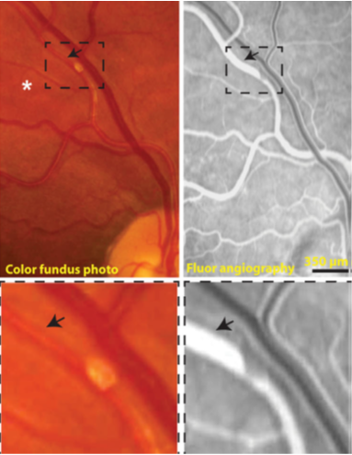
Indirect evidence of thromboangioplasticity in human retina photography
Symptom onset
Follow up
Grutzendler et al. Science Trans Med, 2014

Slide 8
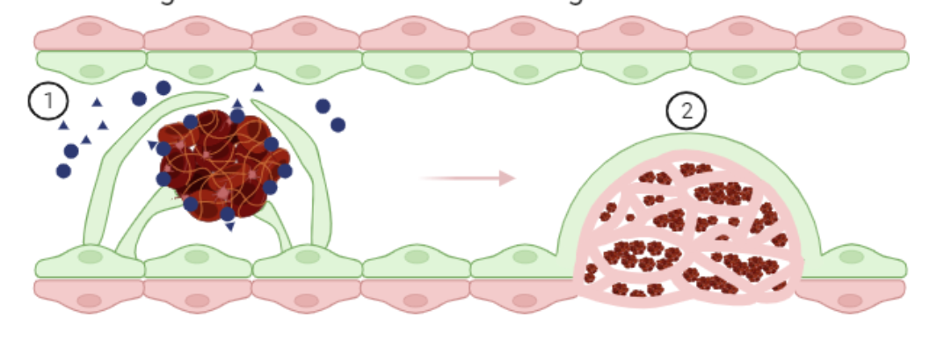
Two interrelated signaling pathways that control thromboangioplasticity
Pathway 1 (P1): a receptor-ligand pair that triggers the initiation of endothelial envelopment, thereby increasing thrombus stability and reducing hemorrhage due to premature washout
Pathway 2 (P2): a circulating protein that accelerates the complete envelopment of thrombi and their subsequent extrusion and vessel recanalization.
P1+P2 are synergistic: activation of P1 and P2 improves vessel recanalization (preliminary data).
Fusion protein P1/P2: retains strong pharmacological activity in vivo
Novel Composition of matter and uses patent pending.

Slide 9
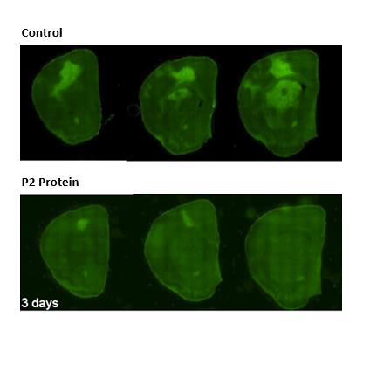
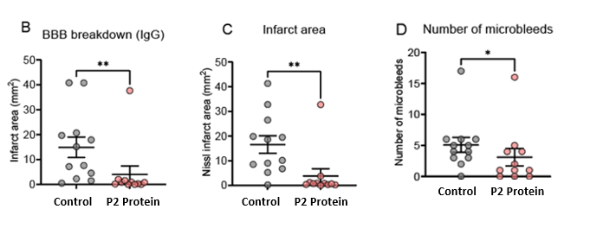
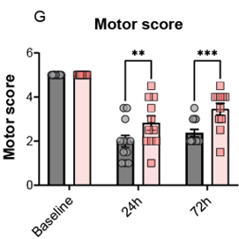
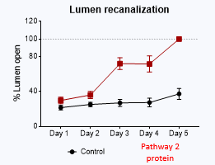
Administration of P2 protein improves pathology
and clinical outcome in brain embolism model

Slide 10
Milestones and Use of Funding
Protein engineering, lead optimization and in vivo testing in mouse models
(Requesting 150K/year for two years)
(0-6 month)
(7-14 month)
(15-24 month)
Protein Engineering
-New recombinant versions of P1-P2 fusion with different domains (~6) and of P2 (~3)
(With CRO)
Pharmacological testing in vitro and in vivo
-In vitro testing of target engagement of the proteins
-in vivo assessment of effects on thromboangioplasticity (CRO and Grutzendler lab)
Testing in disease models
-Test effect of recombinant proteins in mouse models of:
Brain ischemia
Traumatic brain injury
Myocardial ischemia
(Grutzendler lab)

Slide 11
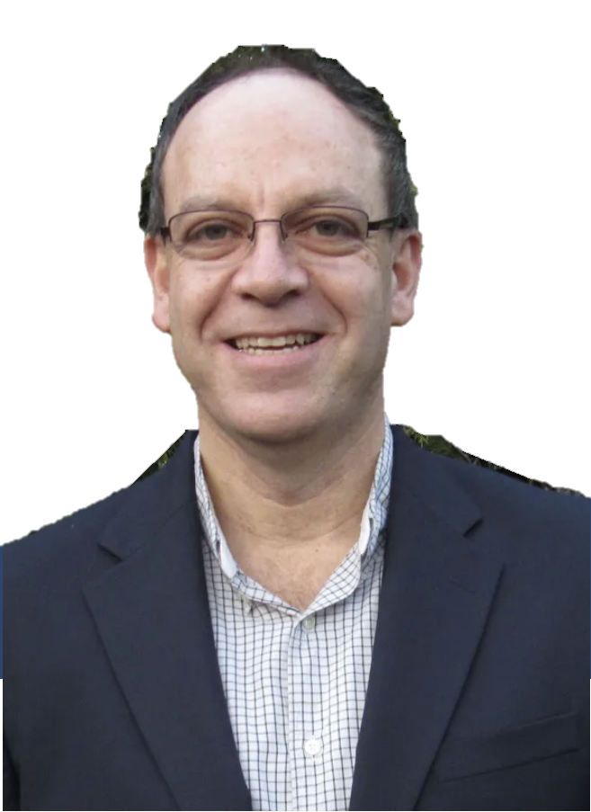
Let’s revolutionize the pharmacotherapy for tissue injury and microvascular occlusion
Jaime Grutzendler, MD
jaime.grutzendler@yale.edu
David Lewin, PhD
Yale Ventures
David.lewin@yale.edu
Jaime Grutzendler, MD
Professor of Neurology & Neuroscience
Vice Chair of Research, Neurology
Yale University
Composition of matter and utility
patent applications pending

