Slide 1
Targeted Delivery of Drugs to Where They are Needed in the Brain
Transforming Treatment of CNS Disorders
Andre Levchenko, PhD, Jaison Cai, PhD, Doug Rothman, PhD, Bruce E. Wexler, MD

Slide 2
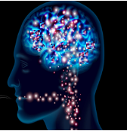
The Problem
Currently drugs go to all parts of the brain
Cause ”off-target side effects”
Limit on-target dosing to sub-optimal levels

Slide 3
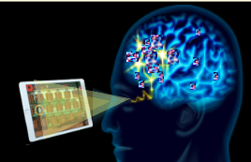
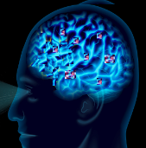
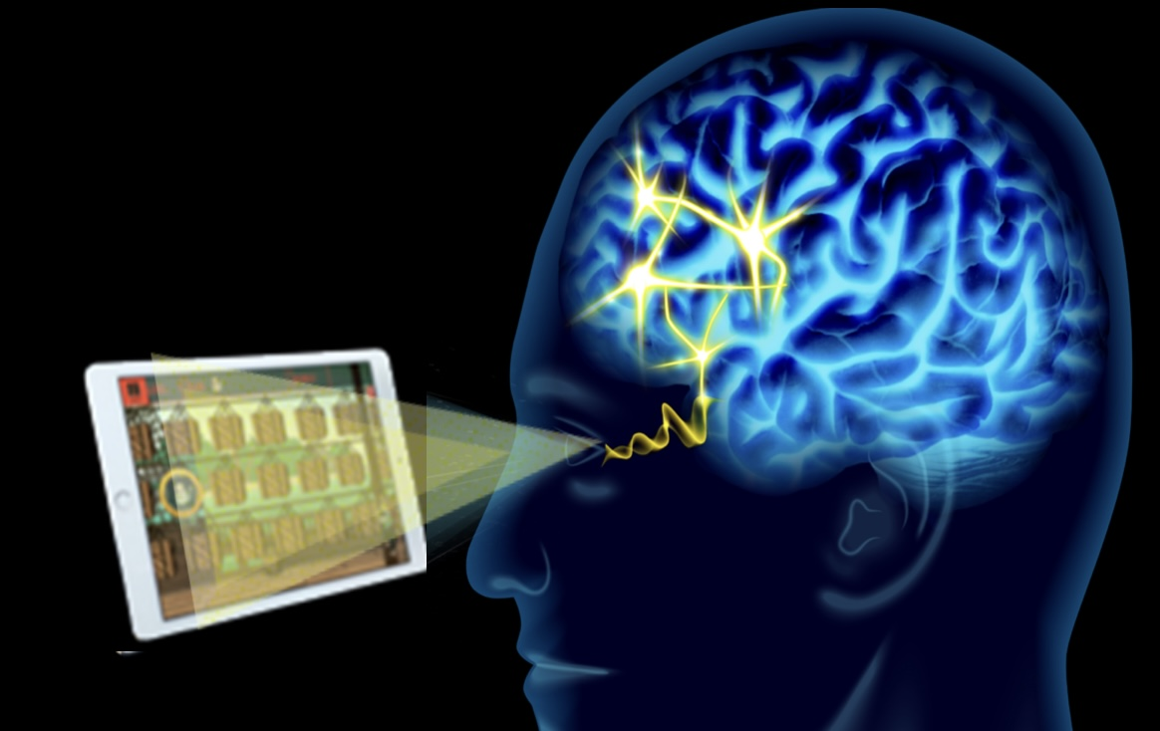
The Solution/Opportunity

Slide 4
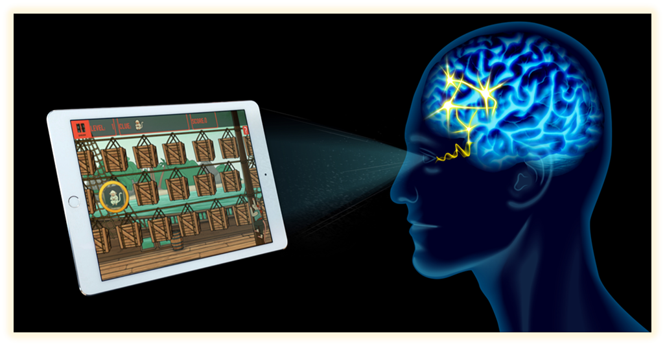
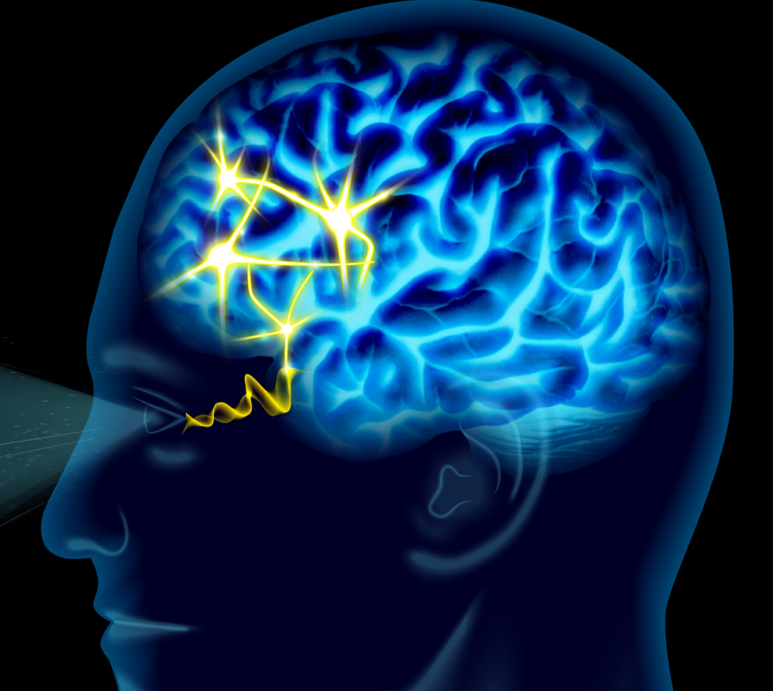
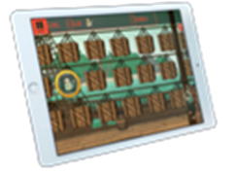
Our TRANSFORMATIONAL solution
Combines 2 steps:
Stimulation of activity in the specific areas of the brain where the drug is needed
Activity-dependent local drug uptake and release
+
=
Activity-sensitive carriers
bring drugs into the brain largely in inactive form
Digital Probe/Activate Technology
identifies and increases neuronal firing in target area for drug delivery
On-Target Delivery
Localized increase in neuronal firing produces localized changes in metabolism that release drug from carrier

Slide 5
The Need and Market are Huge
CNS diseases are projected to be the #1 health burden in the U.S. by 2030
$1.5 trillion per year—8.8 percent of gross domestic product (GDP)
Current Pharmacotherapies Have Limited Effectiveness and High Off-Target Side Effects
Side effects include sedation, confusion, dulled thinking, falling, weight gain, abnormal movements, decreased libido and sexual dysfunction.
Blavatnik funding: Major Depression (MDD), novel proof-of-principle compound (Yale IP)
18.4 % of Americans diagnosed at some time with MDD with prevalence increasing by 54% from 2006 to 2019
13% of Americans over 18 report using anti-depressant medications over the previous 30 days
25% of women > 60 years old are taking anti-depressant medications
60% take antidepressants for > 2 years and 10% for >10 years.
Competitors: None

Slide 6
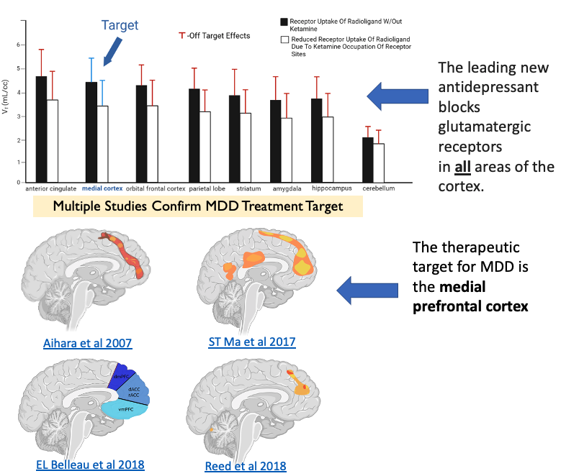
Our Focus is a 2-DG-Ketamine Conjugate to Demonstrate Proof of Principle and Create a New Therapeutic for Depression (Yale IP)
Why 2-DG-Ketamine?
Both (DG and ketamine) in regular human use with IV administration
Potentially lower regulatory hurdles (neither requires licensing - no proprietary exclusivity)
Extensive imaging and clinical experience at Yale
Proprietary new therapeutic and Yale IP
Off-Target Action Results in BOTH suboptimal on-target dosing and increased side effects and drug discontinuation

Slide 7
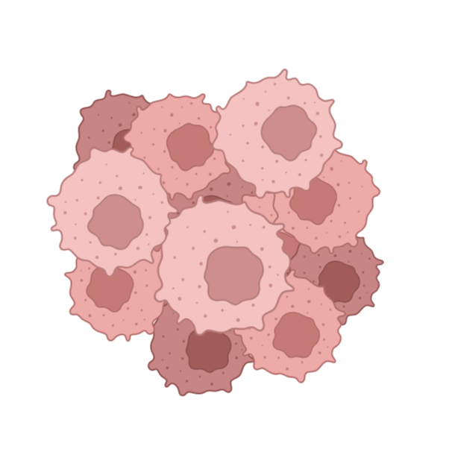
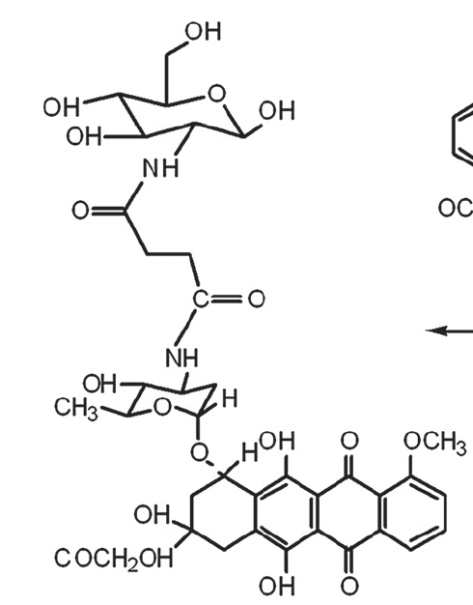
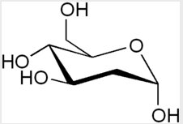
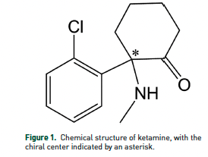
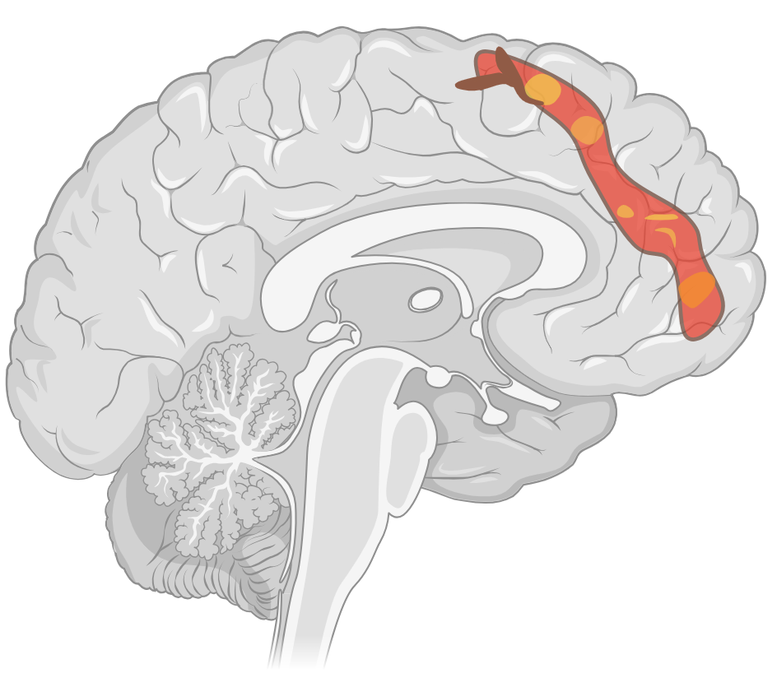
Precedent in cancer drug delivery: metabolically driven targeting
Established
2-DG Carries & Releases Adriamycin in Tumors
High tumor cell energy consumption drives increased uptake of 2-DG and selective cancer drug delivery to the tumor
2-DG
Tumor
Linker
Adriamycin
Proposed
2-DG Carries and Releases Ketamine in the Activated Brain Target area
Targeted increases in neuronal firing induced by cognitive activation tasks make the neurons metabolically more active than other neurons in the brain increasing 2-DG-Drug uptake and enabling localized decoupling of the drug. (Same effect that produces PET & fMRI images.)
Linker
Brain
2-DG
Ketamine

Slide 8
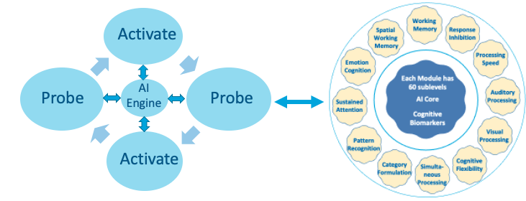
Precision Identification and Activation of Brain Targets for Drug Delivery in Individual Patients
Provided Through Collaboration with C8Sciences, a Blavatnik-Supported Yale Start Up
Target Identification:
Proprietary Personalized Micro-Cognition Biomarkers
Target Activation:
Adaptable Digital Neurotherapy Modules
Established platform technology used in >35,000 people that seamlessly integrates assessment and and activation

Slide 9
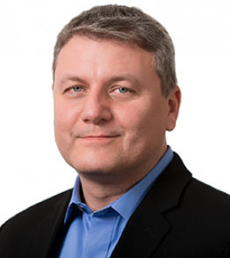
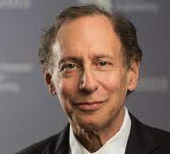
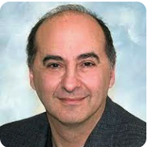
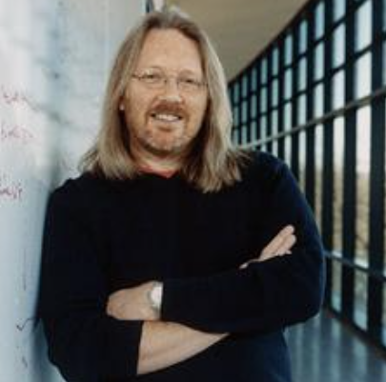
The Science and Business (Neutargeton) Team Extensive Science and Start-Up Experience in Emerging Technologies
Founders
Bruce E. Wexler, MD
Professor Department of Psychiatry,
Yale School of Medicine
Andre Levchenko, PhD
John C Malone Professor of Biomedical Engineering, Director, Yale Systems Biology
Robert S. Langer, PhD
David H. Koch Institute Professor, Massachusetts Institute of Technology
Douglas Rothman, PhD
Professor, Radiology, Biomedical Imaging &Engineering, Director
Yale MR Research Center
W. Mark Saltzman, PhD
Goizueta Foundation Prof/Chair of Biomedical Engineering & Physiology,
Yale University
Company Building Industry Experience
Business and company building veteran
CEO and operations in multiple start-ups in therapeutic emerging areas: Digital Health, Biosimilars, Neurologic conditions
Fund raising expertise
Alex Waldron
CEO Neutargetoon, Yale EIR

Slide 10
Blavatnik Budget and Deliverables
2024
Budget/Time
3 months $75K
5 months $100K
4 months $125K
Conjugate Synthesis and Transport
Validation
Conjugate Design
Targeted Release
2-DG-Drug Conjugate
Technology for Targeted Delivery of Drugs for Multiple CNS Disorders
2-DG-Ketamine Conjugate for
Major Depressive
Disorder
Novel IP created

Slide 11
Supplimental

Slide 12
Therapeutic and Business Development
2023
2024
2025
Funding
Funding
Funding
Funding
ARPA-H Grant
Blavatnik Award
Pre/Seed Round
Series A
Carrier Development
2-Deoxyglucose Carrier
Route of Admin | IV
Cargo Limitations | Small molecule (e.g. ketamine)
Collaborator | Levchenko, Rothman & Cai
Yale IP | Proprietary 2-DG-drug Conjugates
Synthetic Nanocarriers (Simultaneous Development)
Type | Liposome | Protein | Polymeric
Route of Admin | IV, IM, SC | IV | IV
Cargo Limitations | None | None | None
Collaborator | Antimisiaris | Lahan | Fricker
Iterative Cycles of Testing and Refinement (“agile development”)
Rodents
Monkeys
Humans
PET/fMRI at Yale Rothman & Cai
Carrier/compound stability in serum
Cross BBB
Within-brain specificity of triggered on-target cargo release
Quantification of relations among triggers, activity-induced changes
Pharmacokinetics
Target Identification and Activation in Humans – Collaboration with C8Sciences (Yale & Blavatnik Start-up)

Slide 13
Blavatnik Budget and Deliverables
2024
Budget/Time
3 months $75K
5 months $100K
4 months $125K
Conjugate Synthesis and Transport
Establish crossing BBB
Quantify pharmacokinetics
Establish Targeted Release
Quantify on-target specificity
Quantify relation between activity-related triggers and on-target specificity
Conjugate Design
Conjugate Design
Linker moiety selected
Validation
2-DG-Drug Conjugate
Technology for Targeted Delivery of Drugs for Multiple CNS Disorders
2-DG-Ketamine Conjugate for
Major Depressive
Disorder
Novel IP created

